Slide 1
TOF calculation
Used runs:
70Zn pencil beam:
  Run500 in exp. data = Run420 in Lise data
  Lise++ file : e843_extended_Ok_Foc62_Run420.lpp
  Information from LISE online notes:
  Run 420 (70Zn28+,28+,30+ without wedge nor slower) -> F31 to +-0.1; F43 to +-0.3; Brho2_RMN = 2.5898 => Brho2_L++ =2.5879
Used runs:
68Ni beam:
  Run516 in exp. data = Run432 in Lise data
  Lise++ file : e843_extended_Ok_Foc62_Run432.lpp
  Information from LISE online notes:
  Run 432 (68Ni with wedge @ ~ 40 MeV/A) -> F31 to +3/+13; F43 to +-15; F51 = -17/+25; Brho2_RMN = 2.1687 => Brho2_L++ =2.1671

Slide 2
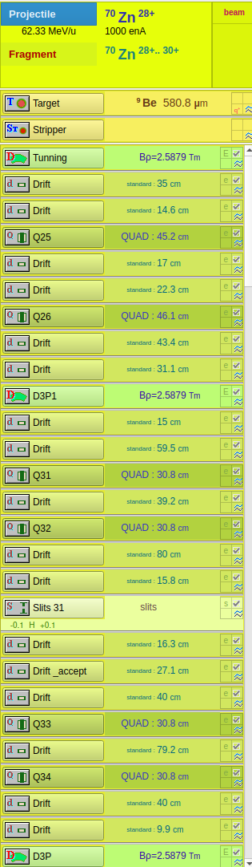
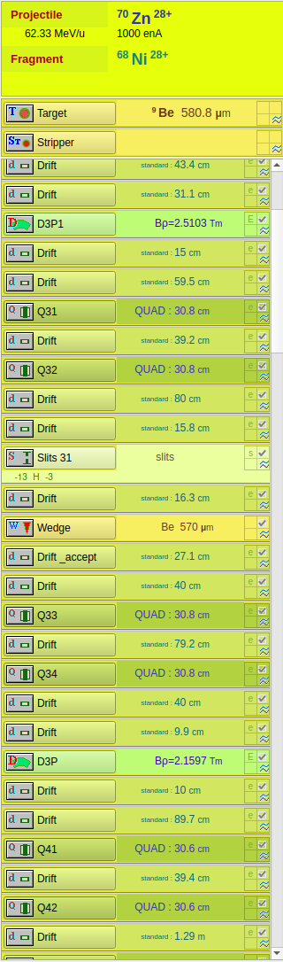
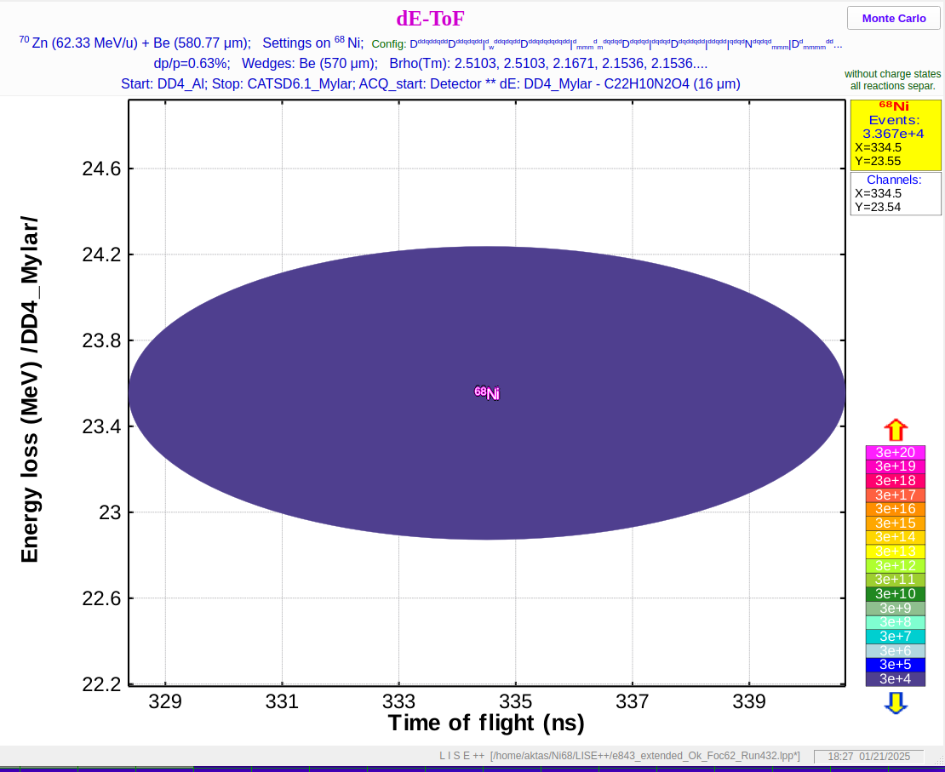
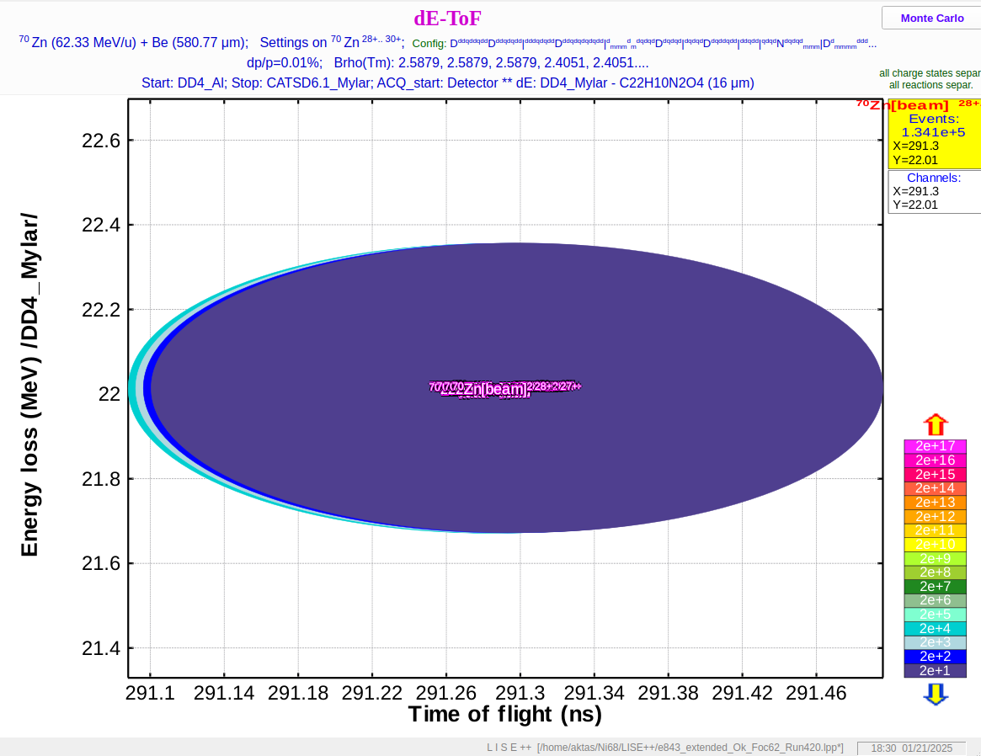
T-CATS1-D4
Without pressing run button brho= 2.5879 as it is written in J-C notes E= 57.71

Slide 3
 | Channel | tof | slope | gain | Slowed tof | energ
d4_cats 70zn | 18993 (17.87) | 291.3 | -0.02615012 | 787.9692 | 457 ns | 17.7
dd6_dd4 70zn | 36607 (67.4) | 231.1 |  |  | 362 ns | 18.7
d4_cats 68Ni | 17341 (47.5) | 334.5
dd6_dd4 68Ni | 32121 (135) | 265.2

Slide 4
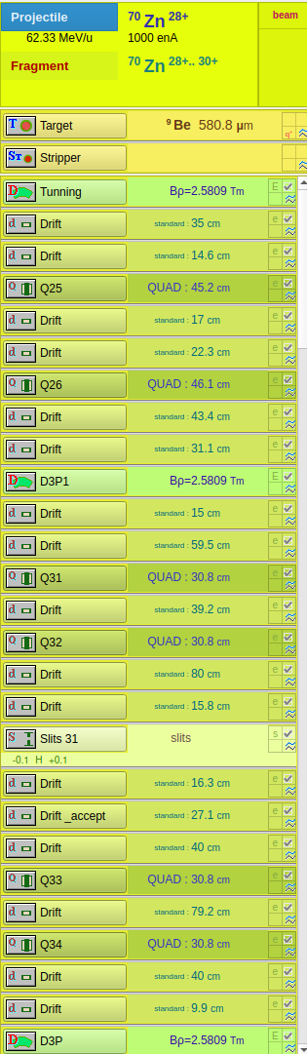

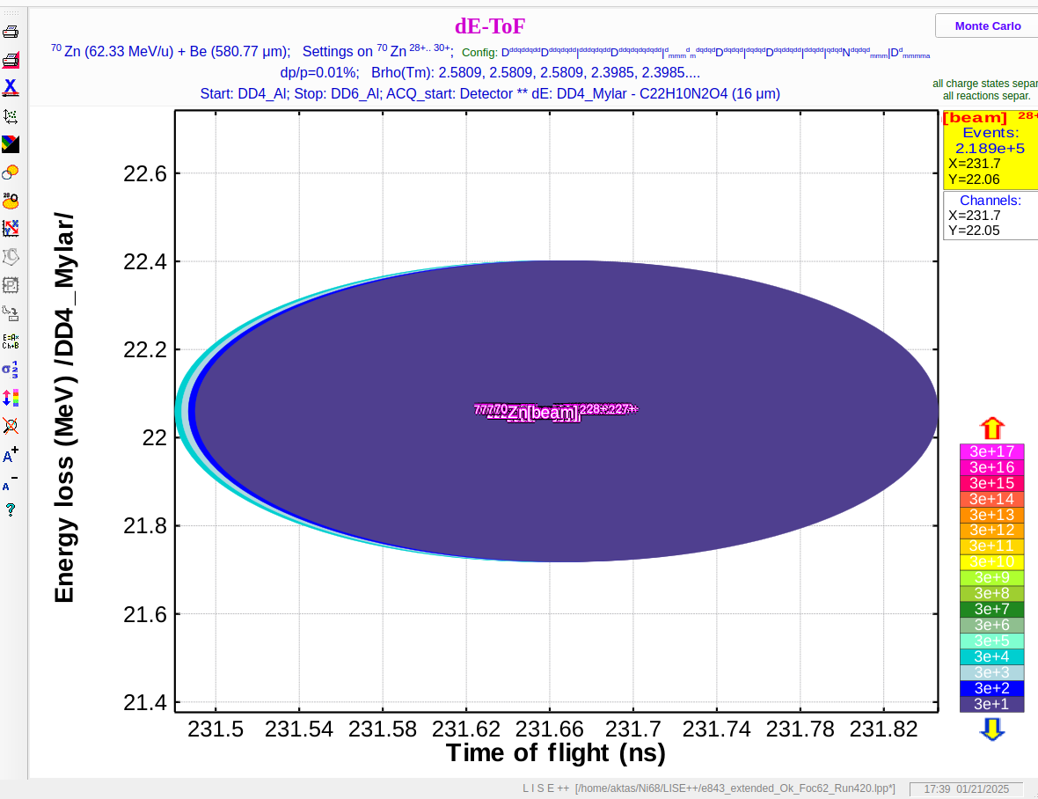
After pressing the run button
Brho = 2.5809 Energy = 57.40774
Tac cats-d4
Tac- d6-d4

Slide 5
 | Channel | tof | slope | gain
d4_cats 70zn | 18993 (17.87) | 292 | -0.02560532 | 778.32
dd6_dd4 70zn | 36607 (67.4) | 231.66
d4_cats 68Ni | 17341 (47.5) | 334.3
dd6_dd4 68Ni | 32121 (135) | 264.9
slowed | 12627 | 455.0018 | Brho : 1.48616 | E: 17.9377

Slide 6
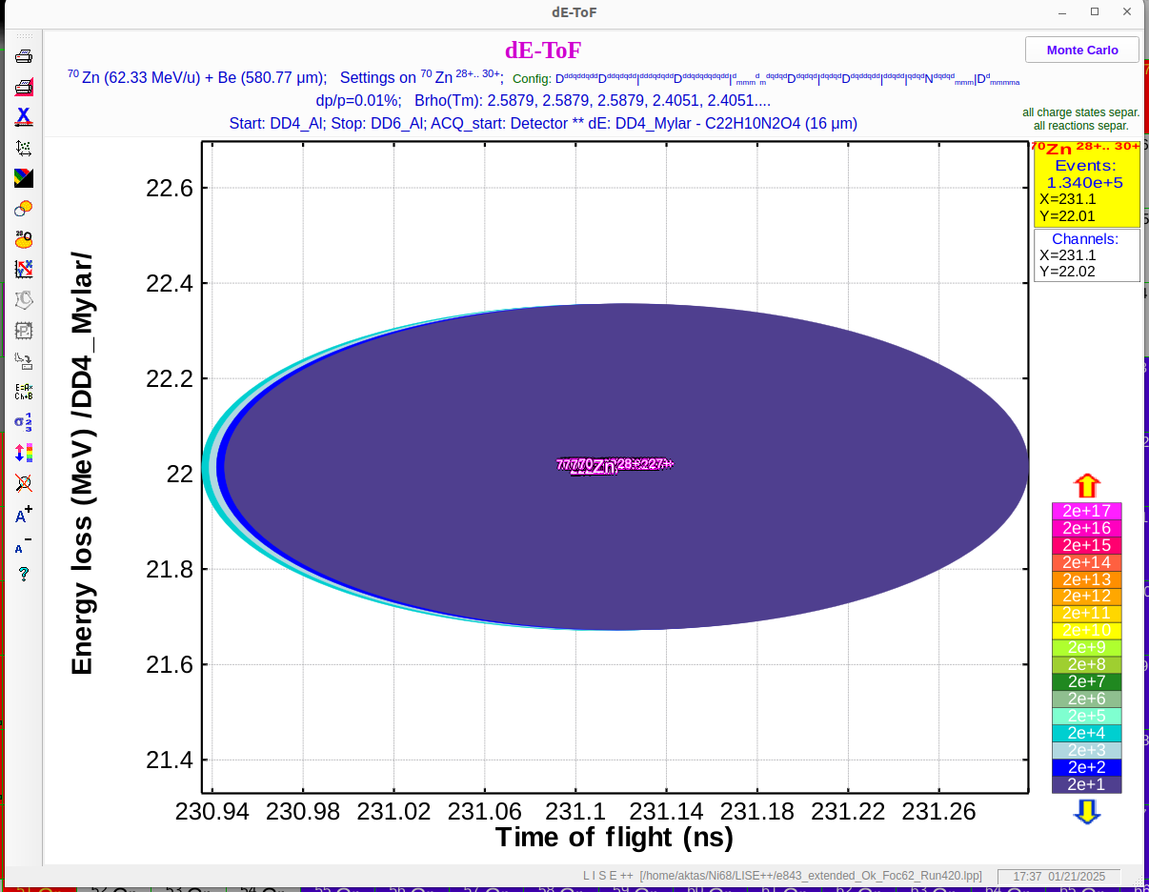
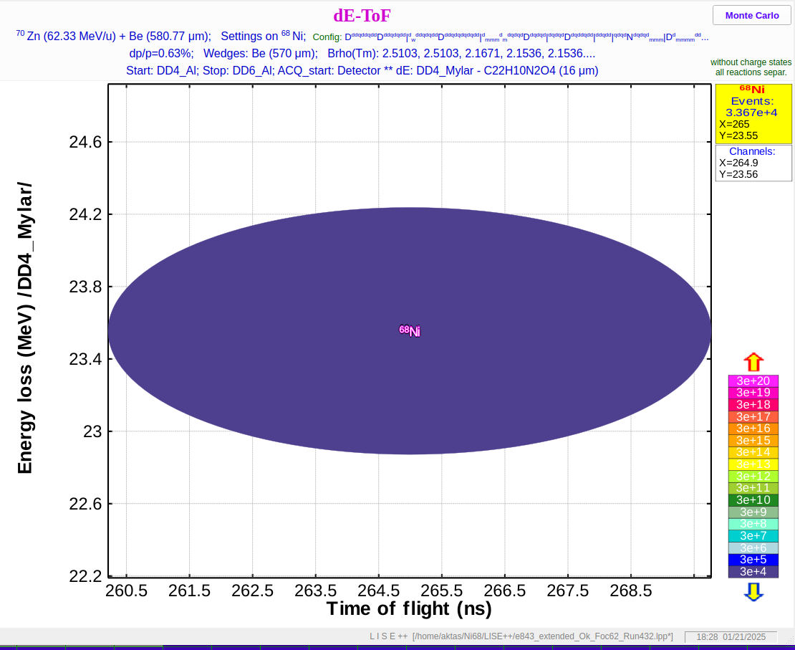
T DD6-DD4
68Ni

Slide 7
