Slide 1

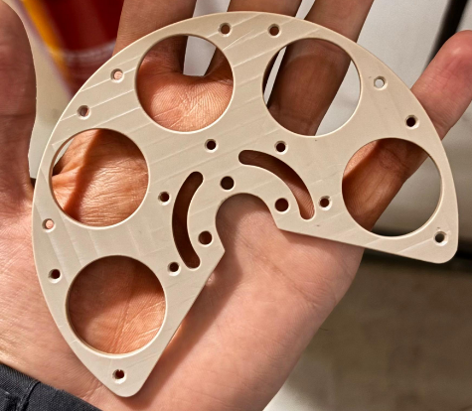
Analysis Status Meet
November 20th, 2025

Slide 2
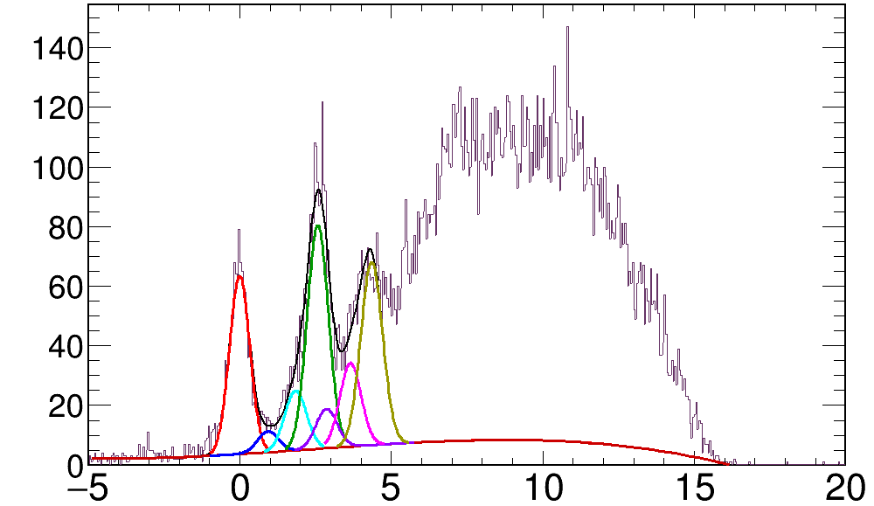
(d,p) excitation function
S(n)
4.6 MeV
Total E* plot
2.5 MeV
Counts/20keV
E* > S(n)
E* < S(n)
G.S.
Deuteron Breakup component
Drift Chamber
Exogam
Carbon
Trajectories: CATS
Ex (MeV)

Slide 3
The need for CATS
DSSD
Light
Correction for dead layer
Correction for target
θ₃
θ₄
Heavy
CATS1, 2
DC X,Y
Ozge’s method: Shift the target spot to minimize the resolution in E* plot
BeamImpact = TVector3(-(CATS->PositionOnTargetX)+1.7,-(CATS->PositionOnTargetY)+2.3,0);

Slide 4
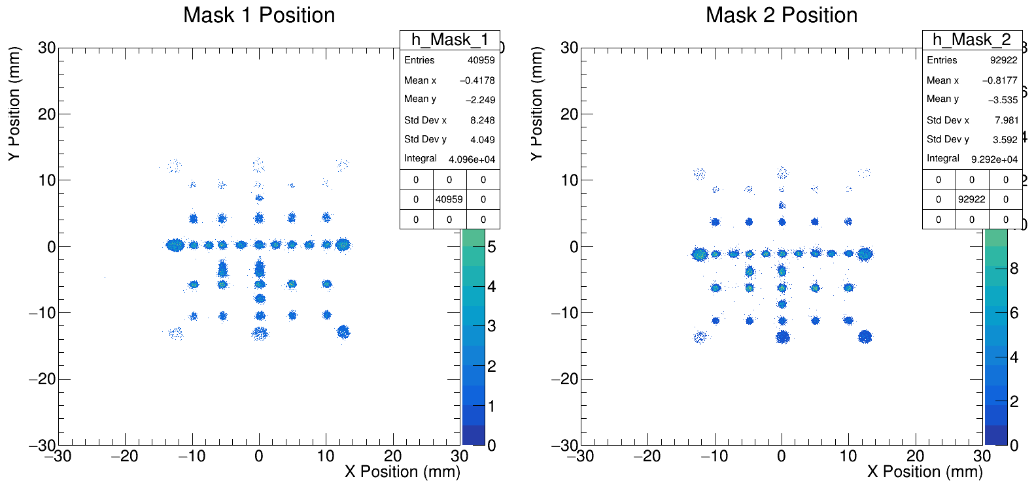
CATS calibration
Known from surveyor:
the pos of central holes only

Slide 5
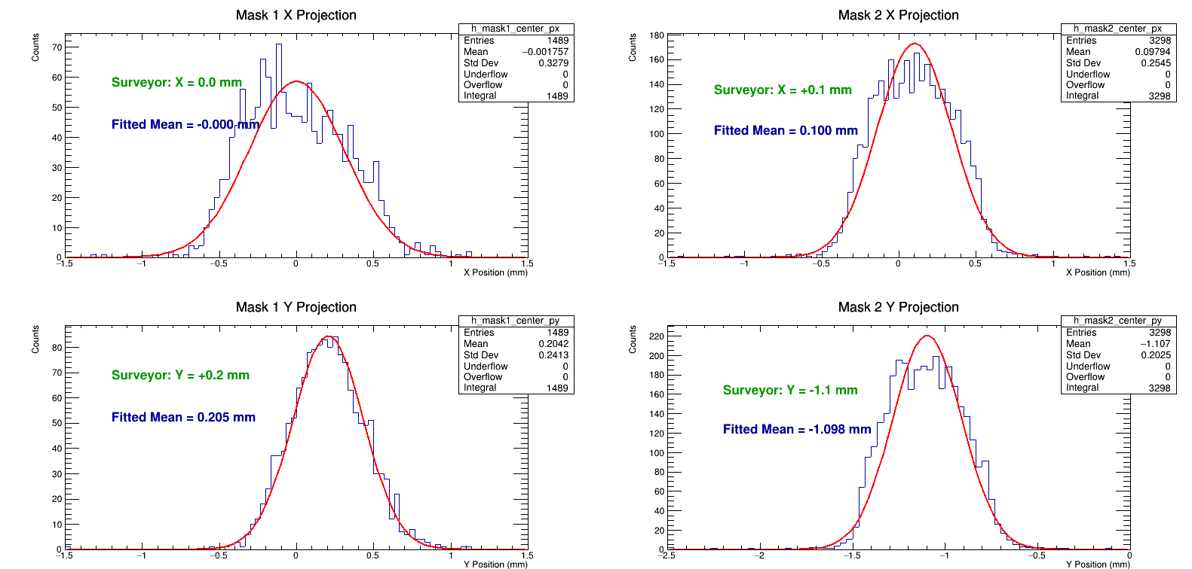
CATS calibration→ mask central holes (x,y)

Slide 6
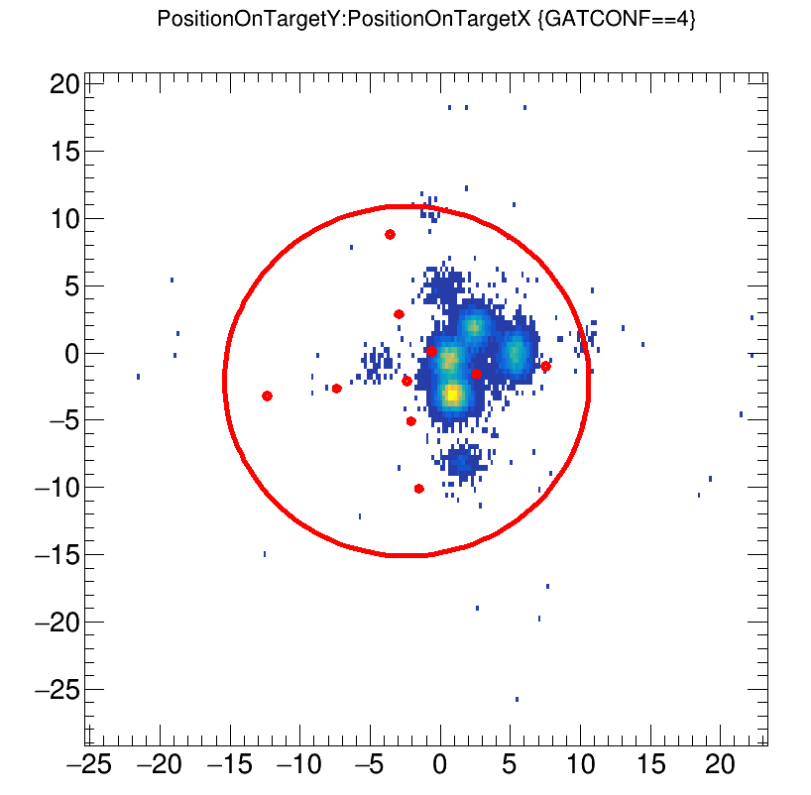
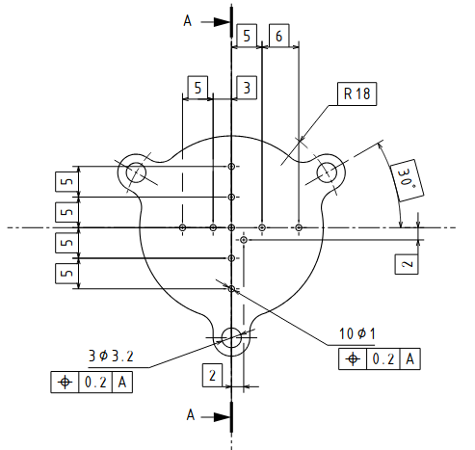
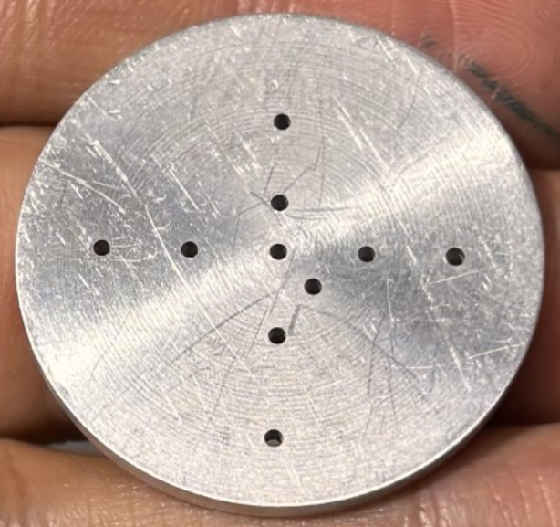
CATS calibration→ target mask holes (x,y)
Acc. To Surveyor
Off by about 3 mm in X and 2 mm in Y
Rotated----------->

Slide 7
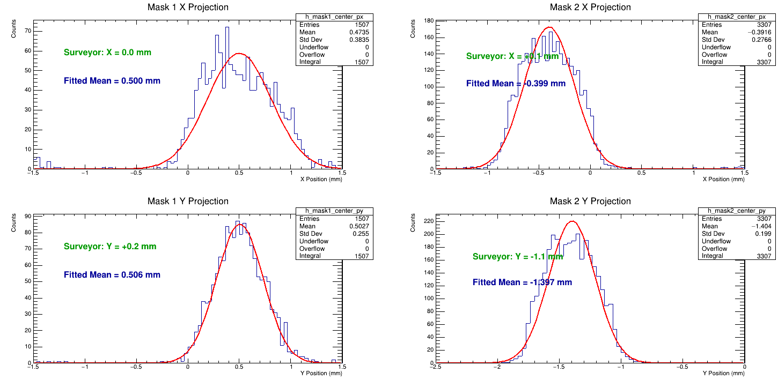
CATS calibration→ cats mask holes shift (x,y)

Slide 8
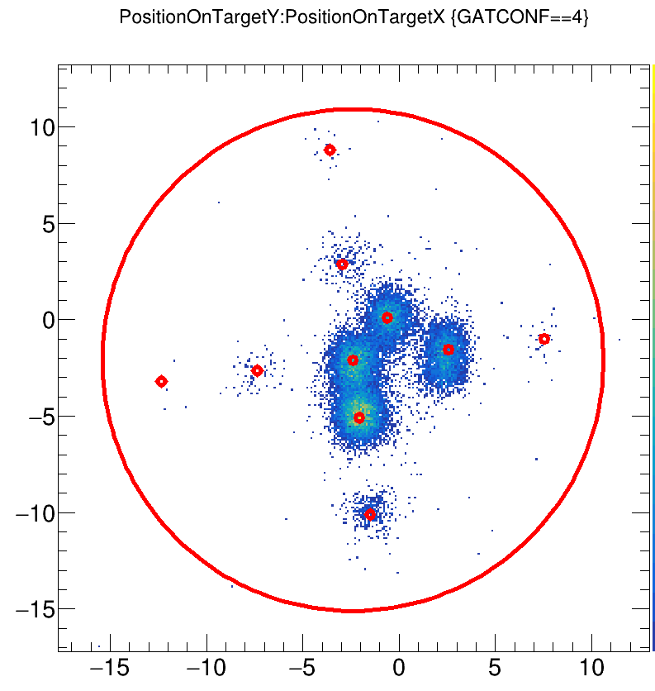
CATS calibration→ target mask holes shift (x,y)
New shifts (Δ = surveyor - measured)
Hole 1 (X, Y): (0.18, 0.32)
Hole 2 (X,Y): (-0.15, 0.04)
Hole 3 (X,Y): (-0.14, 0.06)
Hole 4 (X,Y): (-0.04, -0.21)
2
1
3
4
Acc. To Surveyor

Slide 9
Drift Chamber : Construction
4 channels in total, 2 horizontal and 2 vertical
anode

Slide 10
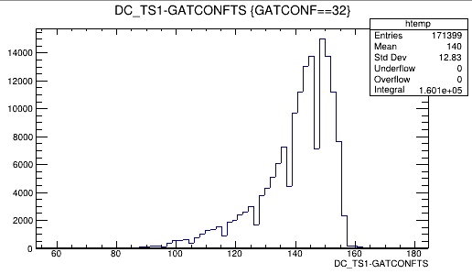
Drift Chamber: working
Drift time
Most events
More events
And more D.T.
Electron drifts
More drift time
Anode wire

Slide 11
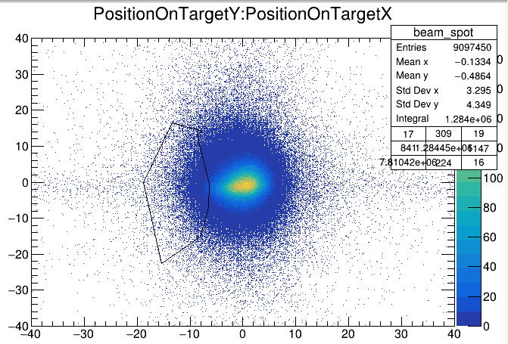
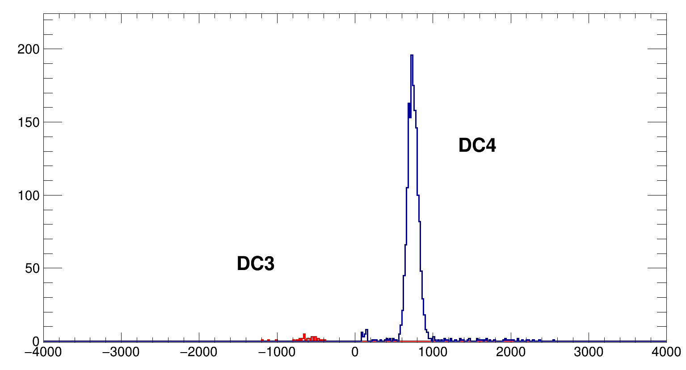
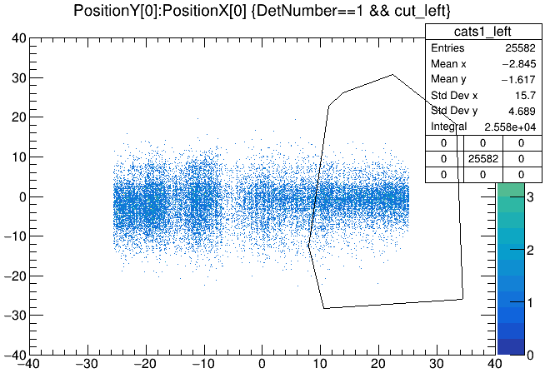
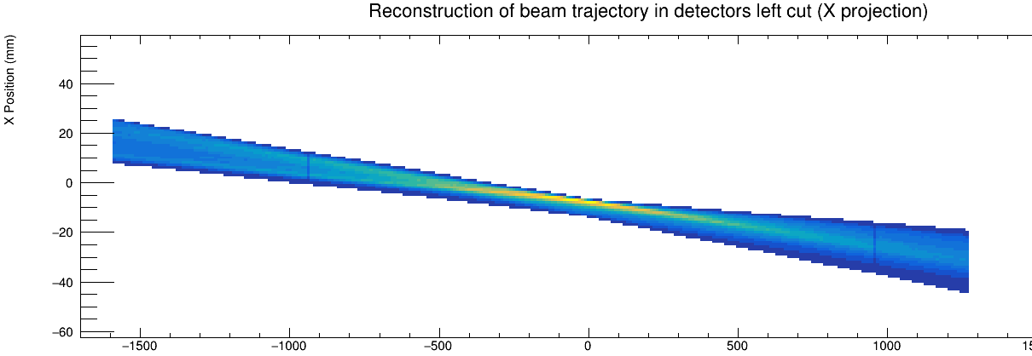
Drift Chamber: Channel identification
Conclusion:
DC4 is left
-DC_3 Energy
DC_4 Energy

Slide 12
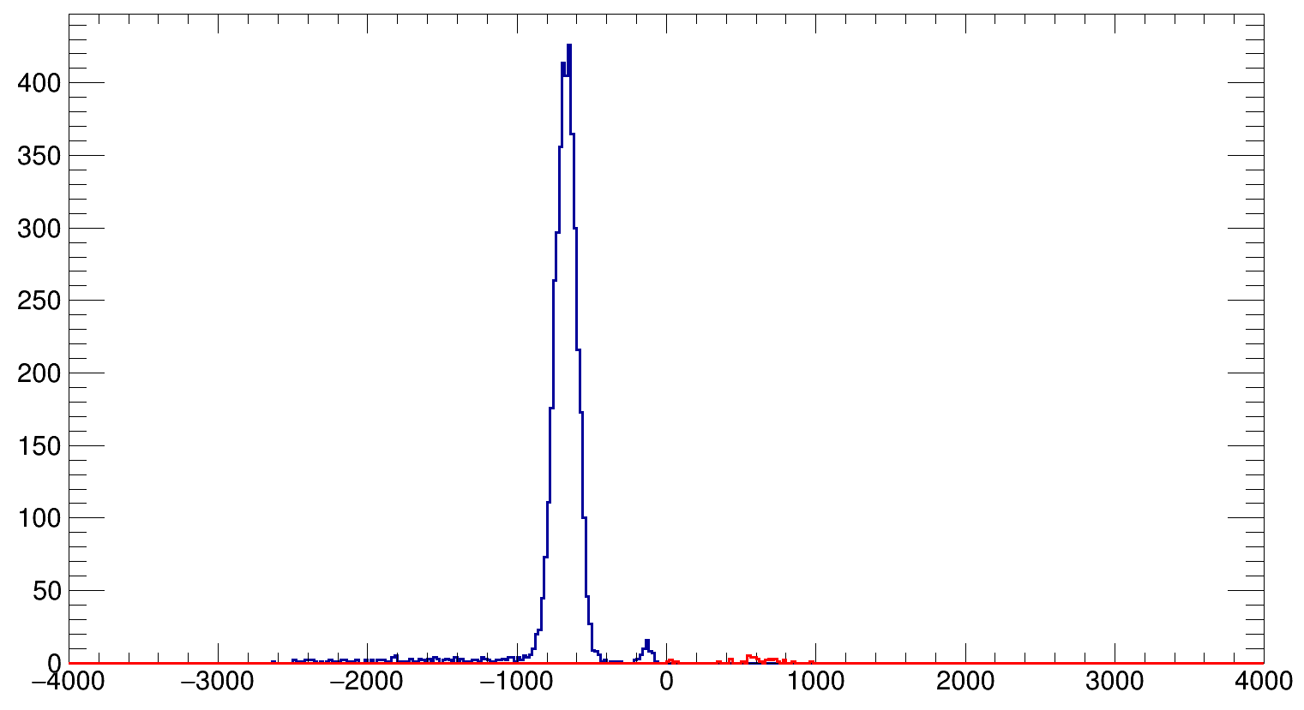
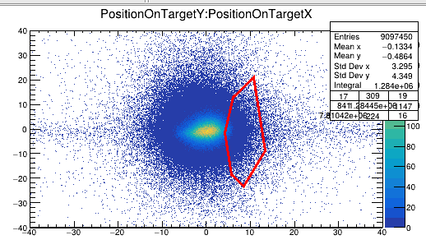
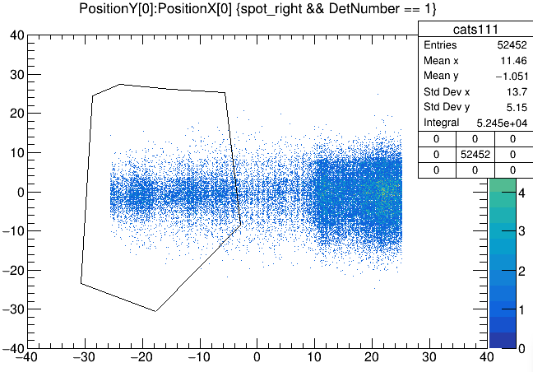
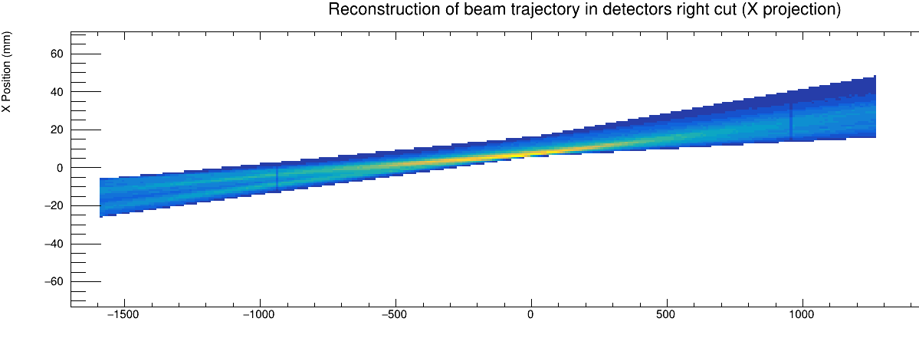
Drift Chamber: Channel identification
Conclusion:
DC3 is right
-DC_3 Energy
DC_4 Energy
Dc2
Dc4
Dc3
Dc1

Slide 13
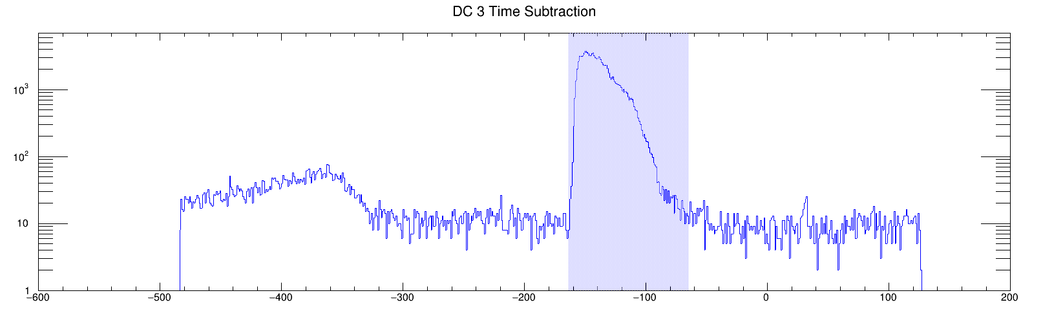
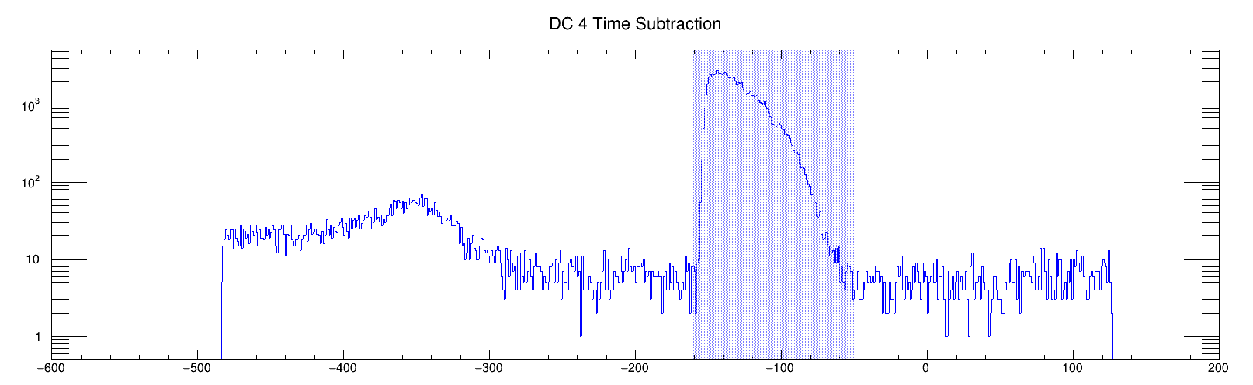
Drift Chamber: Channel identification
More drift time
Counts in log scale

Slide 14
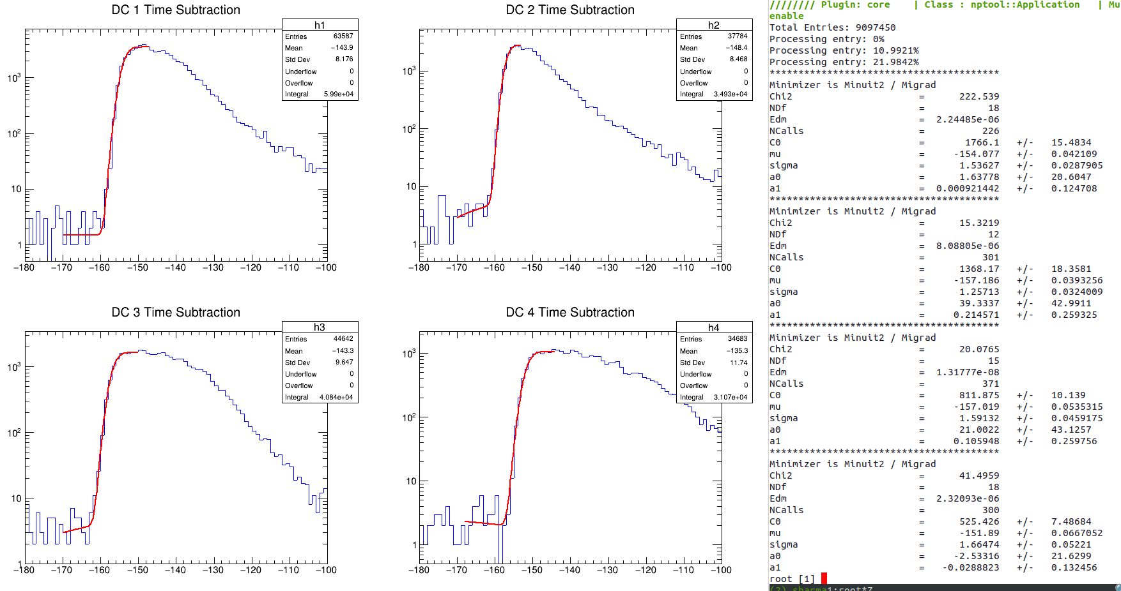
Drift Chamber: Drift time spectra

Slide 15
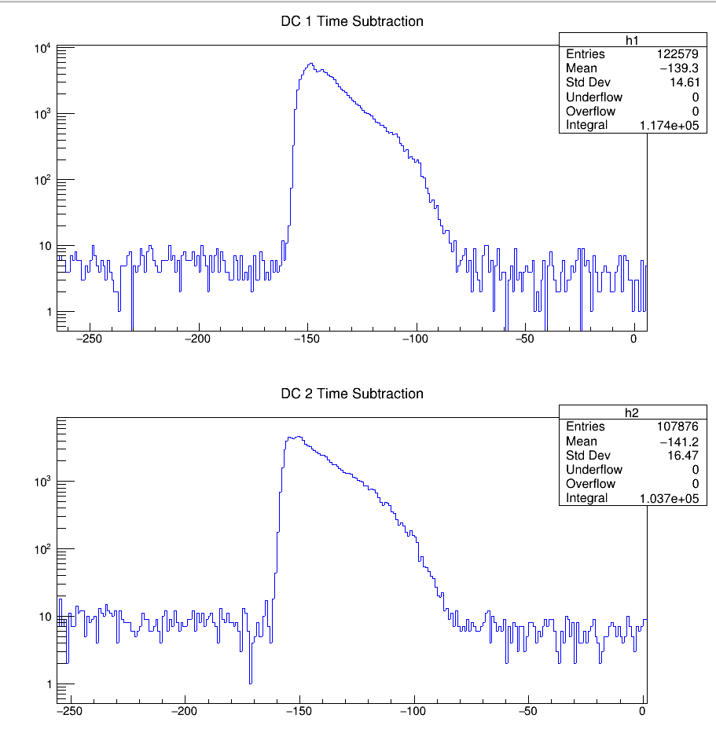
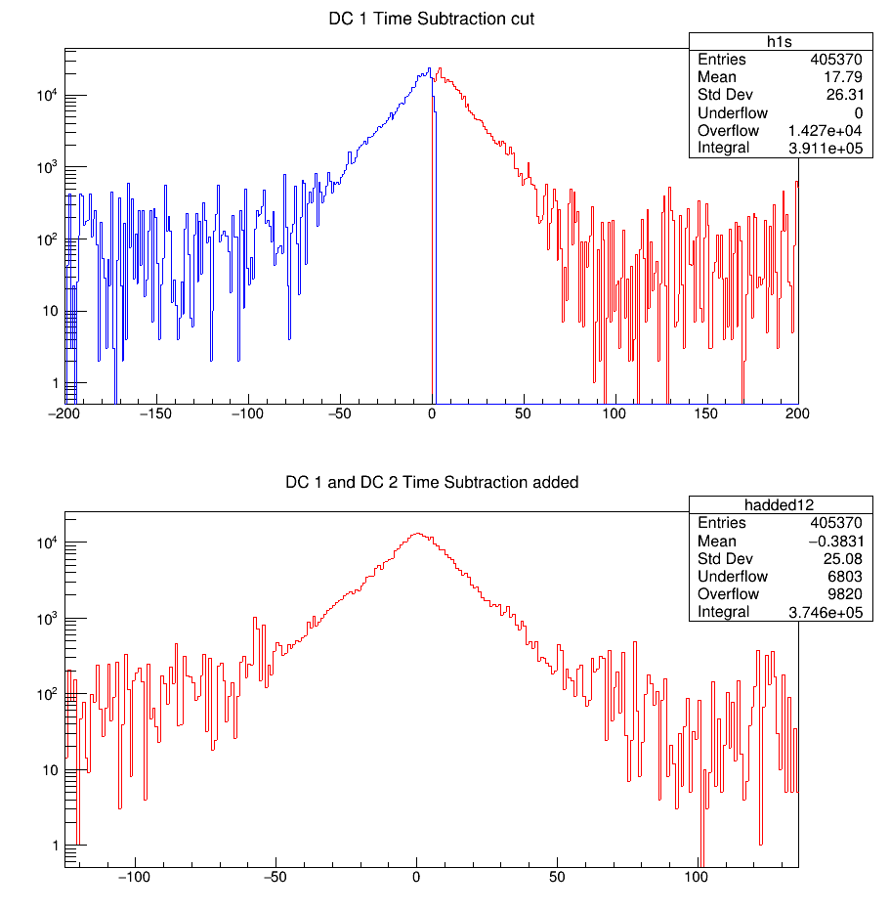
Drift Chamber: Drift time spectra

Slide 16
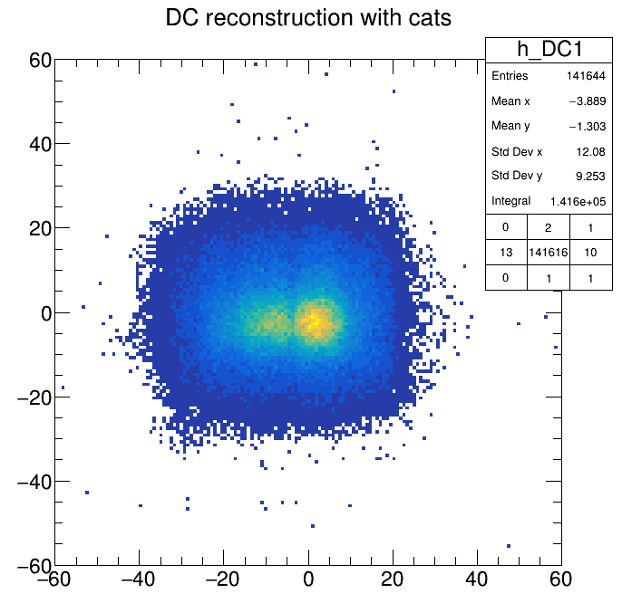
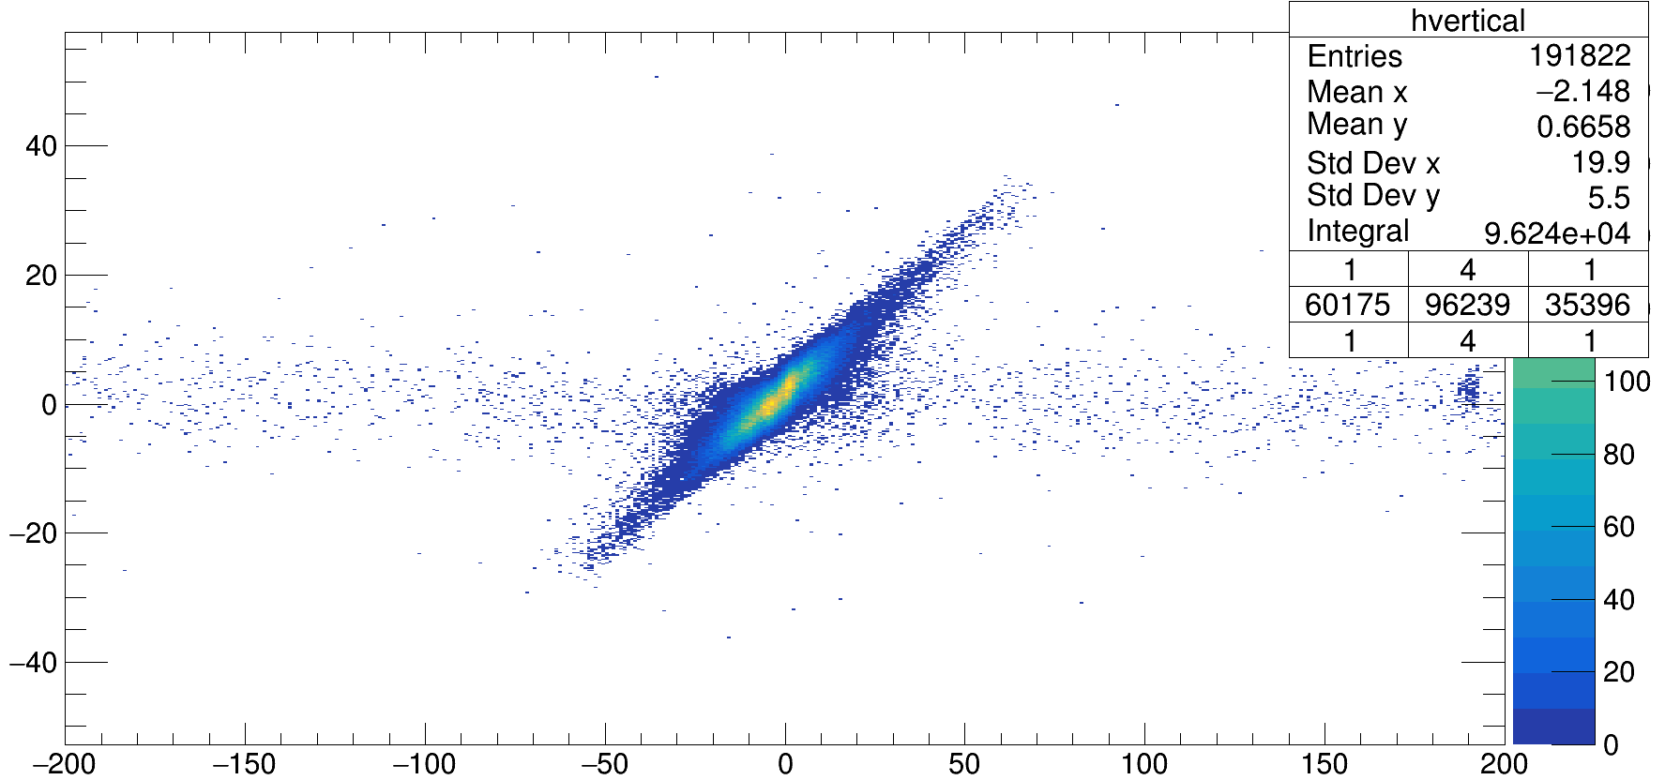
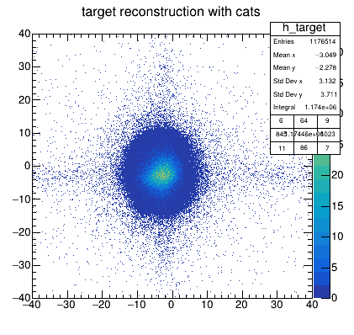
Drift Chamber: Trajectory by CATS
-1090.1 mm
Hole 0 mm
-1587.1 mm
1260.9 mm
Y Position on DC by CATS
Drift time combined

Slide 17
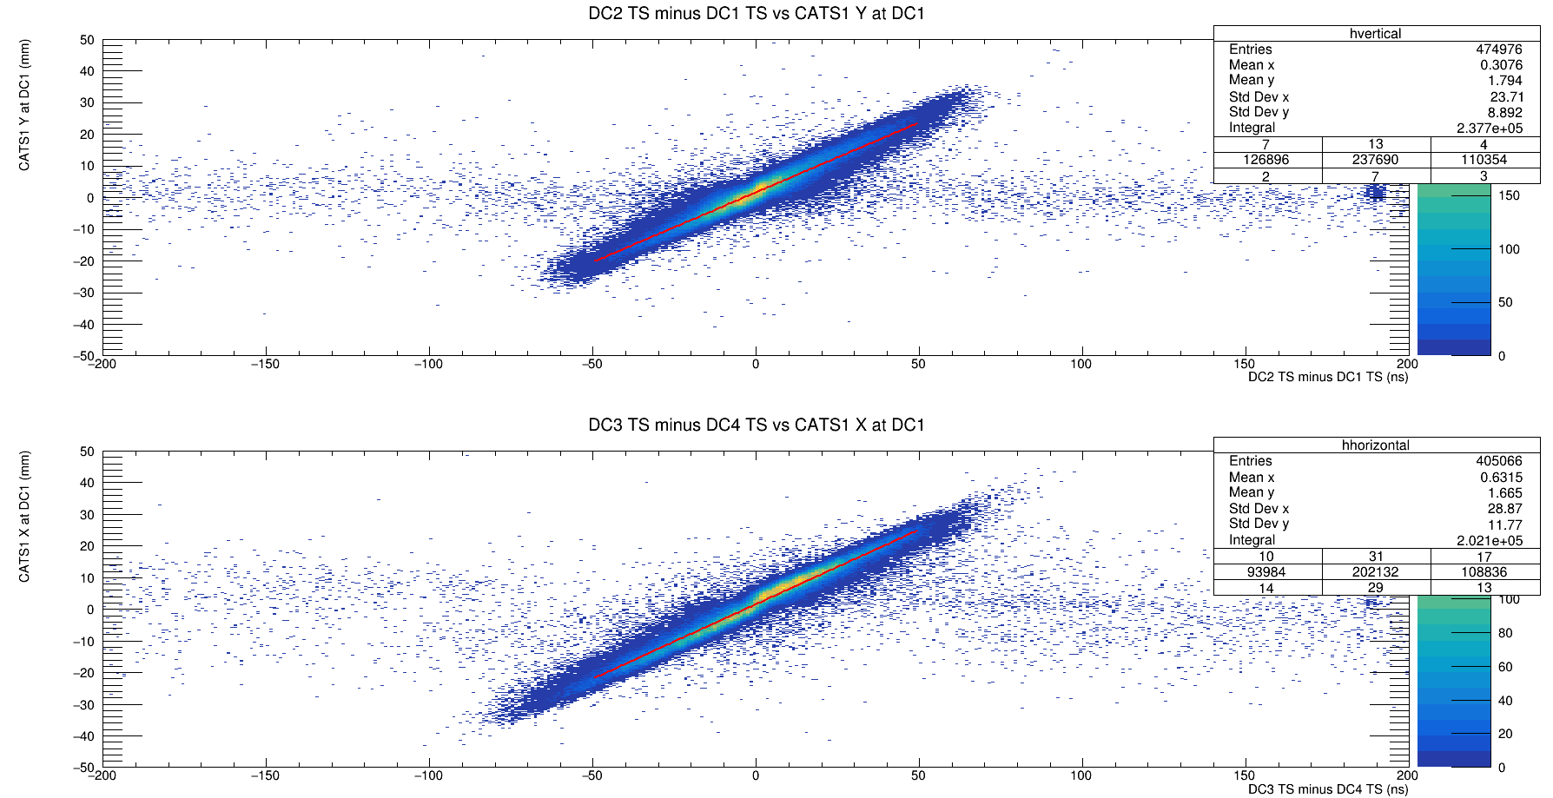
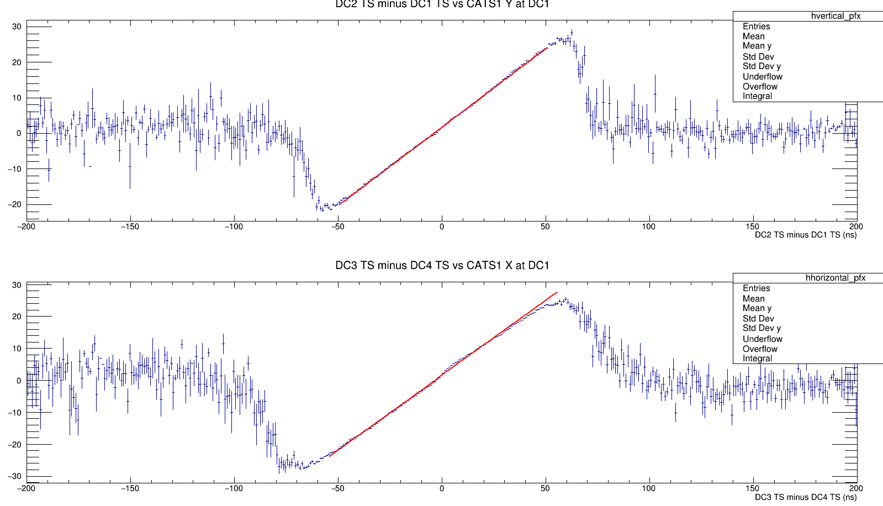
Drift Chamber: CATS cons. vs Drift time

Slide 18
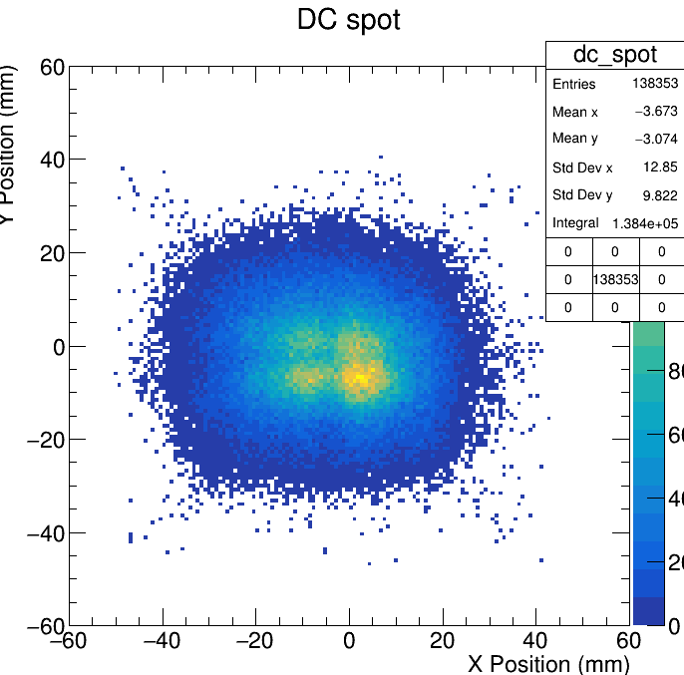
Drift Chamber: Spot on DC1

Slide 19
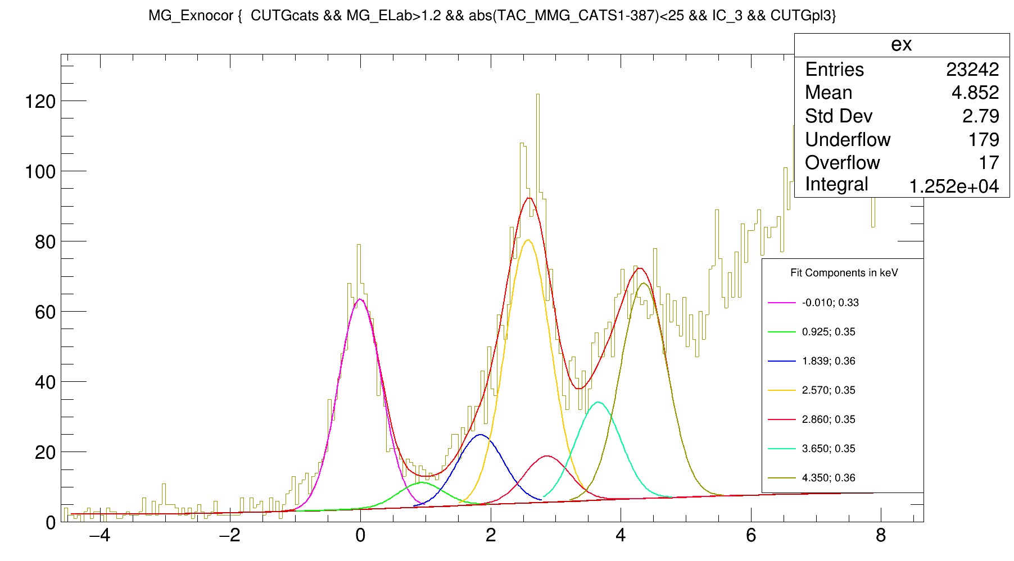
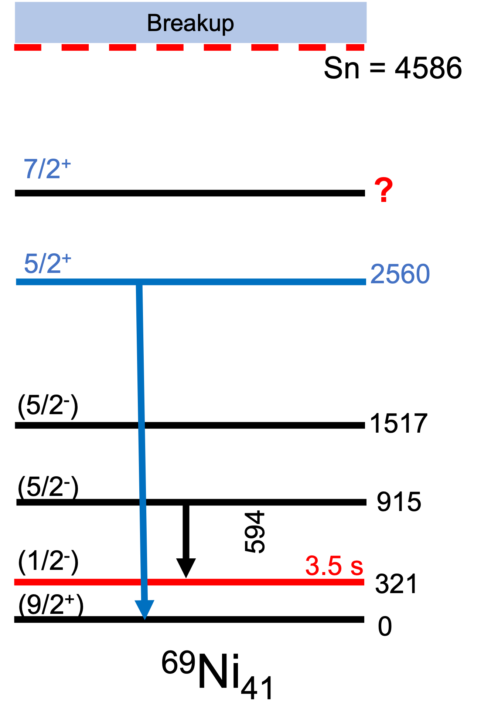
E* < S(n)

Slide 20
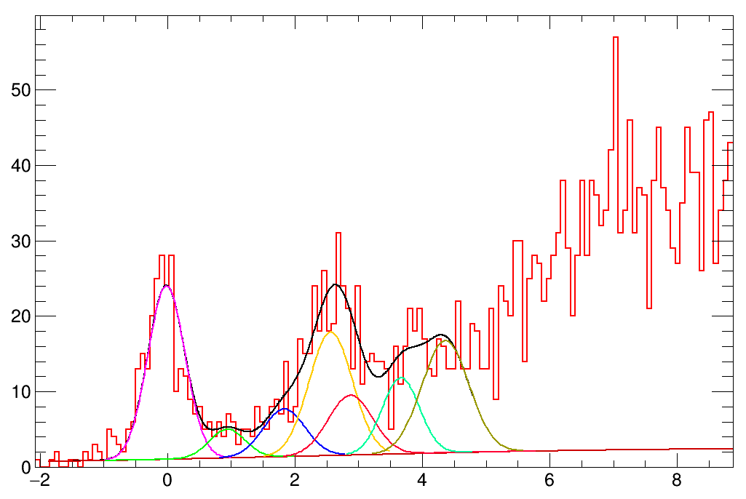
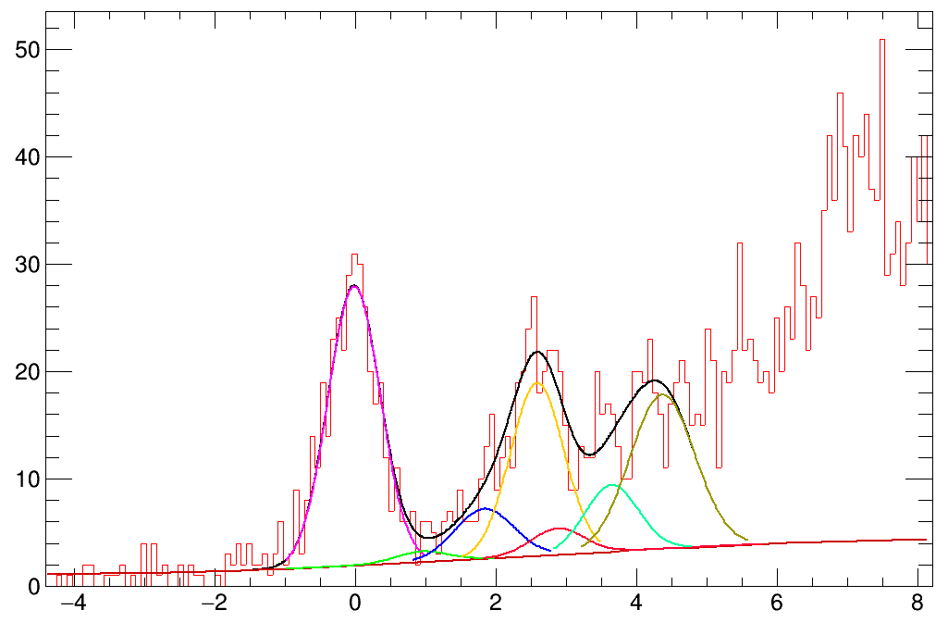
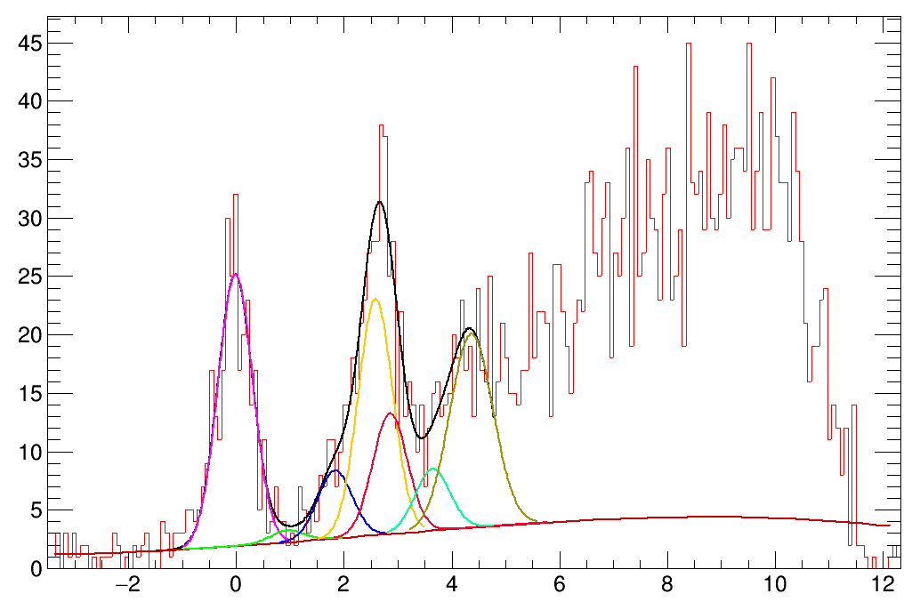
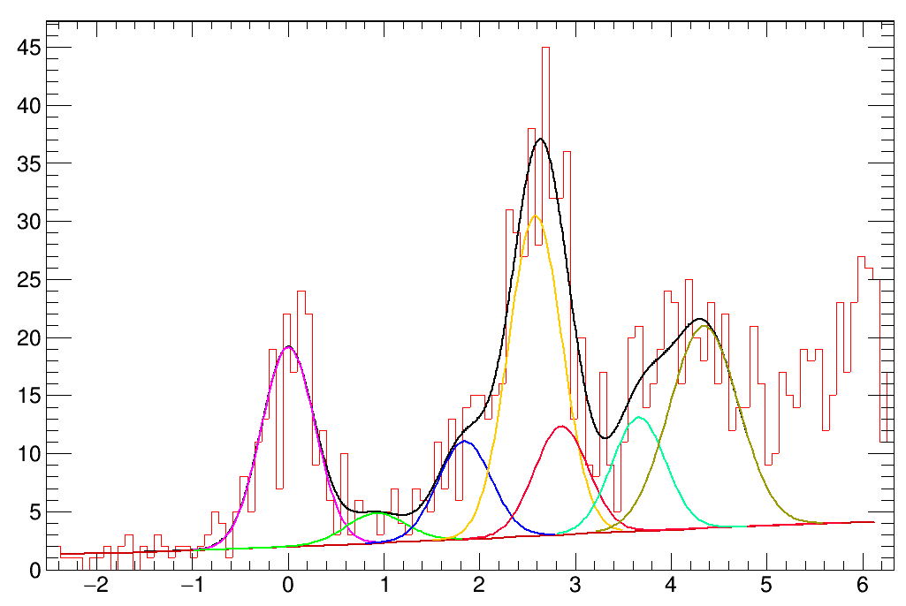
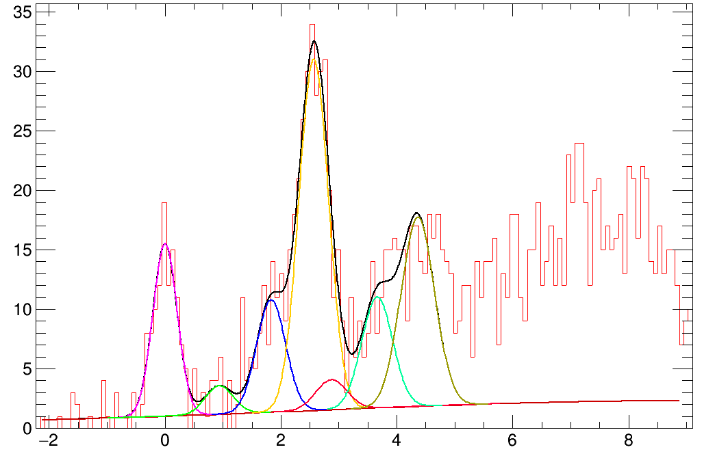
E* < S(n)
115-124
124-133
133-142
142-151
151-160

Slide 21



E* < S(n): Resolution
Gamma rays can help identify and constrain states.
For that, we gate on a definite value of Ex and see the gamma rays.
The resolution of EXOGAM will depend on 3 factors:
  The intrinsic resolution.
  The angle uncertainty
  Beta spread of the beam
Thesis: Stephane Leenhardt (2000)

Slide 22
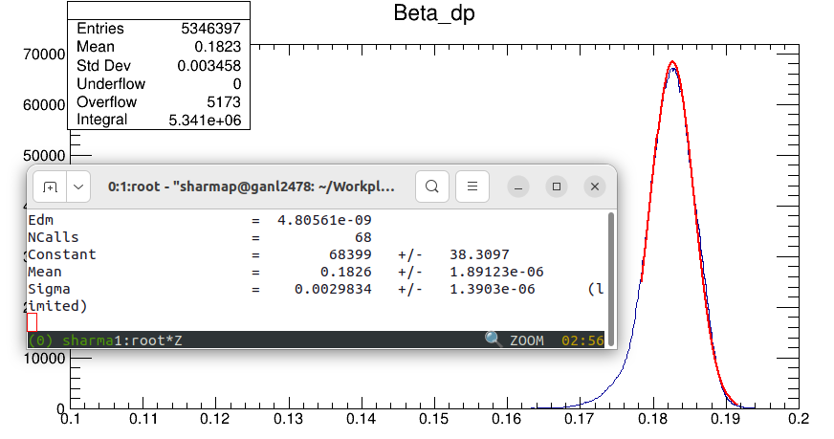
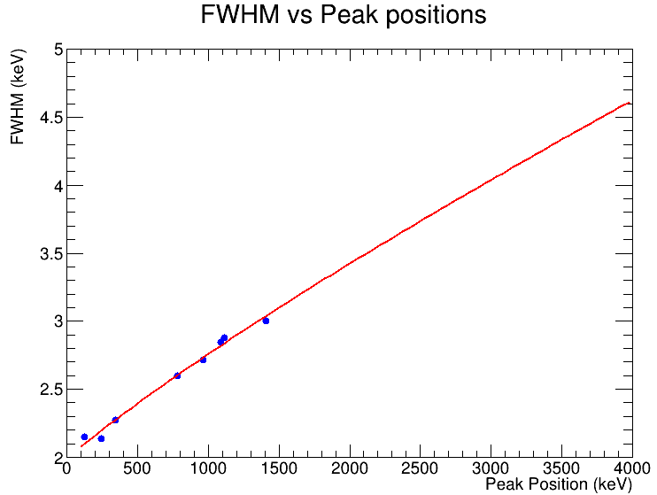
Exogam: Resolution
Beta = 0.18, sigma(beta) = 0.003
Angles = 90, 135 degrees
Sigma (angles): taken 27.5 mm pitch with 140 mm target to crystal distance

Slide 23
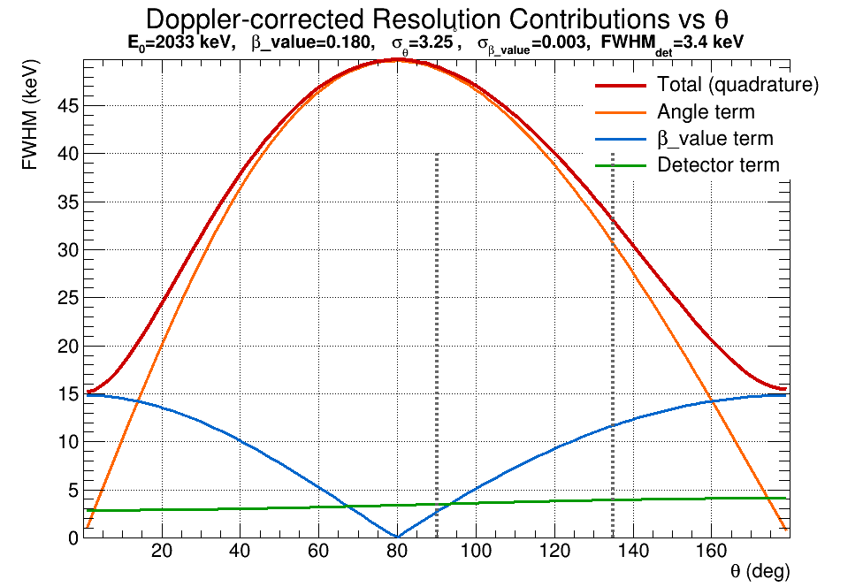
Exogam: Resolution
For example: @ 2033 keV from ⁶⁸Ni, FWHMint = 3.44
Total FWHM = 43.8

Slide 24
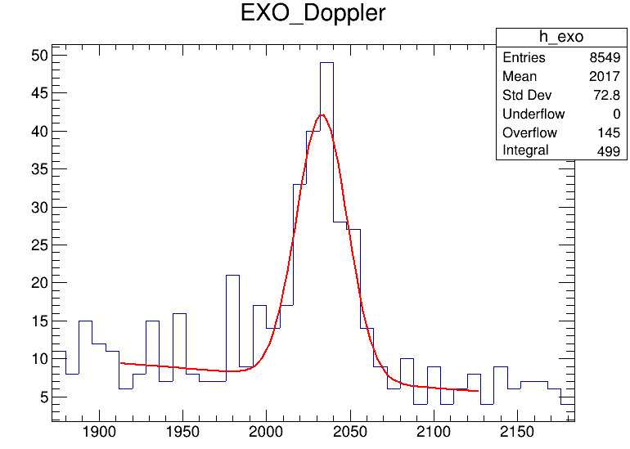
Exogam: Resolution
FWHM = 36 +- 4 keV

Slide 25
To-do/Ongoing Work:
Implementing this Drift Chamber with multiplicity > 0 with preference given to events predicted by CATS.
Build the angular correlation of light and heavy.
Building the excitation plot with new positions of CATS.
Then move on to the gamma vs E*.

Slide 27
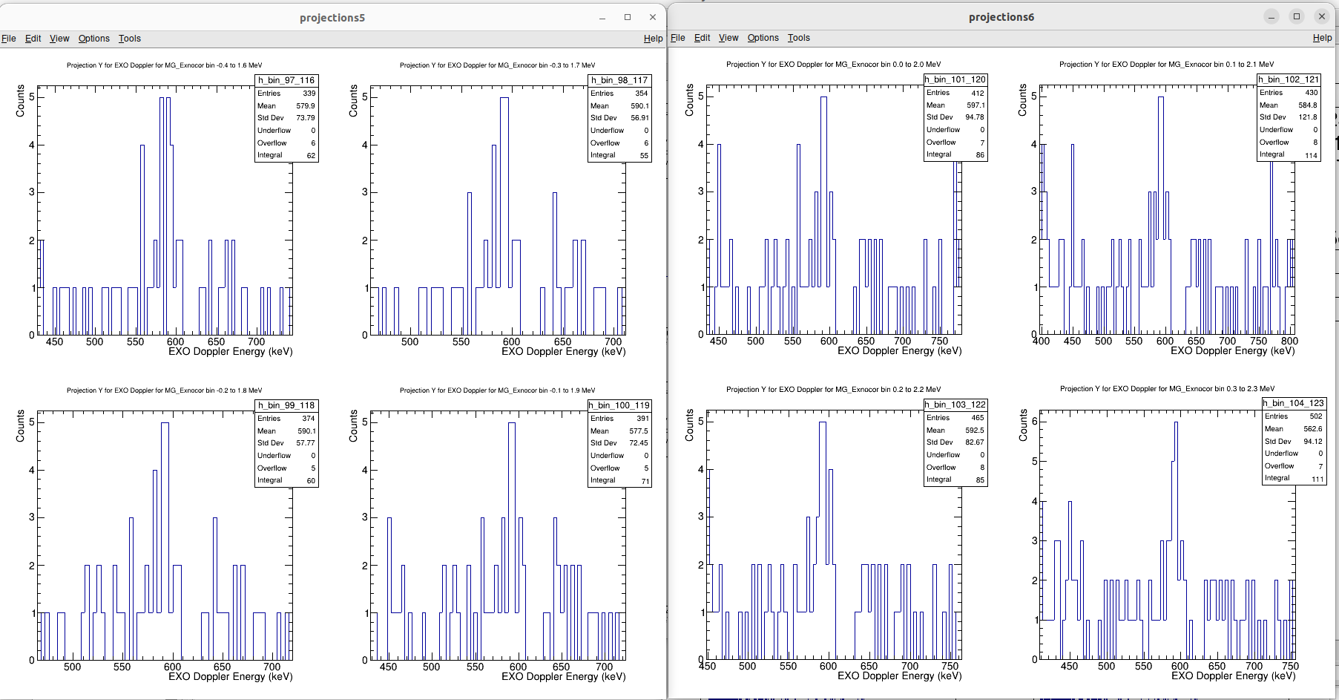
The 594 keV transition: whether to include in the fit
Should have sigma ~ 5.5 keV

Slide 28
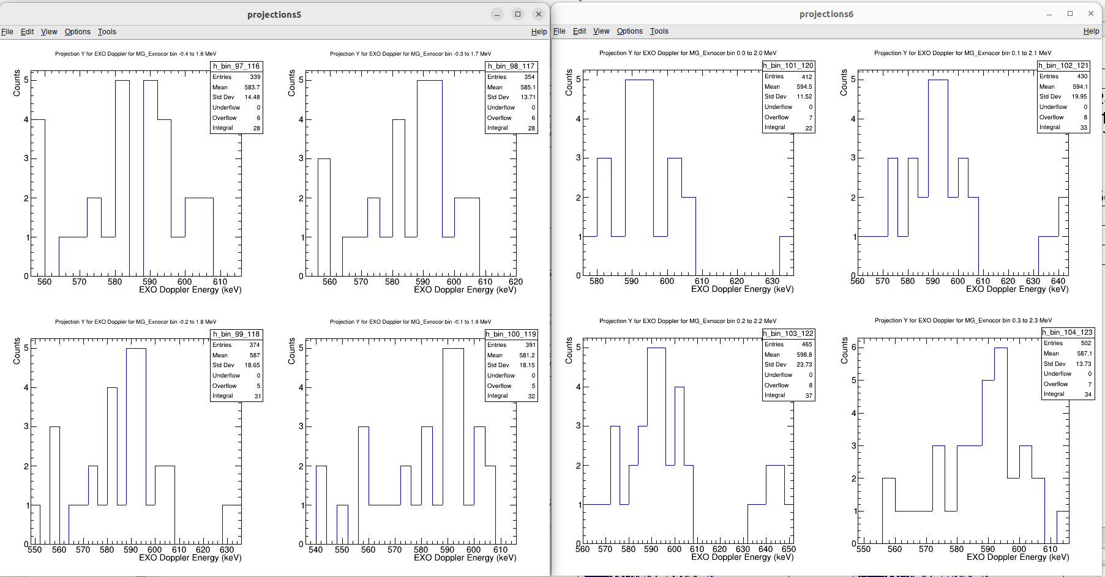
594: zoomed in

Slide 29
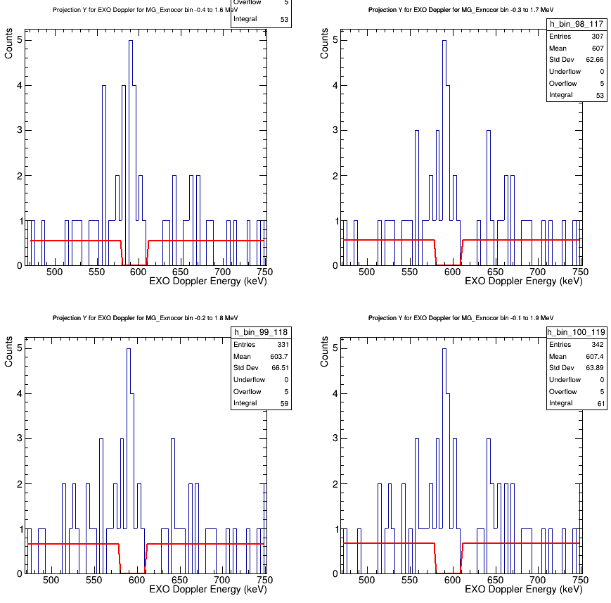
CATS calibration→ cats mask holes shift (x,y)
If this is 594, with the sigma value of 5.5keV I count the yeild for 594 +- 16
With gates on slices of E* spectrum.

Slide 30
Drift Chamber: Channel identification
Carbon reaction with 68Ni will appear differently in TACs because of heavier residual nucleus.
Theta heavy vs theta light and effect of Carbon.
ϴ

Slide 31
Backup

Slide 32
Drift Chamber: Channel identification

Slide 33
Drift Chamber: Channel identification

Slide 34
Drift Chamber: Channel identification

Slide 35
Drift Chamber: Channel identification

Slide 36
Drift Chamber: Channel identification

Slide 37
Drift Chamber: Channel identification

Slide 38
CATS calibration→ cats mask holes shift (x,y)

Slide 39
CATS calibration→ cats mask holes shift (x,y)

Slide 40
CATS calibration→ cats mask holes shift (x,y)

Slide 41
CATS calibration→ cats mask holes shift (x,y)

Slide 42
CATS calibration→ cats mask holes shift (x,y)

Slide 43
CATS calibration→ cats mask holes shift (x,y)

Slide 44
CATS calibration→ cats mask holes shift (x,y)

Slide 45
CATS calibration→ cats mask holes shift (x,y)

Slide 46
CATS calibration→ cats mask holes shift (x,y)

Slide 47
CATS calibration→ cats mask holes shift (x,y)

Slide 48
CATS calibration→ cats mask holes shift (x,y)

Slide 49
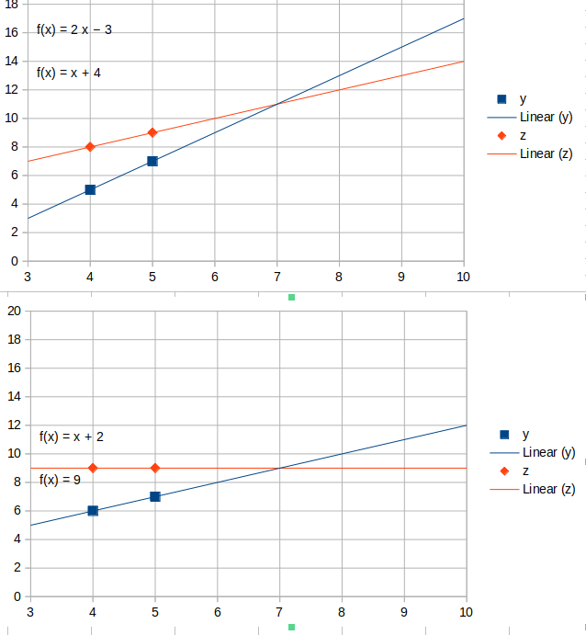
Drift Chamber: Channel identification

