Slide 1
Dunning, T. and Nilekani, J. (2013). Ethnic quotas and political mobilization: Caste, parties,
and distribution in Indian village councils. APSR
Cesar B. Martinez-Alvarez
Spring 2018
Distributive Politics

Slide 2
Summary
The presence of demographic quotas does not translate into targeting of state spending along the same lines.
Partisan dynamics are a better predictor of allocation of funds

Slide 3
The Puzzle
There is a sizable literature that documents the distributional impact of quotas based on demographic characteristics (ethnicity and gender).
However, disadvantaged groups still receive fewer resources
Moreover, in many cases the process of assignment into treatment (quotas) is correlated with other variables that may, in turn, be associated with political outcomes
“Are quotas for council presidencies an effective means of channeling benefits to marginalized groups?”

Slide 4
Research Setting
In the Indian states of Karnataka, Rajasthan, and Bihar, there is a procedure to reserve council presidencies to scheduled tribes and scheduled castes
Qualitative research shows that such officials are relevant in the allocation of governmental benefits, such as unemployment insurance
Therefore, we should expect to see group-based allocation

Slide 5
The Empirical Strategy
The authors leverage on an exogenous source of variation in the selection of villages with presidencies reserved to SC and ST
Step 1: determining the % of council presidencies to SC and ST
Step 2: bureaucrats rank all the constituencies. Then, the first X% of them have presidencies reserved to ST and SC.
Step 3: constituencies located in the neighborhood of the threshold should be indistinguishable from one another except for treatment. This is an RDD equivalent to a block-randomized experiment with matched pairs
Step 4: in one state, Karnataka, presidencies are actually randomly assigned
Step 5: covariate balance test
Step 5: simple differences in means

Slide 6
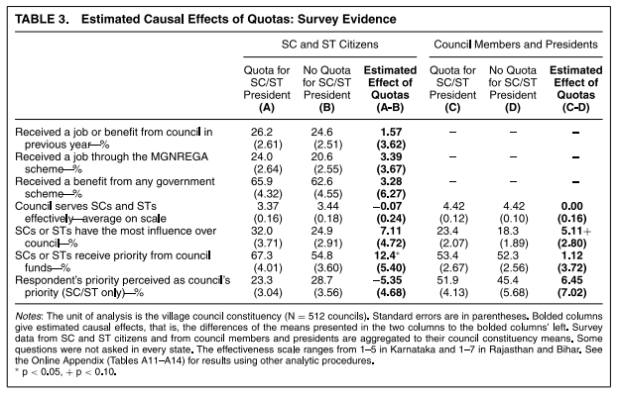
Outcomes and Results
Outcomes: survey to a probability sample of citizens and members of the village council on government transfers

Slide 7
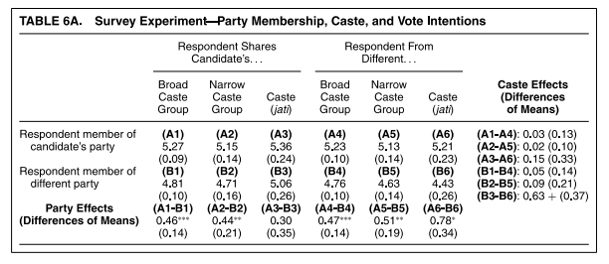
The Empirical Strategy: further evidence
What explains these mostly null results?
Survey evidence: observational and experiment
This second cut of the empirical analysis show that parties matter in the allocation of transfers from the government

