Slide 1
Drivers of Distributive Preferences: Symbolic Preferences vs Self-Interest in Africa
Ethan and Jenny

Slide 2
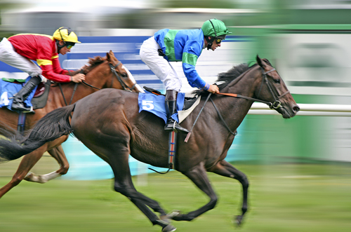
Explaining Preferences: The Horserace

Slide 3
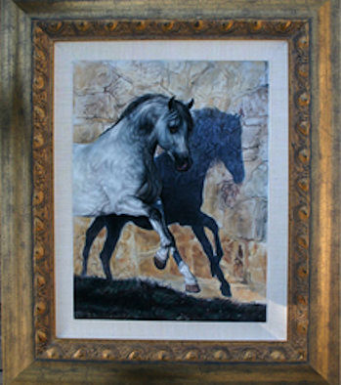
Framing the Horse Race

Slide 4


Rationality vs Materially Self- Interested
VS

Slide 5


What is “Symbolic Politics”?

Slide 6

African Politics &Material Interest

Slide 7

Schooling
Q5/Q6 = political ideology
Q1-Q4 -> self interest / theoretically unmotivated

Slide 8

Avoiding Ebola

