Slide 1

BANK APPLICATION
BATCH-86
TEAM G
Presented by:-
Mahesh Parikipandla
PRATEEK SHRIVASTAVA
Santhosh Kumar
Thanu Priya

Slide 2
CONTENTS
PROBLEM STATEMENT
SHORT DESCRIPTION
DESIGN
TECHNOLOGY USED
SCREEN SHOTS
CONCLUSION

Slide 3
PROBLEM STATEMENT
The banking industry is witnessing a revolution in products, process, markets and regulations. And It’s a revolution that is not about to stop or even slow down. Since the only option is to adapt and evolve, it is essential that system have the flexibility to quickly adjust the need of today’s financial market. Moreover, the need to retain existing customers and attract new ones often conflicts with the need to reduce costs and improve the efficiency. But whatever the challenges facing in retail banking operation, Online Banking System - OBS can help to meet and overcome them.

Slide 4
TECHNOLOGY USED
ANGULAR
BOOTSTRAP
SPRINGBOOT
MY SQL
TYPESCRIPT
CSS

Slide 5
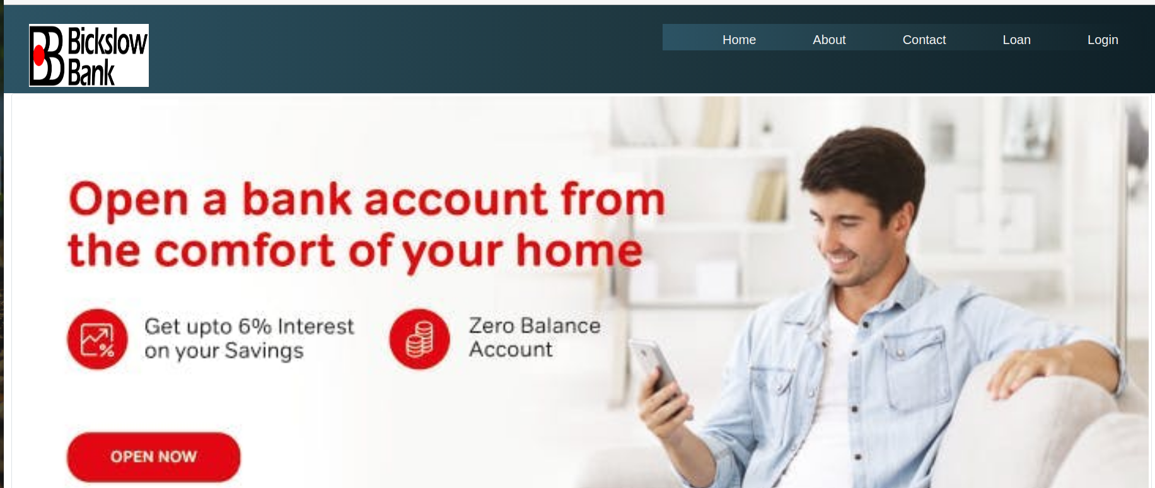
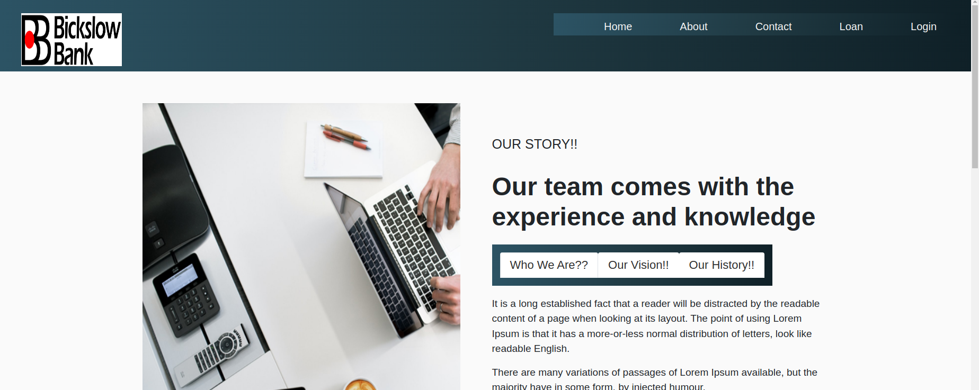
SNAP SHOTS

Slide 6
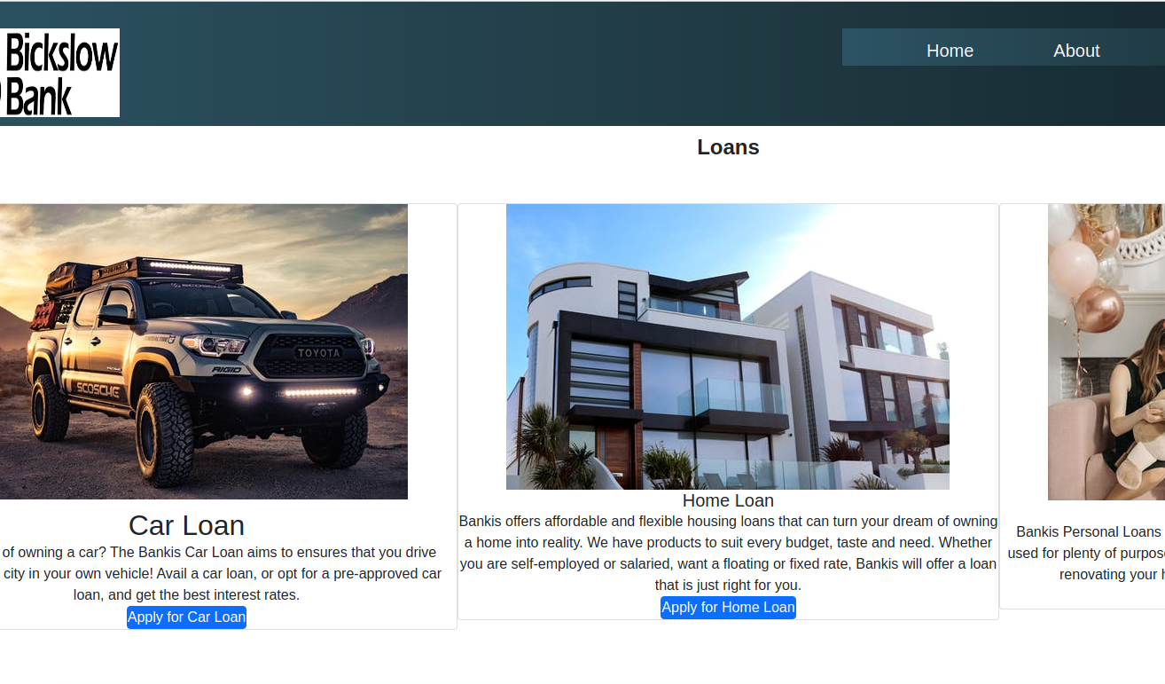
SNAP SHOTS

Slide 7
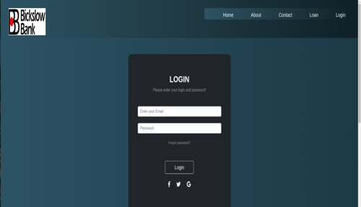
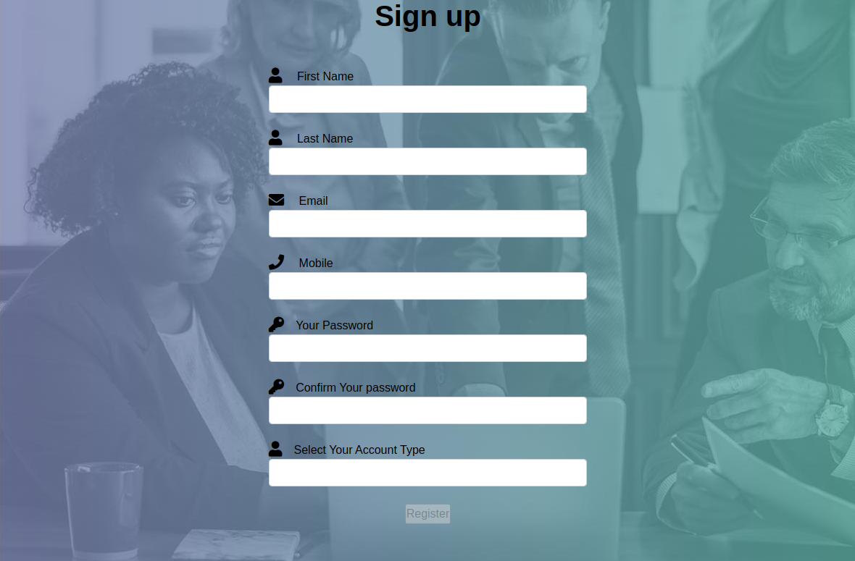
SNAPSHOTS

Slide 8
CONCLUSION
The mobile and wireless market has been one of the fastest growing markets in the world. The arrival of technology and the escalating use of mobile and smart phone devices, has given the banking industry a new platform. Connecting a customer anytime and anywhere to their money and needs is a must have service that has become an unstoppable necessity. This worldwide communication is leading a new generation of strong banking relationships. The banking world can achieve superior interactions with their public base if they accommodate all their customer needs.

Slide 9
THANK YOU

