Slide 1
Generative system design: Memory architecture

Slide 2
Challenges
Context is Not Consistent
Issue – There is no consistent app state in AI-backend which causes inconsistent responses from LLM.
Solution – A consistent App state in the backend. We call it “State Memory”
LLM Token Limit for a Long-Running Session
Issue - Long-running sessions can exceed the token limit.(FM models have 3.2k token limit for each request)
Solution – Context computation and retrieve app state before calling LLM Model. The computed context will have whole/part of the app state as input to the LLM along with the user query.
Client-Side Operations Are Not Acknowledged by the Backend
Issue – Non-AI CRUD operations on the client side are not currently synchronized with the AI–backend automatically. This creates inconsistencies in the app state and can cause mismatched responses from the LLM.
Solution – use REST-API calls and maintain the AI-BackEnd app state(State Memory) for each operation performed on the front end including undo/redo.

Slide 3
Front end -UI

Slide 4
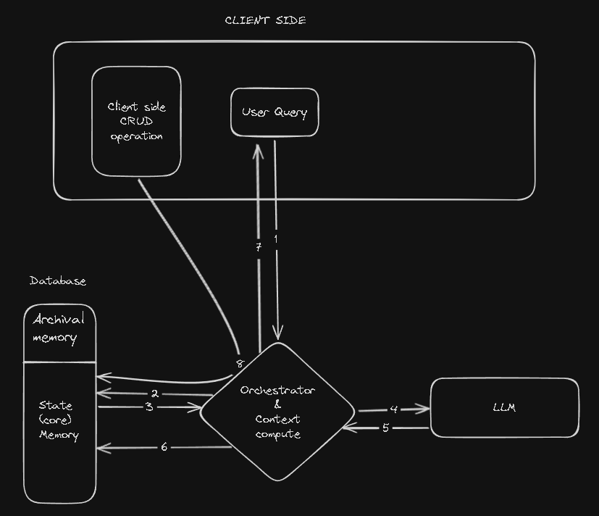
xSystems high level design - Key Components
State Memory (Core Memory):
Represents the current app state.
Acts as the central context that is immediately relevant to the user query.
Versioning
Add version number to each entry in the table.
Archival Memory:
Stores user interactions and LLM responses.
Serves as a log of all communication.
Can be used for creating summary and how system design evolved over time.
3) Orchestrator(Context Compute)
Control Unit
Manages Database
Handles Query Routing(agents/ LangGraph)
Creates Context for the LLM Model
Re-Prompting(TBD in future)
Undo and redo
Design Reference – MEMGPT, PAPER

Slide 5
Flow of Operations
User Query:
The user initiates a query, providing input to the system.
Step 1 & 2:
The orchestrator receives the query and logs it into the database(Archival) for persistence and future reference.
Step 3:
The orchestrator retrieves and computes the context for the query using:
The current state of the app (State Memory).
Historical conversation from Archival memory, if needed.
Context computation ensures that the LLM receives both current and relevant historical data.
Step 4:
The orchestrator sends the query along with the computed context to the LLM.
Step 5:
The LLM processes the information and provides a response.
Step 6-7:
The orchestrator:
Updates the database (to reflect new changes).
Sends the response back to the user.

Slide 6
Flow of Operations
Step 8: CRUD Operation - Client to Backend
If a CRUD operation is performed on the client:
The client-side CRUD module notifies the AI-Backend of the operation via an API call.
The orchestrator logs this information and updates the State Memory to reflect the changes in the app state and updates the version.
Advantages of Step 8
Seamless CRUD Synchronization:
Ensures that if CRUD operations performed directly on client which do not use LLM then, also we update the app state in our state/core memory.
Keeps the Core Memory updated with the latest app state, ensuring consistency for future queries.

Slide 7
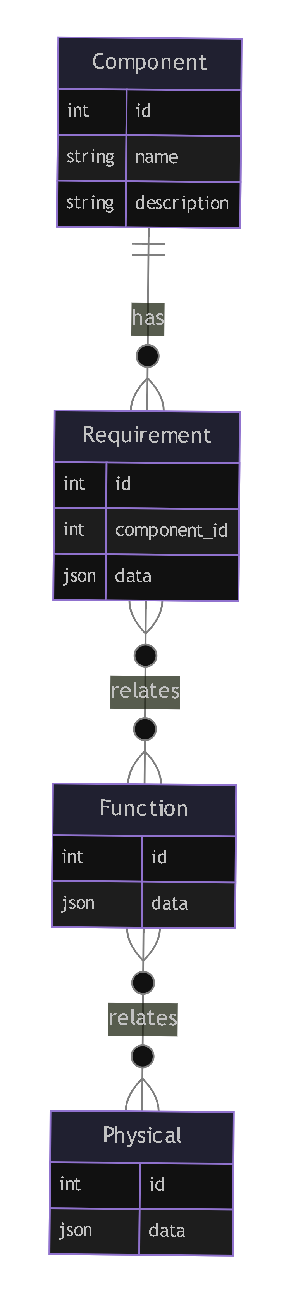
State(core) memory
Functions
Current state of the app
Version - for each entry(for undo and redo)
Metadata – e.g. time stamp etc.
Operations
CRUD
Undo and Redo
Database Schema – next page

Slide 8
Data base schema – Relation diagram
{
"component_name": "Electric Scooter",
"component_description": "Personal electric scooter system",
"requirements": [
{
"description": "Charge time to 80%",
“index": “1”,
“title": "Charge time to 80%",
"sub_requirements": [
{"description": "Battery longevity", "spec": "500 cycles"}
“index” : ”1”,
"functions": [
{“title:”charging”, "description": "Turn on/off", “index": “1"},
"physicals": [
{"component": "Battery", "type": "Lithium-ion, 48V"},
{"component": "Motor", "type": "Hub motor"}
]
],
},
{
"description": "Power for 40 miles",
“title": "10Ah battery",
"functions": [
{"description": "Power output", "operation": "regulated output"}
],
"physicals": [
{"component": "Motor controller", "type": "PWM"}
]
}
]
}
Component
Requirement
Functions
Physical

Slide 9
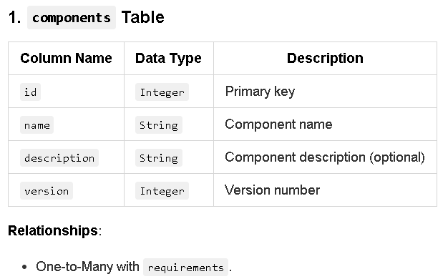
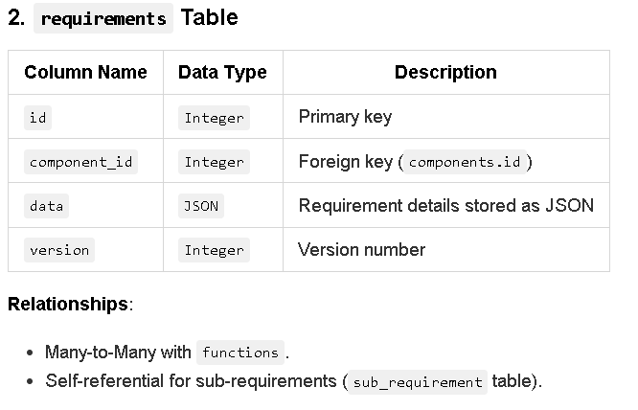
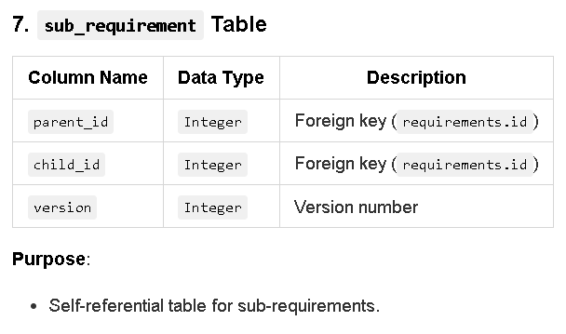
Data organization in the State memory db
{
"component_name": "Electric Scooter",
"component_description": "Personal electric scooter system",
"requirements": [
{
"description": "Charge time to 80%",
“index": “1”,
“title": "Charge time to 80%",
"sub_requirements": [
{"description": "Battery longevity", "spec": "500 cycles"}
“index” : ”1”,
"functions": [
{“title:”charging”, "description": "Turn on/off", “index": “1"},
"physicals": [
{"component": "Battery", "type": "Lithium-ion, 48V"},
{"component": "Motor", "type": "Hub motor"}
]
],
},
{
"description": "Power for 40 miles",
“title": "10Ah battery",
"functions": [
{"description": "Power output", "operation": "regulated output"}
],
"physicals": [
{"component": "Motor controller", "type": "PWM"}
]
}
]
}
Component
Requirement
Sub-Requirement

Slide 10
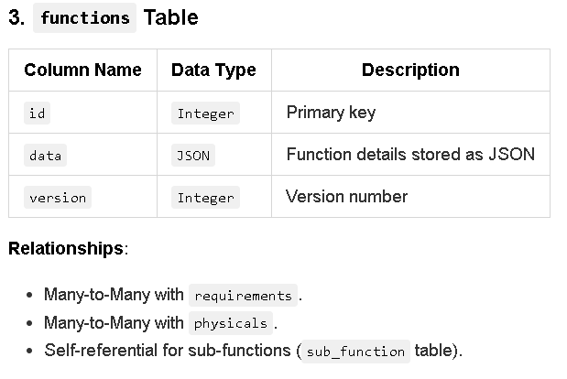
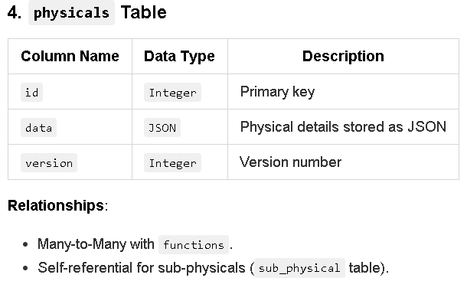
State memory schematics – Main tables

Slide 11
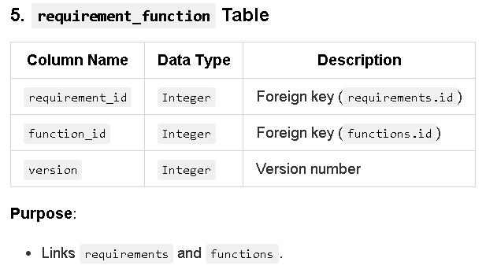
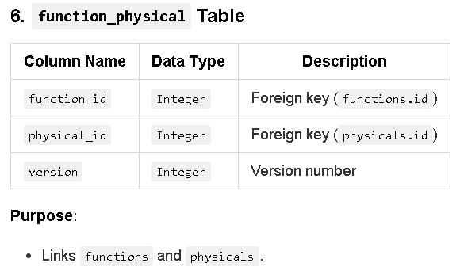
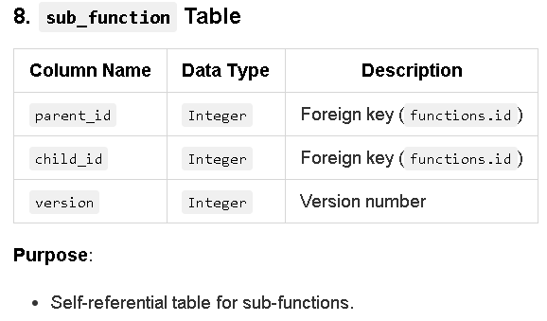
State memory – association tables

Slide 12
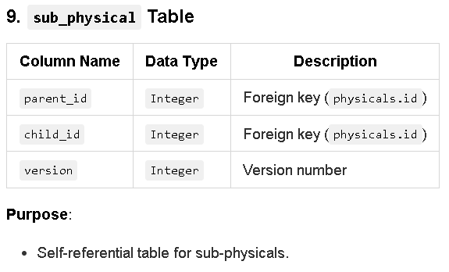
State memory - association tables

Slide 13
Advantages of Using a Database as memory
Overcoming LLM Limitations:
Context consistency:
State Memory ensures the context in AI-Backend is always consistent with client side.
Prevents the LLM from generating off-topic – because we will always compute context from state memory before calling LLM
Token Limit Management:
Avoids exceeding token limits by selectively retrieving(if needed)
Client Side CRUD operations are in sync with backend
Non-AI CRUD operation on client side is being communicated back to the backend hence AI-Backend will always be in sync.
Reduced LLM Calls(TBD with Client)
Request schema introduced a few more parameters with the help of which LLM don’t have to categorize the type of question.
Enhanced Functionality:
Multi-user Support:
We have the database hence we can support multiuser support. Each user will have its own database.
Each user session can have distinct state handling.
Alignment with Agentic Frameworks:
The design aligns with established frameworks, making it easier to adopt industry best practices and scale.
Data Integrity and Export:
Persistent storage ensures no loss of data.
Historical states can be exported for analysis or debugging.
Speed: Storing pre-processed data avoids the inefficiency of feeding entire histories into the LLM for each interaction.

Slide 14
Potential Enhancements
Caching Layer: Implementing an intermediate caching mechanism for even faster retrieval of recent states.
Version Control for States: Using some versioning systems for fine-grained tracking of state changes.

Slide 15
Low Level tasks
Steps to tackle Memory Architecture
Approach -
Database in ipynb to prototype before final design
Create low level design diagrams at micro level whenever necessary.
Database low level design
State Memory -
Learning Curve - learn ORM and SQL. - In Progress(parallel)
Design the schema - for now Component and one requirement - In Progress
Create prototype and CRUD wrapper functions and test functionality
Complete the schema for RFLP
Investigate on relationship design for each table. e.g. self-referential. Since the design is not nested anymore so linking should be robust. Investigate approaches
Archival database
Design the schema
History table -
table with entries for user and AI conversation
Design the spec and implement low level.
Orchestrator low level design
Non AI-CRUD operations
This will designed first
Create wrapper functions on top of state memory database
Expose the endpoints for each CRUD operation underneath it should be using the wrapper functions.
Investigate on propagation(non ai-crud + ai crud)
AI-CRUD operations
Syncing with LangGraph agents
Transactions to/from LLM
Leverage the NON-AI CRUD wrapper functions
To be continued

Slide 17






