Slide 1

#LifeKoKaroLift
Automatic Ticket Classification

Slide 2



Course : Machine Learning
Lecture On : Pre Assignment
Instructor : Manish Kumar

Slide 3
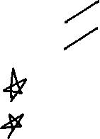
Agenda
Problem Statement walkthrough
Business Objective
Analytical Objective
Solution Approach
Starter Code Walkthrough

Slide 4
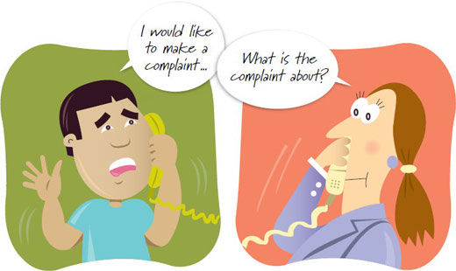
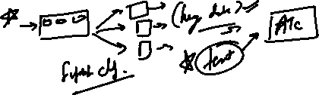
Automatic Ticket Classification
These customer complaints are unstructured text data; so, traditionally, companies need to allocate the task of evaluating and assigning each ticket to the relevant department to multiple support employees. This becomes tedious as the company grows and has a large customer base
In this case study, you will be working as an NLP engineer for a financial company that wants to automate its customer support tickets system. As a financial company, the firm has many products and services such as credit cards, banking and mortgages/loans.

Slide 5
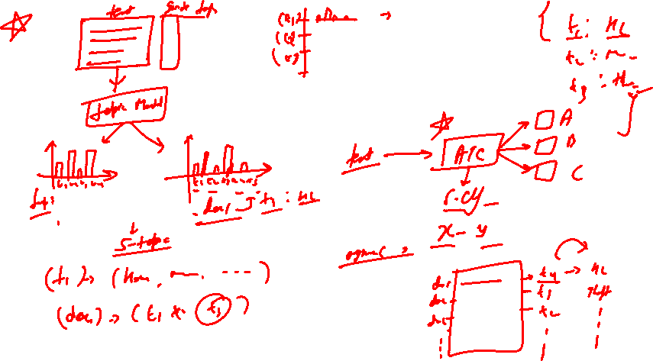

Slide 6


Automatic Ticket Classification
Requirements
You need to build a model that is able to classify customer complaints based on the products/services. By doing so, you can segregate these tickets into their relevant categories and, therefore, help in the quick resolution of the issue.
What you need to do?
You will be doing topic modelling on the .json data provided by the company and classify tickets into the following five clusters based on their products/services:
Credit card / Prepaid card
Bank account services
Theft/Dispute reporting
Mortgages/loans
Others
You can then use this data to train any supervised model such as logistic regression, decision tree or random forest. Using this trained model, you can classify any new customer complaint support ticket into its relevant department.

Slide 7
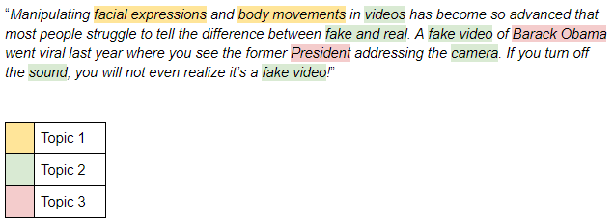
What is Topic Modeling
Topic Modeling is an unsupervised technique to automatically discover the abstract “topics” that occur in a collection of text objects and to derive hidden patterns exhibited by this text corpus. Thus, assisting better decision making.
All topic models are based on the same basic assumption:
each document consists of a mixture of topics, and
each topic consists of a collection of words.
Notes:
In natural language understanding (NLU) tasks, there is a hierarchy of lenses through which we can extract meaning — from words to sentences to paragraphs to documents. At the document level, one of the most useful ways to understand text is by analyzing its topics. The process of learning, recognizing, and extracting these topics across a collection of documents is called topic modeling.

Slide 8
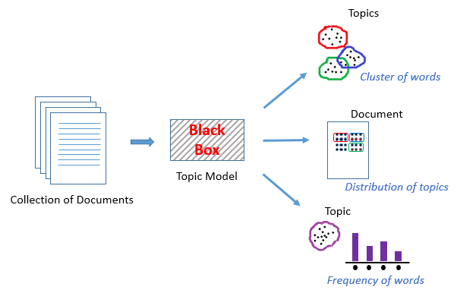
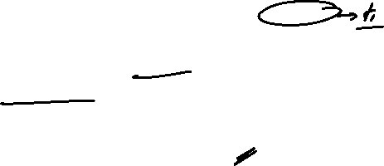
What is Topic Modeling
For now, let’s understand a topic model as a black box
This black box (topic model) forms clusters of similar and related words which are called topics. These topics have a certain distribution in a document, and every topic is defined by the proportion of different words it contains.

Slide 9

Starter Code

Slide 10

#LifeKoKaroLift
Thank You!

