Slide 1





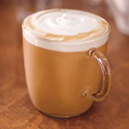

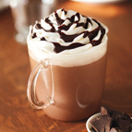
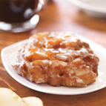
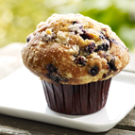
Coffee
$ 1.65
Latte
$ 3.45
Espresso
$ 1.80
Hot Chocolate
$ 2.55
Apple Fritter
$ 2.00
Muffin
$ 1.80

