Slide 1
Location-based Routing Algorithms in Mobile Ad Hoc Networks
Sachin Leelasena
Supervisor: Dr J.A. Barria
Notes:
Before I start, I want you to imagine a scenario. Let’s say you’ve been to Wembley to see your team win a cup final, or you’ve been to a concert watch your favourite artist. You’re making your way to the nearest tube station in a large crowd as you make your way home. But what you don’t know is that the station is closed due to overcrowding. You have no way of checking either since the large number of people in the area have clogged up the cellular networks. So now you have to fight your way through the crowd and find a different way home, which is annoying enough to ruin your day. But what if there was a way to change that?

Slide 2
Outline
Introduction
Performance Metrics
System Design
Results
Conclusions
Notes:
In this presentation I’ll give a brief introduction to my project before covering the key aspects of the system design. The results obtained from the system will be discussed along with the conclusions drawn, before finishing with some ideas for further work.

Slide 3
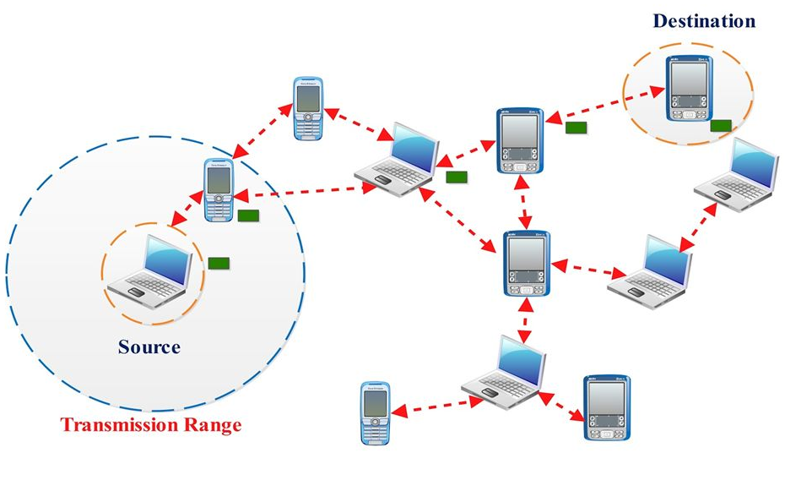
Introduction
No fixed routers in a Mobile Ad Hoc Network (MANET)
Crowd control for local area events
Identify best routing algorithm
Notes:
Wireless networks typically refer to infrastructure networks which have fixed routers. Mobile ad hoc networks don’t have fixed routers and connections are directly between nodes in the network e.g. between 2 smartphones. All nodes in a MANET can move so the links in the network can change dynamically. This dynamic nature presents some challenges but can also be exploited to give better performance. MANETs are less hardware reliant than infrastructure networks so can be used where it may be too expensive to have a permanent network. They can also be used in rescue operations if infrastructure networks have been damaged for example after an earthquake.
The use case investigated in my project is for crowd control as a response to local area events. A local area event in this context is something that causes disruption to transport links e.g. station closure due to overcrowding or road closure. The crowd being controlled is specifically a crowd of people leaving a stadium after an event such as a football match. In situations like this, cellular networks can get ‘clogged up’ and information transfer can be difficult using infrastructure networks. My project investigates the use of a MANET between smartphones carried by people leaving the stadium being used to propagate information about local area events. The aim of my project is to identify the best routing algorithm to use in this proposed network.

Slide 4
Performance Metrics – Group Transmission Time (GTT)
Primary performance measure
Measure of transmission speed
Time taken for all relevant nodes in the network to receive the message being propagated
Theoretical minimum exists:
Notes:
Skip equation

Slide 5
Performance Metrics – Power Consumption
Secondary performance measure
Considered due to the use of mobile devices
Average Transmission Power Consumption (ATPC)
Power consumption as a result of transmission
Average calculated per node in test group
Notes:
End ~ 3 min (2m45)
Skip ATPC definition if time is short

Slide 6
System Design – Overview
Notes:
I created a simulation environment using MATLAB where the movement of people leaving Wembley Stadium and heading towards nearby transport links was modelled. I then simulated a station closure and investigated the performance of an ad hoc network where the nodes were smartphones of people heading towards the closed station.
This flowchart shows the overall flow of each simulation. The program flow can be broken down into 3 main components: initialisation, a transmission step and a movement step. The initialisation stage occurs once and the transmission and movement stages loop over a defined number of time slices. Each time slice represents 1 second in real time so the simulation works by simulating the environment as a series of 1 second slices. Once the simulation reaches the end, the results are calculated so a performance comparison can take place.
The system was designed to be as modular as possible to allow common elements to be reused between simulations. The main differences between the simulations of the different algorithms are found in the “transmission possible” decision and simulate transmission step.

Slide 7
System Design – Mobility Model
Accurately model people leaving a stadium
Shortest Path Map Based Movement (SPMBM) mobility model
Graph representing geographical area
Dijkstra’s algorithm
Bioinformatics toolbox
Notes:
Try and keep to 1 min

Slide 8
System Design – Mobility Model 2
Generates position at each time slice
Some random behaviour
Path recalculation limitations
Notes:
Try and keep to 1 min

Slide 9

System Design – Routing Algorithms
4 algorithms implemented and simulated
Distance Routing Effect for Mobility (DREAM)
‘Reactive’
‘Reactive Delay’
Lightweight Mobile Routing (LMR)
Transmission via Bluetooth Low Energy (BLE)
Transmission range
Transmission timings
Notes:
Takes approx 1.5 min
End ~ 8 min (~ 10 – 15 s after is fine)

Slide 10
System Design – Distance Routing Effect for Mobility (DREAM)
Active routing algorithm
Location Table
Message Table
Update messages
Notes:
30 s
8.5

Slide 11
System Design – ‘Reactive’ Algorithm
Uses flooding to discover routes
Routes discarded after 1 second
Variable transmission limit
Notes:
30 s
9

Slide 12
System Design – ‘Reactive Delay’ Algorithm
Modified version of the Reactive algorithm
Variable route discovery blocking period
Notes:
30 s
9.5

Slide 13
System Design – Lightweight Mobile Routing (LMR)
Uses flooding to discover routes
Only maintains single routes to neighbours
Routes discarded from cache after transmission
Routes may be invalid due to blocking period
Notes:
30 s
End ~ 10.5 mins

Slide 14
Results – Group Transmission Time
Notes:
1.5 mins
End ~ 12 mins

Slide 15
Results – Power Consumption
Notes:
1 min
End ~ 13 mins

Slide 16
Conclusions
Realistic mobility model implemented
1 active & 3 reactive algorithms implemented
GTT & power consumption measured
Reactive algorithm identified as most suitable for dense networks
Implementation was challenging
Simulation framework developed
Notes:
2 mins
End ~ 15 mins

Slide 17
Background
Routing protocols
Active
Reactive
Hybrid
Location-based
Wireless communication technologies
Mobility models
Simulation packages
Evacuation systems
Notes:
Discuss route discovery via flooding – mention what flooding is…

Slide 18
System Design – Routing Algorithms 2
Object-oriented approach
Modular design
Cell array data structure

Slide 19
Results – DREAM GTT

Slide 20
Results – DREAM ATPC

Slide 21
Results – Reactive GTT

Slide 22
Results – Reactive ATPC

Slide 23
Results – Reactive Delay GTT

Slide 24
Results – Reactive Delay ATPC

Slide 25
Results – LMR GTT

Slide 26
Results – LMR ATPC

Slide 27
Results – LMR PTER

Slide 28
Further Work
Test different algorithms
Increase graph complexity
Increase complexity of local area event
Move away from MATLAB

