Slide 1
Lab 2 Psych 241 Beginning Stroop
Notes:
Starting with the date and time because that’s basically the theme for the day. Show up! Do the work, and talk to me in advance!

Slide 2
Welcome
Any Questions?
Notes:
Go to slide page!

Slide 3
Outline
Quiz!
Overview of original Stroop
Explain our alternative design
Begin experiment
Come back together, talk about expt
Assign HW
Notes:
Go to slide page!

Slide 4
Quiz
1. What is the point per day penalty for late lab reports?
2. What is the maximum number of lab meetings you can miss during the semester?
3. Define Plagiarism
Notes:
Only take ~5 minutes
Total: worth 3 pts

Slide 5
Goals of Stroop Project
Perform ‘true’ experiment
Connect with Statistics knowledge from Psych 240 (or wherever else)
Introduce APA-style writing
Write a really solid Methods and Results Section (and the rest of the APA paper)
Notes:
Go to slide page!

Slide 6
Stroop, 1935 -Built on Earlier Literature
James McKeen Cattell (1886)
RED VS
This difference does change with age (Lund 1927), this difference doesn’t change with age (Brown 1915, Ligon 1932)
Notes:
Go to slide page!

Slide 7
Stroop, 1935
It’s all about interference
Notes:
Not too bad, eh?
Stroop was interested in interference…
3 expts
1) Color works (no congruent colors) vs black

Slide 8
Stroop, 1935: Expt 1
Red
Blue
Brown
Orange
Green
Notes:
Not too bad, eh?
Stroop was interested in interference…
3 expts
1) Color works (no congruent colors) vs black

Slide 9
Stroop, 1935: Expt 1 control
Red
Blue
Brown
Orange
Green
Notes:
Not too bad, eh?
Stroop was interested in interference…
3 expts
Color works (no congruent colors) vs black; no effect

Slide 10
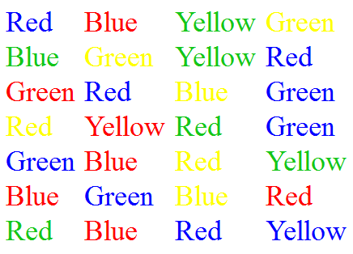
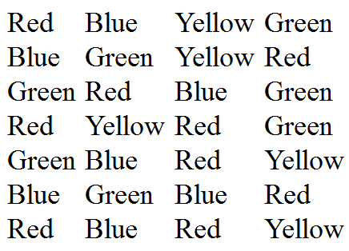
How Was That?
Notes:
Arranged in a 10x10 order.
Didn’t use yellow (might be more difficult than the others to see)
Never actually had a congruent set

Slide 11
Expt 2, Get Ready…
Notes:
Go to slide page!

Slide 12
RED
Notes:
Go to slide page!

Slide 13
GREEN
Notes:
Go to slide page!

Slide 14
BLUE
Notes:
Go to slide page!

Slide 15
BLUE
Notes:
Go to slide page!

Slide 16
ORANGE
Notes:
Go to slide page!

Slide 17
RED
Notes:
Go to slide page!

Slide 18
YELLOW
Notes:
Go to slide page!

Slide 19
BLUE
Notes:
Go to slide page!

Slide 20
GREEN
Notes:
Go to slide page!

Slide 21
Stroop, 1935: Expt 2; Control
Red
Blue
Brown
Orange
Green
Notes:
Way Easier
Again, his was arranged in a 10x10 card

Slide 22
Stroop 1935

Slide 23
Expt 3
Over the course of many days
Effect of practice/learning
Changed Control:
&&&
&&&
&&&
&&&
Notes:
Control made it easier to make the shade of the colors the same
More importantly, this equated the amount of information (as in, alphanumeric character that looks more like letters)
24 pt font

Slide 24
Stroop 1935, expt 3
Notes:
Interestingly, also observed a temporary ‘Reverse Stroop Effect’
-> Participants were actually slightly slower at reading color words (expt 1) than before
-> Though, that vanished almost immediately (with second test)
Cited around 12164 times, according to google scholar, as of yesterday
Primarily for expt 2
~700 articles, as of 1991 that did variations

Slide 25
Stroop, our lab
Closest match is the classic Stroop, his 2nd expt
But, we’re using a different kind of stimulus
Everybody will be BOTH
a participant (first)
a researcher (after you have been a participant)
the slip of paper gives your subject number and the order of the conditions you will do
We will be heading out to the foyer/steps and then coming back into the room in groups.
Notes:
Why might this order be important, participant than subject?

Slide 26
Stroop Instruction
This is a study of reaction time. Each participant will be shown two sheets of paper, one at a time. Each sheet contains a series of black and white animal silhouettes: a dog, a cat, a pig, a cow, and a bear. The task, in all cases, is to name the animal silhouettes as quickly as possible. Accuracy is very important. On one sheet, the silhouettes contain superimposed words. The task is to ignore the words and name the silhouettes.
Notes:
I’ll read these all aloud. These instructions will probably be useful in writing your ‘methods’ section.
Of course, you’ll need to put all of this material into your own words. However, this can at least serve
As a reminder of what we do in class today.
Silhouettes ~ color

Slide 27
Stroop Instructions
The researcher will place the appropriate stimulus sheet face down in front of the participant. When the researcher says “Begin” the participant should flip the stimulus sheet over and begin to name the silhouettes row by row from top left through to the last silhouette at the bottom right. The researcher should start the stop watch as soon as the sheet is flipped over. When the participant has finished naming all the silhouettes on the sheet, the participant should say “Done” and the researcher should stop the stop watch.
Notes:
Silhouettes ~ color

Slide 28
Stroop Instructions
The researcher then records the data for that trial on the data sheet. The information recorded should include the numbers assigned to the researcher and the participant, the number of errors the participant made, and the time it took the participant to name all the silhouettes on the sheet. The researcher needs to make sure they have recorded the information in the correct area of the sheet.
Notes:
Silhouettes ~ color

Slide 29
Stroop Instructions
Notice that the top area is the answer sheet and data for the silhouette alone condition while the bottom area is the answer sheet and data for the incongruent label condition. The participant is only scored as making an error if they say the wrong name, do not self correct. If, for some reason, the researcher loses track of the correct position on the answer sheet, they should NOT interrupt the participant but rather simply leave no score for accuracy for that participant. The time is the more important measure.
Notes:
Participant: Strive for high accuracy.
Researcher: Just go with it. We care way more about an solid RT record

Slide 30
Stroop Instructions
There will also be a demographics data sheet to fill out for each participant
Notes:
In general, these are useful. Organizations like NIH requests basic demographics; never know when these kinds of data may be useful…
Of course, no one is obliged to provide such information if they’d prefer to not.

Slide 31
While you wait…
Start reading Ehri. (1976) Do Words Really Interfere in Naming Pictures? (CP 55-58)
That, along with the article by Reading Research Articles will be HW for Thursday
CP 51-54
Notes:
They basically relate to each other. I’d say, go through RRA first (keeping a note about the questions), read Ehri, then look through RRA again

Slide 32
Stroop
What was the task?
Accurately identify all animals as quickly as possible
What were the Dependent Variables (DVs)?
Reaction Time
Remember, a higher number = worse performance
Accuracy
Amount named correctly
What were the Independent Variables (IVs)?
Notes:
Going to become awesome at spelling the word ‘silhouettes’

Slide 33
Stroop, to think about
What were some ways that we tried to control our internal validity
What threats did we have to Internal Validity?
How about to our External Validity?
i.e., to whom could we generalize?
Notes:
Internal Validity (can think of 4 off the top of my head…)
-> we included a control condition (just silhouettes (what is ‘slower’ anyway?))
-> naive to stimuli
-> repeated measures (controlled secondary = sub differences)
-> counterbalancing (controlled secondary = order (i.e., fatigue, practice/learning…))
External…Patrick was this fast on this day at this time, after having this many cups of coffee and this little sleep…does that generalize to other times even for me?

Slide 34
Switching directions…
Reading Research Articles
One of the most important things to remember is that most articles require being read multiple times

Slide 35
First Reading
Gives basic idea of
What was done
What was found

Slide 36
Second Reading
Pick out details relevant to YOU

Slide 37
HW, due Thursday: Jan 28
Read/Finish Ehri. (1976) Do Words Really Interfere in Naming Pictures?
Pgs 55-58 of Course Packet (CP)
Additionally, read/finish Reading Research Articles from CP
Pgs 51-54
Answer all questions
Write up your answers and bring them on Thursday

Slide 38
Stroop
What stimuli did we use?
Silhouettes of animals
cat, dog, cow, pig, and bear
What conditions did we use?
No label
Incongruent labels
How did we order the Conditions?
Why?
Notes:
Going to become awesome at spelling the word ‘silhouettes’

Slide 39
Stroop, our lab
Open ended question: was this an Inductive or Deductive experiment?

