Slide 1
Fitness
7
PILOT PARTNERSHIP PROPOSAL
A visual coach
for every member.
A mobile-first workout companion designed to help Fitness 7 members start the right workout with confidence.
Sagar Paperwala
Founder & Product Lead · Fitness 7
50-member pilot · August 2026
Notes:
[Sources]
Fitness 7 internal PRD, 11 August 2026.

Slide 2
THE PROBLEM
Gym-floor uncertainty kills momentum.
When the app is unavailable, members lose the simplest thing they need: a clear next exercise.
1
2
3
4
App unavailable or incomplete
→
Search YouTube / ask ChatGPT
→
Wait for a trainer
→
Skip, improvise, or lose confidence
The opportunity is not another generic workout list. It is dependable, visual guidance at the exact moment a member needs it.
FITNESS 7 / GYM COMPANION
PILOT PARTNERSHIP · 02
Notes:
[Sources]
Fitness 7 internal PRD — member problem and trainer/operations problem.

Slide 3
WHY NOW
A local operating problem creates a clear first wedge.
The numbers establish a controlled pilot opportunity — not a claim of market size or revenue.
1,000
2
₹60K
active members across the Fitness 7 member base
locations included in the current operating case
annual maintenance cost avoidance estimate
Investment thesis: use the Fitness 7 pilot to prove adoption, member confidence, trainer efficiency, and a repeatable operating model before wider scale.
FITNESS 7 / GYM COMPANION
PILOT PARTNERSHIP · 03
Notes:
[Sources]
Fitness 7 internal PRD — operating context and business case. ₹60K is approved planning basis for annual cost avoidance only.

Slide 4
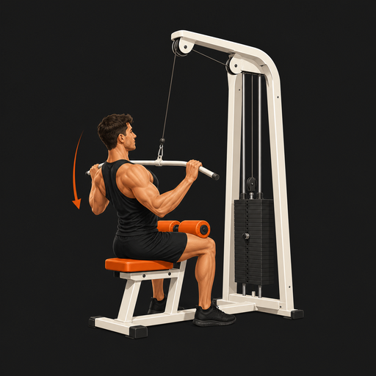

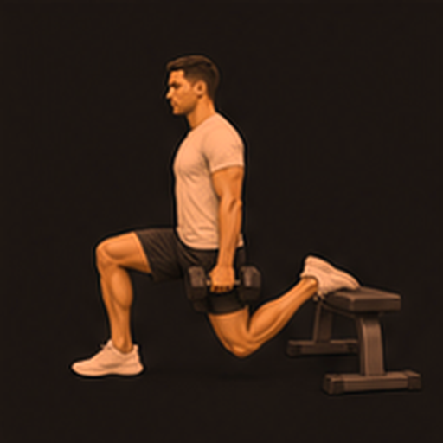
THE PRODUCT
A personal workout companion built for the gym floor.
One phone screen gives members the routine, visual explanation, alternative, recovery guidance, and a way to complete the session.
What members see
• Today's workout in sequence
• One selected primary or alternative
• Three-phase form explanation
• Warm-up and recovery guidance
• Completion and progress cues
Visual-first content replaces uncertainty without replacing trainer judgement.
FITNESS 7 / GYM COMPANION
PILOT PARTNERSHIP · 04
Notes:
[Sources]
Fitness 7 internal PRD — current product requirements, V4 showcase functionality. Images are approved internal Fitness 7 exercise assets.

Slide 5
MEMBER JOURNEY
From “What should I do?” to “I know what to do next.”
1
→
2
→
3
→
4
OPEN
UNDERSTAND
ADAPT
COMPLETE
Today’s training is clear
See setup, move, return
Choose a relevant alternative
Track workout and recovery
The product is designed so a member can reach the first exercise in two meaningful taps.
FITNESS 7 / GYM COMPANION
PILOT PARTNERSHIP · 05
Notes:
[Sources]
Fitness 7 internal PRD — product principles and daily workout selection.

Slide 6
TWO-SIDED VALUE
A better member experience also makes trainer operations easier.
For members
For trainers & operators
✓ Start with confidence
✓ Reduce repetitive basic demonstrations
✓ Understand names visually
✓ Publish approved exercise content
✓ Switch when equipment is unavailable
✓ Manage member-specific routines
✓ Keep the session structured
✓ See the evidence needed to improve
Gym Companion supports coach authority — it does not replace it.
FITNESS 7 / GYM COMPANION
PILOT PARTNERSHIP · 06
Notes:
[Sources]
Fitness 7 internal PRD — personas, jobs to be done, and product principles.

Slide 7
WHAT EXISTS TODAY
Four versions prove the member experience; production operations are the next milestone.
V1
V2
V3
V4
Visual Routine MVP
Guided Workout
Accounts foundation
Rich visual experience
● LIVE SHOWCASE
◐ VALIDATING
○ FOUNDATION
● LIVE SHOWCASE
Status discipline matters: V4 is a public showcase, V3 is a technical foundation, and V5 is the pilot-ready target.
FITNESS 7 / GYM COMPANION
PILOT PARTNERSHIP · 07
Notes:
[Sources]
Fitness 7 internal PRD — V1–V4 version history; Product Review and System Blueprint — capability status matrix.

Slide 8
WHY THIS CAN WIN
The defensible asset is a structured, gym-compatible training experience — not a list of exercises.
Visual exercise library
Equipment-aware alternatives
Members understand movements before reading long explanations.
The plan stays useful when a machine is busy or unavailable.
Three-phase guidance
Coach-managed foundation
Setup, move, and return build confidence at each exercise.
Member plans, roles, and private records support future operations.
FITNESS 7 / GYM COMPANION
PILOT PARTNERSHIP · 08
Notes:
[Sources]
Fitness 7 internal PRD — exercise detail, alternatives, V3/V4 foundations.

Slide 9
CONTROLLED PILOT
A 50-member pilot lets evidence decide.
1
2
3
4
Readiness
Onboard
Observe
Review
→
→
→
Trainer approval, equipment check, mobile QA
Small cohorts with clear support
Usage, completion, questions, reliability
Correct, expand, or pause
Pilot success thresholds are defined in the PRD: adoption, weekly activity, reliable page loads, trainer feedback, and no unresolved safety/privacy issue.
FITNESS 7 / GYM COMPANION
PILOT PARTNERSHIP · 09
Notes:
[Sources]
Fitness 7 internal PRD — pilot plan, success criteria, and release gates.

Slide 10
COMMERCIAL HYPOTHESIS
Prove operating value first; validate pricing only after the pilot.
1
2
3
Gym license
Onboarding
Content operations
Per location or member-tier access to the member experience
Content setup, branding, trainer enablement, and pilot support
Approved exercise library, routine changes, and admin workflows
Pricing, revenue projections, and unit economics are explicitly to be validated — they are not represented as current facts.
FITNESS 7 / GYM COMPANION
PILOT PARTNERSHIP · 10
Notes:
[Sources]
Commercial model is a Fitness 7 planning hypothesis; no pricing or revenue is asserted.

Slide 11
EXPANSION LOGIC
The path to scale is evidence-led: Fitness 7 first, comparable gyms second.
1
→
2
→
3
→
4
50-member pilot
1,000-member rollout
Repeatable gym playbook
Comparable multi-location gyms
Prove trust and operability
Expand in measured cohorts
Package onboarding and support
Validate broader demand
No unverified TAM claim. The first proof is a repeatable operating model that earns the right to scale.
FITNESS 7 / GYM COMPANION
PILOT PARTNERSHIP · 11
Notes:
[Sources]
Fitness 7 internal product scope — staged rollout approach. No TAM or revenue claim included.

Slide 12
ROADMAP WITH DISCIPLINE
Each release earns the next by solving one measurable member or operating outcome.
V5
V6
V7
Production personalization & gym operations
Anywhere training & goal management
Progress intelligence & gamification
Pilot-ready data, roles, plans, memberships
Keep consistency when gym attendance changes
Healthy adherence, progress insight, responsible motivation
◐ VALIDATING
○ PLANNED
○ PLANNED
The roadmap is sequenced to avoid scope creep: trust → continuity → intelligence.
FITNESS 7 / GYM COMPANION
PILOT PARTNERSHIP · 12
Notes:
[Sources]
Fitness 7 V5–V7 Product Scope. Status labels distinguish validating work from planned releases.

Slide 13
TECHNICAL TRUST
Separate apps protect the member journey and private data.
Member app
Coach app
Supabase
Approved assets
→
→
→
Vercel
Member experience
Vercel
Staff-only workspace
Auth · PostgreSQL · RLS
Versioned exercise visuals
Member data is protected through authentication and row-level security; privileged credentials stay server-side.
FITNESS 7 / GYM COMPANION
PILOT PARTNERSHIP · 13
Notes:
[Sources]
Fitness 7 Product Review and System Blueprint — current technical architecture.

Slide 14
PILOT PARTNERSHIP REQUEST
Approve a controlled pilot before a scale or capital conversation.
This is a request for operational access, trainer review time, and an evidence review — not a request for a stated funding amount.
1
Approve the 50-member pilot
Start with a defined cohort and two-location operating context.
Decision
needed
2
Assign trainer & operations partners
Pilot partnership
Review routine safety, equipment fit, onboarding, and support.
Review evidence after four weeks
Not funding amount
3
Decide to correct, expand, pause, or open a funding discussion.
FITNESS 7 / GYM COMPANION
PILOT PARTNERSHIP · 14
Notes:
[Sources]
Fitness 7 internal PRD — pilot gates and pilot operating dependencies.

Slide 15
CLOSING
Let’s prove that every member can start the right workout with confidence.
The immediate goal is simple: make the gym floor easier for members, trainers, and operators — then let evidence guide the next investment decision.
Sagar Paperwala · Founder & Product Lead
Current V4 showcase: gym-companion-member-v4.vercel.app
Reference deployments: V1 · V2 · V3 member · V3 coach/admin (staff-only) · V4
FITNESS 7 / GYM COMPANION
PILOT PARTNERSHIP · 15
Notes:
[Sources]
Fitness 7 deployment directory, PRD appendix. V4 showcase URL: https://gym-companion-member-v4.vercel.app/.

