Slide 1
CSC110 Computer Programming I
Lecture 1

Slide 2
Why Program?
spreadsheets
databases
word processing
games
etc.
Computers are tools that can be programmed to perform many functions, such as:
Computers are versatile because they can be programmed.
Computer programmers implement programs that perform these functions.

Slide 3
What Is a Program?
A program is a set of instructions a computer follows in order to perform a task.
public class HelloWordApp
{
public static void main(String[] args)
{
System.out.println("Hello World!");
}
}

Slide 4
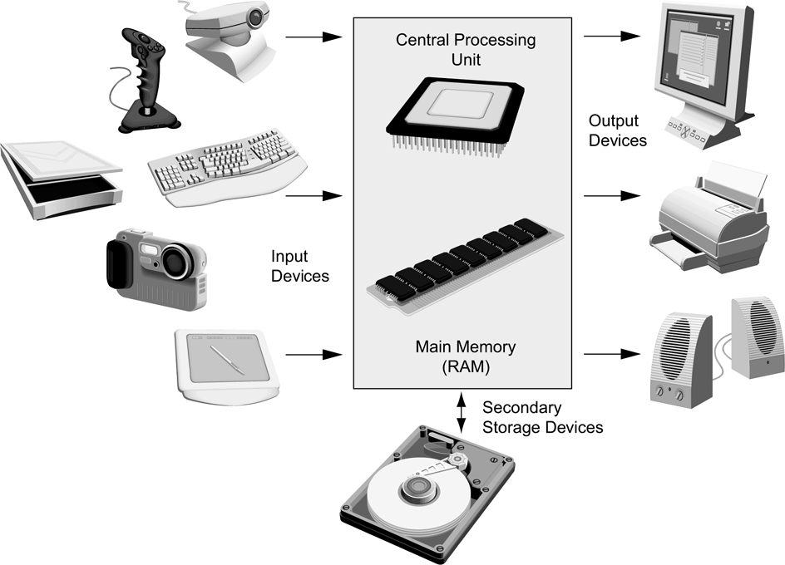
The Anatomy of a Computer

Slide 5
Central Processing Unit (CPU)
CPU
Arithmetic Logic Unit
Instruction (input)
Result (output)
Control
Unit

Slide 6
Main Memory
Commonly known as random-access memory (RAM)
RAM contains:
currently running programs
data used by those programs.
RAM is divided into units called bytes.
A byte consists of eight bits that may be either on or off.

Slide 7
When You Run a Program…
Program instructions and data are stored on the hard disk, on a compact disk, or elsewhere on the network.
When a program is started, it is brought into memory, where the CPU can read it.
The CPU runs the program one instruction at a time. The program may react to user input.
As directed by these instructions and the user, the CPU reads data, modifies it, and writes it back to memory, the screen or secondary storage.

Slide 8
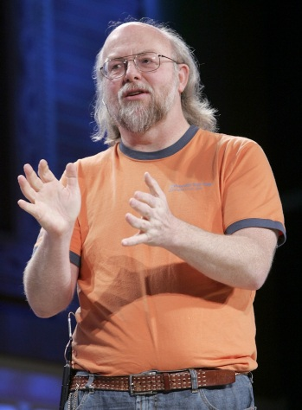
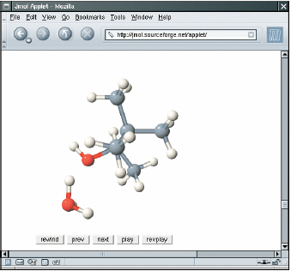
The Java Language
In 1991, James Gosling of Sun Microsystems designed what would become the Java programming language
Java was originally designed for programming consumer devices, but it was first successfully used to write Internet applets
An applet is typically embedded inside a web page and runs in the context of a browser

Slide 9
Java TimeLine
Version | Year | Important New Features
1.0 | 1996
1.1 | 1997 | Inner classes
1.2 | 1998 | Swing, Collections framework
1.3 | 2000 | Performance enhancement
1.4 | 2002 | Assertions, XML support
5.0 | 2004 | Generic classes, enhanced for loop, auto-boxing, enumerations, annotations
6 | 2006 | Library improvements
7 | 2011 | Small language changes and library improvements
8 | 2014 | JVM and language level improvements.
Oracle purchased Sun (along with Java) in 2010
There are still quite a few references and links to Sun Microsystems which are now re-directed to Oracle

Slide 10



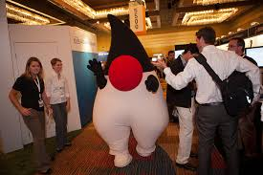
Duke, the Java Mascot

Slide 11
The Java Language
Java Design Goals
Safe: Can be run inside a browser and will not attack your computer
Portable: Run on many Operating Systems
Windows
Mac OS
Java programs are distributed as instructions for a ‘virtual machine,’ making them platform-independent
Virtual machines are available for most Operating Systems.

Slide 12
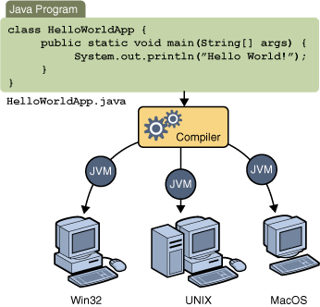
Java Virtual Machines
Source code
Portable ‘byte code’
The compiler generates byte code in a ‘class’ file which can be run on any Java Virtual Machine

Slide 13
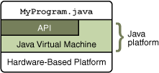
The Java API
The Java Platform consists of two parts:
1) Java Virtual Machine
2) Java API
-- also called libraries
The Application Programming Interface (API) is a huge collection of handy software packages that programmers can use:
Graphics, user interface, networking, sound, database, math, and many more

Slide 14
The Java SDK
You need to install the Java SDK (Software Development Kit) to create Java programs
Google ‘Java SDK download,’ Get SE version
Location after installed on Windows will be:
C:\Program Files\Java\jdk1.8.x
The last few numbers may vary with releases
The SDK includes programs such as:
java.exe (Executes Java applications)
javac.exe (Java compiler)
javadoc.exe (Javadoc generator)

Slide 15
Programming Environment
There are many free programming tools available for Java
Components of an Integrated Development Environment (IDE):
Source code editor helps programming by:
Listing line numbers of code
Color lines of code (comments, text…)
Auto-indent source code
Output window
Debugger

Slide 16
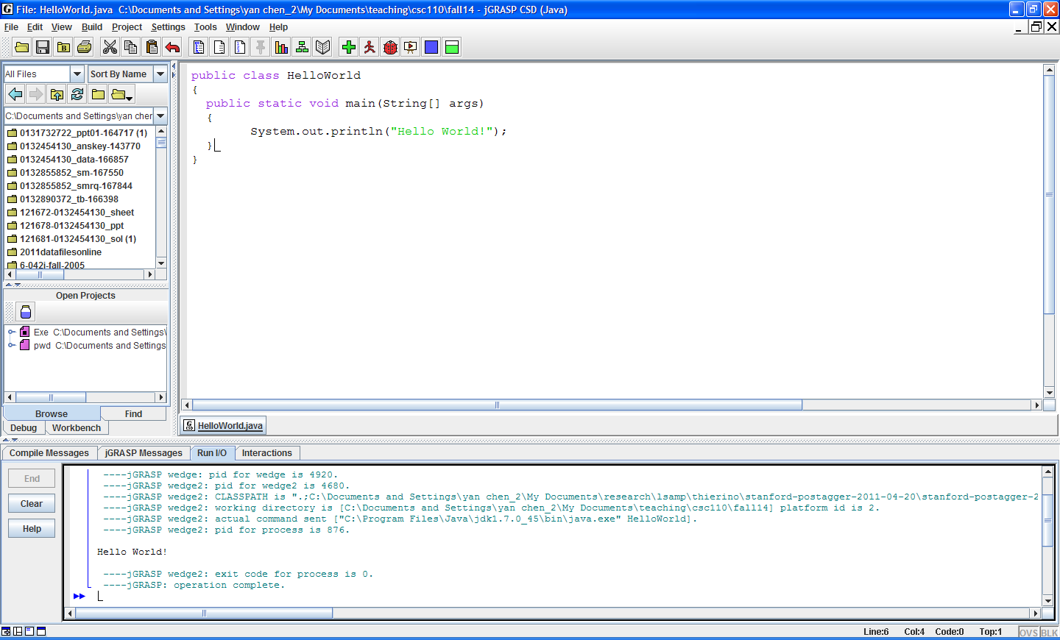
An Example IDE
Editor
Output

Slide 17
Your First Program
Traditional ‘Hello World’ program in Java
We will examine this program in the next section
Typing it into your IDE would be good practice!
Be careful of spelling
JaVa iS CaSe SeNsItiVe
Java uses special characters, e.g. { } ( ) ;
public class HelloPrinter
{
public static void main(String[] args)
{
System.out.println("Hello World!");
}
}

Slide 18
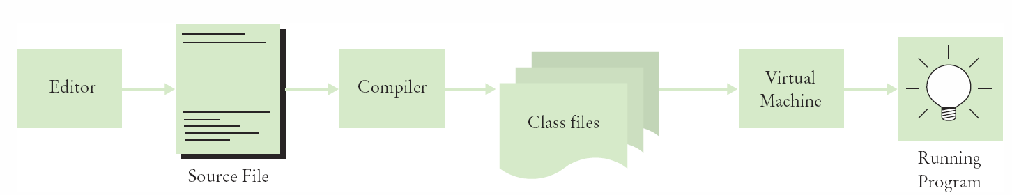
Source Code to Running Program
The compiler generates the .class file which contains instructions for the Java Virtual machine
Class files contain ‘byte code’ that you cannot edit
D:\temp\hello>Type HelloPrinter.class
╩■║╛ 2 ↔ ♠ ☼ ► ↕ ‼ ¶ § ▬☺ ♠<init>☺ ♥()V☺ ♦Code☺ ☼LineNumberTable☺ ♦main▬([Ljava/lang/String;)V☺
Hello, World! elloPrinter.java♀ ↨♀ ↑ ↓☺

Slide 19
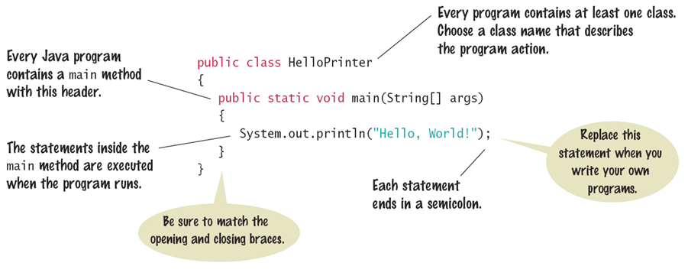
The Java Program
Every application has the same basic layout
Add your ‘code’ inside the main method

Slide 20
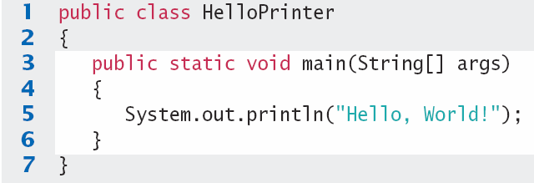
Analyzing your First Program
1: Declares a ‘class’ HelloPrinter
-- Every Java program has one or more classes.
3: Declares a method called ‘main’
-- Every Java application has exactly one ‘ main’ method
-- Entry point where the program starts
5: Method System.out.println outputs ‘Hello, World!’
-- A statement must end with a semicolon (;)

Slide 21
Calling Java Library methods
Line 5 shows how to ‘call’ a ‘method’ from the Java API: System.out.println
Code that somebody else wrote for you!
Notice the dots (periods)
Parenthesis surround the arguments that you ‘pass’ to a method
We are passing a String “Hello World”
Note the double quotes which denote a String inside
You can also print numerical values
System.out.println(3 + 4);

Slide 22
Getting to know println
The println method prints a string or a number and then starts a new line.
System.out.println("Hello");
System.out.println("World!”);
Hello
Hello
World!
println has a ‘cousin’ method named print that does not print a new line.
System.out.print("00");
System.out.println(3+4);
00
007

Slide 23
Exercise 1
Start jGRASP.
On the main menu, click File > New File >Java. A jGRASP CSD (Java ) window will be opened.
In the window, write your very first Java program as following,
public class HelloWorld
{
public static void main(String[] args)
{
System.out.println("Hello World!");
}
}
To be continued on the next slide

Slide 24
Exercise 1 (cont’d)
Save your work in a file called HelloWorld.java. Pay attention to the case of letters in your program and in the name of the file. The file name and the class name must be exactly the same.
Compile your program. What files are contained in the directory after you have compiled the program?
Run your program. What is the output of your program? What is contained in the .class file?
To be continued on the next slide

Slide 25
Exercise 1 (Cont’d)
It’s okay to make errors. In fact, the more errors you make, the quicker you will become an expert Java programmer. Each error can teach you an important lesson. So … let’s make a few errors by experimenting with the HelloWorld program.
a) Try deleting the only semicolon. What happens when you compile? Fix the error.
To be continued on the next slide

Slide 26
Exercise 1 (Cont’d)
b) Try deleting the left brace under the main method and compiling your program. What happens? Fix the error.
c) Delete the first left brace in the program. What happens when you compile? Fix the program.
d) Change main to Main. Does the program compile? What happens if you run the program from the console window? What is the problem?
End of Exercise 1

