Slide 1
CSC110 Computer Programming I
Lecture 2

Slide 2
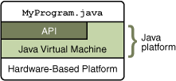
The Java API
The Java Platform consists of two parts:
1) Java Virtual Machine
2) Java API
-- also called libraries
The Application Programming Interface (API) is a huge collection of handy software packages that programmers can use:
Graphics, user interface, networking, sound, database, math, and many more

Slide 3
The Java SDK
You need to install the Java SDK (Software Development Kit) to create Java programs
Google ‘Java SDK download,’ Get SE version
Location after installed on Windows will be:
C:\Program Files\Java\jdk1.7.x
The last few numbers may vary with releases
The SDK includes programs such as:
java.exe (Executes Java applications)
javac.exe (Java compiler)
javadoc.exe (Javadoc generator)

Slide 4
Programming Environment
There are many free programming tools available for Java
Components of an Integrated Development Environment (IDE):
Source code editor helps programming by:
Listing line numbers of code
Color lines of code (comments, text…)
Auto-indent source code
Output window
Debugger

Slide 5
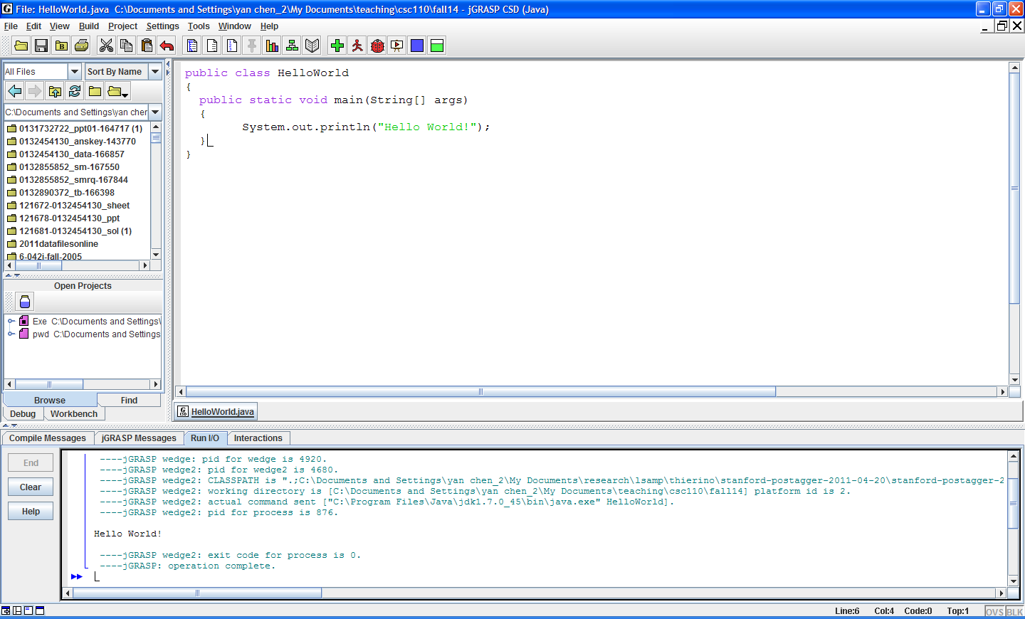
An Example IDE
Editor
Output

Slide 6
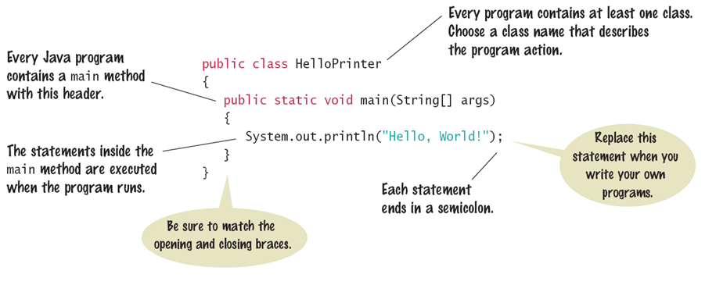
The Java Program
Every application has the same basic layout
Add your ‘code’ inside the main method

Slide 7
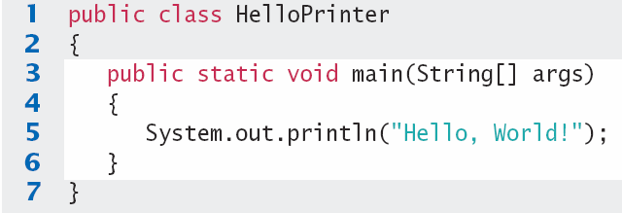
Analyzing your First Program
1: Declares a ‘class’ HelloPrinter
-- Every Java program has one or more classes.
3: Declares a method called ‘main’
-- Every Java application has exactly one ‘ main’ method
-- Entry point where the program starts
5: Method System.out.println outputs ‘Hello, World!’
-- A statement must end with a semicolon (;)

Slide 8
Calling Java Library methods
Line 5 shows how to ‘call’ a ‘method’ from the Java API: System.out.println
Code that somebody else wrote for you!
Notice the dots (periods)
Parenthesis surround the arguments that you ‘pass’ to a method
We are passing a String “Hello World”
Note the double quotes which denote a String inside
You can also print numerical values
System.out.println(3 + 4);

Slide 9
Getting to know println
The println method prints a string or a number and then starts a new line.
System.out.println("Hello");
System.out.println("World!”);
Hello
Hello
World!
println has a ‘cousin’ method named print that does not print a new line.
System.out.print("00");
System.out.println(3+4);
00
007

Slide 10
Syntax Errors
A syntax error (compile-time error) is a violation of the programming language rules that is detected by the compiler.
Spelling, Capitalization, punctuation
Ordering of statements, matching of braces/parenthesis…
No .class file is generated by the compiler
Correct first error listed, then compile again

Slide 11
Syntax Errors
What happens if you
Misspell a word: System.ou.println
Don’t Capitalize a word system.out.println
Leave out a word void
Forget a Semicolon after ("Hello, World!")
Don’t match a curly brace? Remove line 6
Try it to see what error messages are generated

Slide 12
Run-time Errors
A run-time error (logic error) causes a program to take the action that the programmer did not intend.
Program runs, but produces unintended results
Program may ‘crash’

Slide 13
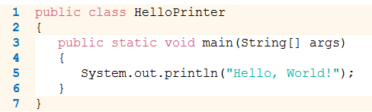
Logic Errors
What happens if you
Divide by Zero System.out.println(1/0);
Mis-spell output ("Hello, Word!")
Forget to output Remove line 5
Programs will compile and run
The output may not be as expected

Slide 14



Consider these 3 situations….
Baking a Cake
Giving Directions
Folding a Paper Bird

Slide 15
Algorithm
What do all 3 have in common?-- They are algorithms.
They are all sets of instructions.
They all solve a problem.
An algorithm is a set of well-defined steps for performing a task or solving a problem.

Slide 16


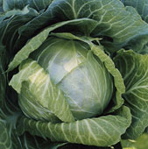
Write an algorithm… Solve the farmer’s problem
A farmer has to take three items, a dog, a goat and a cabbage, across a river. He has a boat but it can only take two objects at once, in other words, the farmer and one other item.
Write an algorithm to tell the farmer how to get the three items across the river.
Note: If the dog and the goat are left together the dog will eat the goat. If the goat and the cabbage are left together the goat will eat the cabbage.

Slide 17

The Farmer’s Solution
1. Begin on side A 2. Take goat across to side B 3. Return with empty boat to side A 4. Take dog across river to side B 5. Return with goat to side A 6. Take cabbage to side B 7. Return with empty boat to side A 8. Take goat to side B 9. END

Slide 18
Algorithm: Calculate gross pay
Display a message on the screen: “How many hours did you work?”
Allow the user to enter the number of hours worked.
Display a message on the screen: “How much do you get paid per hour?”
Allow the user to enter an hourly rate.
multiply the two numbers and store the result in memory.
Display a message on screen shows the amount of money earned. The message must include the result of the calculation performed in previous step.

Slide 19
Your Turn…
The following algorithm has an error. The program is supposed to ask the user for the length and width of a rectangular room, and then display the room’s area. The program must multiply the width by the length in order to determine the area. Find the error.
area =width x length
Display “What is the room’s width?”
Input width.
Display “What is the room’s length?”
Input length.
Display area.

Slide 20
Solution
Display “What is the room’s width?”
Input width
Display “What is the room’s length?”
Input length
Calculate area =width x length
Display area.

Slide 21
Exercise 1
Start jGRASP.
On the main menu, click File > New File >Java. A jGRASP CSD (Java ) window will be opened.
In the window, write your very first Java program as following,
public class HelloWorld
{
public static void main(String[] args)
{
System.out.println("Hello World!");
}
}
To be continued on the next slide

Slide 22
Exercise 1 (cont’d)
Save your work in a file called HelloWorld.java. Pay attention to the case of letters in your program and in the name of the file. The file name and the class name must be exactly the same.
Compile your program. What files are contained in the directory after you have compiled the program?
Run your program. What is the output of your program? What is contained in the .class file?
To be continued on the next slide

Slide 23
Exercise 1 (Cont’d)
It’s okay to make errors. In fact, the more errors you make, the quicker you will become an expert Java programmer. Each error can teach you an important lesson. So … let’s make a few errors by experimenting with the HelloWorld program.
a) Try deleting the only semicolon. What happens when you compile? Fix the error.
To be continued on the next slide

Slide 24
Exercise 1 (Cont’d)
b) Try deleting the left brace under the main method and compiling your program. What happens? Fix the error.
c) Delete the first left brace in the program. What happens when you compile? Fix the program.
d) Change main to Main. Does the program compile? What happens if you run the program from the console window? What is the problem?
End of Exercise 1

Slide 25
Exercise 2
Write a Java program that displays the following information, each on a separate line:
Your name
Your address, with city, state, and ZIP
Your phone number
Your college major

Slide 26
Exercise 3
Write a Java program to display the following pattern:
*
* *
* * *
* * * *
* * * * *
* * * *
* * *
* *
*

Slide 27
Exercise 4
Write a program that prints the sum of the first ten positive integers, 1+2+…+10.

