Slide 1
CSC110 Computer Programming I
Lecture 13

Slide 2
Comparing Characters
Characters can be tested using the relational operators.
Characters are stored in the computer using the Unicode character format.
Unicode is stored as a sixteen (16) bit number.
Characters are ordinal, meaning they have an order in the Unicode character set.
Since characters are ordinal, they can be compared to each other.
char c = ′A′;
if(c < ′Z′)
System.out.println("A is less than Z");

Slide 3
Checkpoint
Write an if statement that displays “Goodbye” if the variable myCharacter contains the character ‘D’.

Slide 4
Programming Style and if Statements
An if statement can span more than one line; however, it is still one statement.
if (average > 95)
grade = ′A′;
is functionally equivalent to
if(average > 95) grade = ′A′;

Slide 5
Programming Style and if Statements
Rules of thumb:
The conditionally executed statement should be on the line after the if condition.
The conditionally executed statement should be indented one level from the if condition.
If an if statement does not have the block curly braces, it is ended by the first semicolon encountered after the if condition.
if (expression)
statement;
No semicolon here. Semicolon ends statement here.

Slide 6
Block if Statements
Conditionally executed statements can be grouped into a block by using curly braces {} to enclose them.
If curly braces are used to group conditionally executed statements, the if statement is ended by the closing curly brace.
if (expression)
{
statement1;
statement2;
}
Curly brace ends the statement.

Slide 7
Block if Statements
Remember that when the curly braces are not used, then only the next statement after the if condition will be executed conditionally.
if (expression)
statement1;
statement2;
statement3;
Only this statement is conditionally executed.

Slide 8
if-else Statements
The if-else statement adds the ability to conditionally execute code when the if condition is false.
if (expression)
statementOrBlockIfTrue;
else
statementOrBlockIfFalse;

Slide 9
if-else Statements
The if-else statement adds the ability to conditionally execute code when the if condition is false.
if (expression)
statementOrBlockIfTrue;
else
statementOrBlockIfFalse;

Slide 10
if-else Statement Flowcharts
No
Yes
Is it cold
outside?
Wear shorts.
Wear a coat.

Slide 11
import java.util.Scanner; // Needed for the Scanner class /** This program demonstrates the if-else statement. */ public class Division { public static void main(String[] args) { double number1, number2; // Division operands double quotient; // Result of division // Create a Scanner object for keyboard input. Scanner keyboard = new Scanner(System.in); // Get the first number. System.out.print("Enter a number: "); number1 = keyboard.nextDouble(); // Get the second number. System.out.print("Enter another number: "); number2 = keyboard.nextDouble();

Slide 12
if (number2 == 0) { System.out.println("Division by zero is not possible."); System.out.println("Please run the program again and "); System.out.println("enter a number other than zero."); } else { quotient = number1 / number2; System.out.print("The quotient of " + number1); System.out.print(" divided by " + number2); System.out.println(" is " + quotient); } } }

Slide 13
Checkpoint
Write an if-else statement that assigns 20 to the variable y if the variable x is greater than 100. Otherwise, it should assign 0 to the variable y.
Write an if-else statement that assigns 1 to x when y is equal to 100. Otherwise it should assign 0 to x.

Slide 14
Checkpoint
Write an if-else statement that assigns 0.10 to commission unless sales is greater than or equal to 50000.0, in which case it assigns 0.2 to commission.
Write an if-else statement that assigns 0 to the variable b and assigns 1 to the variable a is less than 10. Otherwise, it should assign -99 to the variable b and assign 0 to the variable c.

Slide 15
Checkpoint
Write an if-else statement that assigns 20 to the variable y if the variable x is greater than 100. Otherwise, it should assign 0 to the variable y.
Write an if-else statement that assigns 1 to x when y is equal to 100. Otherwise it should assign 0 to x.

Slide 16
Checkpoint
Write an if-else statement that assigns 0.10 to commission unless sales is greater than or equal to 50000.0, in which case it assigns 0.2 to commission.
Write an if-else statement that assigns 0 to the variable b and assigns 1 to the variable a is less than 10. Otherwise, it should assign -99 to the variable b and assign 0 to the variable c.

Slide 17
if-else-if Statements
if-else-if statements can become very complex.
Imagine the following decision set.
if it is very cold, wear a heavy coat,
else, if it is chilly, wear a light jacket,
else, if it is windy wear a windbreaker,
else, if it is hot, wear no jacket.

Slide 18
if-else-if Statements
if (expression)
statement or block
else if (expression)
statement or block
// Put as many else ifs as needed here
else
statement or block
Care must be used since else statements match up with the immediately preceding unmatched if statement.

Slide 19
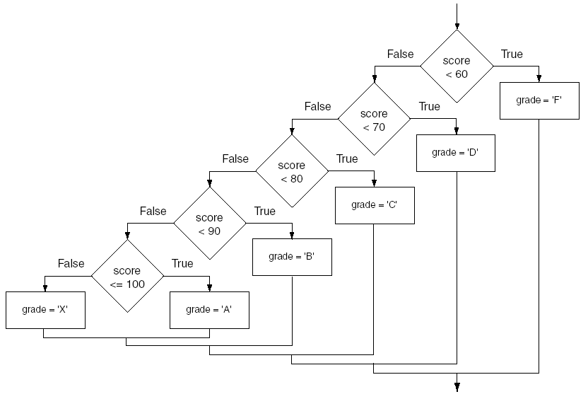
if-else-if Flowchart

Slide 20
Exercise 1
Write a program that prompts the user to input two numbers. It then prints the smaller number.

Slide 21
Exercise 2
Write a program that prompts the user to input a number. The program should first output the number and a message saying whether the number is a positive, negative or zero, then output the absolute value of the number.

Slide 22
Exercise 3
Write a program that allows the user to convert either from degree Celsius to Fahrenheit or from degrees Fahrenheit to Celsius. Use the following formulas:
C=5(F-32)/9
F=9C/5+32
Prompt the user to enter a temperature and either a ‘C’ (or ‘c’) for Celsius or ‘F’ (or ‘f’) for Fahrenheit. Convert the temperature to Fahrenheit if Celsius is entered or to Celsius if Fahrenheit is entered.

Slide 23
Exerciser 4
The date June 10, 1960 is special because when we write it in the following format, the month times the data equals the year:
6/10/60
Write a program that asks the user to enter a month (in numeric form), a day and a two digit year. The program should then determine whether the month times the day is equal to the year. If so, display a message saying the date is magic. Otherwise it should display a message saying the date is not magic.

