Slide 1
CSC110 Computer Programming I
Lecture 22

Slide 2
What is a method?
A method is a sequence of instruction with a new name.
You call a method in order to execute its instructions
public static void main(String[] args)
{
double result = Math.pow(2, 3);
. . .
}
A method packages a computation consisting of multiple steps that can be easily understood and reused.

Slide 3
Implementing Methods
A method to calculate the volume of a cube
What does it need to do its job?
What does it answer with?
When writing this method:
Pick a name for the method (cubeVolume).
Declare a variable for each incoming argument
(double sideLength) (called parameter variables)
Specify the type of the return value ( double )
Add modifiers such as public static
public static double cubeVolume(double sideLength)

Slide 4
Inside the Box
Then write the body of the method
The body is surrounded by curly braces { }
The body contains the variable declarations and statements that are executed when the method is called
It will also return the calculated answer
public static double cubeVolume(double sideLength)
{
double volume = sideLength * sideLength * sideLength;
return volume;
}

Slide 5
Back from the Box
The values returned from cubeVolume are stored in local variables inside main
The results are then printed out
public static void main(String[] args)
{
double result1 = cubeVolume(2);
double result2 = cubeVolume(10);
System.out.println("A cube of side length 2 has volume" + result1);
System.out.println("A cube of side length 10 has volume " + result2);
}

Slide 6
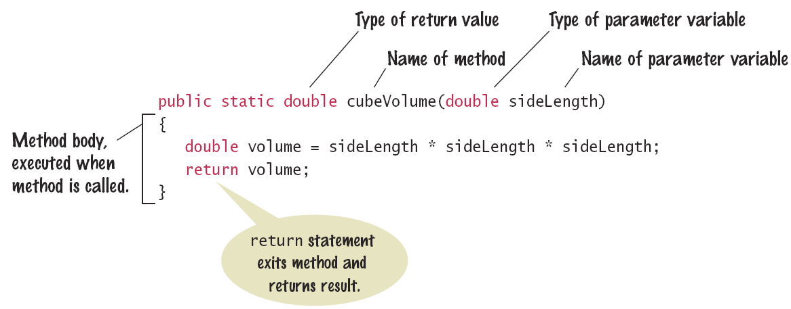
Method Declaration

Slide 7
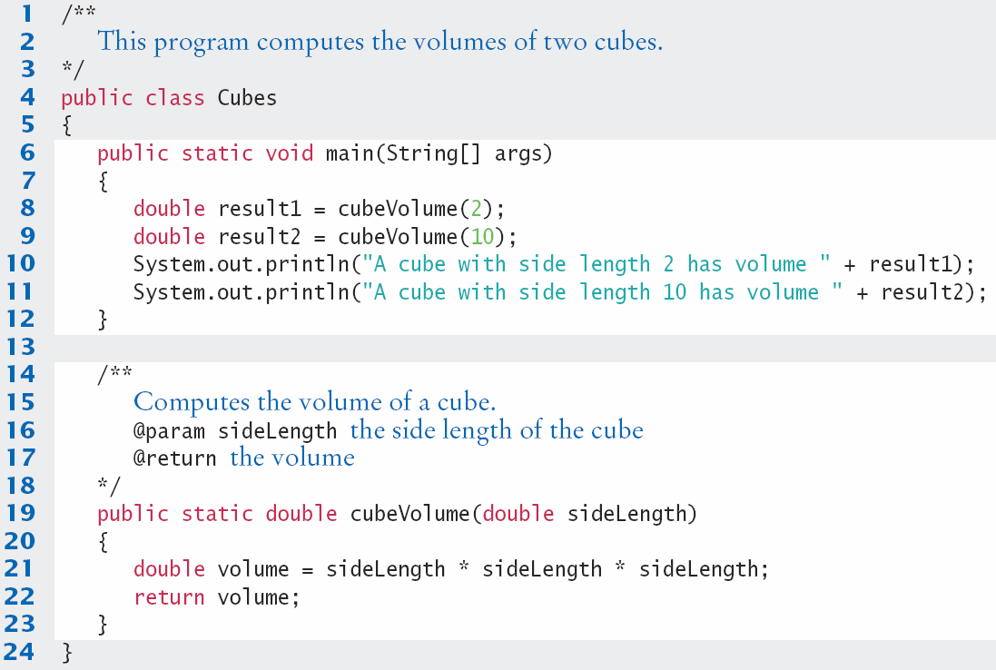
Cubes.java

Slide 8
Checkpoint
Consider the following method. What is the result of the call mystery(2, 3)?
public static int mystery(int x, int y)
{
double result=(x+y)/(y-x);
return result;
}

Slide 9
Checkpoint
What does this method do?
public static boolean mystery(int x)
{
if(n%2==0)
return true;
else
return false;
}

Slide 10
Checkpoint
What does this method do?
public static int mystery(int x)
{
int y=x*x;
return y;
}
public static void main(String[] args)
{
int a=4;
System.out.println(mystery(a+1));
}

Slide 11
Checkpoint
Declare a method squareArea that computes the area of a square of a given side length.

Slide 12
Method Comments
Write a Javadoc comment above each method
Start with /**
Note the purpose of the method
@param Describe each parameter variable
@return Describe the return value
End with */
/**
Computes the volume of a cube.
@param sideLength the side length of the cube
@return the volume
*/
public static double cubeVolume(double sideLength)

Slide 13
Parameter Passing
Parameter variables receive the argument values supplied in the method call
They both must be the same type
The argument value may be:
The contents of a variable
A ‘literal’ value
aka. ‘actual parameter’ or argument
The parameter variable is:
Declared in the called method
Initialized with the value of the argument value
Used as a variable inside the called method
aka. ‘formal parameter’
Calling Method
out
Argument value
Parameter variable
in
Called Method

Slide 14




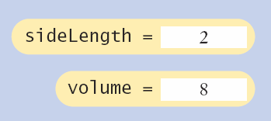
Parameter Passing Steps
public static void main(String[] args)
{
double result1 = cubeVolume(2);
. . .
}
public static double cubeVolume(double sideLength)
{
double volume = sideLength * sideLength * sideLength;
return volume;
}

Slide 15
Return Values
Methods can (optionally) return one value
Declare a return type in the method declaration
Add a return statement that returns a value
A return statement does two things:
Immediately terminates the method
Passes the return value back to the calling method
return type
public static double cubeVolume (double sideLength)
{
double volume = sideLength * sideLength * sideLength;
return volume;
}
return statement
The return value may be a value, a variable or a calculation
Type must match return type

Slide 16
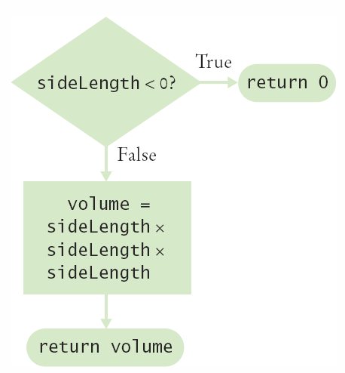
Multiple return Statements
A method can use multiple return statements
But every branch must have a return statement
public static double cubeVolume(double sideLength)
{
if (sideLength < 0)
{
return 0;
}
return sideLength * sideLength * sideLength;
}

Slide 17
Common Error
Missing return Statement
Make sure all conditions are handled
In this case, x could be equal to 0
No return statement for this condition
The compiler will complain if any branch has no return statement
public static int sign(double x)
{
if (x < 0) { return -1; }
if (x > 0) { return 1; }
// Error: missing return value if x equals 0
}

Slide 18
Implementing a Method: Steps
Describe what the method should do.
Determine the method’s “inputs”.
Determine the types of parameter values and the return value.
Write Algorithm for obtaining the desired result.
Implement the method body.
Test your method.
Design test cases and code
public static double pyramidVolume(double height, double baseLength)
{
double baseArea = baseLength * baseLength;
return height * baseArea / 3;
}

Slide 19
Exercise 1
Why does the code on the next slide contain a compile-time error?

Slide 20
public class Area
{
public static void main(String[] args)
{
int x = 2;
int y = 3;
System.out.println("x: " + x + " y: " + y + " Sum: " + sum(x,y));
}
/**
Computes the sum of two arguments.
@param a an int operand to be added
@param b another int operand
@return the sum of a and b
*/
public static int sum(int a, int b)
{
return a + b;
System.out.println("Finished adding...");
}
}

Slide 21
Exercise 2
Write a method
public static String repeat(String str, int n)
that returns the string str repeated n times. For example. Repeat(“ho”, 3) returns “hohoho”.

Slide 22
Exercise 3
Write a method called makeRow that is passed two arguments: an int n and a String s, and which returns a String containing n copies of s, concatenated in a row. For instance, if we call the method with makeRow(5, "*"), the method returns *****. Write a main method that uses the method to print the string *****=====*****.

Slide 23
Exercise 4
Write a method
public static int countWords(String str)
that returns a count of all words in the string str. Words are separated by spaces. For example,
countWords(“Mary has a little lamb”) should return 5.
Write a program to test the method.

