Slide 1
CSC110 Computer Programming II
Lecture 26

Slide 2
What Makes an Object?
An objects can represent almost anything.
Characteristics of an object:
identity (it acts as a single whole).
properties (it has various properties, which might change).
behavior (it can do things and can have things done to it).
Object-oriented programming is centered on creating objects rather than procedures.

Slide 3
An Alarm Clock Example
Identity:
Alarm Clock
Properties:
second (a value in the range of 0-59)
minute (a value in the range of 0-59)
hour (a value in the range of 1-12)
The time the alarm is set for (a valid hour and minute)
Whether the alarm is on or off (“on” or “off”)

Slide 4
An Alarm Clock Example (cont’d)
Behavior
Set time
Set alarm time
Turn alarm on
Turn alarm off
Increment the current second
Increment the current minute
Increment the current hour
Sound alarm

Slide 5
Class
A class defines a kind of objects. It’s an abstract view the objects.
It specifies the kinds of data an object of the class can have (properties of an object).
It provides methods specifying the actions an object of the class can take (behavior of an object).
The data items and the methods are referred to as members of the class.
An object satisfying the class definition is an instance of the class.

Slide 6
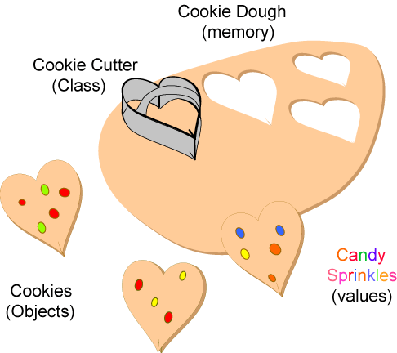
Class and Objects

Slide 7
A Rectangle Object
Identity
rectangle
Properties
length
width
Behavior
get the length
get the width
change the length
change the width
calculate area
…

Slide 8
Building a Rectangle class
A Rectangle will have the following fields:
length. The length field will hold the rectangle’s length.
width. The width field will hold the rectangle’s width.

Slide 9
Building a Rectangle class
The Rectangle class will also have the following methods:
setLength. The setLength method will store a value in an object’s length field.
setWidth. The setWidth method will store a value in an object’s width field.
getLength. The getLength method will return the value in an object’s length field.
getWidth. The getWidth method will return the value in an object’s width field.
getArea. The getArea method will return the area of the rectangle, which is the result of the object’s length multiplied by its width.

Slide 10
Writing the Code for a Class
The general form of a class definition is as follows:
AccessSpecifier class Name
{
Members
}

Slide 11
Writing the Code for the Class Fields
public class Rectangle
{
private double length;
private double width;
}

Slide 12
Access Specifiers
An access specifier is a Java keyword that indicates how a field or method can be accessed.
public
When the public access specifier is applied to a class member, the member can be accessed by code inside the class or outside.
private
When the private access specifier is applied to a class member, the member cannot be accessed by code outside the class. The member can be accessed only by methods that are members of the same class.

Slide 13
Header for the setLength Method
Return Type
Notice the word static does not appear in the method header designed to work on an instance of a class (instance method).
Access specifier
Method Name
public void setLength (double len)
Parameter variable declaration

Slide 14
Writing and Demonstrating the setLength Method
/**
The setLength method stores a value in the
length field.
@param len The value to store in length.
*/
public void setLength(double len)
{
length = len;
}

Slide 15
Writing the getLength Method
/**
The getLength method returns a Rectangle
object's length.
@return The value in the length field.
*/
public double getLength()
{
return length;
}
Similarly, the setWidth and getWidth methods can be created.

Slide 16
Writing and Demonstrating the getArea Method
/**
The getArea method returns a Rectangle
object's area.
@return The product of length times width.
*/
public double getArea()
{
return length * width;
}

Slide 17
Accessor and Mutator Methods
Because of the concept of data hiding, fields in a class are private.
The methods that retrieve the data of fields are called accessors.
Each field that the programmer wishes to be viewed by other classes needs an accessor.
The methods that modify the data of fields are called mutators.
Each field that the programmer wishes to be modified by other classes needs a mutator.

Slide 18
Accessors and Mutators
For the Rectangle example, the accessors are:
getLength : Returns the value of the length field.
public double getLength() …
getWidth : Returns the value of the width field.
public double getWidth() …
and mutators are:
setLength : Sets the value of the length field.
public void setLength(double len) …
setWidth : Sets the value of the width field.
public void setLength(double w) …
Other names for these methods are getters and setters.

Slide 19
Class Layout Conventions
The layout of a source code file can vary by programmers.
A common layout is:
Fields listed first
Methods listed second
Accessors and mutators are typically grouped.

Slide 20
Creating a Rectangle object
Rectangle box = new Rectangle ();
A Rectangle object
The box variable holds the address of the Rectangle object.
length:
0.0
address
width:
0.0

Slide 21
Calling the setLength Method
box.setLength(10.0);
The box variable holds the address of the Rectangle object.
A Rectangle object
length:
10.0
address
width:
0.0
This is the state of the box object after the setLength method executes.

Slide 22
Exercise 1
Write a Circle class that has the following fields:
radius: double
PI: a final double initialized with the value 3.14159
The class should have the following methods:
setRadius: A mutator method for the radius field
getRadius. A accessor method for the radius field.
getArea: Returns the area of the circle, which is calculated area=radius *radius*PI.
getCircumference: returns the circumference of the circle, which is calculated as circumference = 2* PI*radius.
Write a program that demonstrates the circle class by asking the user for the circle’s radius, creating a Circle object, and then reporting the circle’s area, diameter and circumference.

Slide 23
Exercises 2
Write a class named Car that has the following fields.
yearModel. It is an int that holds the car’s year model.
make. It references a String object that holds the make of the car.
speed. It is a int that holds the car’s current speed.
In addition, the class should have the following constructor and other methods.
Mutators: Appropriate accessor methods should set an object’s yearModel, make and speed fields.
Accessors. Appropriate accessor methods should get the values stored in an object’s yearModel, make and speed fields.
accelerate. It should add 5 to the speed field each time it is called.
break. It should subtract 5 from the speed field each time it is called.
Demonstrate the class in a program.

