Slide 1
Rust Actor Library
Preston Sahabu

Slide 2
Question: What are you talking about?

Slide 3

Rust
New systems language
Managed by Mozilla, originally for Firefox
Emphasis on safety
  vs. C, C++
  no shared memory
  especially with concurrency

Slide 4
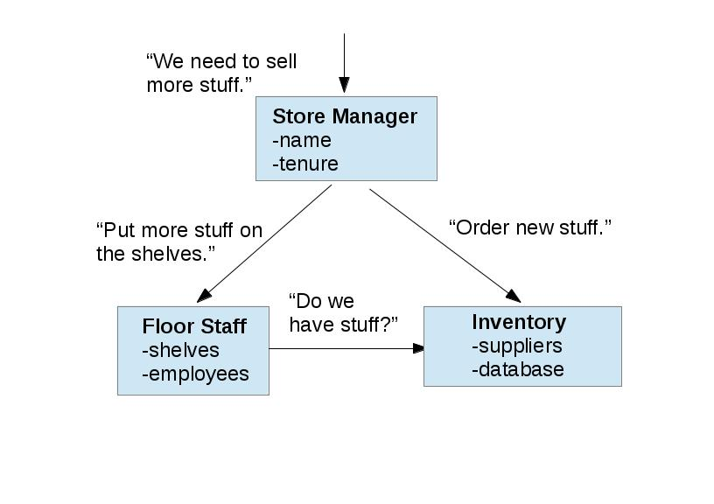
Object-Oriented Programming
Prelude to Actors
Object: clump of data
Objects send messages to each other to carry out tasks using their data
  method calls in Java are an abstraction over message sending

Slide 5
Actor
Concurrency model
Object-Oriented, but all at once
  Object <--> Actor
Emphasis on safety
  vs. other concurrency models
  ideally, no shared data
This, but more complicated.

Slide 6
How does that work? How is that different?

Slide 7
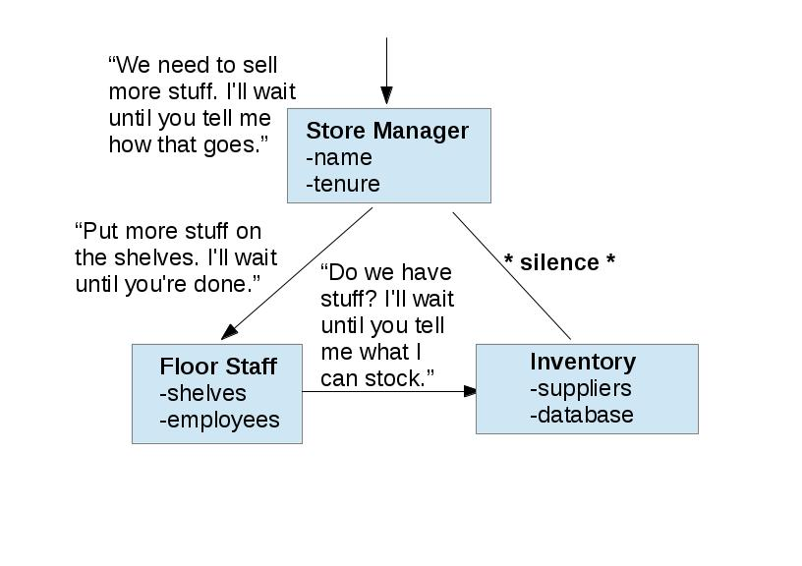
OOP, in detail
There's a whole lot of waiting going on here.

Slide 8
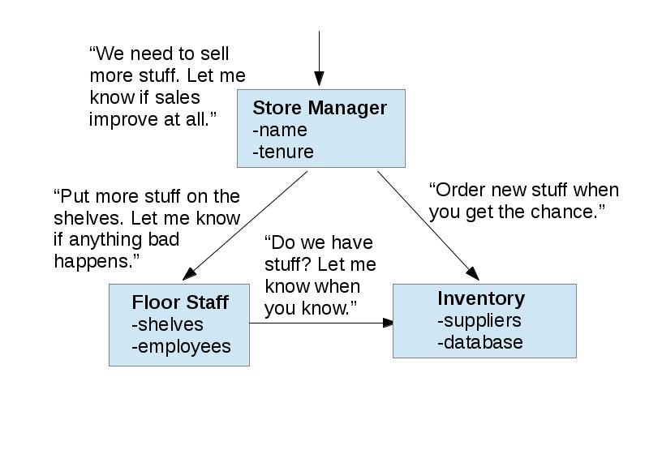
Actors, in detail
That's much better. But, poor Inventory can't do two things at once.

Slide 9

Inboxes
Collect the messages for an Actor and store them in the order they're received
Give them to the Actor one by one
Order cannot matter, or else the Actor model is not useful

Slide 10

Library
A library is a pack of code that provides convenient models for programs to use
Given the emphasis on safety and concurrency in Rust and in Actors, a library makes sense

Slide 11

The problem
Akka is a modern Actor library for Scala
Scala caters to object-oriented programming
The Actor model is object-oriented
Rust is not (at this time) object-oriented

Slide 12
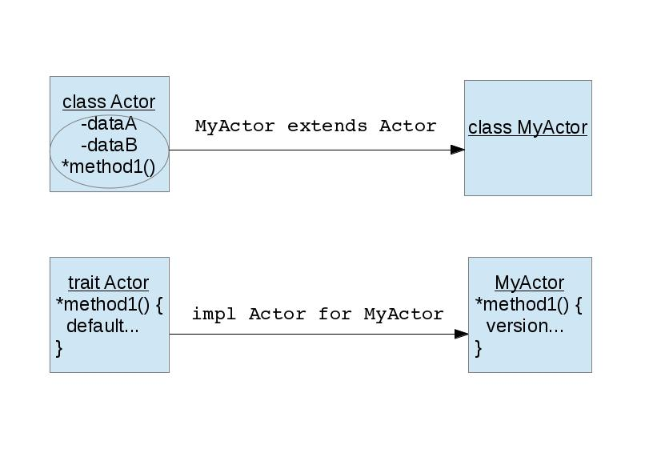
Scala vs Rust typing
The Scala (& Java) way
The Rust way

Slide 13
The solutions
Define the method to take a bundle of data as an argument, provided by a wrapper data type
Use Rust's built-in tasks and channels as the foundations for an Actor
Solution meme

Slide 14
Design

