Slide 1
Cage: an Actor library for Rust
Preston Sahabu

Slide 2
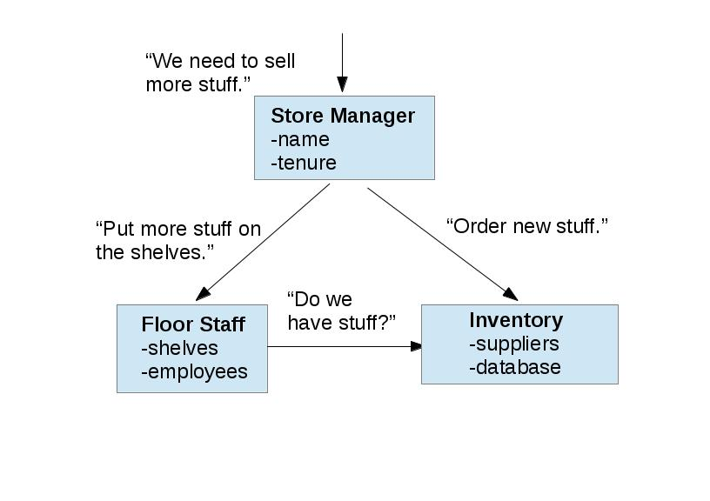
Object-Oriented Programming
Prelude to Actors
Objects send messages to each other to carry out tasks using their data
  method calls in Java are an abstraction over message sending

Slide 3
Actor model
Concurrency model
Object-Oriented, but all at once
  Object <--> Actor
Emphasis on safety
  vs. other concurrency models
  ideally, no shared data
This, but more complicated.

Slide 4
How does that work? How is that different?

Slide 5
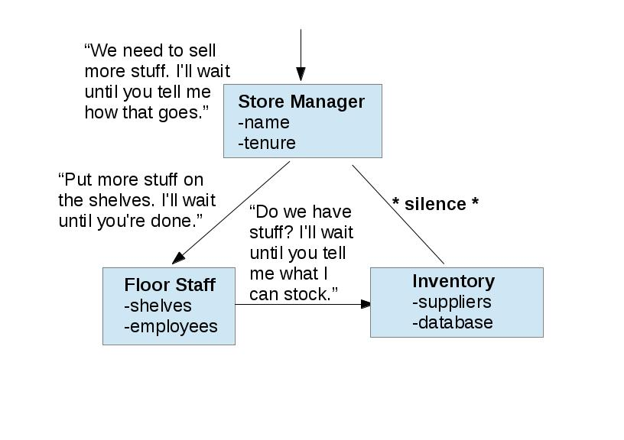
OOP, in detail
There's a whole lot of waiting going on here.

Slide 6
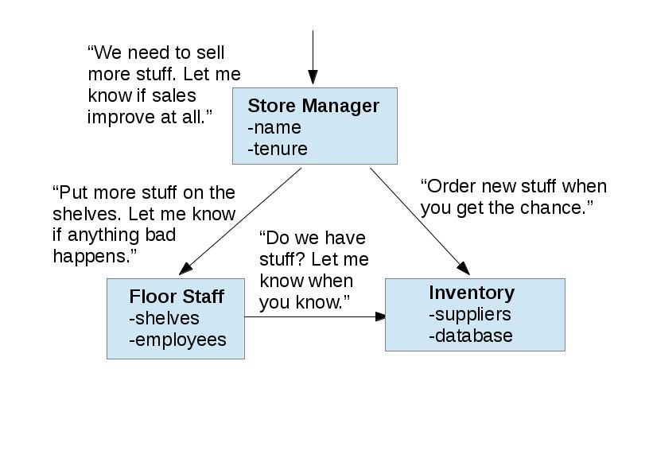
Actors, in detail
That's much better. But, poor Inventory can't do two things at once.

Slide 7

Inboxes
Collect the messages for an Actor and store them in the order they're received
Give them to the Actor one by one
Order cannot matter, or else the Actor model is not useful

Slide 8

Rust
New systems language
Managed by Mozilla, originally for Firefox
Emphasis on safety
  vs. C, C++
  especially with concurrency

Slide 9

Rust primitives
Tasks
  Closure-based
  No shard memory
Channels
  Inter-task communication
Structs, Impls, Traits
  Data structuring, typing
  No inheritance

Slide 10

The Akka model
Akka is a modern Actor library for Scala
Ideas taken:
  Broadcasting
  Futures
  Library messages
  “Dummy root”
  Any type messages
Ideas dropped

Slide 11
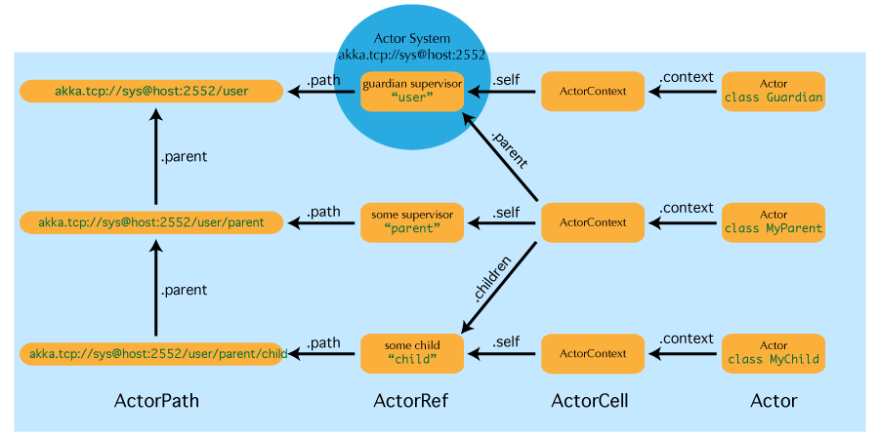
Akka design

Slide 12

#badideas
Typed Actors
  Hierarchy issues
  Defining messages
Concurrent tree of all-powerful ActorRefs
  Just no.
Hash table of Agents

Slide 13

Cage
trait Actor
  New() -> Self
  Receive()
struct Context
  Parent, children
  Starting children
Agent, CageMessage
  Sender, library type
Stage

Slide 14

The battle of trait Message {}
Wrapped by CageMessage
“Any” way you want it
Trait objects
  Send bound
Broadcasting
  Need to Clone
Runtime reflection
  Need for Any
  Macro, import required

Slide 15
Sample code
struct Forest {
trees: int
}
impl Actor for Forest {
fn new() -> Forest {
Forest { trees: rand::task_rng().gen_range(100, 300) }
}
fn receive(&mut self,
context: &mut Context,
msg: Box<Message>,
sender: Agent) {
match_any! { msg match
if FireSeason {
_ => {
for child in context.children().iter() {
child.deliver(context.send(msg.clone_me()));
}
}
}
else { () }
};
}
fn pre_start(&mut self, context: &mut Context) {
for _ in range(0, self.trees) {
context.start_child::<Fir>();
}
}
}
Starting Actors
fn main() {
let mut stage = Stage::new();
let forest = stage.start::<Forest>();
let smokey = box FireSeason;
let arsonist = forest.request(smokey);
arsonist.unwrap();
println!("only you can prevent forest fires");
}

Slide 16
Conclusions
Message is non-idiomatic.
  So non-idiomatic.
Actor makers have a weird import and macro
Actor users have a real easy time
Future: inter-process

Slide 17
Questions?

