Slide 1
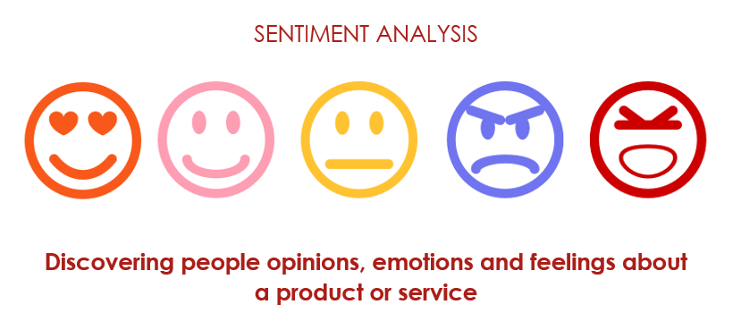
Symantic Analytics
This Photo by Unknown author is licensed under CC BY-SA.

Slide 2
Team Members
Mentor
Ms. Pooja Deepak Sahu
Ms. Vaishnavi Rajesh Sharma
Mr. Pratik Nitin Sonawale
Mr. Sagarla Varun Yadav
Mr. Apoorv Gupta
Mr. Kunal Kaanaiyalal Sharnagat
Mr. Kaadulari Kiran Kumar Gaud
Ms. Neha Gupta

Slide 3
Contents
Business Objective
Understanding Data Set
Data Quality And Assessment
EDA And Visualization
Text Processing
Model Building
Model Selection And Performance
Deployment
Challenges That We Faced
What We Discovered ?

Slide 4

Business Objective
Identifying areas for improvement: By analyzing sentiment across financial statement data, you may be able to identify areas where the business is underperforming or where customers have expressed dissatisfaction. This could help the business prioritize investments or make strategic decisions to improve customer satisfaction and financial performance.
Monitoring customer sentiment: By monitoring sentiment across financial statement data on an ongoing basis, you can track changes in customer sentiment over time and identify trends or shifts in customer preferences or priorities. This can help the business stay ahead of changing customer needs and make more informed strategic decisions.
This Photo by Unknown author is licensed under CC BY-SA.

Slide 5

Business Objective
Evaluating brand reputation: By analyzing sentiment across financial statement data, you can evaluate the overall sentiment and perception of the business and its brand. This can help the business understand how it is perceived in the market and identify opportunities to improve its reputation and positioning.
Identifying emerging risks: By analyzing sentiment across financial statement data, you may be able to identify emerging risks or issues that could impact the business's financial performance or reputation. This can help the business proactively address these issues and minimize potential negative impacts.
Benchmarking against competitors: By analyzing sentiment across financial statement data, you can compare the business's sentiment against that of its competitors. This can help the business identify areas where it is outperforming or underperforming relative to its peers and make more informed strategic decisions.
This Photo by Unknown author is licensed under CC BY-SA-NC.

Slide 6
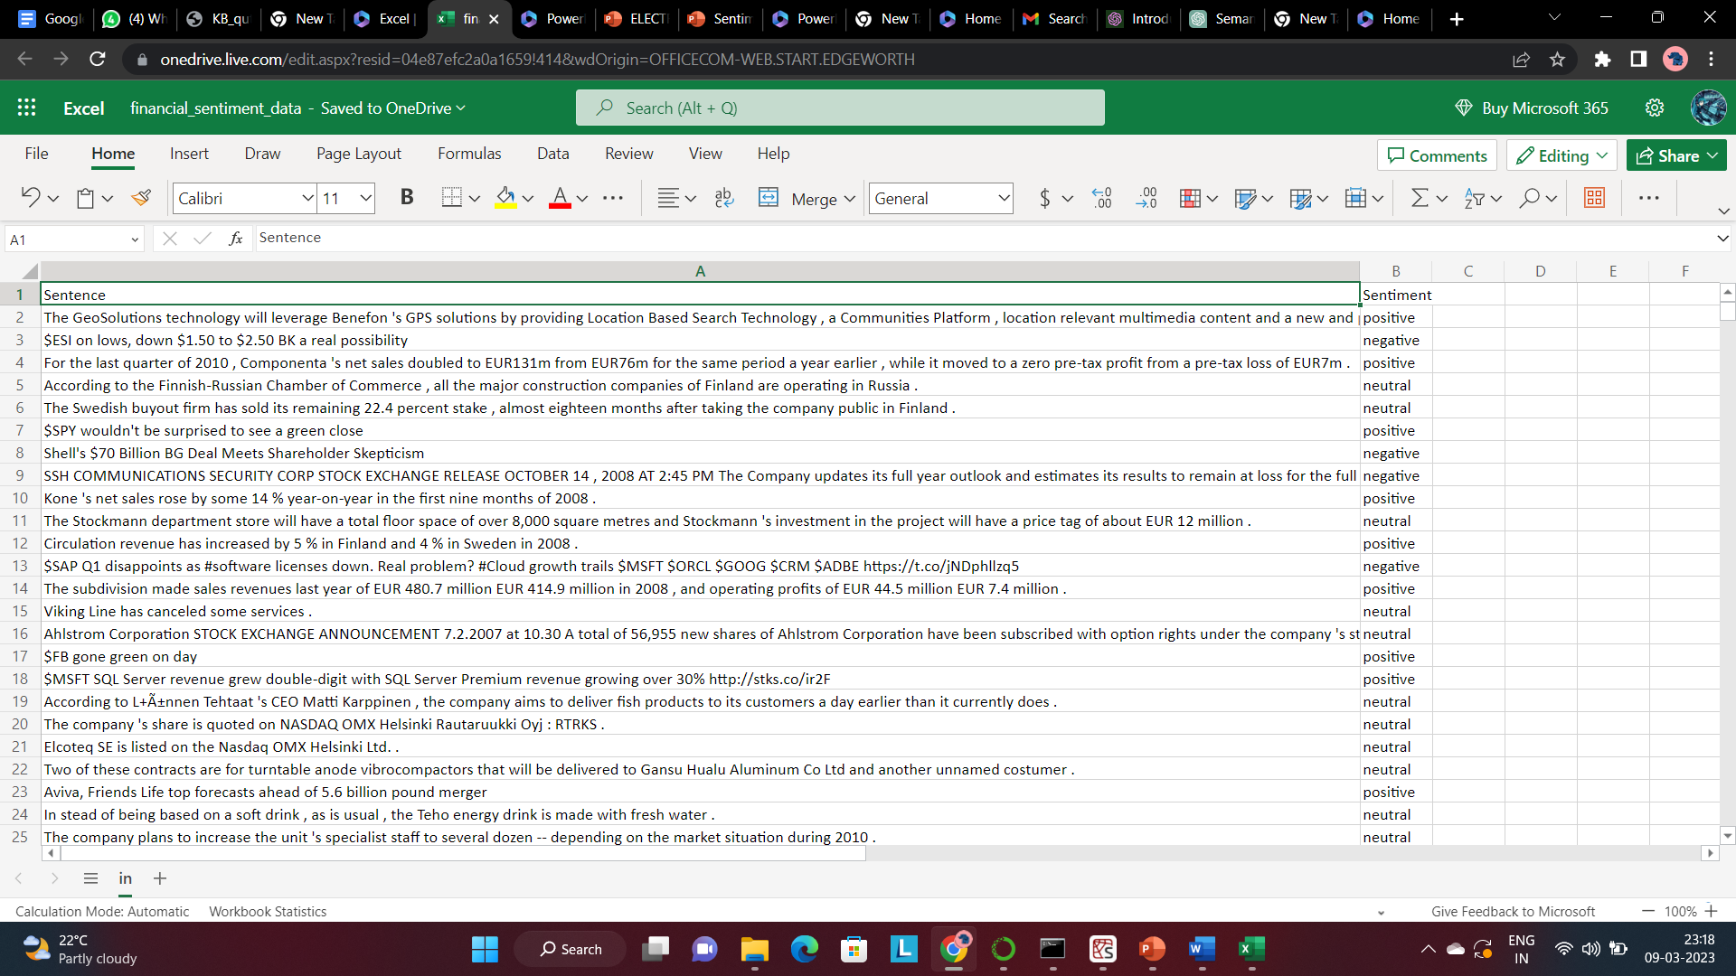
Understanding The Data Set

Slide 7
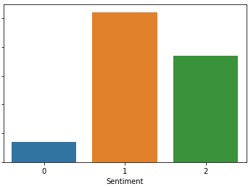
Understanding The Data Set
5842 entries, 0 to 5841 Data columns (total 2 columns):
3 Types of Sentiment
Positive
Negative
Neutral

Slide 8
Data Quality And Assessment
Dealing with Duplicates
Same Sentence With Different Sentiment
Unbalenced Data

Slide 9
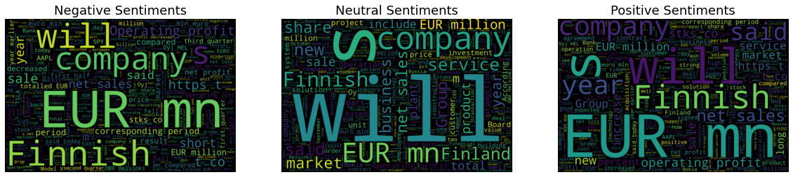
EDA And Visualization

Slide 10
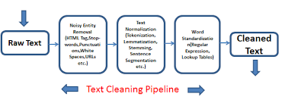
Text Pre-Processing
Text processing is the technique of analyzing and manipulating text-based data sources, such as emails, social media posts, or other written communications.
Text processing typically involves a range of techniques, including natural language processing, machine learning, and data visualization.
The goal of text processing is to extract meaning and insights from unstructured text-based data sources, which can be difficult to analyze using traditional data analysis techniques.
Some of the key techniques used in text processing include tokenization, part-of-speech tagging, named entity recognition, sentiment analysis, and topic modeling.
Tokenization is the process of breaking down text into individual words or phrases, which can then be analyzed more easily.

Slide 11
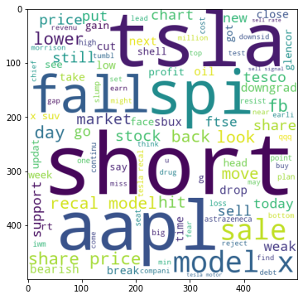
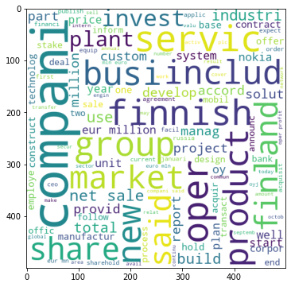
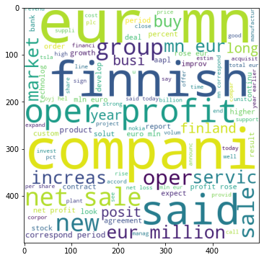
EDA And Visualization
Negative Sentiment
Neutral Sentiment
Positive Sentiment

Slide 12
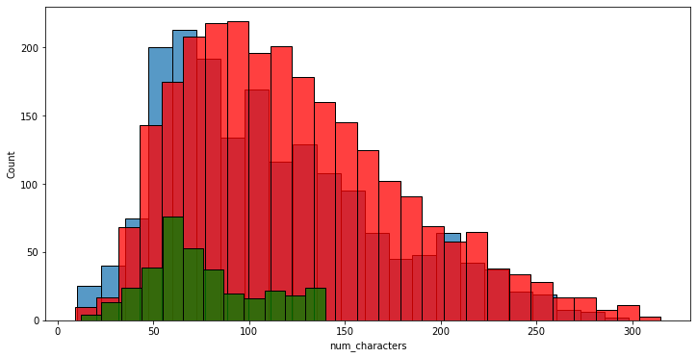
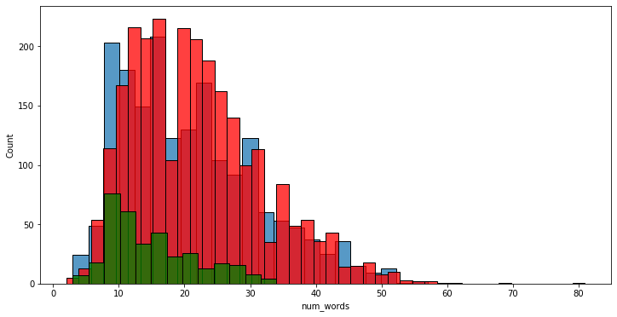
EDA And Visualization

Slide 13
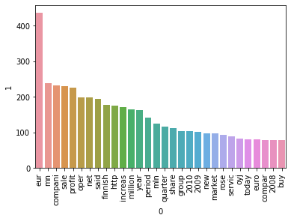
Most Common Words in Each Corpus
Positive

Slide 14
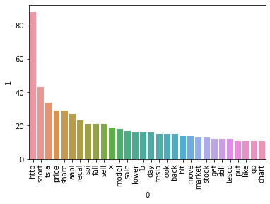
Most Common Words in Each Corpus
Negative

Slide 15
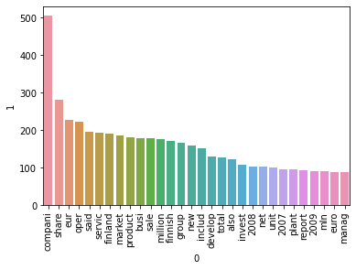
Most Common Words in Each Corpus
Neutral

Slide 16
Model Building
Logistic Regression
Random forest
Support Vector Classifier

Slide 17
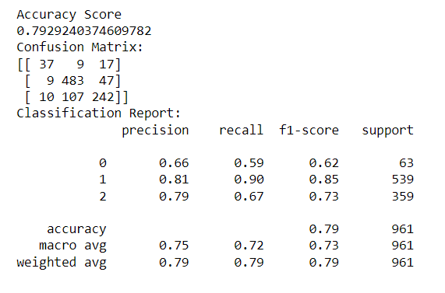
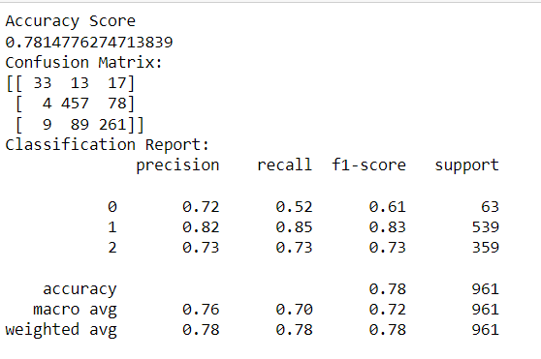
Model Selection And Performance
SVC
Random forest Classifier

Slide 18
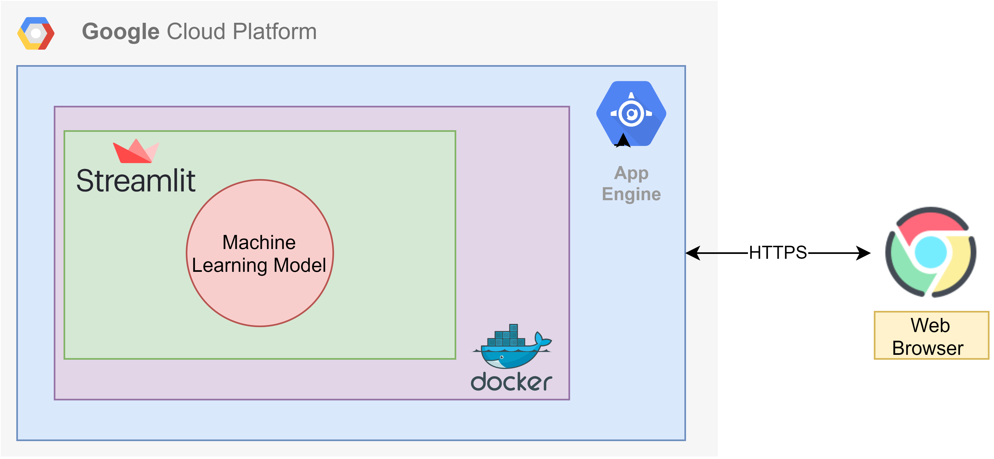
Deployment
Streamlit
Spiderweb

Slide 19

Challenges That We Faced
One of the key challenges of semantic analytics is the need for high-quality data. incomplete, inconsistent, or inaccurate can lead to incorrect or misleading insights.
The complexity of the analysis process is another challenge of semantic analytics. Since the analysis often involves a range of techniques, including tokenization, part-of-speech tagging, and sentiment analysis, it can be difficult to know which techniques to use and how to apply them effectively.
Contextual understanding is critical for accurate analysis, which can be challenging given the nuance and complexity of language.
The need for skilled analysts with expertise in NLP and machine learning is another challenge of semantic analytics. Since these techniques require specialized knowledge and expertise, organizations may struggle to find qualified analysts who can effectively apply them to their data.

Slide 20

What We Discovered Throughout This Project
Understanding The problem Statement And Data set
Dealing with Duplicates
EDA And Visualizations
Try Multiple Models
Model Selection
Deployment

Slide 21



