Slide 1
VORTEX
DESIGN OF
HANDY WASHING MACHINE

Slide 2
INTRODUCTION
A novel washing machine that is cheap, portable, compact and easy to use.

Slide 3
THE CONCEPT OF WASHING
Soap has ions that have both hydrophilic and hydrophobic ends that are used in making dirt ions (that are hydrophobic) mobile.
A washing machine simply induces agitation.

Slide 4
FEATURES
-Light weight/Portable
-Timer
-Level detector
-Noiseless operation
-No vibration
-Stable
-Tangle free operation

Slide 5
PUMPS AND STRUCTURE
Three pumps are fitted in an optimized configuration to create a clockwise vortex. These are noiseless, compact, submersible pumps that have a pump head of 1.2m.

Slide 6
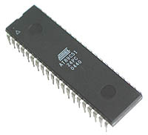
TIMER
An ATMega16A-PU
40-Pin Microcontroller is being used
To implement a 5-minute and
A 10-minute timer.

Slide 7
ALGORITHM FLOWCHART

Slide 8
Start
no
no
If
TimerA=1 AND Level sensor=1
If
TimerB=1 AND Level sensor=1
yes
yes
Machine works till
5 min
Machine works till
10 min

Slide 9
CODING ATMEGA 16

Slide 10
#include<avr/io.h>
assign portA.1=timer_5;
assign portA.2=timer_10;
assign portA.3=level_sensor;
assign portB.1=relay_op;
void main()
{
DDRA portA=#FFxh; // port a is set as input from timer switch
DDRA portB=#00xh;
while(1)
{
if(timer_5==1 && level_sensor==1) %delay generation
{
for(int i=0;i<=500;i=i+1)
{
relay_op=#01xh;
for(int j=0;j<=10000;j=j+1);
}
relay_op=#00xh;
break; % as soon as 5 minutes is over it comes out of loop
}
if(timer_10==1 && level_sensor==1)
{
for(int i=0;i<=500;i=i+1)
{
relay_op=#01xh;
for(int j=0;j<=10000;j=j+1);
}
relay_op=#00xh;
break;
}
}
}

Slide 11
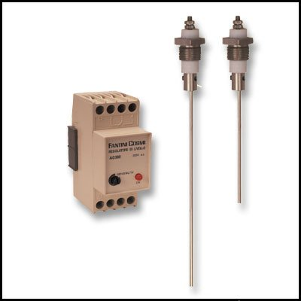
LEVEL DETECTON
A pair of probes are attached to the top of the instrument, at the appropriate depth, which shall detect continuous water
Between the two.

Slide 12
COST ESTIMATION
PER UNIT (OFF THE SHELF)
Submersible Pump – 1200/-
ATMEGA16 Controller – 270/-
Relay – 75/-
Misc. Electronics – 300/-
Misc. Frame – 150/-
NET – 1995/-

Slide 13
COST ESTIMATION
PER UNIT
(LARGE SCALE PRODUCTION)
Submersible Pump – 600/-
ATMEGA16 Controller – 100/-
Relay – 50/-
Misc. Electronics – 100/-
Misc. Frame – 100/-
NET – 950/-

Slide 14
THANK YOU

