Slide 1

Basic Details of the Team and Problem Statement
Ministry/Organization Name/Student Innovation: All India Council for Technical Education (AICTE).
PS Code: DR718
Problem Statement Title: Online integrated platform for projects taken up by the students of various universities/colleges.
Team Name: Caching Analysts
Team Leader Name: Chirag Gupta
Institute Code: U-0473
Institute Name: S.R.M. Institute of Science & Technology, Chennai, KTR

Slide 2
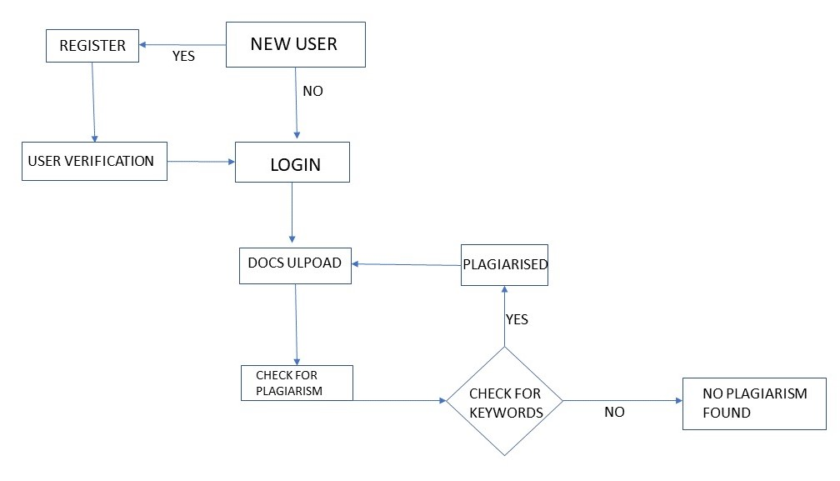
Idea/Approach Details
Describe your idea/Solution/Prototype here:
→ We have designed a working model in which a user can
upload their projects
view many other projects for learning or referencing purposes.
Also checks for plagiarism when one uploads a file,
Gives a value in the plagerized tag.
Describe your Technology stack here:
HTML
CSS
JavaScript
Python
MongoDB

Slide 3
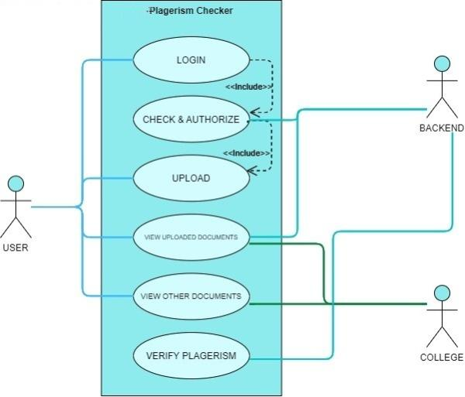
Idea/Approach Details
Describe your Dependencies / Show stopper here
Describe your Use Cases here
DEPENDENCIES:
For faster comparisons of documents, we have included a json file that stores uploaded documents' keywords so that the checks can be made more quickly.
SHOW STOPPER:
As of now, our database only supports PDF files uploaded as documents.

Slide 4
Team Member Details
Team Leader Name: Chirag Gupta
Branch (Btech): Stream ( CSE): Year (I):
Team Member 1 Name: Abhishek Yadav
Branch (Btech): Stream ( CSE): Year (I):
Team Member 2 Name: Subha Bal Pal
Branch (Btech): Stream ( CSE): Year (I):
Team Member 3 Name: Sushmitha Sudharsan
Branch (Btech): Stream (CSE AI/ML): Year (II):
Team Member 4 Name: Kalpana Katta
Branch (Btech): Stream ( CSE): Year (I):
Team Member 5 Name: Aditya Majumdar
Branch (Btech): Stream ( CSE): Year (I):
Team Mentor 1 Name: K.Senthil Kumar
Category (Academic): Expertise (Theory of Computation, Compiler Design, Artificial Intelligence, Design and Analysis of Algorithms): Domain Experience (19):

Slide 5
Important Pointers
Please ensure below pointers are met while
Kindly keep the maximum slides limit to 4 pages
All the topics should be utilized for description of your idea
Try to avoid paragraphs and post your idea in points
Keep your explanation precisely and easy to understand
Idea should be unique and novel. If it has a business potential more weightage will be given.
Apart from this PPT abstract of your idea will be asked separately while submitting
You need to save the file in PDF and upload the same on portal. No PPT, Word Doc or any other format will be supported
You can delete this slide (Important Pointers) when you upload the details of your idea on SIH portal.

