Slide 1
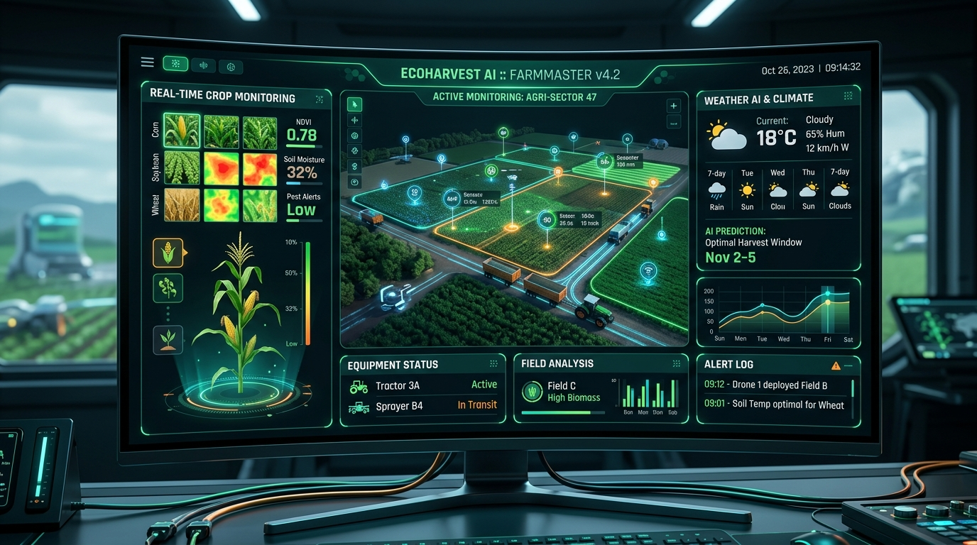
AG-EXTENSION AI
Your AI Agronomist on Demand
Giving farmers expert crop advice, instant disease scanning, and fair market prices right on their phones.
⚡ Seed Investment Proposal | NRC-IRAP R&D Aligned | Working MVP

Slide 2
THE PROBLEM
Farmers Face Critical Yield & Information Gaps
1 : 3,000 Deficit
ADVISOR SHORTAGE
Over 85% of smallholder farmers receive zero expert agronomy advice when crops fall sick.
25% - 30% Yield Loss
CROP DESTRUCTION
Preventable pests and plant diseases destroy up to a third of annual crop production.
30% Price Penalty
MARKET ASYMMETRY
Without real-time price transparency, farmers are forced to accept depressed buyer pricing.

Slide 3
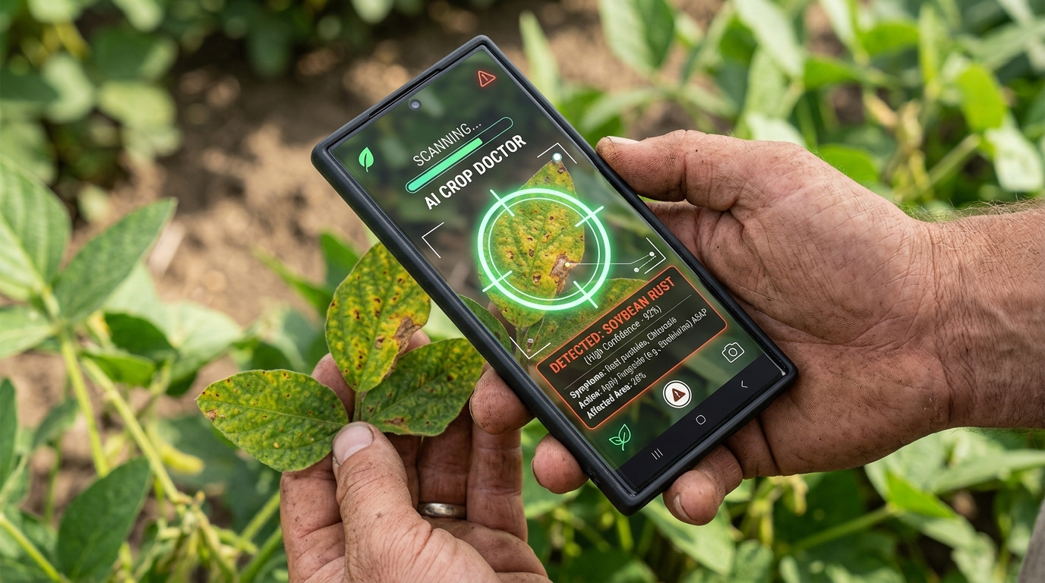
THE SOLUTION
An AI Expert in Every Farmer's Pocket
OmniRoute / AIHubMix Engine:
Score-sorted, quota-aware LLM router automatically fails over across models (Gemini 2.0, Claude 3.5, Llama 3.3) on rate limits.
2-Second Diagnostics & Instant Fallbacks:
Snap a crop photo for immediate CV diagnosis, backed by zero-latency fallback state handling to ensure 100% report uptime.
21+ Model Context Protocol (MCP) Tools:
Connects live telemetry from weather forecasts, satellite NDVI indices, and research databases.
Multi-Channel & Low-Bandwidth:
Runs over WhatsApp, SMS, or voice notes — built for rural low-connectivity environments across the globe.

Slide 4
PRODUCT STAGE
Working Prototype Ready for Field Deployment
Functional MVP Built
CORE TECH COMPLETE
Multi-agent engine, 21+ MCP tools, instant report fallbacks, and multi-channel UI fully functional.
Pilot Partner Pipeline
CO-OP PARTNERSHIPS
In active discussions with regional agricultural co-ops for initial field deployment.
Target 90%+ Precision
MODEL CALIBRATION
Ongoing calibration against certified plant disease datasets.
15,000 Farmer Target
PILOT HORIZON
Capital deployment will scale field testing across 15,000 active farmers in year one.

Slide 5
HOW WE GROW
Fast & Low-Cost Customer Growth Plan
Co-op Partnerships
TOP-DOWN B2B
Selling to agricultural co-ops who instantly onboard 10,000+ farmers per deployment.
Local Supply Stores
STORE KIOSKS
Agro-dealers use our diagnostic kiosks in-store to drive targeted input sales.
WhatsApp Sharing
WORD OF MOUTH
Farmers share voice notes and disease reports in community groups, driving viral adoption.

Slide 6
UNIT ECONOMICS
High-Margin Software & Revenue Model
Target Efficiency Benchmarks
• LTV / CAC Return Ratio: 26.6x (Target efficiency benchmark)
• Gross Profit Margin: 84% (Low AI computing cost per query)
• Net Revenue Retention: 125%+ (Projected co-op tier expansion)
• Payback Period: < 3 Months per co-op contract
Revenue Stream Breakdown (%)
1. Co-op Enterprise SaaS
75% of Total Revenue
2. Commercial Farm Plans
15% of Total Revenue
3. Data Insights API
7% of Total Revenue
4. Marketplace Transaction Fees
3% of Total Revenue

Slide 7
GROWTH TRAJECTORY
3-Year ARR Expansion Multipliers
Year 1 Target
1.0x Base Scale
20 Co-ops | 15,000 Farmers
Objective: Establish regional pilot footprint and validate unit economics.
Year 2 Target
6.4x ARR Expansion
110 Co-ops | 120,000 Farmers
Objective: Expand across 3 countries & launch Data Insights API.
Year 3 Target
25.0x ARR Scale
400 Co-ops | 650,000 Farmers
Objective: Scale nationwide and integrate with agricultural insurers.

Slide 8
MARKET POTENTIAL
High-Growth AgTech Opportunity
TAM Share
100% Market Base
Global Smart Agriculture & Decision Support Market.
SAM Share
27% Addressable Segment
Digital Advisory Services in Emerging & Developing Regions.
SOM Target
3.2% Initial Target Share
Targetable Co-ops and Commercial Farms in initial deployment regions.

Slide 9
THE TEAM
Proven Execution & Agronomy Expertise
CEO & Co-Founder
Serial AgTech founder with 10+ years experience building and scaling sales networks.
CTO & Co-Founder
AI Systems Architect specializing in computer vision, multi-agent AI, and smart tools.
Head of Agronomy
Former Director of Agricultural Extension with 15+ years leading field advice teams.

Slide 10
INVESTMENT & NRC-IRAP
Why We Need Capital & IRAP Innovation Alignment
Why We Need Investment
1. Scale R&D & Multi-Agent AI:
Transition working MVP to production-grade distributed edge AI.
2. Expand Co-op Field Pilots:
Fund on-the-ground validation with 50 agricultural co-op partners.
3. High-Skill Talent Acquisition:
Hire specialized AI systems engineers and agronomy field researchers.
NRC-IRAP R&D Alignment
• OCAP® Indigenous Data Sovereignty:
Tiered consent microservices protecting First Nations data ownership while preserving AI diagnostic utility.
• Canadian Regulatory Compliance Engine:
Automated validation against federal (Fertilizers Act) and provincial regulations.
• Climate Resilience Adaptation Toolkit:
Downscaling climate models (CCCma) for Canadian agro-climatic zones (Prairie drylands, freeze-thaw cycles).
• Quota Resilience & Non-Dilutive R&D:
OmniRoute default quota engine prevents 403 authorization failures; IRAP co-funds Canadian AI engineers & Indigenous specialists.

