Slide 1
AGENTIC AI FACTORY | AIONOS · ASSIGNMENT 1
Executive Productivity Agent
From a messy week of meetings, emails, voice notes and calendars
to one daily action brief Arjun can trust.
Commitment register
Deadline-aware
De-duplicated
No invented owners
Cites every source
User: Arjun Malhotra, VP Sales · Week of Mon 21 – Fri 25 Sep 2026
Notes:
Introduce the problem in one line: an executive's commitments are scattered across channels, dates drift, and ownership gets lost. The agent turns that into one grounded, time-aware brief.

Slide 2
The problem: one week, four channels, no single truth
Everything the agent knows comes from the data pack — nothing else.
1
25
2
34
meeting transcript
emails
voice notes
calendar entries
Leadership Sync, Mon 9:00
5 threads × 5
Arjun, to himself
4 people
Example: the vendor list for Raghav
One promise shows up in 7 places with 4 different dates: "end of day tomorrow" (meeting) → "today?" (Raghav) → "first thing tomorrow morning" (email) → "might slip to tomorrow morning" (voice note) → "tomorrow (Wednesday) morning for sure" (email) → "still good for this morning?" (Raghav, no reply).
Meanwhile the Mumbai lease has nobody signing it off, and the deck review is booked on top of board prep.
Executive Productivity Agent · 2/10
Notes:
Lead with the numbers, then the vendor list example: it's the clearest case of why de-duplication and deadline tracking matter.

Slide 3
What the agent does — mapped to the brief
Each requirement has a matching acceptance test (13/13 passing).
1
Identifies commitments
2
Mine vs waiting on others
Speech acts on every clause: "I'll", "I'd", "I owe", "can you…".
Owner = Arjun → my action. Named owner → waiting. None → needs owner.
3
Deadlines & overdue
4
De-duplicates
Fuzzy dates resolved; countdown from the chosen "as of" moment.
One commitment per (topic, owner, kind) — 7 sources → 1 item.
5
Flags unclear ownership
6
Daily brief + Q&A
Lists who disclaimed and who was suggested. Never assigns.
Ranked priorities, annotated calendar, cited answers.
Executive Productivity Agent · 3/10
Notes:
Walk the six requirements quickly; each maps to a UI area and a test in test/agent.test.js.

Slide 4
Architecture & process flow
Deterministic, auditable core · optional Claude tool-use layer on top
Meeting
1 · Ingest
2 · Extract
3 · Reason
4 · Check
5 · Brief
Emails
Records → 71 citable clauses
Topic · speech acts · people · deadline
Replay to as-of · merge by topic + owner + kind
Clashes · missing entries · unowned · at-risk
Priorities · calendar · mine / waiting / owner
Voice notes
Calendars
Runs in the browser, Node CLI or server. No API key needed for the core.
Optional · Claude tool-use agent (claude-opus-5)
Free-form questions → Claude calls get_daily_brief · list_commitments · get_commitment · get_calendar · list_flags · search_sources over the same engine, then answers with [source ids]. The engine is its only source of truth.
Executive Productivity Agent · 4/10
Notes:
Five stages. Emphasise: the LLM consumes the engine via tools; it cannot invent owners or dates. Source: src/engine/*.js and src/llm/claude-agent.js.

Slide 5
Inputs, sources & assumptions
Transcribed word for word into data/sources.js — every output cites ids like T1.E4, MTG1.U3, VN1, CAL.arjun.8
Phrase | Resolves to
first thing | 9:00 AM
morning | by 12:00 PM
end of day / "by Wednesday" | 6:00 PM
evening | 9:00 PM
this week | Fri 6:00 PM
before board prep | start of that event
see you at 3 | 3:00 PM
1
Time
"Today" = the as-of moment you choose. The agent only uses statements made by then.
2
Voice notes
Arjun's own statements. A private note never relaxes a promise made to someone else.
3
Ownership
Request → addressee owns it. Commitment → speaker owns it. A suggestion is only a candidate.
4
Conflicts
A clock time wins over other dates; otherwise the last date that isn't negated ("not Thursday").
5
Transcription
T2.E4 breaks across pages. Read as "9:30 AM Thursday", which matches T2.E5 and Neha's calendar.
Executive Productivity Agent · 5/10
Notes:
Full list in docs/INPUTS_AND_ASSUMPTIONS.md. Call out the T2.E4 transcription assumption explicitly.

Slide 6
De-duplication & deadlines: 7 sources → 1 commitment
"Send Raghav the updated vendor list" — owner: Arjun · for: Raghav · status as of Thu 8:30 AM: OVERDUE
Mon 9:00
Meeting
"I'll get that to him by end of day tomorrow."
Tue 6:00 PM · promised
Key
(topic,
owner,
kind)
Mon 9:50
Email
Raghav: "can you send … today?"
Mon 6:00 PM · requested
Mon 5:40
Email
"will send first thing tomorrow morning instead."
Tue 9:00 AM · revised
Effective date = latest firm statement.
Requests and private notes don't override a promise.
Mon 6:40
Voice
"might slip to tomorrow morning"
self-note · doesn't relax it
Tue 9:15
Email
Raghav: "whenever … today works."
Tue 6:00 PM · agreed
Tue 6:30
Email
"by tomorrow (Wednesday) morning for sure."
Wed 12:00 PM · effective
Wed 8:45
Email
Raghav: "still good for this morning?"
chaser · reply owed
Executive Productivity Agent · 6/10
Notes:
This is the de-duplication and deadline story in one picture. The UI drawer shows exactly this timeline with clickable citations.

Slide 7
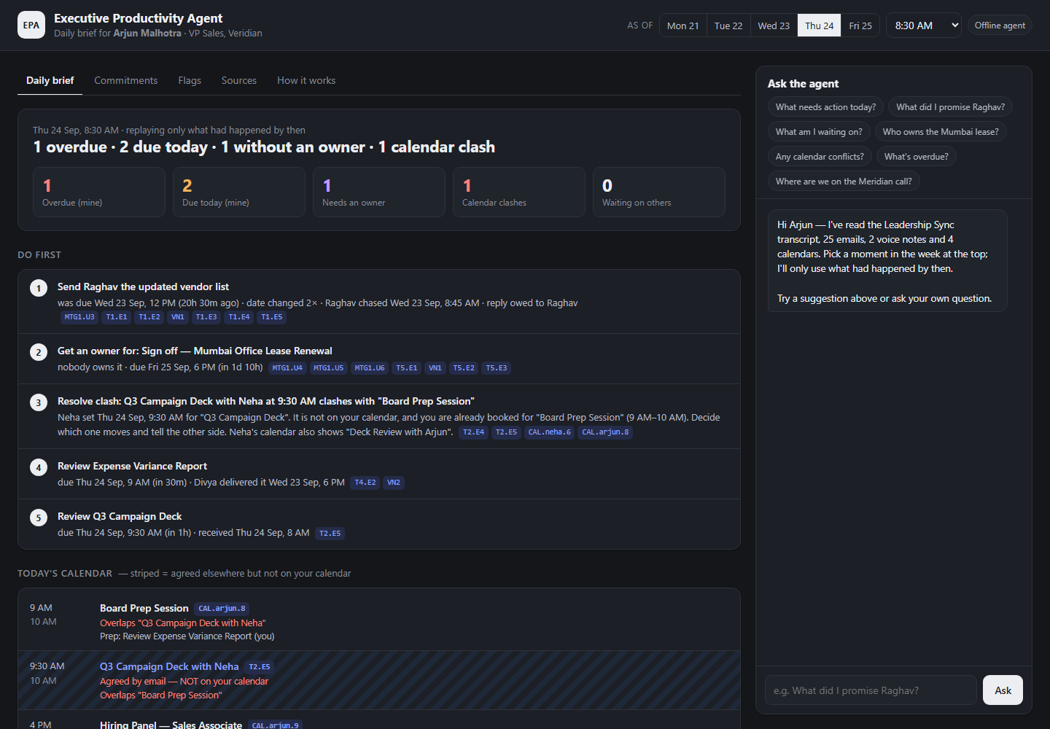
The daily brief — Thu 24 Sep, 8:30 AM
1
Do first
Vendor list overdue → Mumbai lease has no owner → 9:30 clash → two reviews before 9:00 / 9:30.
2
Annotated calendar
Striped slot = agreed by email but not on Arjun's calendar.
3
Time travel
Pick any day/time: the agent only knows what had happened by then.
4
Ask
"What did I promise Raghav?" · "What needs action today?"
Executive Productivity Agent · 7/10
Notes:
Live demo here. Click the vendor list to open the evidence drawer; switch days to show time travel.

Slide 8
Flags: what a good chief of staff would catch
Every flag cites its sources. None of them invents an owner or a date.
No owner · Mumbai lease sign-off
Calendar clash · Thu 9:30 AM
Due Fri 25 Sep, 6 PM. Disclaimed by Arjun and Divya. Facilities was suggested but never confirmed. The agent refuses to assign it and suggests raising it at Friday's 10 AM Facilities check-in.
Neha set the deck review inside Board Prep (9–10 AM). It's on Neha's calendar, not Arjun's.
At risk · expense report (Mon–Tue)
Stale reminder · Meridian call
Divya's email target was "Thursday morning", after the 9 AM board prep it was needed for. The flag cleared once she agreed to Wednesday evening.
VN2 (Wed 8:15): "I owe Priya a time". Priya had already confirmed Wed 3 PM on Tue 5:45 PM, so it's de-duplicated and not reopened.
Executive Productivity Agent · 8/10
Notes:
Also detected: 'Quick Call with Arjun' Tue 9 AM on Divya's calendar but not Arjun's; replies owed to Raghav.

Slide 9
AI tools used — and how the output is kept honest
Claude Code (Claude Opus 5)
Build time
13 / 13
Transcribed the data pack from photos. Helped design and write the engine, UI, tests, docs and this deck. All checked against the printout and the tests.
acceptance tests passing
Grounding test: every citation id and deadline phrase exists word for word in the sources
Owners come only from explicit requests or commitments
Same input gives the same brief every time, with no API key
LLM only reads the data through tools
Claude API · claude-opus-5
Run time (optional)
Tool-use agent for free-form questions. It calls 6 tools over the engine, answers with [source ids], and the UI shows which tools it called.
Why not LLM-only? It gives different answers each run, it's harder to audit, and it's more likely to guess an owner for the lease. The LLM adds flexibility where it's useful: open-ended questions.
Executive Productivity Agent · 9/10
Notes:
See docs/AI_TOOLS_USED.md. Add any other tools you used during the 6 hours.

Slide 10
Try it · demo · what's next
1
Run it
2
Links
3
Next steps
npm start → localhost:3000
or double-click index.html
npm test · npm run brief
Claude mode: npm install + ANTHROPIC_API_KEY
GitHub: github.com/<you>/executive-productivity-agent
Hosted: GitHub Pages (static)
Demo video: Google Drive (anyone with link)
LLM extraction into the same schema, keeping the grounding check
Mail / calendar / speech-to-text connectors
Draft replies and calendar fixes for one-click approval
Thank you — questions?
Notes:
Replace <you> with your GitHub username and paste the Drive link before submitting.

