Slide 1
Comparative Analysis among Three CNN models to identify blight diseases in Potato plants
Shuvojeet Paul ☸ Souvik Pal

Slide 2
Content
Introduction
Literature Review
Proposed Method
Dataset
Data Pre-processing
Background
Models
Result & Analysis
Conclusion
Reference

Slide 3
Introduction
The study focuses on the challenges of feeding a growing global population while preserving natural ecosystems through sustainable agriculture practices.
Agriculture is a key tool for reducing poverty and fostering economic development, with potatoes being one of the most widely farmed crops.
Potato plants are susceptible to diseases that can hinder agricultural development, emphasizing the need for early detection and treatment.
Deep learning algorithms, particularly convolutional neural networks (CNNs), are well-suited for improving classification accuracy.
- Various well-known CNN architectures, such as VGG16, Xception, and Inception, are tested in the study.
The study compares the classification results of different architectures on the potato dataset.
- The aim is to enhance potato production by deep learning algorithms, contributing to a strong food security system and addressing agricultural development challenges.

Slide 4
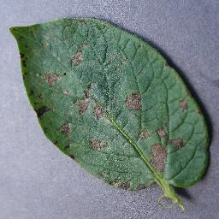
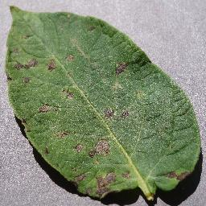
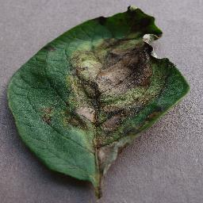
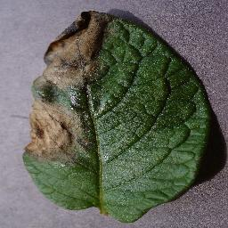
Potato is one of the most popular crops of the world which contribute to sustain world population diets. However, two diseases common to both crops are early blight and late blight, which cause serious problems for both these crops and farmers.
Early Blight:
Early blight is a common potato disease caused by the fungus Alternaria solani. The first symptoms of early blight appear as small, circular or irregular, black spots with concentric rings on the older leaves . These spots enlarge up to 3/8 inch in diameter and gradually may become angular-shaped.
Late Blight:
Found on potato plants, late blight is caused by the fungus Phytophthora infestans. This disease forms dark-brown to black and irregular spots with a drenching appearance on the leaves, which eventually turn yellow and infections quickly spread to petioles and young stems and entire leaves die off.

Slide 5
Literature Review
SL No. | Study | Approach | Models | Dataset | Accuracy
1 | Islam, Monzurul, | Integration of image processing and machine learning | Support Vector Machine (SVM) | Plant Village' | 95%
2 | S. Widiyanto, R. Fitrianto and D. T. Wardani | CNN model without segmentation | Convolutional Neural Networks (CNN) | 5 types of leaf diseases | 96.60%
3 | Khalifa, N. E., Taha, M., Abou El-Magd, L. & Hassanien, | 3-step process: image segmentation by k-means,feature extraction, classification | 14-layer deep learning architecture | Blight diseases in potato leaves | 98%
4 | Huiqun H | Deep learning with transfer learning and different network structures | ResNet50, Xception, MobileNet, ShuffleNet, DenseNet121_Xception | Tomato leaf disease and 9 other types | 83.68% - 97.10%
5 | Sholihati, Rizqi Amaliatus, | Deep learning with GoogleNet, Resnet50, and VGG16 | GoogleNet, ResNet50, VGG16 | Two types of diseases in potato plants | 97%

Slide 6
SL No. | Study | Approach | Models | Dataset | Accuracy
6 | M. A. Iqbal and K. H. Talukder | Image segmentation-based potato leaf detection model | Random Forest classifier | PlantVillage dataset | 97%
7 | Gokulnath B.V., Usha Devi G. | Loss-fused CNN model for disease identification | Convolutional Neural Networks (CNN) | PlantVillage dataset | 98.93%
8 | Tiwari, V., Joshi, R. C., & Dutta, M. K. | Deep convolutional neural network for plant disease detection and classification | Dense Convolutional Neural Network | Large plant leaves image dataset | 99.58% (cross-validation), 99.199% (test)
9 | Changjian Z | Restructured residual dense network for tomato leaf disease identification | Hybrid deep learning model | Tomato test dataset | 95%

Slide 7
Proposed Method
In this study, we use three CNN pre-trained models - VGG16, Inception and Xception on pre-processed dataset with combination of five optimizers – Adam, Adagrad, AdamW, RMSProp, SGD and two learning rate – 0.001 & 0.0001 for classification of potato leaf diseases into three category – Early Blight, Late Blight and Healthy.
We have done a comparative analysis among these three CNN models.

Slide 8
Load Potato Leaf Dataset
Data splitting into Training, Test and Validation
Image Augmentation and downscaled to 224x224x3
VGG16, Inception and Xception pre-trained model
SGD Optimizer
RMSProp Optimizer
Adam Optimizer
AdamW Optimizer
Adagrad Optimizer
Model Evaluation
Result Visualization

Slide 9
Dataset
In this paper, two distinct datasets such as PlantVillage, and three classes are gathered. Early and late blight are two frequent potato diseases; however, we also included healthy leaf as a class in the total three classes.
This dataset contains total 1842 images which have three categories potato leaf images- Healthy:142, Early Blight:850, Late Blight:850.
Table 1. Detail description of potato leaf image dataset.
Serial No. | Class | Number of Samples | Training Sample | Test Sample
01 | Healthy | 142 | 102 | 40
02 | Early Blight | 850 | 700 | 15
03 | Late Blight | 850 | 700 | 150
Total |  | 1842 | 1502 | 340

Slide 10
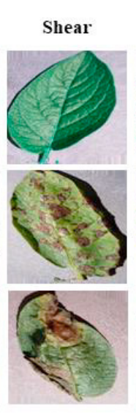
Pre-processed data
Data augmentation is a powerful method for increasing the accuracy of modern image classifiers . We applied several augmentation techniques to the raw dataset to improve our model performance and recognition capability.
1
Here we set the rescale parameter to 1./255, which means that the pixel values of the images will be divided by 255, effectively rescaling them to a range between 0 and 1.
2
We set the shear_range parameter to 0.2, which means that the images will be randomly sheared with a maximum intensity of 20% along either the horizontal or vertical axis.

Slide 11
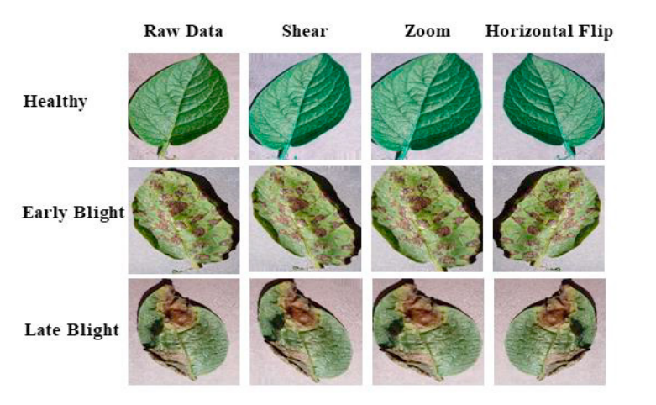
Pre-processed data (contd.)
3
In this example, the zoom_range parameter is set to 0.2, which means that the images will be randomly zoomed with a maximum magnification or shrinkage of 20%.
4
Here we set the horizontal_flip parameter to True, which means that the images will be randomly flipped horizontally with a probability of 0.5.

Slide 12

Transfer Learning
Transfer learning is a machine learning technique that utilizes knowledge gained from solving one problem to improve
performance on a different but related problem.
The pre-trained model, typically a deep neural network, learns generic features in its earlier layers and task-specific features in its later layers.
The pre-trained model acts as a feature extractor or feature generator, and the later layers of the model are adapted or fine-tuned for the target task.
Transfer learning can save computational resources, reduce training time, and improve performance, particularly when the target task has limited data.
It has been successfully applied in various domains such as computer vision, natural language processing, and speech recognition.

Slide 13
Steps for transfer learning…..
Choose a pre-trained model.
Remove the last layers and freeze the previous layers.
Add new layers specific to the target task.
Prepare the target task dataset.
Perform feature extraction using the pre-trained model.
Train the combined model
Evaluate and test the model's performance.

Slide 14
VGG-16
VGG16 is a CNN architecture.
It consists of 16 layers, including convolutional and fully connected layers.
The output layer has 1000 neurons corresponding to the 1000 possible classes for the ImageNet dataset.
The architecture is characterized by a uniform structure with small filters (3x3) and max pooling layers.
VGG16 is widely used as a base model for transfer learning in computer vision tasks.
Its pre-trained weights enable feature extraction and transfer learning in image classification tasks.VGG16

Slide 15
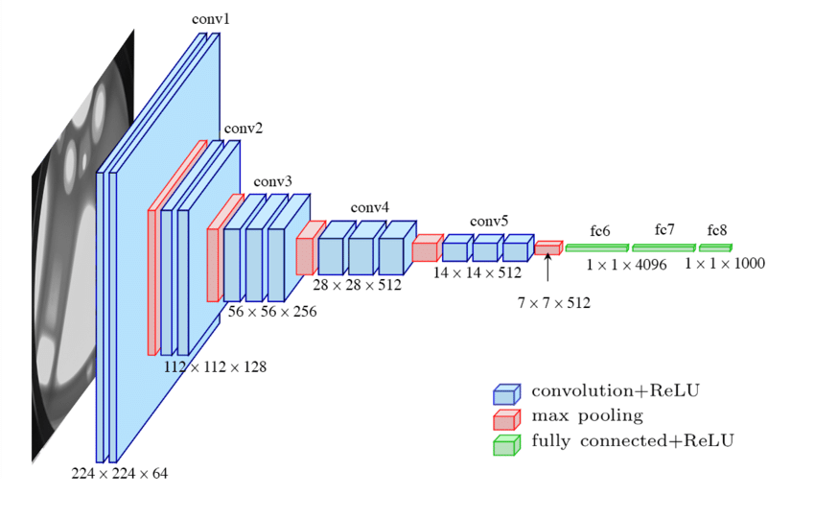
VGG 16 model architecture

Slide 16
Inception
The Inception model is a CNN architecture developed by Google researchers.
It aims to balance computational efficiency and model accuracy.
The key concept introduced in the Inception model is the use of "inception modules".
Inception modules consist of parallel convolutional layers with different filter sizes, enabling the network to capture information at multiple scales.
This allows the model to extract both local and global features from images effectively.
Different versions of the Inception model have been released, such as Inception V2 and Inception V3.

Slide 17
Filter concatenation
1x1 convolution
3x3 convolution
5x5 convolution
3x3 max pooling
Previous layer
Inception module, Naïve version
Filter concatenation
1x1 convolution
3x3 convolution
5x5 convolution
1x1 convolution
1x1 convolution
1x1 convolution
3x3 max poolng
Previous layer
Inception module with dimension reductions

Slide 18
Xception
Xception is a deep convolutional neural network architecture.
It introduces depthwise separable convolutions as a fundamental component.
Depthwise separable convolutions consist of separate depthwise and pointwise convolutions.
Xception reduces computational complexity and the number of parameters compared to traditional convolutions.
The model efficiently captures spatial information while being computationally efficient.
Xception's design offers a balance between performance and efficiency in deep learning tasks.

Slide 19
Transfer learning for VGG16
Output layer with three class
Healthy
Dense layer with 256 neurons
Early Blight
Late Blight
VGG-16 without last three dense layer

Slide 20
Result & Analysis

Slide 21
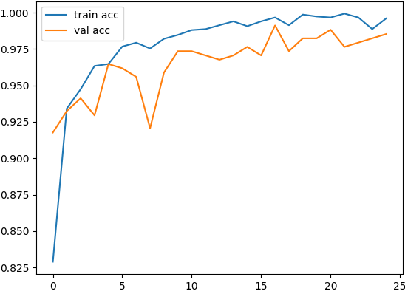
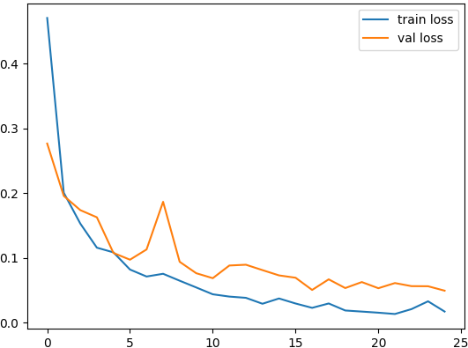
Highest accuracy for VGG-16 at learning rate 0.001
With a learning rate of 0.001, the VGG16 model demonstrated excellent performance across different optimizers. The highest validation accuracy of 97.82% with the AdamW optimizer demonstrates the model's capability to achieve exceptional accuracy.
Accuracy
Optimizer | Validation Accuracy (%)
Adagrad | 91.14
Adam | 95.76
AdamW | 97.82
RMSProp | 88.89
SGD | 93.04
Loss

Slide 22
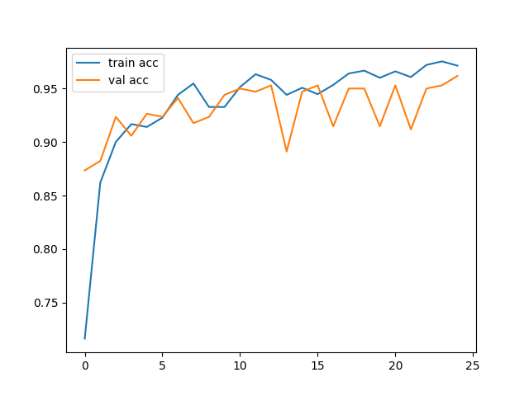
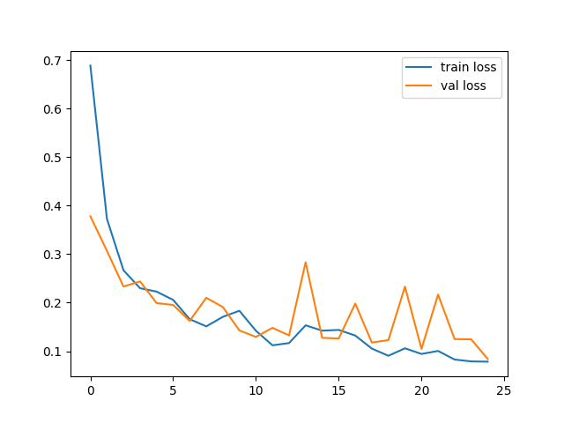
Highest accuracy for VGG-16 at learning rate 0.0001
When utilizing a learning rate of 0.0001, the VGG16 model exhibited strong performance across different optimizers. These results highlight the VGG16 model's capability to capture intricate patterns and features within the dataset, resulting in accurate predictions. The model's consistent high accuracy with a learning rate of 0.0001 demonstrates its effectiveness in various optimization scenarios.
Accuracy
Optimizer | Validation Accuracy (%)
Adagrad | 83.27
Adam | 96.52
AdamW | 96.00
RMSProp | 91.81
SGD | 87.67
Loss

Slide 23
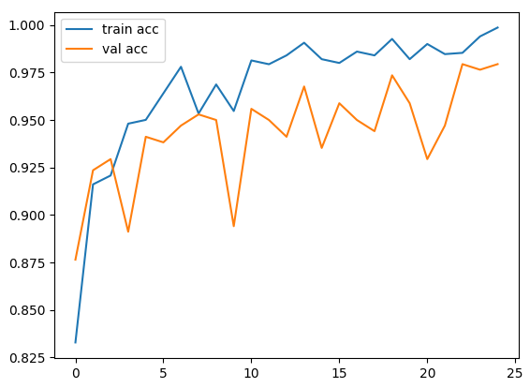
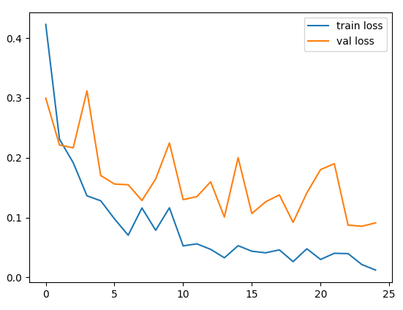
Highest accuracy for inception at learning rate 0.001
With a learning rate of 0.001, the Inception model displayed impressive performance across various optimizers.These results highlight the model's ability to effectively learn and capture intricate patterns and features within the given dataset.
Accuracy
Optimizer | Validation Accuracy(%)
Adagrad | 95.58
Adam | 95.79
AdamW | 95.19
RMSProp | 92.68
SGD | 96.73
Loss

Slide 24
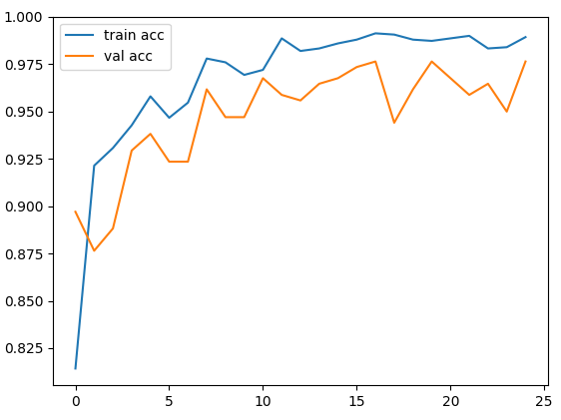
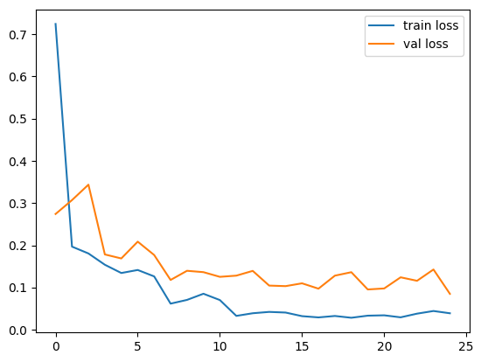
Highest accuracy for inception at learning rate 0.0001
When using a learning rate of 0.0001, the Inception model showcased strong performance across different optimizers. These results highlight the model's ability to capture intricate patterns and features within the dataset, resulting in accurate predictions.
Accuracy
Optimizer | Validation Accuracy(%)
Adagrad | 92.58
Adam | 96.74
AdamW | 96.41
RMSProp | 94.05
SGD | 95.15
Loss

Slide 25
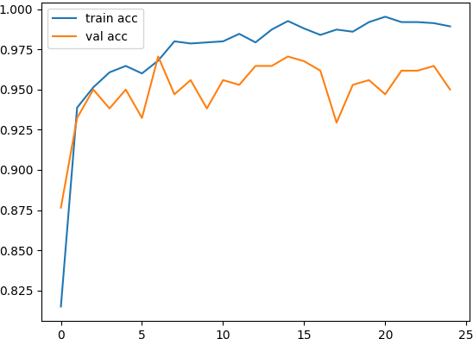
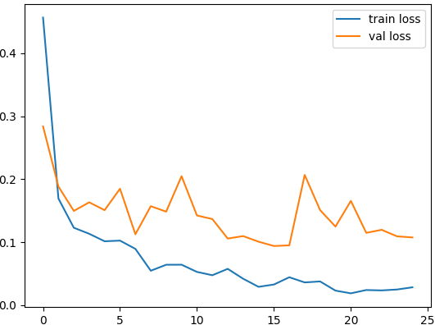
Highest accuracy for Xception at learning rate 0.001
When using a learning rate of 0.001, the Xception model exhibited strong performance across different optimizers. Despite slightly lower accuracies compared to some other models, the Xception model still performed well with a learning rate of 0.001.
Accuracy
Optimizer | Validation Accuracy(%)
Adagrad | 94.26
Adam | 93.80
AdamW | 93.47
RMSProp | 93.21
SGD | 95.02
Loss

Slide 26
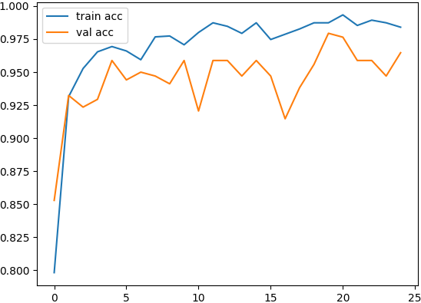
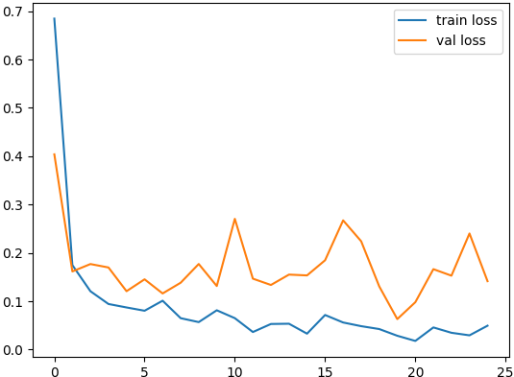
Highest accuracy for Xception at learning rate 0.0001
With a learning rate of 0.0001, the Xception model demonstrated competitive performance across different optimizers. Although slightly lower than some other models, the Xception model still achieved respectable accuracy with a learning rate of 0.0001, showcasing its effectiveness in various optimization scenarios.
Accuracy
Optimizer | Validation Accuracy(%)
Adagrad | 92.38
Adam | 95.05
AdamW | 95.14
RMSProp | 91.96
SGD | 93.87
Loss

Slide 27
Result & Analysis
Table. 8. shows the results in the form of table for different optimizers. The optimizers are implemented with three different models (VGG16, Inception, Xception).
Optimizers | Models | Validation Accuracy (%)
 |  | Lr-0.001 | Lr-0.0001
Adam | VGG16 | 95.77 | 96.52
 | Inception | 95.79 | 96.74
 | Xception | 93.80 | 95.05
AdamW | VGG16 | 97.82 | 96.5
 | Inception | 95.19 | 96.41
 | Xception | 93.47 | 95.10
Adagrad | VGG16 | 91.14 | 83.27
 | Inception | 95.58 | 92.58
 | Xception | 94.26 | 92.32
RMSProp | VGG16 | 88.89 | 91.89
 | Inception | 92.68 | 94.05
 | Xception | 93.21 | 91.96
SGD | VGG16 | 93.04 | 87.61
 | Inception | 96.73 | 95.15
 | Xception | 95.02 | 93.87

Slide 28
Summary of the result
VGG16:
Achieved impressive validation accuracies across different optimizers, particularly with AdamW.
Highest accuracy: 97.82% with AdamW and learning rate 0.001.
Second highest accuracy: 96.5% with AdamW and learning rate 0.0001.
Inception:
Also performed well in terms of validation accuracies.
Highest accuracy: 95.19% with AdamW and learning rate 0.001.
Second highest accuracy: 96.41% with AdamW and learning rate 0.0001.
Xception:
Showed slightly lower accuracies compared to VGG16 and Inception.
Highest accuracy: 95.10% with AdamW and learning rate 0.0001.

Slide 29
Highest accuracy
It was observed that VGG16 with AdamW optimizer at learning rate 0.001 achieved the highest validation accuracy of 97.82%.
Validation Accuracy
Validation Loss

Slide 30
conclusion
VGG16 consistently achieved high validation accuracy, with values ranging from 88.89% to 97.82%.
Inception also showed competitive performance with validation accuracy ranging from 92.68% to 96.73%.
Xception had slightly lower validation accuracy compared to VGG16 and Inception, ranging from 91.96% to 95.10%.
The learning rate of 0.001 generally yielded higher accuracy for VGG16 and Inception models, while a learning rate of 0.0001 yielded higher accuracy for Xception.
Overall, VGG16 and Inception demonstrated strong performance and stability across different optimizers and learning rates.
The choice of optimizer and learning rate significantly affected the performance of the models.
VGG16 consistently outperformed Inception and Xception in terms of validation accuracies.
AdamW optimizer consistently yielded the highest accuracies for VGG16 and Inception.

Slide 31
References
1. Islam, Monzurul, et al. (2017) “Detection of potato diseases using image segmentation and multiclass support vector machine.” IEEE 30th canadian conference on electrical and computer engineering (CCECE). IEEE.
2. S. Widiyanto, R. Fitrianto and D. T. Wardani, "Implementation of Convolutional Neural Network Method for Classification of Diseases in Tomato Leaves," 2019 Fourth International Conference on Informatics and Computing (ICIC).
3. Khalifa, N. E., Taha, M., Abou El-Magd, L. & Hassanien, A. E. Artificial intelligence in potato leaf disease classification: a deep learning approach.
4. Huiqun H et al., (2020) “Tomato disease detection and classification by deep learning. International Conference on Big Data.” Artificial Intelligence and Internet of Things Engineering (ICBAIE)
5. Sholihati, Rizqi Amaliatus, et al. (2020) “Potato leaf disease classification using deep learning approach.” International electronics symposium (IES). IEEE.
6. M. A. Iqbal and K. H. Talukder, "Detection of Potato Disease Using Image Segmentation and Machine Learning," 2020 International Conference on Wireless Communications Signal Processing and Networking (WiSPNET), Chennai, India, 2020, pp. 43-47, doi: 7.1109/WiSPNET48689.2020.9198563.
7. Gokulnath B.V., Usha Devi G., Identifying and classifying plant disease using resilient LF-CNN, Ecological Informatics, Volume 63, 2021,
8. Tiwari, V., Joshi, R. C., & Dutta, M. K. (2021). Dense convolutional neural networks based multiclass plant disease detection and classification using leaf images. Ecological Informatics, 63, 101289.
9. Changjian Z et al. (2021) “Tomato leaf disease identification by restructured deep residual dense network.” IEEE Access 9:28822-28831.

Slide 32
Thank You...

