Slide 1
AD ASTRA
Viral dynamic characterization
1 November 2024

Slide 2
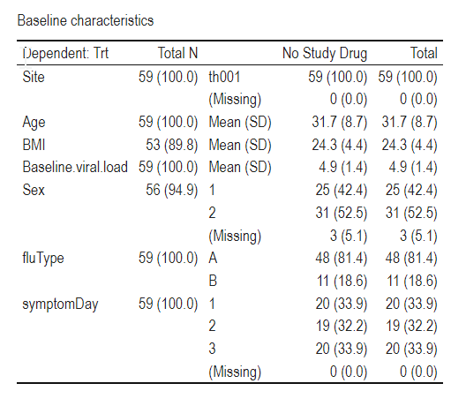
Data
Date: From 28 Feb 2023 to 25 Aug 2024
Arm: No study drug
Patient with PCR data: 72 (Flu A: 60; Flu B: 12)
mITT population: 59 (Flu A: 48; Flu B: 11); excluded 13
> 250 mean genomes/mL on D0
Having PCR data from D0 to D3
Randomisation to date: Thailand (82); All sites (90)

Slide 3
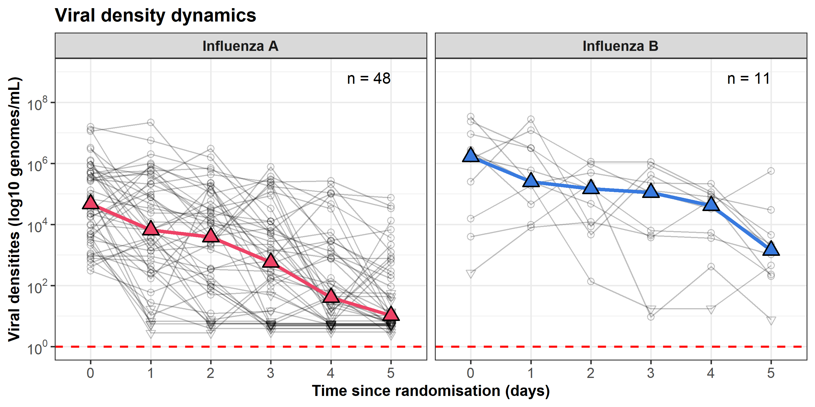

Slide 4
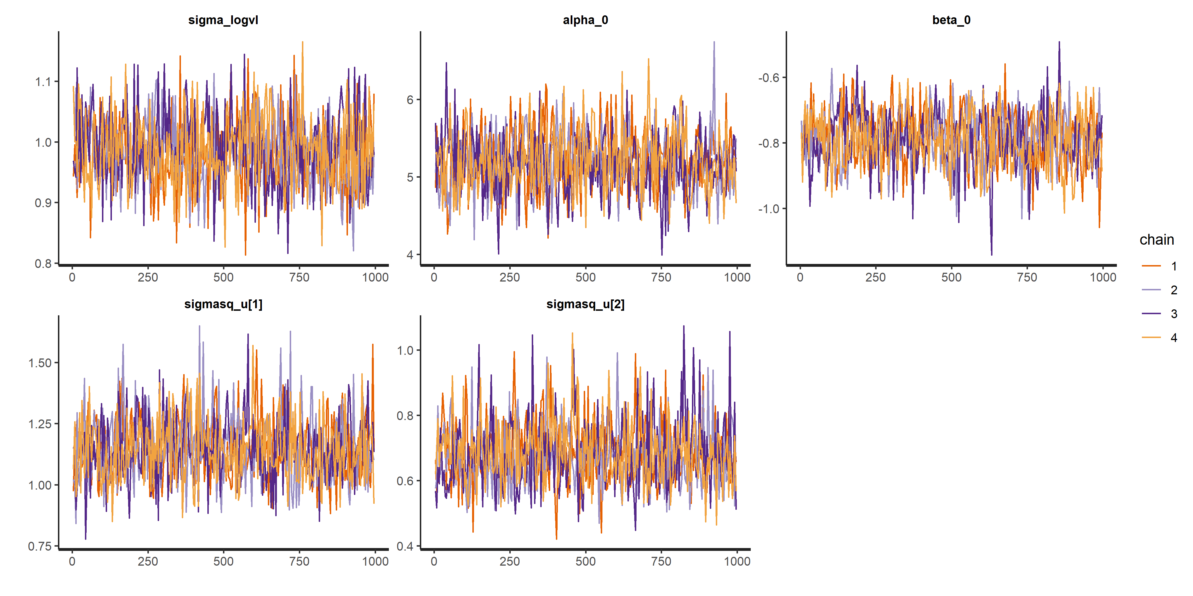
1.0 [95% CrI: 0.9 to 1.1]
5.2 [95% CrI: 4.4 to 6.0]
-0.8 [95% CrI: -1.0 to -0.6]
Intra-individual variation
Population intercept
Population slope
1.1 [95% CrI: 0.9 to 1.4]
0.7 [95% CrI: 0.5 to 0.9]
Interindividual variation
on intercept
Interindividual variation
on slope

Slide 5
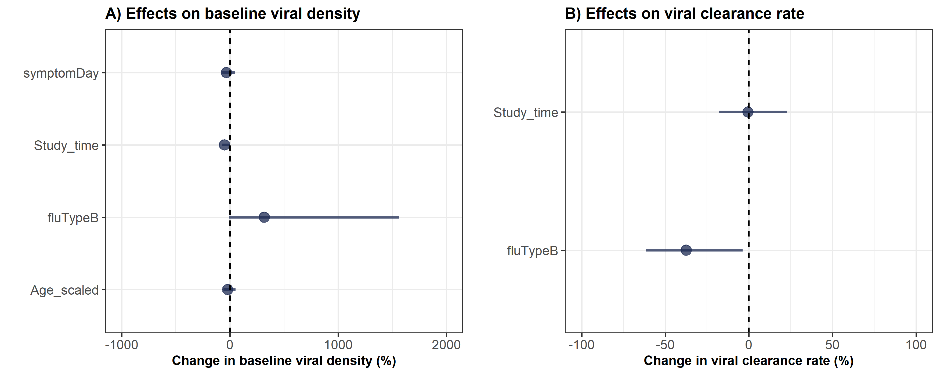
Half-life
Flu A: 7.5 h [95% CrI: 9.2 to 11.5 h]
Flu B: 14.6 h [95% CrI: 9.7 to 23.1 h]

Slide 6
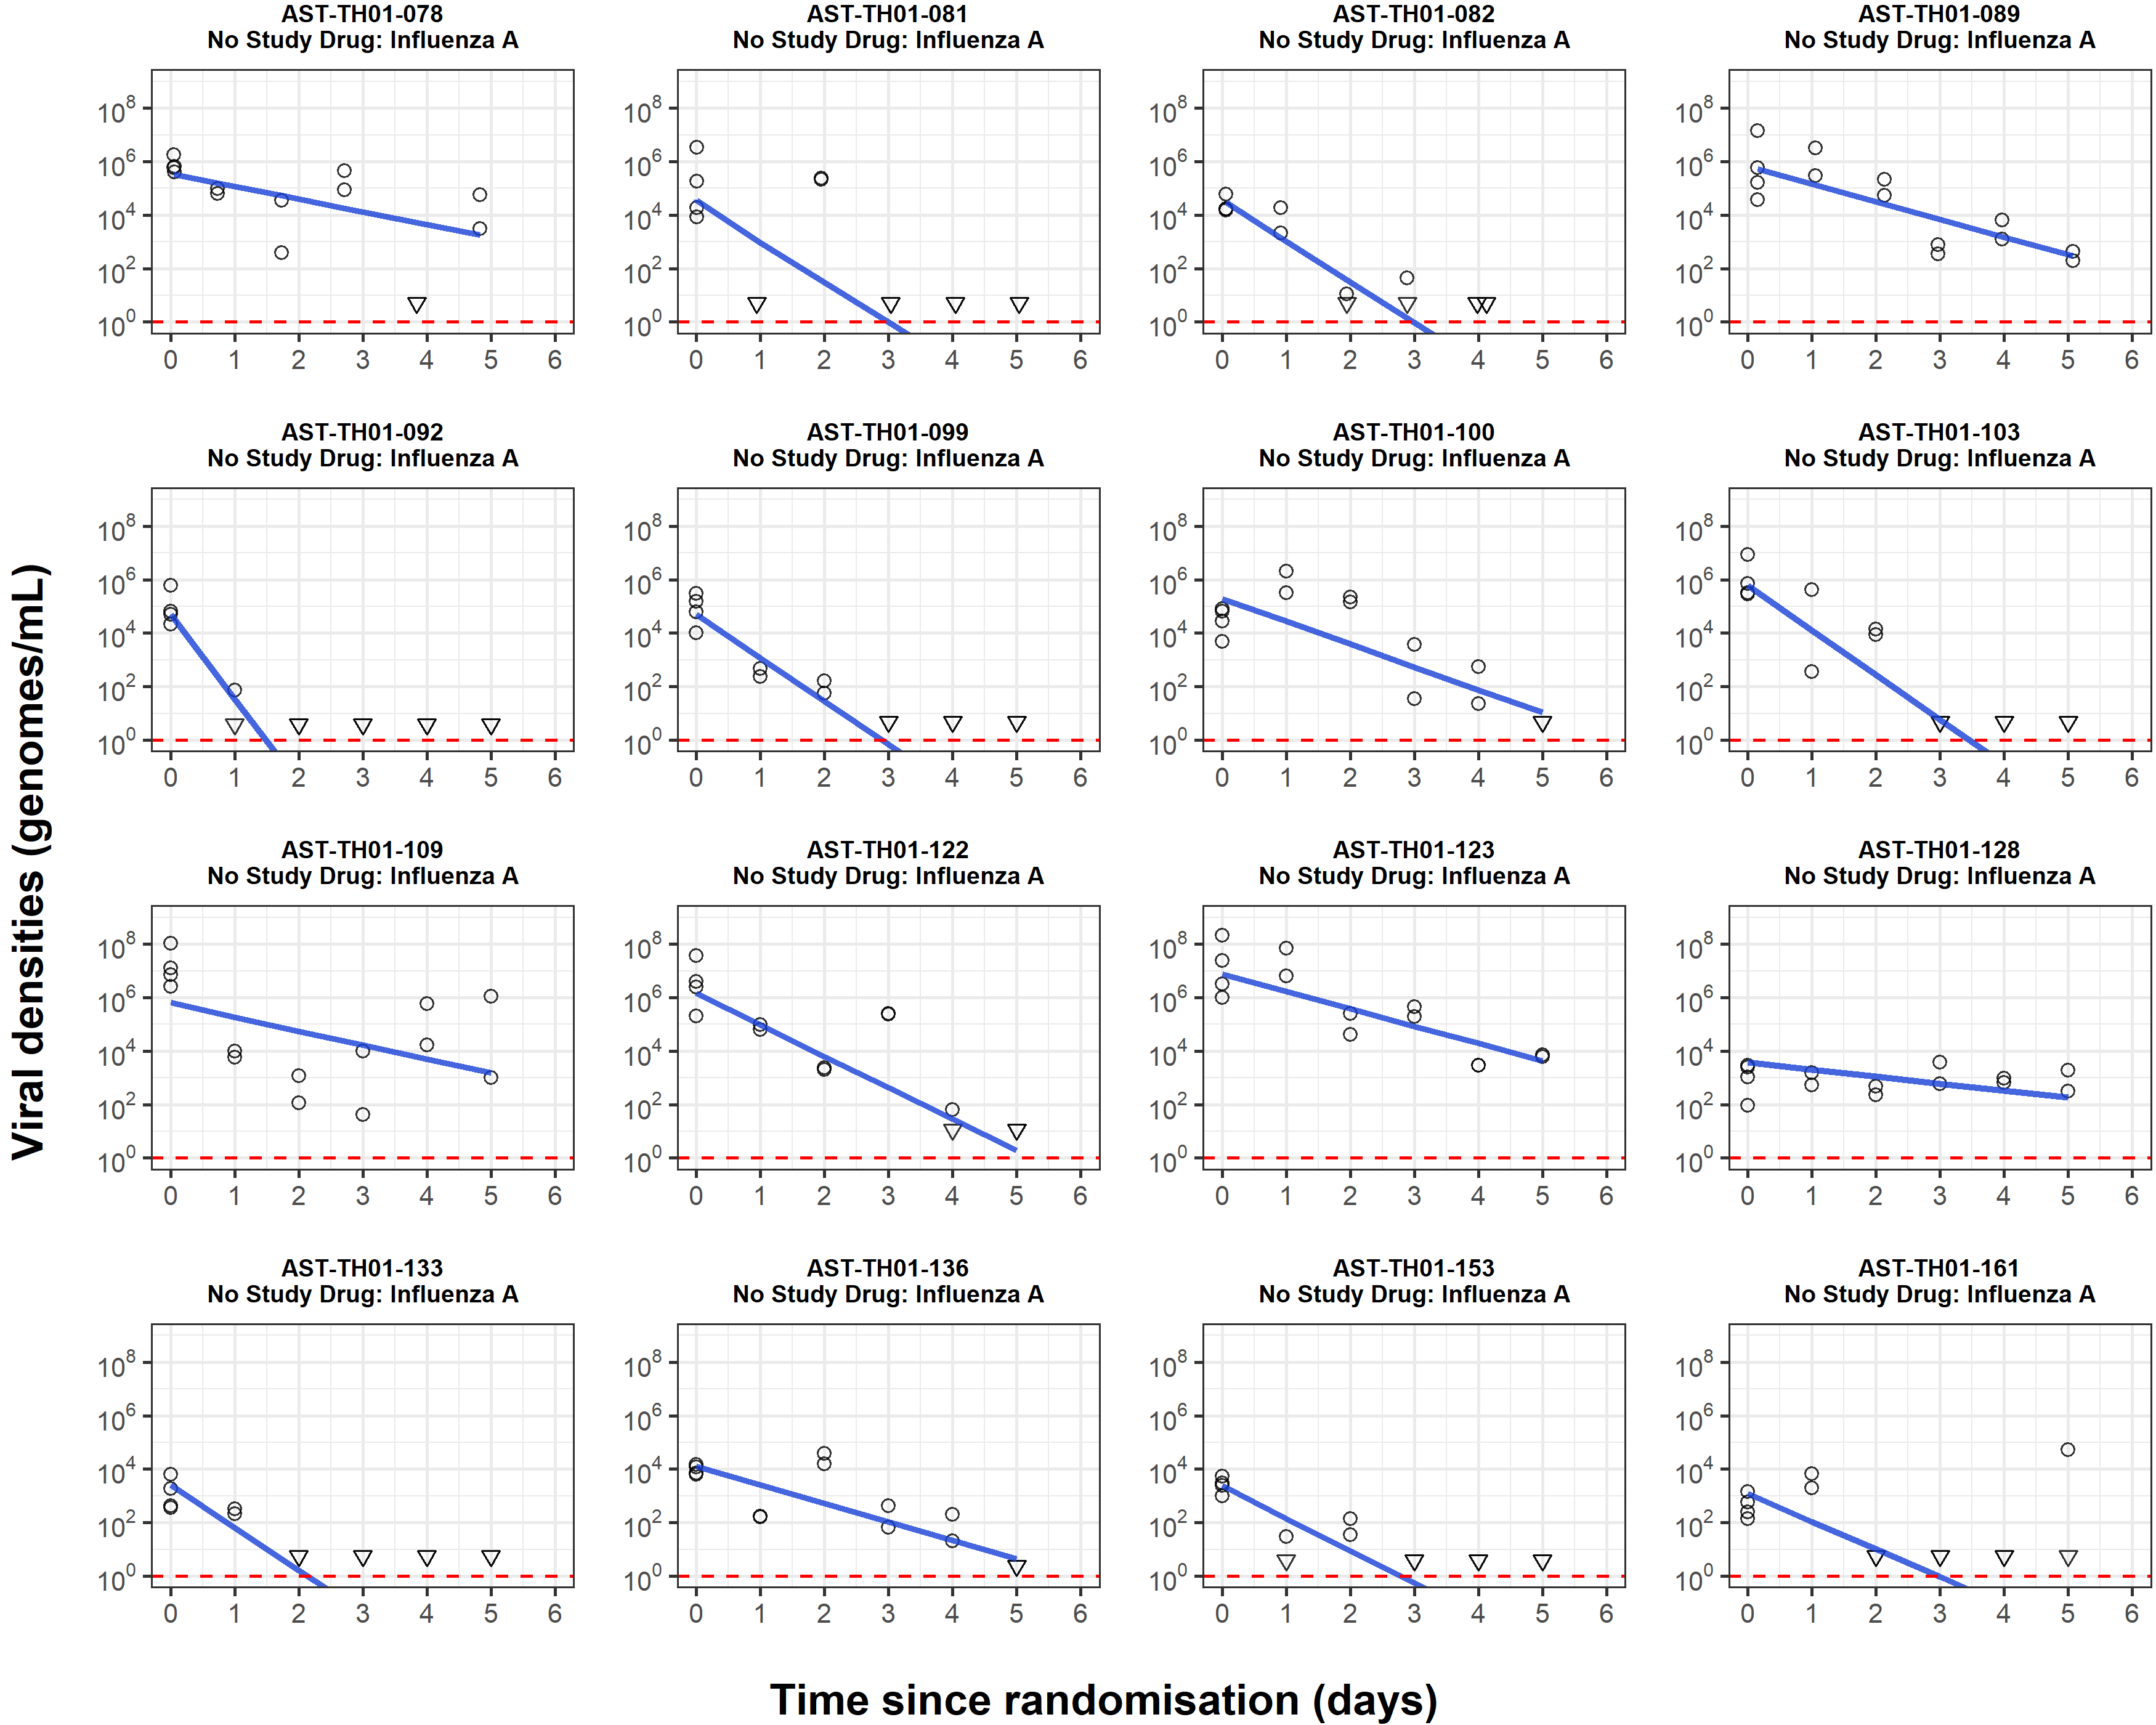

Slide 7
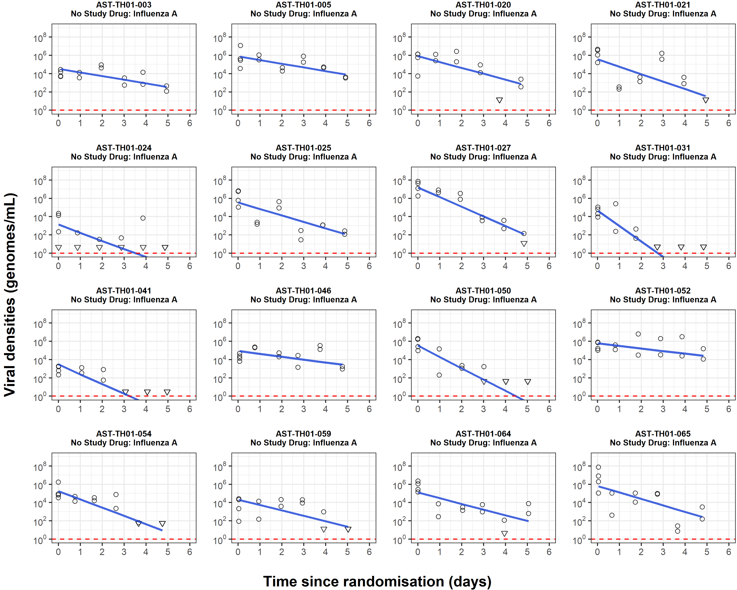

Slide 8
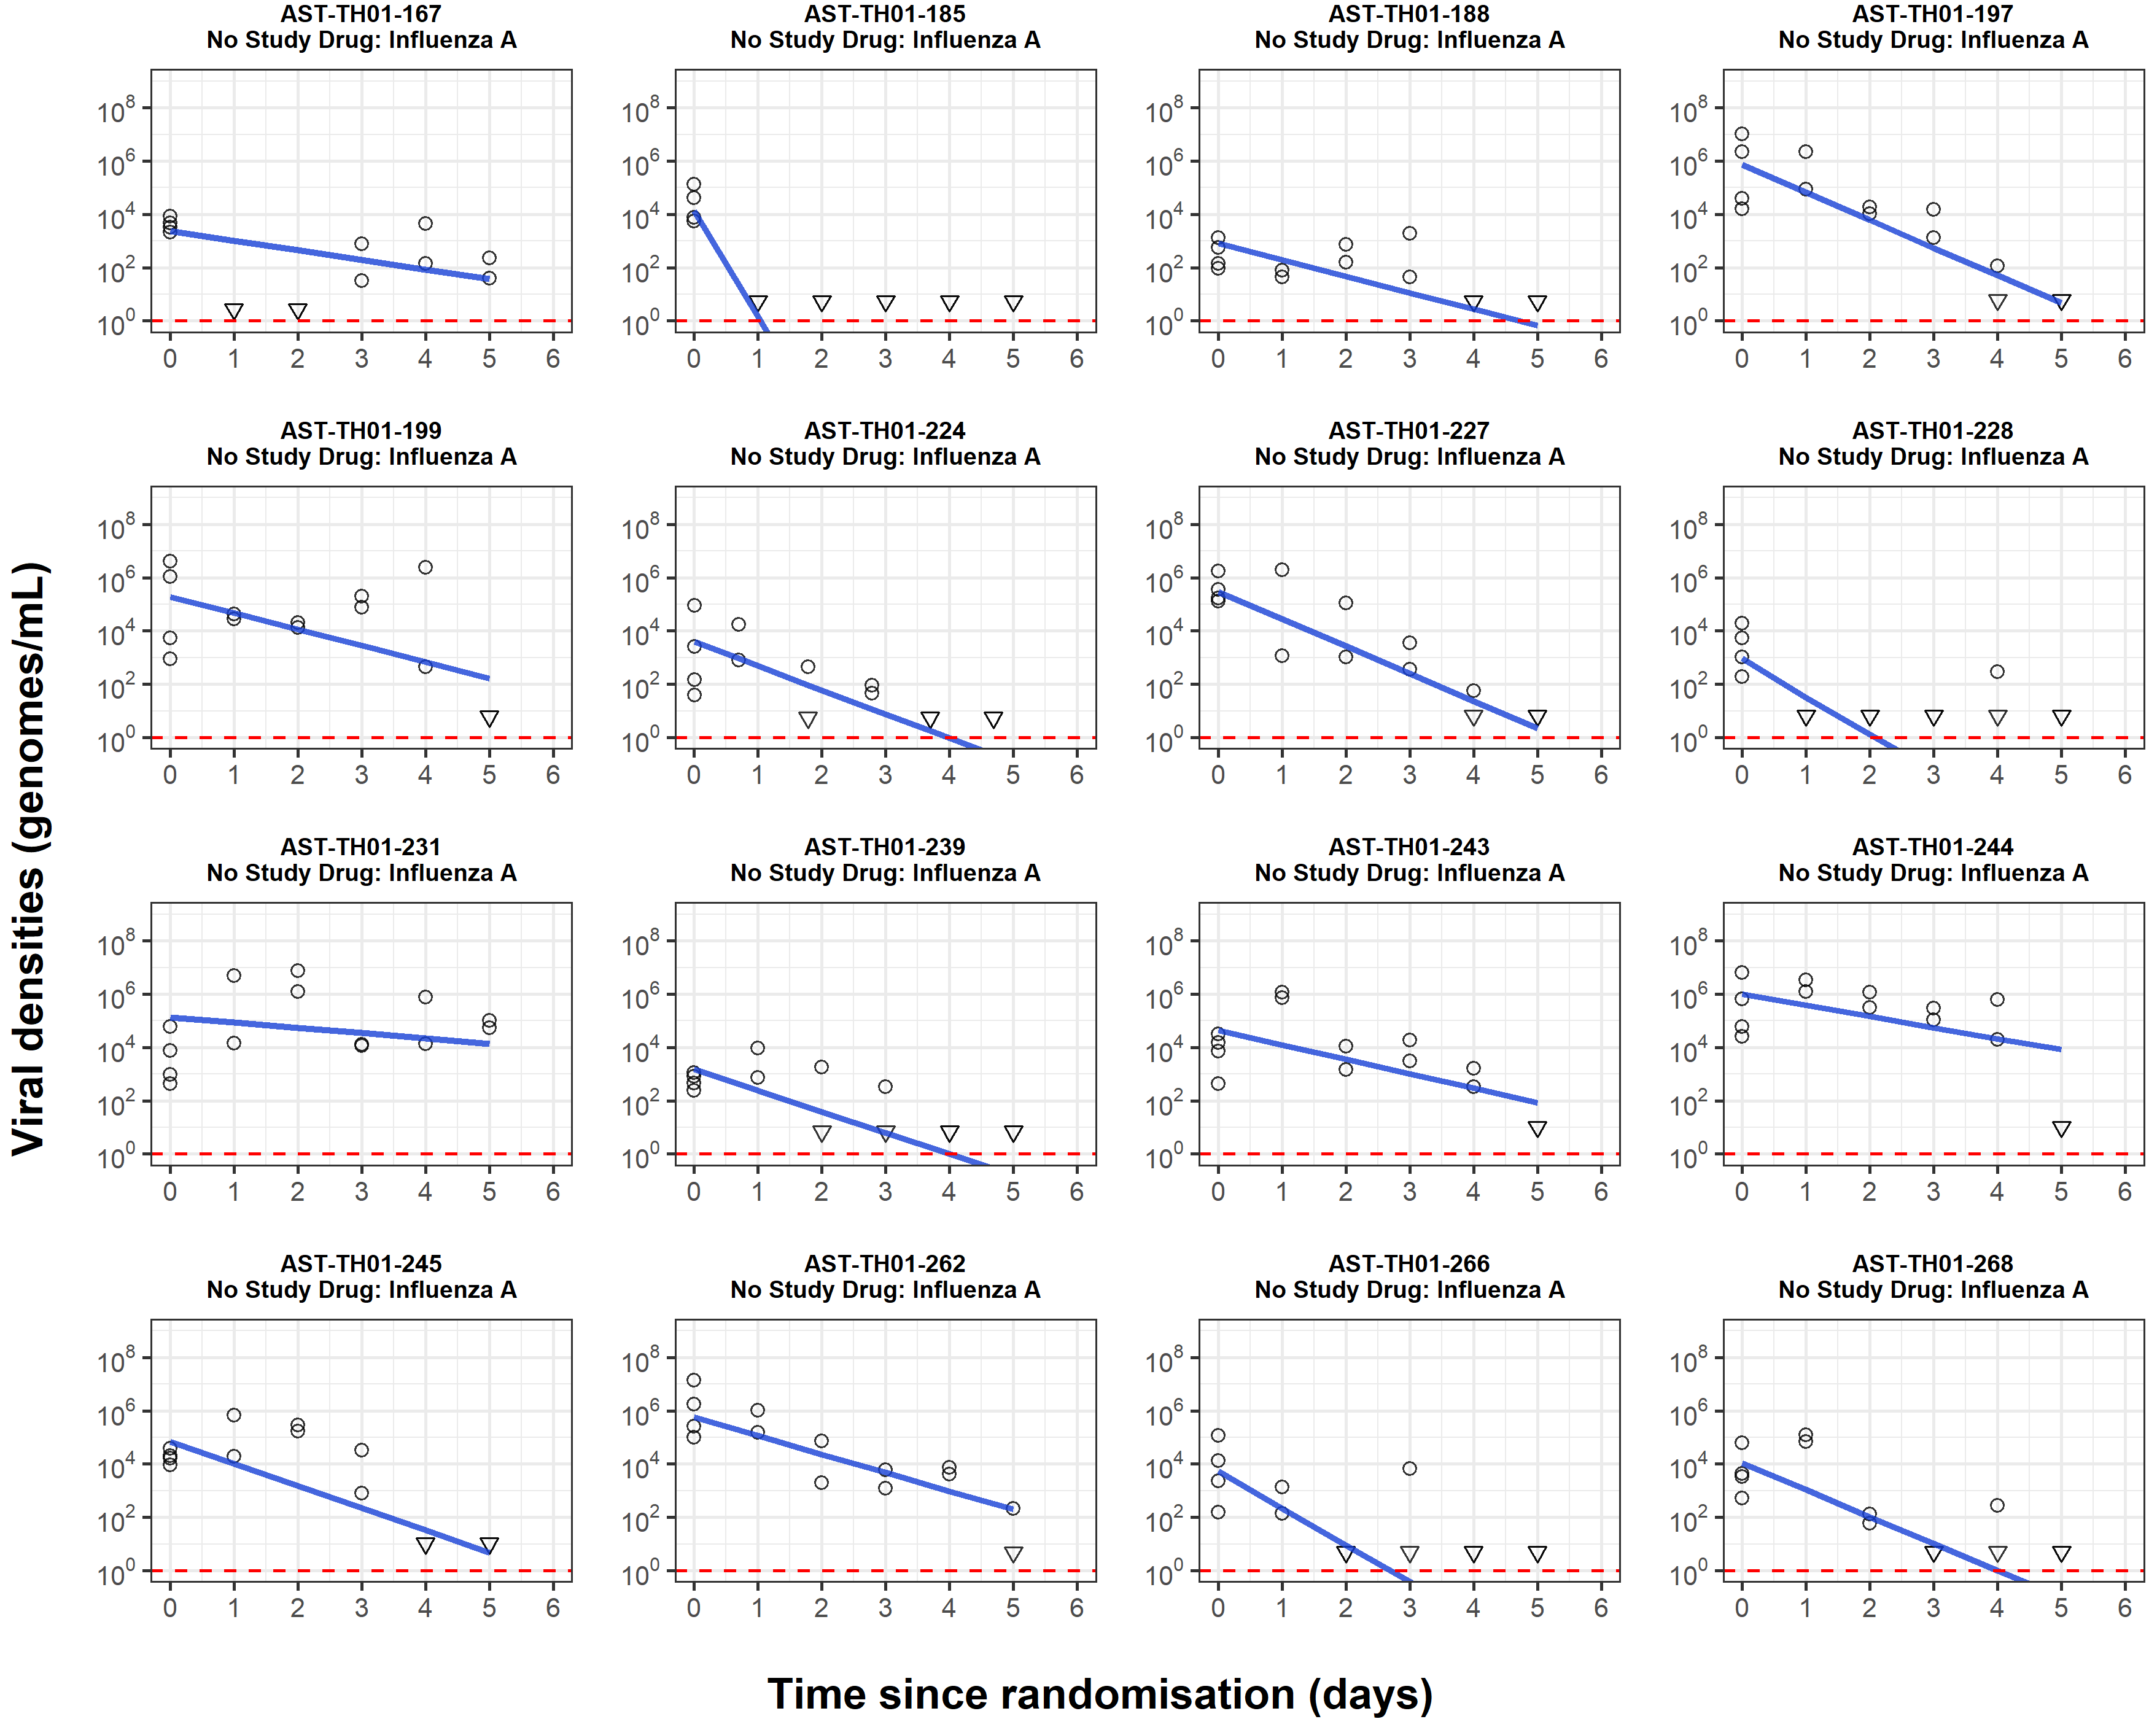

Slide 9
