Slide 1
ECONOMIC ANALYSIS FOR A CONSTRUCTION CORPORATION
Group-9: Prerit Samria
Yuheng Gao
Moath Kamli

Slide 2
OBJECTIVE
What should be made by a construction corporation on a plot of land in the city of Boston, Massachusetts to maximize their earnings?
The three alternatives that the managers came up with are:
Residential Buildings
Mall
Hotel
Notes:
THE OBJECTIVE OF THE PROJECT IS TO FIGURE OUT BEST ALTERNATIVE THAT MAXIMIZES THE CORPORATION’S EARNINGS

Slide 3
CASH FLOWS
The cost of land is a cash flow that will occur in all the alternatives. Thus, we will ignore it for our economic analysis.
The costs for constructing a building are the same. These costs are:
Plumbing
Flooring
Foundation
Roofing
Wiring
Carpentry
Heating & Cooling Systems
Notes:
FOR CASHFLOW ...
COST FOR CONSTRUCTING THE BUILDINGS ARE THE SAME ! FROM PLUMBING …..

Slide 4
ALTERNATIVE-A: Residential Buildings
Initial Investment:
It comprise of four 20-story high buildings.
The construction cost per apartment includes the cost of materials, labor, machines, and contractor which amounts to $635,000.
Thus, the total cost for building 4 such buildings amounts to $711.2 million.
Notes:
The residential buildings comprise of four 20-story high buildings. Each floor comprises of 14 four-bedroom apartments. The area of the foundation of each building is 20000 square feet. The remaining area of 20000 square feet is left for garden and roads.

Slide 5
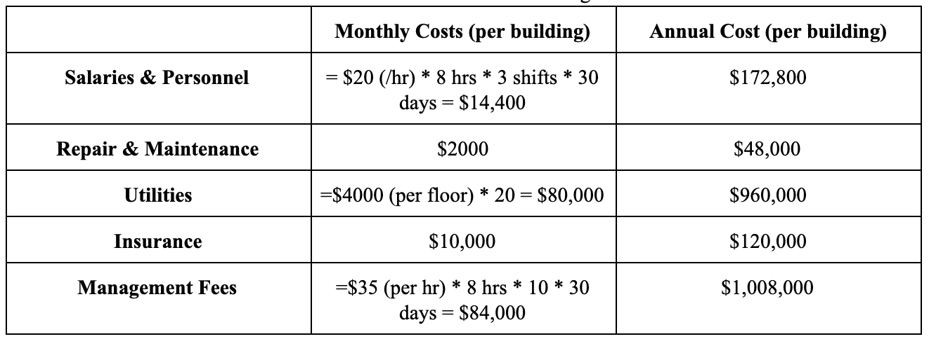
ALTERNATIVE-A: Residential Buildings
Annual Cost:
Notes:
For Repair & Maintenance: Assuming each building requires maintenance for plumbing, heating/cooling, electric appliances, etc.

Slide 6
ALTERNATIVE-A: Residential Buildings
Annual Cost:
For Marketing: The initial cost is assumed to be $8,000 per month.
Assuming that for the first 2 years, marketing is going to be 100% of the initial cost.
The marketing cost would decrease in the future.
The marketing rate is assumed to be fixed at 70% of the initial cost from year-3 onwards. The Annual cost (per building) for marketing = $8,000* 12 = $96,000.
Notes:
The marketing cost would decrease and is assumed to remain fixed after the end of year-2 since only a few apartments would be vacated each year. Also, the marketing would be done by word of mouth of the occupants who would talk to their friends, colleagues about the apartments.

Slide 7
ALTERNATIVE-A: Residential Buildings
Annual Revenue:
All the apartments are leased on a yearly basis.
The rent for each apartment is $5600 per month. Thus the ideal total Annual revenue amounts to:
$5600 * 14 apartments (per floor) * 20 floors * 4 buildings * 12 months = $ 75,264,000.
We take the occupancy rate into account to calculate the total annual revenue.
Assume that for the first 2 years, the occupancy rate is 50% and 70% respectively, and for the subsequent years, the occupancy rate is assumed to be 100%
Notes:
Two types of cash flows are considered: Uniform & Geometric. The geometric rate is fixed at 2% annually.

Slide 8
ALTERNATIVE-B: Mall
Construction
Mall
90,000 sqft. X 3 Floor → 270,000 sqft Mall Area
33.33% Public Area → 180,000 sqft. Pure Store Area
Garage
90,000 sqft Basement Garage
Notes:
For the Alternative B, we are building a mall.
It contains 3 floors of store of total 270,000 sqft
And a basement garage of 90,000 sqft
The mall itself has three floors, 90,000 sqft each, and we have a total area of 270,000 sqft of Mall area.
Considering 33.33% area as public area, we have left with 180,000 sqft of pure store area.
And on the basement floor, we are using the whole floor and build it as a garage as convenience for parking and also make money from that.

Slide 9
ALTERNATIVE-B: Mall
Initial Investment:
Mall
27,000 sqft. X ($200(M) + $250(L)) = $121,500,000
Garage
90,000 sqft. X ($30(M) + $30(L)) = $5,400,000
Total Initial Investment of Mall Project: $121,500,000 + $5,400,000 = $126,900,000
Notes:
The Initial Investment is calculated based on the area multiply by the material and labor fee,
with the same calculation done to the garage but with much cheaper material and labor fee per area,
And we have the initial investment amount of 126 M 900 thousand dollars

Slide 10
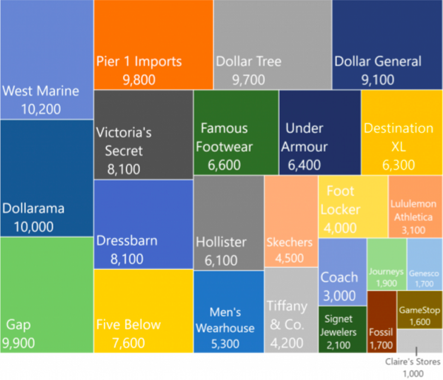
ALTERNATIVE-B: Mall
Regulation: Area of Store
Unit Store Area: 2000 SF
1 Unit: GameStop, Fossil
2 Unit: Tiffany & Co., Foot Locker
3+ Unit : Under Armour, Victoria’s Secret
https://www.camoinassociates.com/average-square-footage-and-retail-sales-square-foot-across-major-brands
Notes:
After the construction and calculating the initial investment,
we have to know how to earn the money back by renting the stores and garage.
So we found a graph of the average size of each retail store.
After consideration, we decide to make the unit store as 2000 sqft.
So that the small retailer stores like GameStop and Fossil can be fit in one unit store.
Medium stores like the Tiffany & Co. and Foot Locker can be fit in two unit stores.
Large stores like Under Armour and Victoria’s Secret would take multiple stores at the same time.

Slide 11
ALTERNATIVE-B: Mall
Revenue
Number of Unit Stores:
18,000 sqft. / 2000 = 90 Unit Stores
Revenue from Mall:
$2,000 sqft. X $50/sqft/mon X 90 Unit Stores = $108,000,000
Revenue from Garage:
$100,000*12 = $1,200,000
Total Annual Revenue: $9,000,000 + $1,200,000 = $109,200,000
https://www.loopnet.com/for-lease/boston-ma/generalretail/?sk=b10cc19dbdd6ac99013f89318e4a1cc7
Notes:
And then let’s talk about the revenue.
One thing I need to clarify before we talk about the revenue is that our revenue only comes from the rent from stores and garage in a yearly contract, so the revenue and cash flow of the individual stores does not mess with our calculation.
According to the market price, our retail store is rent $50/sqft/month, so after calculation, our annually revenue from the mall is $108 million
And for the garage, we just rent it for $100 thousand per month and it’s 1.2 M per year.
So the total annual revenue is $109 M 200 thousand.

Slide 12
ALTERNATIVE-B: Mall
Cost & BTCF
Utility: (270,000 * 33.33%) * $80 + 90,000 * $1.6 = $7,344,000
Salary of Personnel: [( 4 + 1 ) * 3 + 2] * $5000 = $85,000
Repair & Maintenance: $10,000
Management Fee: 3 * $7000 = $21,000
Insurance: $30,000
Annual Cost : $7,490,000 * 12 = $89,880,000
TOTAL Mall Project BTCF: $109,200,000 - $89,880,000 = $19,320,000
Notes:
The cost of the mall will also be calculated only in the public area.
It contials utility, salary of personnel and security, Repair & Maintenance, Management Fee, and the Insurance.
So the Annual Cost is around 90 million dollars.
And we subtract that from the revenue, and get the BTCF of $19 M 320 thousand per year.
For the utility, we multiply the public area by the average rate ($80 / sqft) plus the fee from the garage($1.6 / sqft) and can be calculated as (270,000 - 180,000) * $80 + 90,000 * $1.6 = $7,344,000.
For the Salaries of the personnel, we decide to hire 4 security and 1 cleaner per floor, and extra two that can be responsible to go around the shopping mall as well as the garage. So the cost of paying the salaries is [( 4 + 1 ) * 3 + 2] * $5000 = $85,000.
For the repair and maintenance, it is assumed to be $10,000.
For the management fee, we decide to hire one manager per floor and resulting in a cost of 3 * $7000 = $21,000
The insurance is estimated to be $30,000 per month.

Slide 13
ALTERNATIVE-C: HOTEL
The hotel is a 20-story building, 200 rooms in total with a pool, restaurant, and 4 conference halls. The building occupies about 70% of the land, which is 70,000 square feet. The rest of the area is assigned for parking and garden.
Notes:
Is the third alternative in our project IS A HOTEL which it’s assumed to be 20 story with 200

Slide 14
ALTERNATIVE-C: HOTEL
Initial costs
The total initial cost for construction is $114,600,000.00 considering the following factors (amount per floor):
Cost of Materials = $1,900,000
Cost of Labor = $1,600,000
Cost of Machines = $970,000
Cost for Contractor = $1,260,000
Thus, initial cost (per floor) = $5,730,000

Slide 15
ALTERNATIVE-C: HOTEL
O&M / REVENUE
Monthly wages totals to $250,650
O&M cost on average $200,000/month (considering peak and off seasons)
Total expenses including insurance, marketing $7,207,800 Annually
Total revenue per year reach up to$22,500,000 and a net revenue of $15,292,200
Notes:
Wages: managers, desk clerks, restaurants workers, guards, and recreation staff.
As per the cost and maintenance they are considered to be high in hotels to increase the quality and customers satisfaction.
Marketing and insurance are two of the most important aspects the business so they are considered high.
Taking into account that in the peak season the rent per room is going to be $550 while the off season it costs $250 per room per night

Slide 16
PLANNING HORIZON
The initial investment is very high for the project.
The discounted payback period would be around 20 years.
So for the corporation to make profits, the planning horizon should be greater than 20 years.
Thus, the planning horizon is assumed to be 30 years.
Notes:
Connect the dots

Slide 17
REGRESSION MODEL
The two types of regression model we have used are Linear & Exponential Regression.
For Residential Buildings
Exponential Regression:
Rent: Y = a * b ^ X,
where X = t- 1
Y = rent for next year
a = rent for year-1
b = Increase rate
Notes:
Yuheng:
The two types of regression model we have used are Linear & Exponential Regression.
Take the Residential Building as an example:
For the Exponential Regression:
Rent is the rent multiply by rent increase to the power of year -1

Slide 18
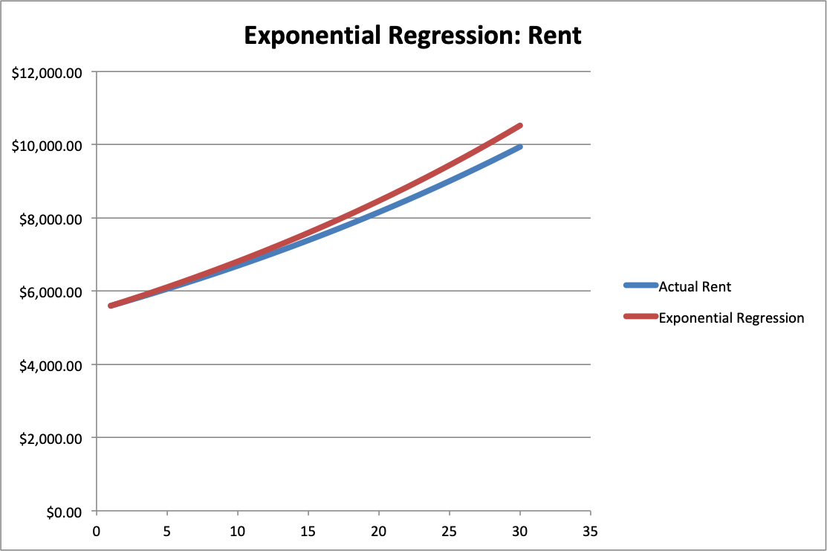
Notes:
Yuheng:
And we put our actual rent and exponential regression into comparison and got this graph.
Our actual Rent is based on 2% geometric increase with the first month rate $5600 shown as the blue line and it reaches about 10 thousand at the end of 30 years.
From the data we had, we got an exponential regression, the A is $5600 as the initial rent, and B is 1.022 as a increase rent of 2.2%.
And we can see the difference of the rent after 30 years.

Slide 19
REGRESSION MODEL
Linear regression:
Rent: Y = a + b*X,
where X = t - 1
Y = rent for next year
a = rent for year-1
b = Increase per year = $100
Notes:
Yuheng:
For the linear regression model, we assume the rent of the next year to be
the current rent plus the rent increase per year multiply by the year -1, here we assume the rent increase to be $100 per year
Combining with our actual rent, we have this graph

Slide 20
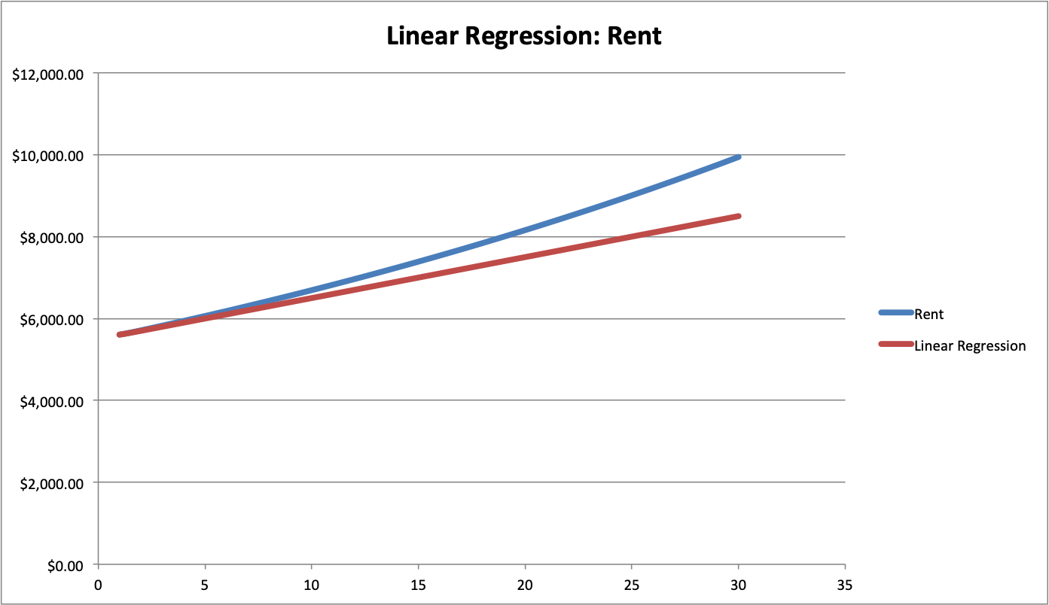
Notes:
Yuheng:
The blue line showing our actual rent is the same as what we have in the previous graph.
And the red line is the a linear regression with A being the first month rate $5600 and B being $100 dollars.
After 30 years we can see the huge difference between them. And in order to make enough profit, we need to be stick to our geometric increase rent plan.

Slide 21
WACC
Percentage
The different resources used are:
Loan 30%
Common Stock 40%
Preferred Stock 20%
Retained Earnings 10%
Notes:
Yuheng:
In In order to obtain the capital of our initial investment, we used the following different resources:
We decide to get 30% from the Loan, 40% from the Common Stock, 20% from Preferred Stock, and 10% from the Retained Earnings.

Slide 22
WACC
Cost of Capital
Loan: The interest rate is assumed to be 5% compounded annually from the bank. So, the effective rate is 5.00%
Common Stock: The dividend per share (CSD) is $5, the current trading price per share (PCs) is $100, & the growth rate is assumed to be 4%.
Preferred Stock: the dividend per share (PSD) is $7, the current trading price per share (PPs) is $100, & the Cps is $1.
Notes:
Yuheng:
This is the detailed distribution of the loan, common stock, and preferred stock,
and we can use them to calculate the Cost of Capital.
The cost of capital can be calculated:
For the loan, it’s effective rate multiplied by the 1 - 40% itr and gives 3%
For the Common Stock, its CSD / PCs + growth rate and gives 9%
For the Preferred Stock, it’s PSD / (PPs - Cps) and gives 7.0707%

Slide 23
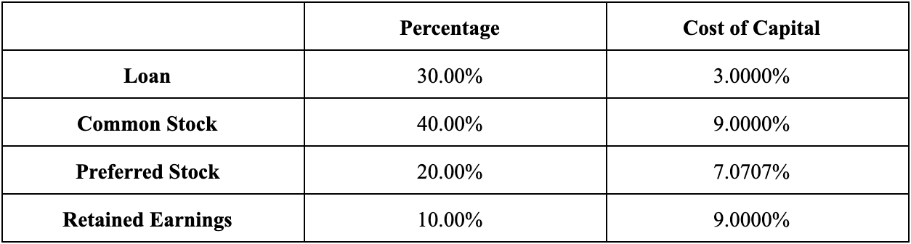
WACC & MARR
WACC = 30% * 3% + 40% * 9% + 20% * 7.0707% + 10% * 9% = 6.81414%
Profit margin = 2%
BTMARR is 6.81414% + 2% = 8.81414%
ATMARR = BTMARR * (1 - itr ) = 5.28848%
Notes:
Yuheng:
And now we can calculate the WACC as the summation of the product of percentage and cost of capital.
Plus the profit margin of 2%, we have the Before Tax MARR of 8.81414%
The after tax can then be calculated by BTMARR x (1-itr) and gives 5.28848%

Slide 24
PAYBACK METHOD
We have used Plan-3 & Plan-4 for paying back the loan.
The Lender’s rate is 5% compounded annually and the ATMARR is 5.28848%, which is equal to TVOM for us.
Thus:
if the lender's rate < TVOM, use plan-4 for borrowing.
if the lender's rate > TVOM, use plan-3 for borrowing.
Notes:
We already know that if the leander’s rate is less than the time value of money, we are benefiting more and thus choosing plan 4 is the wise decision to make. And on the contrary if the leader’s rate is more than the time value of money to than plan 3 should be considered to mitigate the interest rate that accumulates over time .

Slide 25
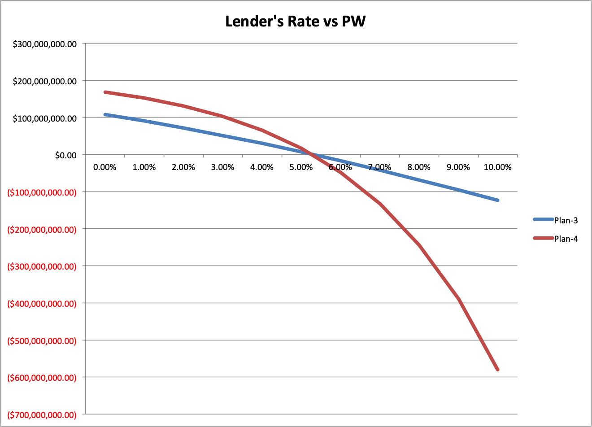
Notes:
Since the lender’s rate (5%) is less than the TVOM (5.29%), thus it is better for us to use Plan-4 for paying back the loan.
It means that the present worth would be greater if we use Plan-4 for paying back the loan rather than using Plan-3.
M

Slide 26
PAYBACK METHOD
Since the lender’s rate (5%) is less than the TVOM (5.29%), thus it is better for us to use Plan-4 for paying back the loan.
It means that the present worth would be greater if we use Plan-4 for paying back the loan rather than using Plan-3.

Slide 27
DEPRECIATION
Two depreciation methods used in the project are Straight Line Depreciation (SLN) & MACRS-GDS.
The residential building is considered to be a 27.5-year residential rental property with mid-month convention and the mall & hotel are considered to be 39-year nonresidential property with mid-month convention.
We are assuming that the salvage value is a constant value and is equal to 30% of the initial investment.
Notes:
Say these two points only here !
Using SLN & MACRS-GDS methods we calculated the depreciation for all 3 properties. After the 30 years planning horizon the salvage value is to be considered 30% of the initial investments in all three alternative.

Slide 28
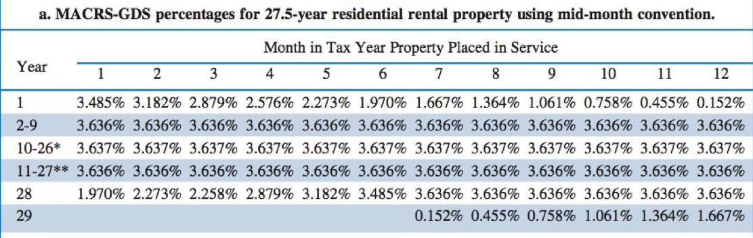
DEPRECIATION
*even-numbered year
** odd-numbered year
Notes:
Since the residential building are considered a 27.5 years residential rental property, it is fully depreciated by the end of the planning horizon !

Slide 29
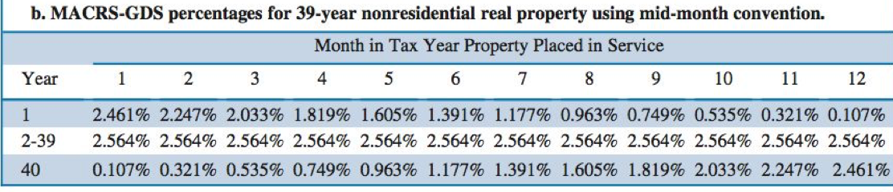
DEPRECIATION
Notes:
As per the Hotel and Mall are considered to be a 39-years non residential properties we used this table to calculate the depreciation and they are not fully depreciated.
KEEPING IN MIND THAT THE LANDS DOES NOT DEPRECIATE!

Slide 30
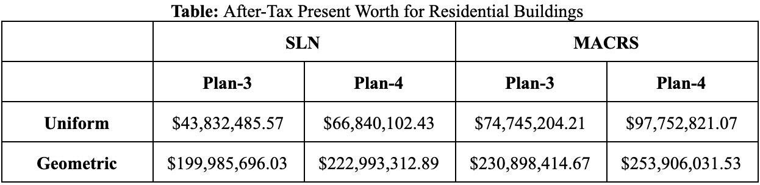
ECONOMIC PERFORMANCE
We use Present worth (PW) & Internal Rate of Revenue (IRR) as evaluation methods for after-tax analysis.
Notes:
Prerit

Slide 31
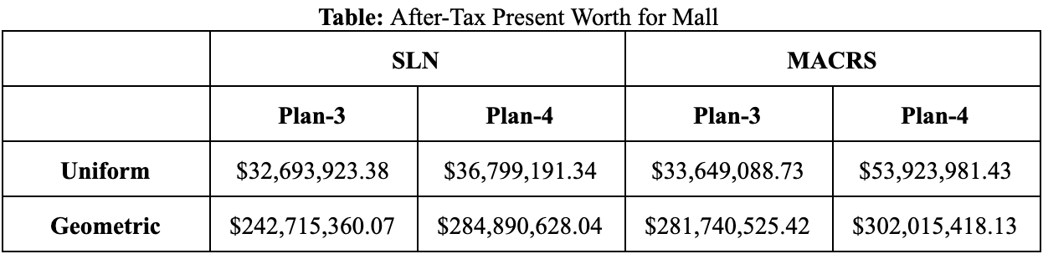
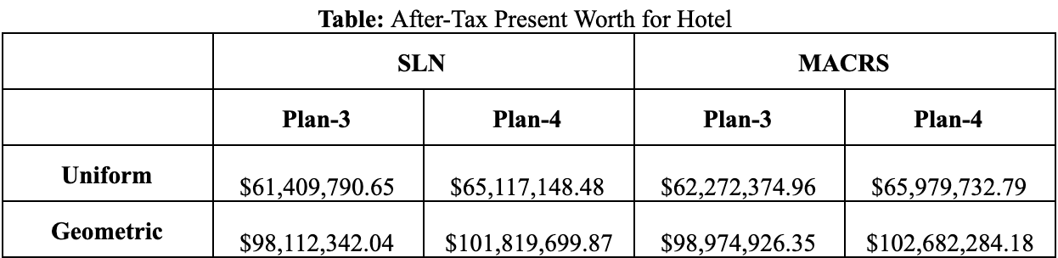
ECONOMIC PERFORMANCE

Slide 32
ECONOMIC PERFORMANCE
We observe the following:
Since lender's rate < MARR, thus we prefer to use Plan-4. Thus, the Present Worth calculated for Plan-4 is greater than the one for Plan-3.
The Present Worth for Geometric CF is greater than the Uniform CF. This is expected since the revenues are greater in geometric CF.

Slide 33
SENSITIVITY ANALYSIS
The sensitivity analysis is done for only Residential Buildings.
The 4 inputs taken into consideration are:
the initial investment
the marketing rate
the geometric increase rate
the rent (per apartment per month) in year-1

Slide 34
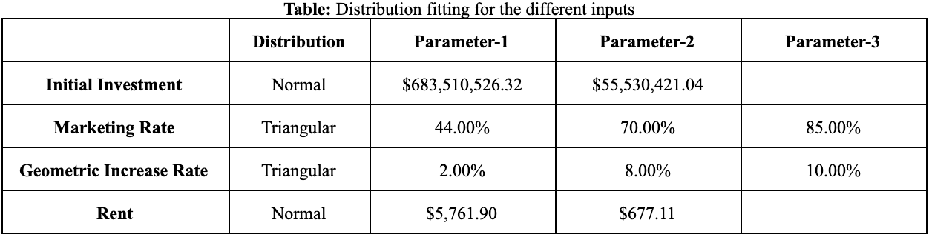
SENSITIVITY ANALYSIS
Notes:
$5761.90

Slide 35
SENSITIVITY ANALYSIS
Risk Analysis:
The outputs for the risk analysis are PW, IRR & Bonus. The simulation is run for 5000 iterations.
Notes:
A simulation tells us the likelihood of meeting the objectives. Assumed Bonus limit to be $800 millions

Slide 36
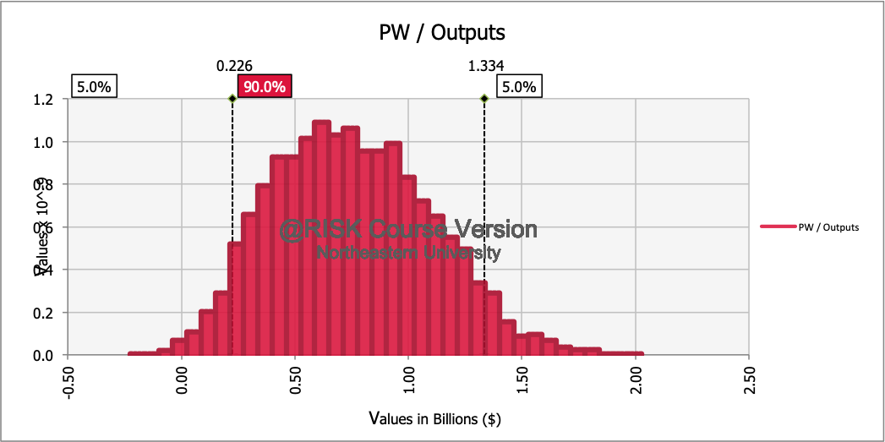
SENSITIVITY ANALYSIS
Notes:
For 90% Confidence interval, the PW lies between around $230 millions & $1.3 billions. Other values could be considered as outliers and can be discarded.

Slide 37
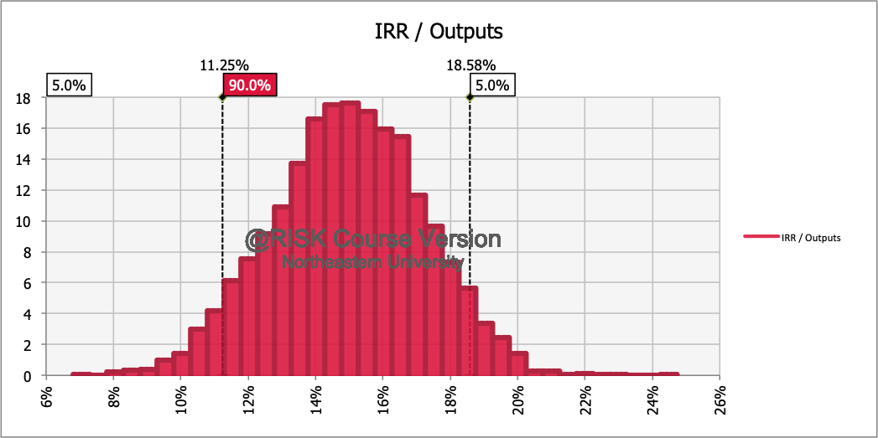
SENSITIVITY ANALYSIS

Slide 38
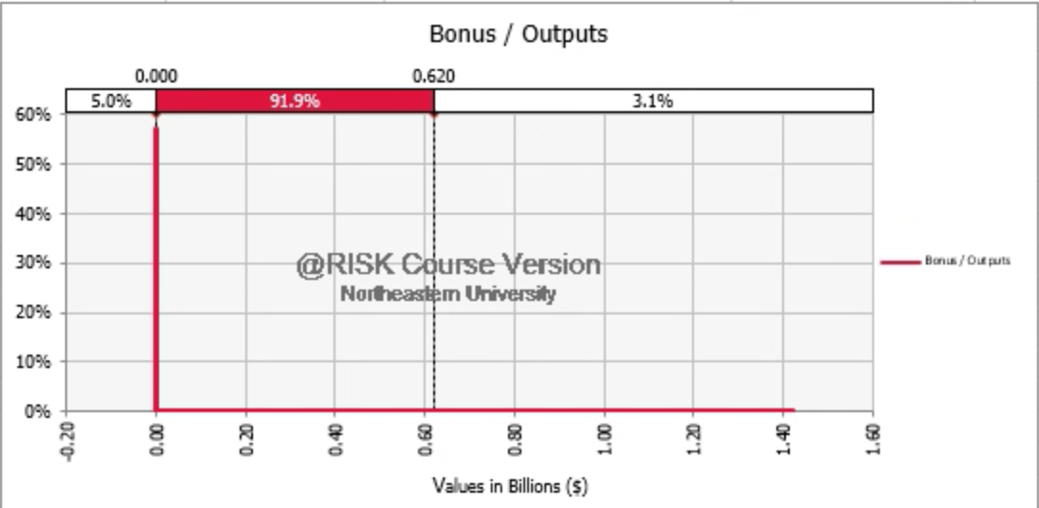
SENSITIVITY ANALYSIS
Notes:
Risks and returns are +vely correlated. Since the returns are high, the risks are also high. THus the probability of making a profit = 0 is about 58%.

Slide 39
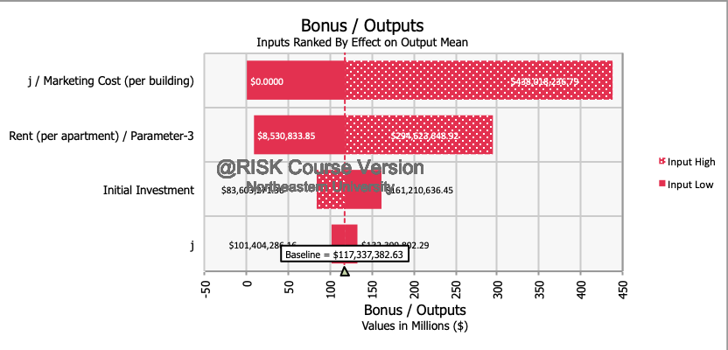
SENSITIVITY ANALYSIS
Notes:
The 4 uncertain inputs have the largest effect on bonus/profit. We ran the simulation for 5000 iterations as before.
This is the tornado chart. It is called a tornado chart because the longest bars are at the top of the chart. The longer the bar, the more effect this uncertain input has on profit.

Slide 40
AHP ANALYSIS
We have taken four factors into consideration to compare the three alternatives.
In AHP Analysis: for each row, Priority Vector = Average of the individual cells in the row divided by the sum of each column.

Slide 41
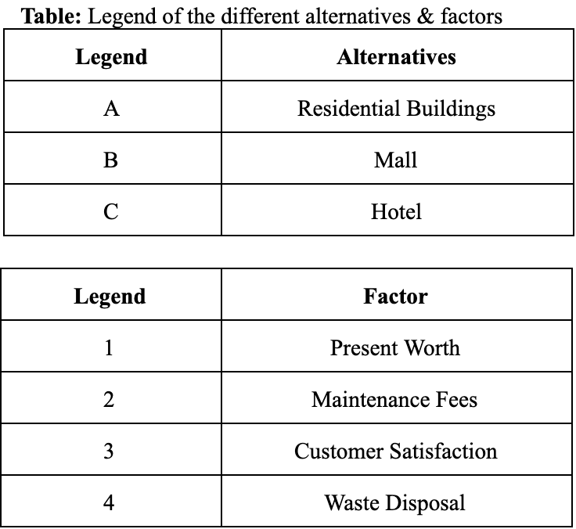
AHP ANALYSIS

Slide 42
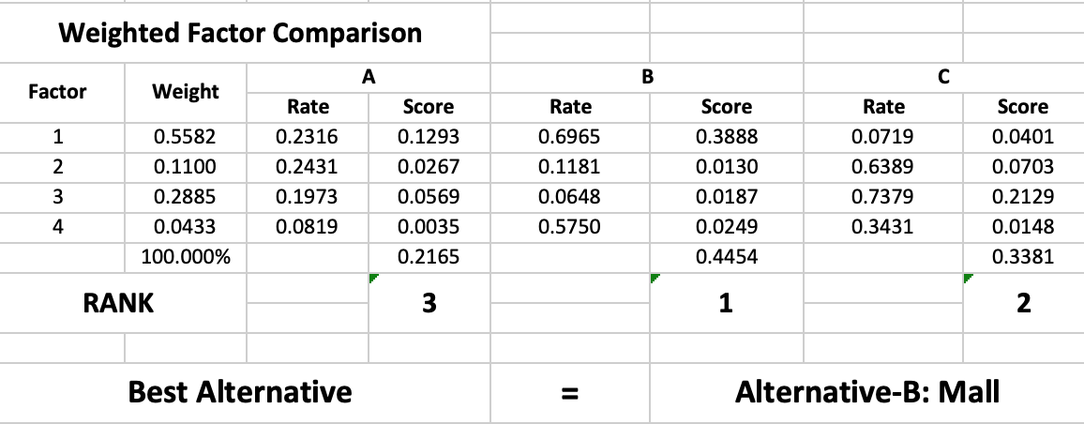
WEIGHTED FACTOR COMPARISON
Rate (i) = the priority vector of each alternative wrt the factor (i)
Score (i) = Weight (i) * Rate (i)
Total Score = summation of all score (i)

Slide 43
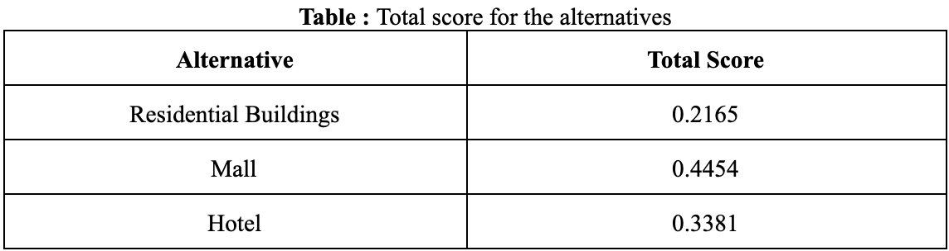
WEIGHTED FACTOR COMPARISON
Highest total score is for Mall.

Slide 44
CONCLUSION
It is the most beneficial for the corporation to construct a Mall, followed by a Hotel, & then Residential Building.

Slide 45
THANK YOU
Any Questions?

Slide 46
