Slide 1
Pandas

Slide 2
What is Pandas ?
It is an open source library built on top on numPy
It allows fast analysis and data cleansing and preparation
It excels in performance and productivity
It has built in visual features
It can work with wide variety of sources.
conda install pandas
pip install pandas

Slide 3
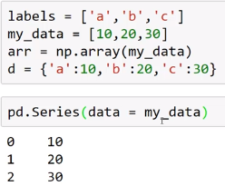
Series-1
import numpy as np
import pandas as pd

Slide 4
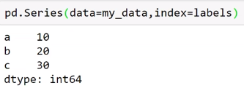
Series-2
Below are the labeled index and data series.
Try : pd.series(d)

Slide 5
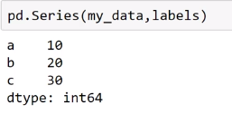
Series-3
Below are the labeled index and data series.
try : pd.Series([1,2,3,4],[‘USA’,’Germany’,’Russia’,’Japan’])
You can perform the same numpy level of operations on Series also
try : Adding two series - series1 + series2

Slide 6
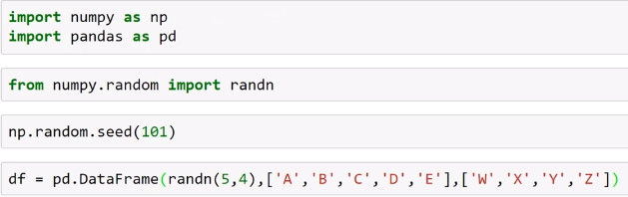
Data Frames -1
DataFrame is a kind of excel styled arrangement of data. But the interesting thing about it is – it serves as a data container object.
Check it out the output looks like excel spreadsheet.

Slide 7
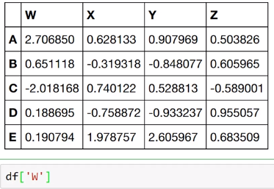
Data Frames -2
So below is the display of the spreadsheet type.
We can display one column data as follows…try it.

Slide 8
Data Frames -3
Try the following outputs:
type(df[‘W’])
type(df)

Slide 9
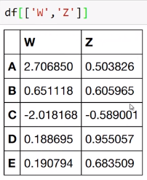
Data Frames -4
Try the following outputs:
type(df[‘W’])
type(df)
To display two data use the columns index as a list :

Slide 10
Data Frames -5
Try the following outputs:
type(df[‘W’])
type(df)
To display two data use the columns index as a list :

Slide 11
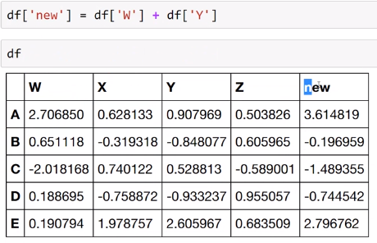
Data Frames -6
We can perform arithmetic operations on the existing as well as new columns. Where we can create new columns like below :

Slide 12
Data Frames -7
Based on the dataframe which was already created. Let us see “df.” and check what all options will show up.
Guess about df.drop(‘new’)
What is the output, does it really drop a column ?
df.drop(‘column’,axis=1) ...

Slide 13
Data Frames -8
df.drop(‘E’) - Does it drop row ‘E’
df.drop(‘E’,axis=0) – Check what it does ?
Why is axis=0 for rows and axis=1 for column deletion.

Slide 14
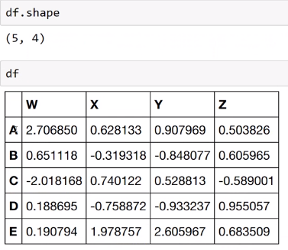
Data Frames -9
df.shape defines the numpy array definition over data frame.

Slide 15
Data Frames -11
df.loc[‘A’] defines the series array row display.
Try the following below :
df.iloc[1] defines the index location of the series row display.
df.drop(‘new’,axis=1,inplace=True)
df > 0 shows Boolean dataframe which is useful for getting the values.
booldf = df >0
df[booldf] …. Shows interesting results.

Slide 16
Data Frames -12
df[‘W’] > 0
df[df[‘W’]>0]
df[(df[‘W’]>0) and (df[‘Y’]>1)] – this is tricky , you should use & operator.
For or operator use | symbol.
df.reset_index()

Slide 17
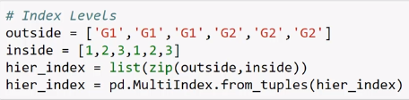
Data Frames -13
Here let’s go line by line in the below example, zip converts two lists into a tuple and MultiIndex will convert into a pandas data frame.
df=pd.DataFrame(randn(6,2),hier_index,[‘A’,’B’]) , creates a hierarchical data frame.
Df.loc[‘G1’].loc[1]
Df.index.names[‘groups’,’nums’]
Df.loc[‘G1’].loc[1][‘B’]
Df.xs(‘G1’)
Df.xs(1,level=‘nums’)

Slide 18
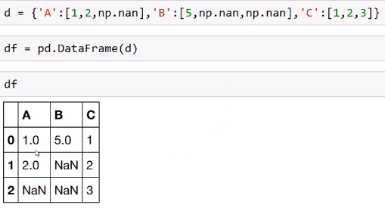
Missing Data
Missing data is all about what we do if a data value in a dataframe is NaN (or) null or missing.
Lets create a DataFrame like below :
It’s a dictionary with letters as keys and lists as values with null values party of the list data.

Slide 19
Missing Data
Now ,let’s try the following commands :
df.dropna()
Check what values are dropped in the pandas.**try shift+tab
Now what happens if we type the following below :
df.dropna(axis=1)
df.dropna(thresh=2)
df.fillna(value=‘FILL VALUE’)
Check these interesting outputs , will be helpful as we go.

Slide 20
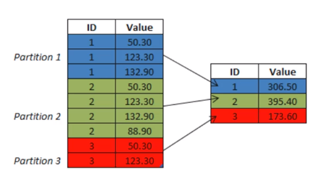
Groupby
So Groupby method is similar to our SQL statements Groupby clause where we can run an aggregation function on Groupby.
Let me explain some SQL to understand better.

Slide 21

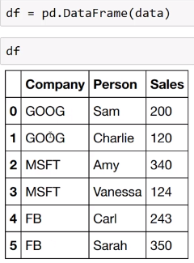
Groupby
So let me create a data frame with strings and lists like below and flip into a dataframe.Let’s use this dataframe to play groupby.

Slide 22
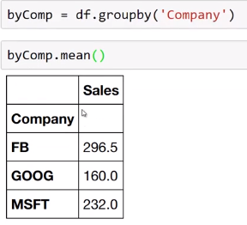
Groupby
Cool part is like in SQL aggregation functions ,we can try around any of the aggregation function like below with groupby
Try around various different aggregation functions in this exercise…
sum(),std(),count(),max(),describe(),transpose() try exclusive counts of a company.Try group by company and max function

Slide 23
Merging ,Joining and Concatenating
Concatenation : It basically glues all the DataFrames.Keep in mind that the dimensions should also match the axis you are concatenating.
Eg : pd.concat([df1,df2,df3],axis=1)
Merging: This is similar to Merge SQL statement , let us see some examples too.
Joining: Joining is a convenient method for combining the columns of two potentially different-indexed DataFrames into a single resultset DataFrame.
We will see it further in the examples which I will show.

Slide 24
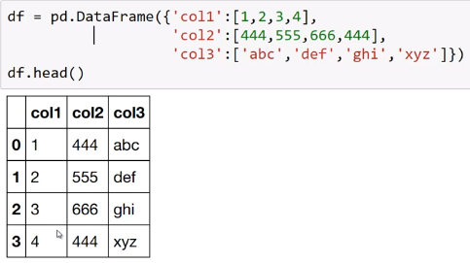
Operations
Let’s start with finding unique values and counts
df[col2].unique()
df[col2].nunique()
df[col2].value_counts()

Slide 25
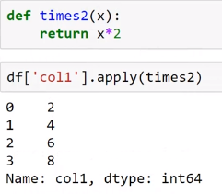
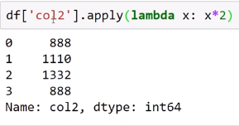
Operations
Usage of apply function

Slide 26
Operations
Try these operations and see:
df.sort_values()
df.isnull()
df.pivot_table()

Slide 27
Data Input and Output
For data input from various different sources :
CSV
Excel
HTML
SQL
You will need to install various different libraries:
sqlalchemy,lxml,html5lib,BeautifulSoap4

Slide 28
Reading and writing file
pd.read_csv(‘example.csv’)
pd.read
pd.to_excel(‘example_output.csv’)
pd.to
From sqlalchemy import create_engine
Engine=create_engine(‘sqllite:///:memory:’)
pd.to_sql

