Slide 1
KINESIS
Guide Review 2
ERC-4337 Deep Dive • Sensor Data Acquisition • Research Roadmap
TEAM MEMBERS
FACULTY GUIDE
P Samuel Vijay 2451-23-749-051
A Sriharsh 2451-23-749-060
P Phani Prasad
Asst. Professor, Dept. of CSE - Allied
Dept. of CSE (IoT & Cyber Security including Blockchain Technology) • MVSR Engineering College
Kinesis | Guide Review 2 | Dept. of CSE (IoT & Cyber Security incl. Blockchain Technology)
1

Slide 2
ERC-4337: Account Abstraction
How the full flow works — addressing the guide's question
Guide's Question: If the platform pays the gas, can't a user just spam unlimited free transactions — repeatedly calling mint, stake, claim — without paying anything?
1
2
3
4
5
User
Action
User
Operation
Bundler
EntryPoint
Contract
Paymaster
Contract
App triggers
a wallet call
An ERC-4337 object,
not a normal tx
Packages UserOps,
pays gas upfront
Singleton — validates
& executes
Checks conditions,
then reimburses
PASS
FAIL
✓ Gas sponsored — executes
✗ User pays / Rejected
The key insight:
The Paymaster is NOT "free gas for everything." It is a smart contract with custom business logic. It approves gas only when specific, programmer-defined conditions are satisfied — which is why users cannot exploit it freely. The conditions (whitelist, rate limit, treasury budget) are set by us and enforced on-chain, not by trust.
Kinesis | Guide Review 2 | Dept. of CSE (IoT & Cyber Security incl. Blockchain Technology)
2

Slide 3
The Paymaster's Three Guard Rails
Why free-gas cannot be exploited — each control is enforced by contract code
1 Operation Whitelist
2 Per-Wallet Daily Limit
3 Treasury Budget Cap
The Paymaster reads the calldata of every UserOperation before approving gas.
The Paymaster maps wallet address → (count, day). Every sponsored call increments the counter.
The Paymaster holds a finite ETH deposit with the EntryPoint, funded from Kinesis's on-chain treasury.
Only specific function selectors — e.g. gameEnter(), claimSteps() — pass the check.
When count >= MAX_FREE_OPS_PER_DAY the sponsorship is revoked for the rest of that day.
If the deposit runs out, the Paymaster can no longer reimburse Bundlers and all free sponsorships halt automatically.
An arbitrary call like transfer() to a friend's wallet returns "unsupported operation" and is rejected before gas is ever spent.
A bot looping mint in a script hits the ceiling after a handful of calls and must pay gas itself.
No code change needed — the platform manages capacity via treasury top-ups, visible on-chain.
Bottom line: a first-time user gets a few smooth, gas-free interactions to onboard. A bot trying to loop the system hits the whitelist, the daily cap, or the treasury limit — whichever comes first.
Kinesis | Guide Review 2 | Dept. of CSE (IoT & Cyber Security incl. Blockchain Technology)
3

Slide 4
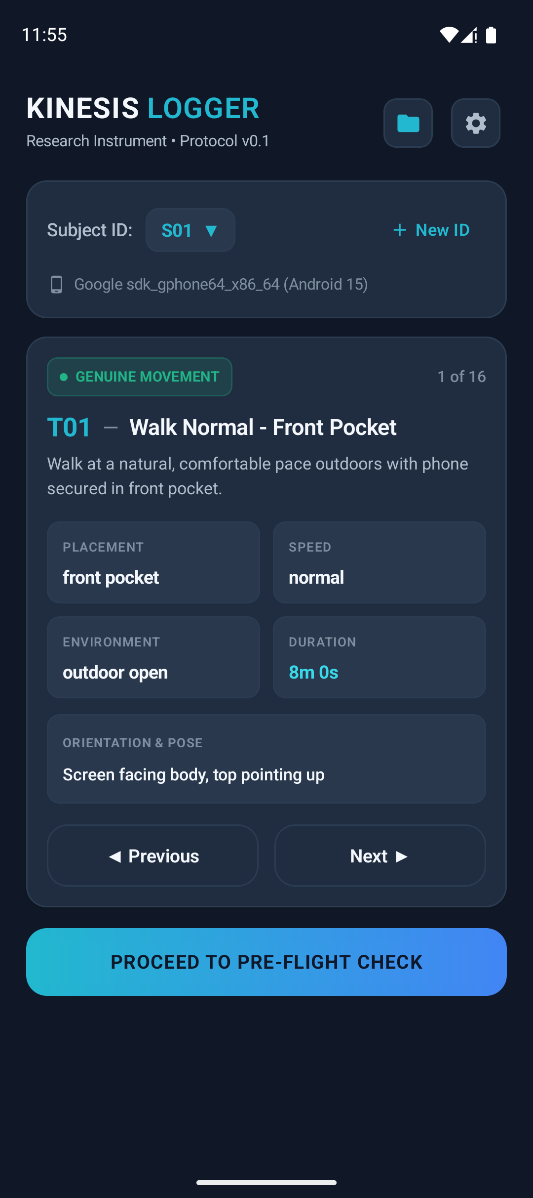
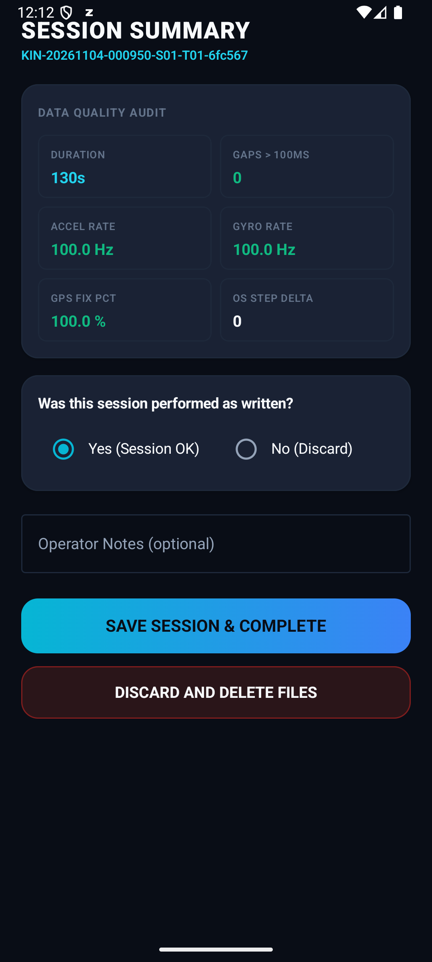
Kinesis Logger — Sensor Data Collection
v0.1 built and tested • github.com/Sriharsh297/kinesis-logger
CAPTURED PER SESSION
UPLOAD PIPELINE
Accelerometer + Gyroscope
Kinesis Logger
(Android App)
100 Hz, elapsed-realtime t_ns
Step Detector + Counter
ZIP + SHA-256 manifest
Per-event + cumulative
GPS (Fused + GPS provider)
API Gateway + Lambda
1 Hz, is_mock flag logged
Session Metadata
Signs 15-min pre-signed PUT URL
16 task cards, subject ID, device
QC Audit
TLS PUT → S3 Private Bucket
Gaps, Hz achieved, GPS fix %, OS step delta
Task card screen
Session QC summary
SHA-256 Manifest
Hash verified on arrival
✓ v0.1 Built & Tested — APK Available
Per-file hash on save
No AWS keys in APK • Pseudonymous IDs only • Raw GPS never on GitHub
Kinesis | Guide Review 2 | Dept. of CSE (IoT & Cyber Security incl. Blockchain Technology)
4

Slide 5
On-Chain Behavioural Analysis — The Plan
The second half of the fusion model | Capstone-II
CAPSTONE-II
DATA SOURCES
ON-CHAIN FEATURES (per wallet window)
Polygon Amoy Testnet
Reward claim interval
Public on-chain events: staking, game entry, reward claims, treasury flows — available through RPC or The Graph
Mean + variance of time between claims. Unusually uniform intervals flag bot-like behaviour.
Claim velocity
The Graph (Subgraph)
Claims per hour vs sensor-plausible steps per hour — the core fusion signal.
Indexed wallet-level event history — faster and cheaper than direct RPC polling. Planned as the dashboard data layer.
Wallet age & activity
New wallets or zero-balance wallets with sudden high claim activity are suspicious.
Hyperledger Fabric Ledger
Immutable fraud-flag and reward audit log (private channel) — cross-reference on-chain data with the HLF record
Multi-account fingerprint
Same device install ID seen across multiple wallet addresses flags coordinated farming.
Kinesis | Guide Review 2 | Dept. of CSE (IoT & Cyber Security incl. Blockchain Technology)
5

Slide 6
Why the Fusion Model? Neither Signal Alone is Enough
Research contribution: B4 (fusion) is tested against B2 (sensor-only) and B3 (on-chain-only)
Sensor-Only
(Baseline B2)
Fusion Model
(B4 — Kinesis)
On-Chain Only
(Baseline B3)
✓
Catches hand shaking, pendulum swings, GPS mock-location, speed-vs-cadence impossibilities
✓
Catches all of B2's attack types PLUS wallet-pattern anomalies — the combined view closes both blind spots
✓
Catches rapid-fire reward claims, abnormal claim intervals, coordinated multi-wallet farming patterns
✗
Misses bots that physically walk but have anomalous wallet-claim patterns that sensors cannot see
?
Open question — does B4 reduce false blocks per device-hour vs each baseline? This is what we measure.
✗
Misses someone who uses a physical device to spoof steps while mimicking a normal wallet-claim tempo
Research question: does the fusion model (B4) achieve lower false blocks per device-hour than B2 and B3 at realistic attack prevalence (1–5%)? Measured in Capstone-II using LOSO / LODO / LOAO evaluation splits.
Kinesis | Guide Review 2 | Dept. of CSE (IoT & Cyber Security incl. Blockchain Technology)
6

Slide 7
Near Future Roadmap
Implementation phases in order
Phase 1
Data Collection
Phase 2
Baseline Models
Phase 3
Fusion Model
Phase 4
Full System
Now → Dec
Jan → Feb
Feb → Mar
Mar → May
Complete all 16 tasks across 6 subjects & 6 phones
B0: OS step counter only
Feature engineering: windowed sensor + on-chain
Smart contracts on Polygon Amoy
Run P0 bench + P1 pilot; fix any gate failures
▶
B1: GPS rule-based
▶
Train B4 fusion model (the contribution)
▶
Hyperledger Fabric audit channel
Cover all label classes: G1–G5, B1–B4, F1–F3, F6, F7
B2: Sensor-only ML (Lee 2025)
LOSO / LODO / LOAO evaluation
Web dApp + product mobile layer
B3: On-chain wallet behaviour
Report false blocks vs baselines
Live demo: inject attack → fraud caught
Current status: Phase 1 is active. The Kinesis Logger app (v0.1) is built and tested. Data collection begins immediately. All subsequent phases depend on the Phase 1 dataset.
Kinesis | Guide Review 2 | Dept. of CSE (IoT & Cyber Security incl. Blockchain Technology)
7

