Slide 1

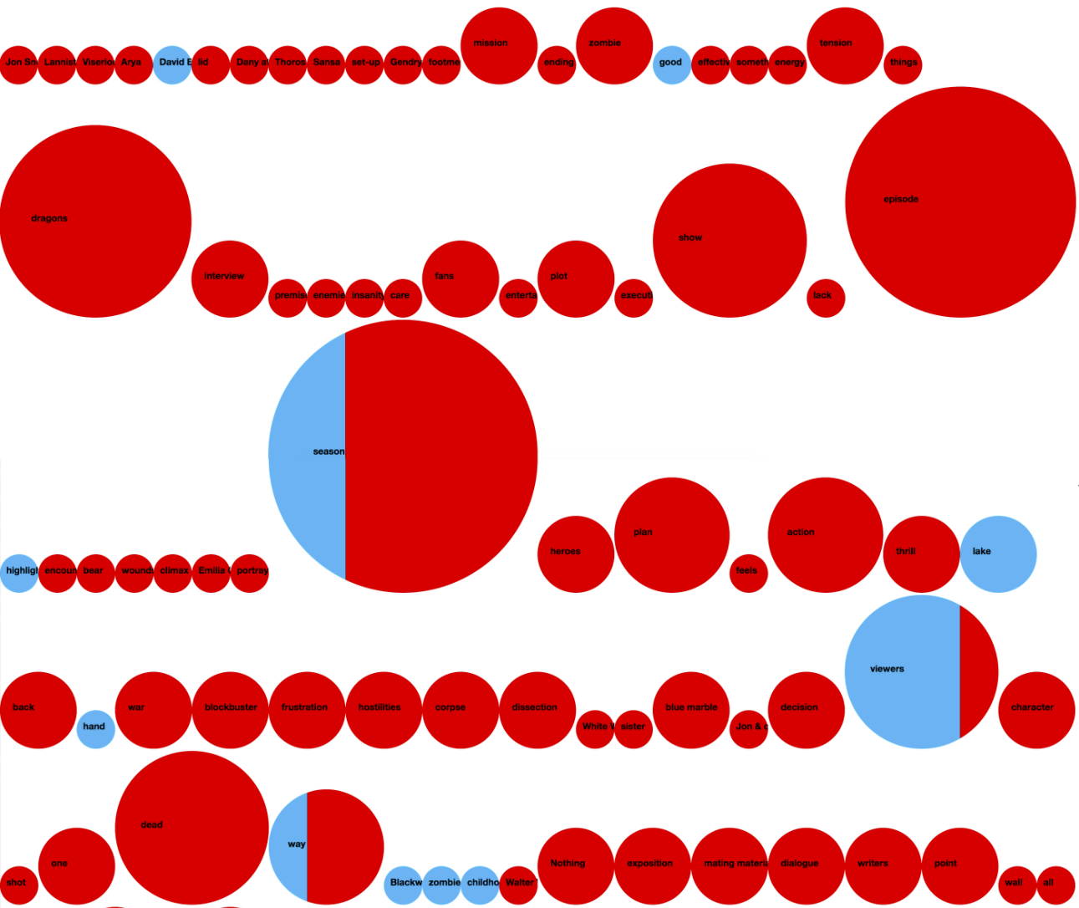
Project 2
Algo Trading using sentiment Analysis
By: Park, Ali and Munir

Slide 2

Hypotheses
Hypothesis 1 = Dual EMA can recognize uptrend stock more accurately than SMA. ATR-Trailing Stop can recognize downtrend faster than SMA. Hence, They are a more profitable technique than SMA for Algo-trading.
Hypothesis 2 = The 5 stocks identified by NLP sentiment analysis have higher potential to rise in the near future when compared to other stocks in the market.

Slide 3

Data Collection & Processing
Sources: Yahoo Finance, NewsAPI
Stocks Bucket : S&P 500 tickers (‘Tickers’)
Feature: Average daily trading volume
Prediction Period: From Oct 1, 2020 to March 31, 2021
First Filter: Tickers are ranked based on Average volume period and top 30 Tickers are selected
Sentiment Analysis Period: March 14, 2021, to April 13, 2021
Second Filter: Vader Sentiment Analysis is run on top 30 Tickers on Sentiment Analysis Period and top 5 Tickers are ranked based average positive sentiment

Slide 4

Research Process
Sentiment Analysis
Machine Learning
Algo Trading
Stock Selection
Prediction
Buy & Sell Signals

Slide 5

Sentiment Analysis-Methodology
Collect all the tickers (‘Tickers’) in S&P 500 from Wikipedia list of SP500 companies
Use Yahoo Finance API to collect daily volume of SP500 tickers for the Volume Period
Using mean function to find average daily volume and ranking of Tickers to get Top 30 Tickers
Use NewsAPI to get articles on Top 30 Tickers and create a data frame with positive, negative, compound and neutral
Using mean function to find average positive sentiment and ranking of Tickers to get Top 5 Tickers in a list

Slide 6






Sentiment Analysis - Outcome
List of top 5 Tickers based on Positive Sentiment in last one month
1. CME Group Inc. (CME) Financial Services CAP USD 73.5bn 22.2% increase in last 6M
2. Ulta Beauty, Inc. (ULTA) Consumer CAP USD 18.3bn 36.6% increase in last 6M
3. Fortune Brands Home & Security, Inc. Consumer CAP USD 14.02bn 18.2% increase in last 6M
(FBHS)
4. Tractor Supply Company (TSCO) Consumer CAP USD 20.56bn 15.4% increase in last 6M
5. Autodesk, Inc. (ADSK) Technology CAP USD 65.62bn 18.48% increase in last 6M
* Market CAP as of April 15, 2021 ** 6 months holding period return without dividends

Slide 7
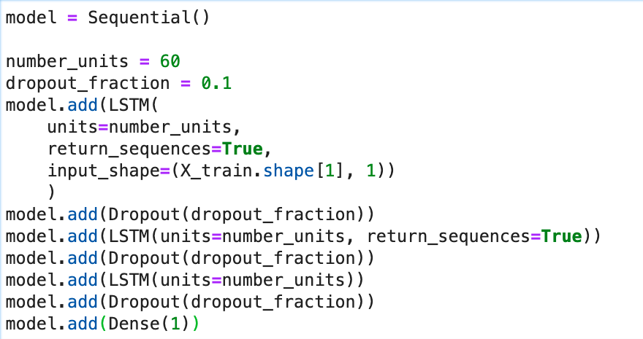
LSTM Model- Methodology
Training Feature set (5 years up to 2020-09-30): Open, Volume, ATR, RSI, high, low.
Target = Closing Price
Portfolio= FBHS, CME, ULTA, ADSK,TSCO
Prediction period= 2020-10-01 to 2021-04-09
Model characteristics:

Slide 8
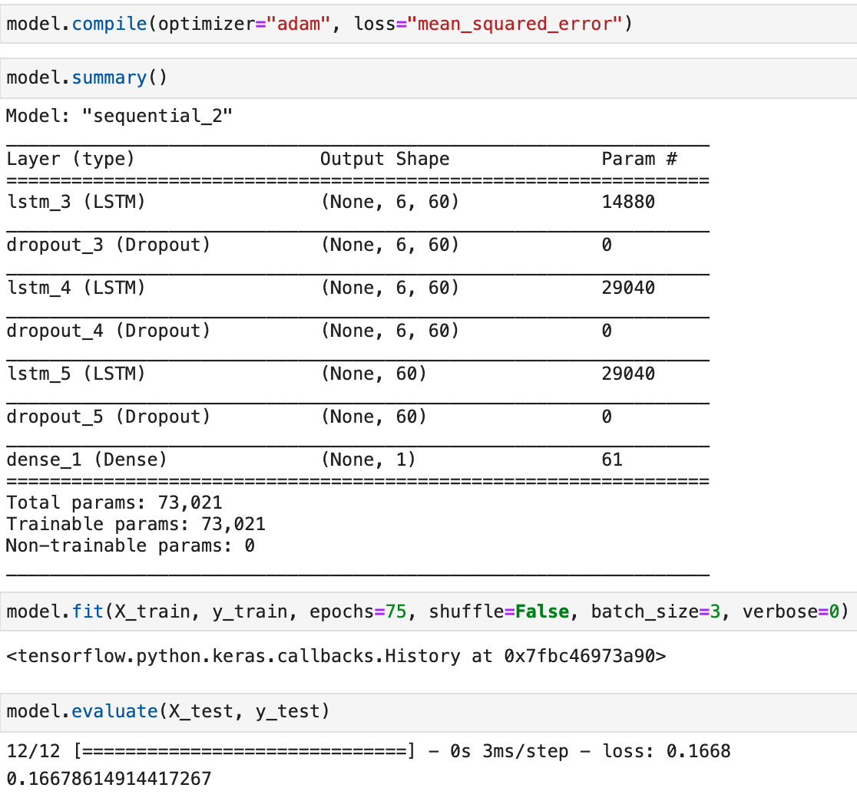
LSTM Model-Summary

Slide 9
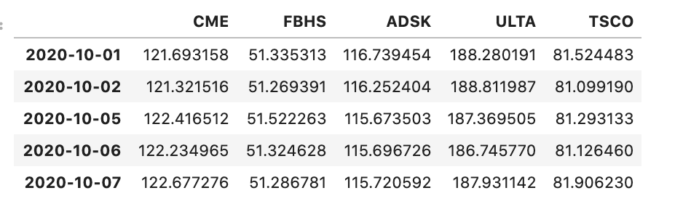
LSTM model-Outcome
IF I had more time , I would I have predicted the features for the next 6 months and prices, but due to limitation of time, prediction period is from last year October till April.

Slide 10
Algo Analysis-Methodology
Identify 5 target stocks for backtesting based on NLP sentiment analysis.
Collect 6 months of historical prices data for backtesting.
Generate entry signals based on dual EMA method. Using 34-periods EMA as short window and 89-periods EMA as long window.
Entry signal is generated when short-EMA is higher than long-EMA
Generate exit signals based on ATR-Trailing Stop method.
Using 89-periods ATR-Trailing Stop, exit signal is generated when closing price is less than ATR-Trailing Stop.

Slide 11
Algo Analysis-Methodology….continued
Generate portfolio holding signal. Because entry and exit signals are generated independently, it was possible that 2 entry signals will be generated consecutively and vice versa. Position holding signal ensure that we do not buy/sell more than portfolio value allows.
Create backtesting based on 6 months of historical prices data.
Generate Evaluation matrix to evaluate the result of Algo trading system. The matrix are: Annual Return, Cumulative Return, Annual Volatility, Sharpe Ratio, and Sortino Ratio
Run the same stock historical data through basic dual SMA Algo trading method for comparison.

Slide 12

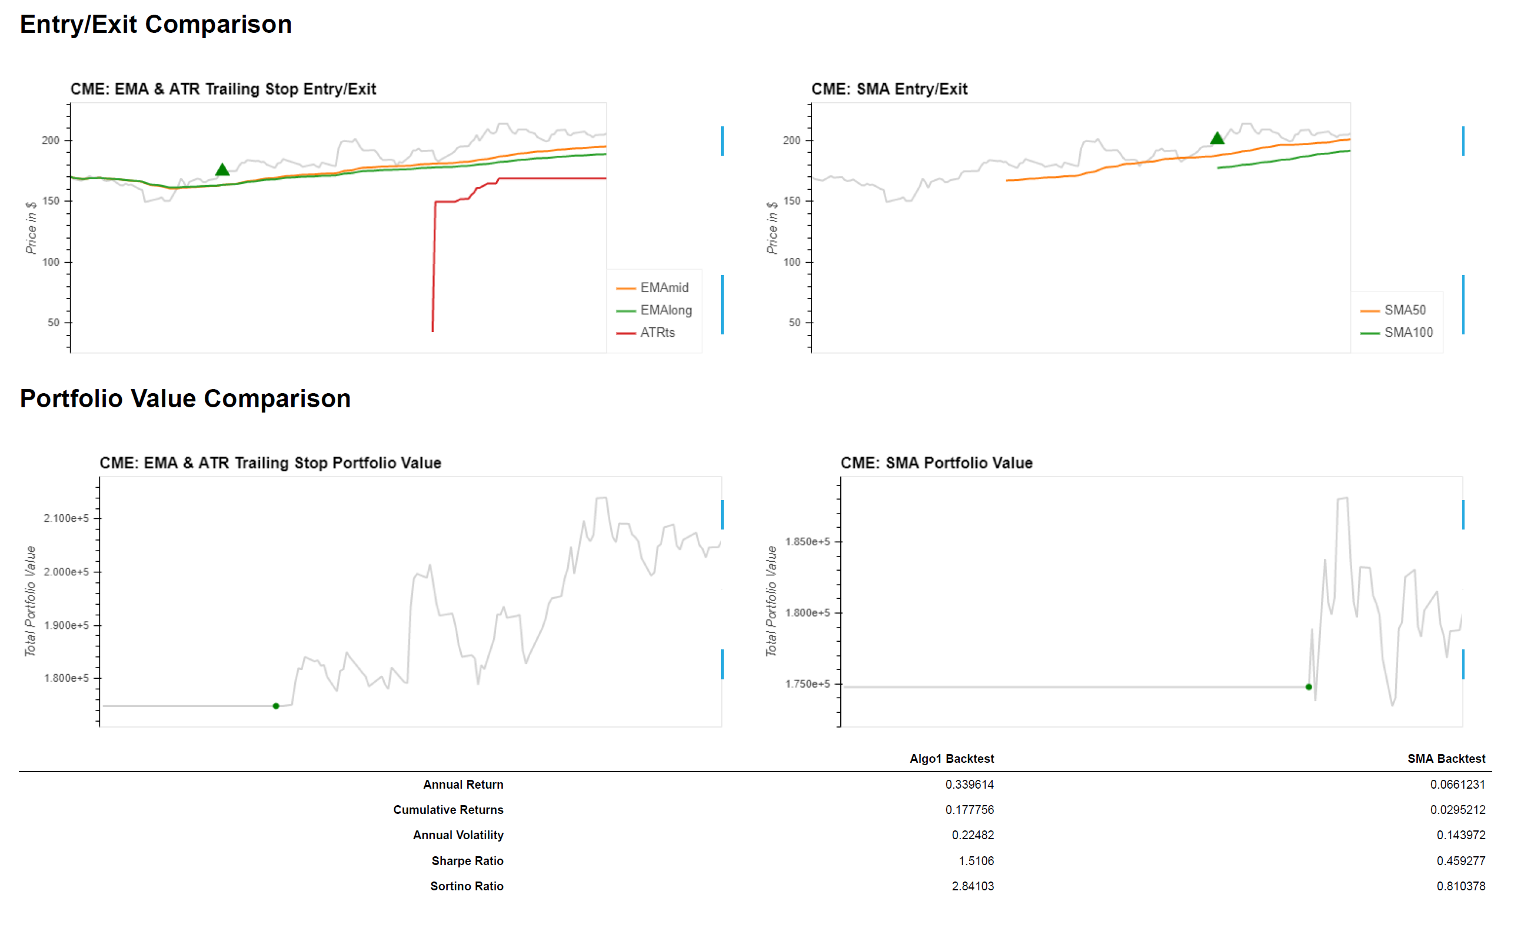
Algo Analysis - CME

Slide 13
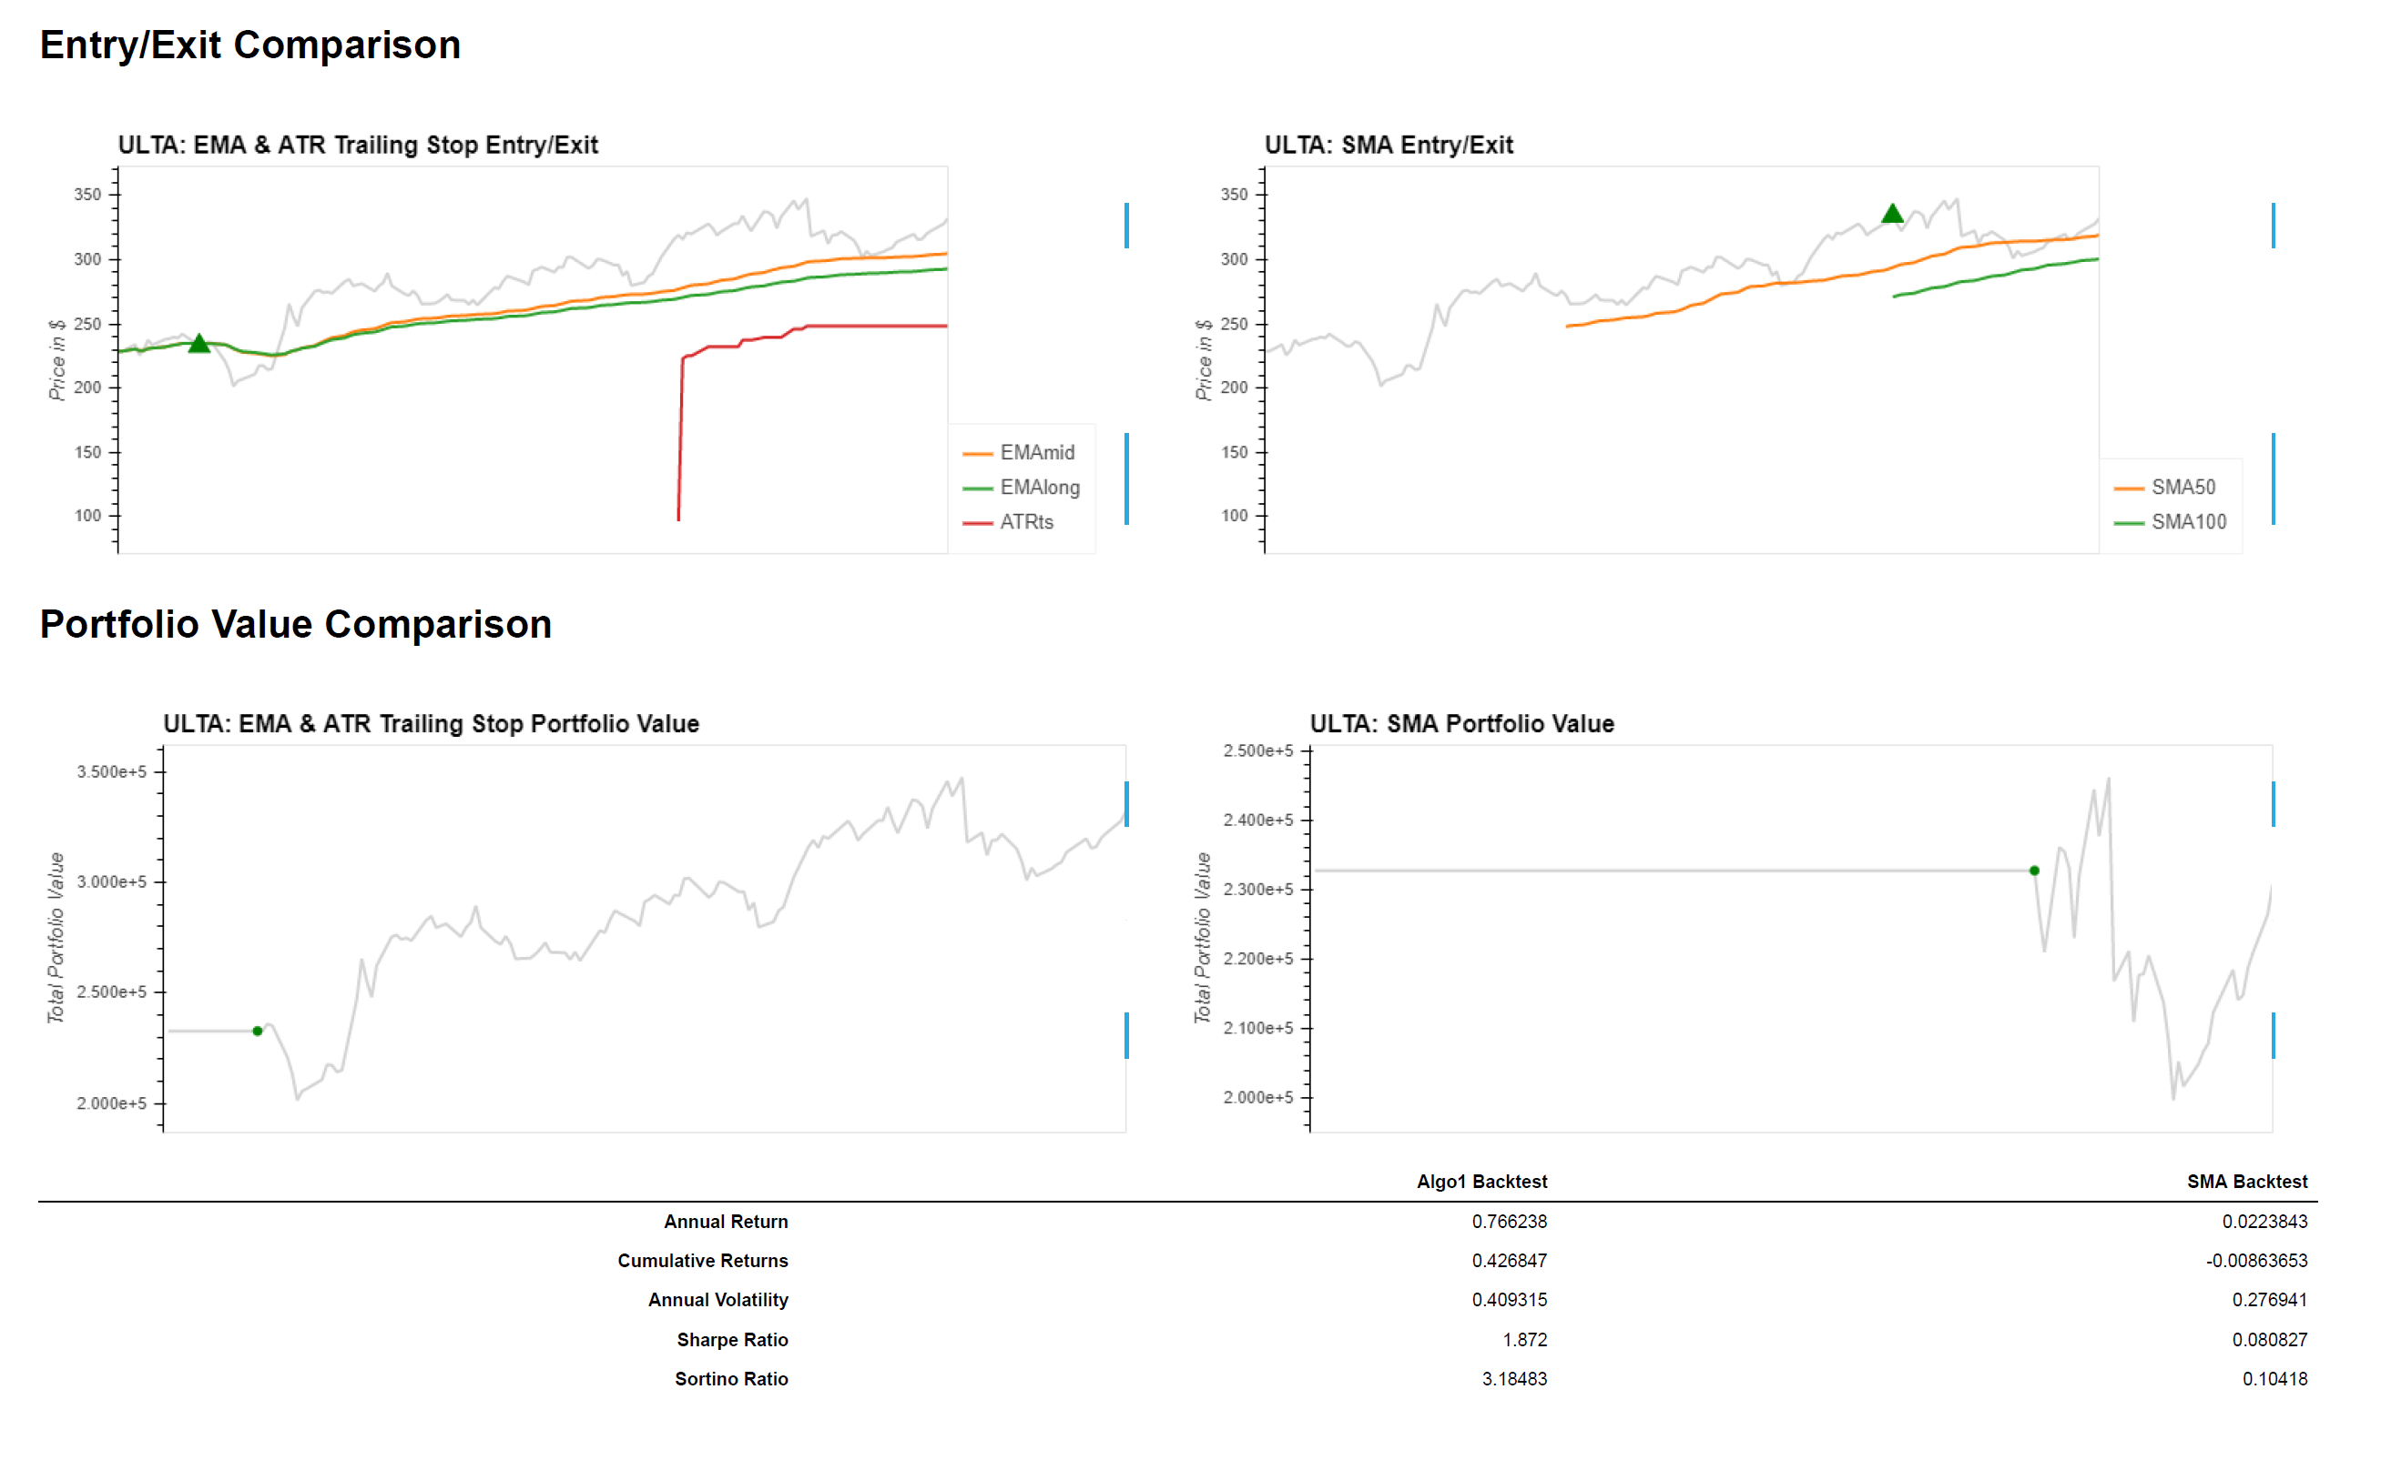
Algo Analysis - ULTA

Slide 14
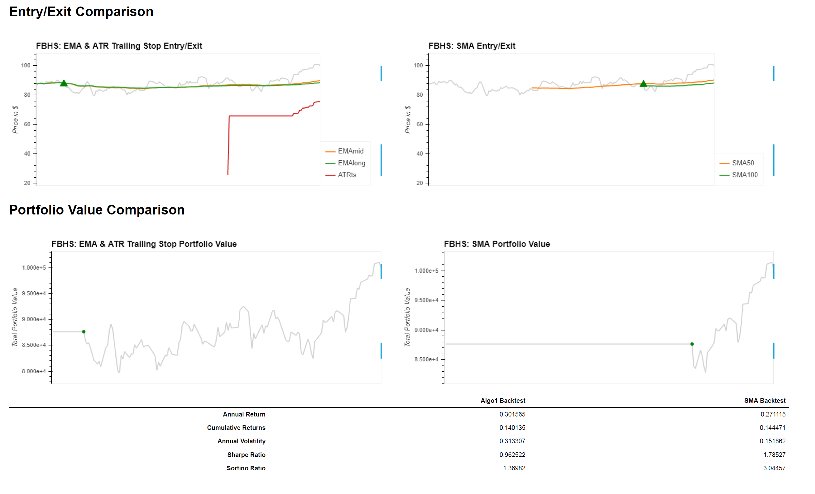
Algo Analysis - FBHS

Slide 15
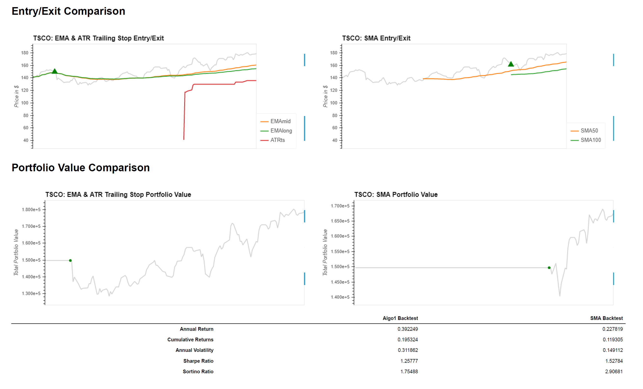
Algo Analysis - TSCO

Slide 16
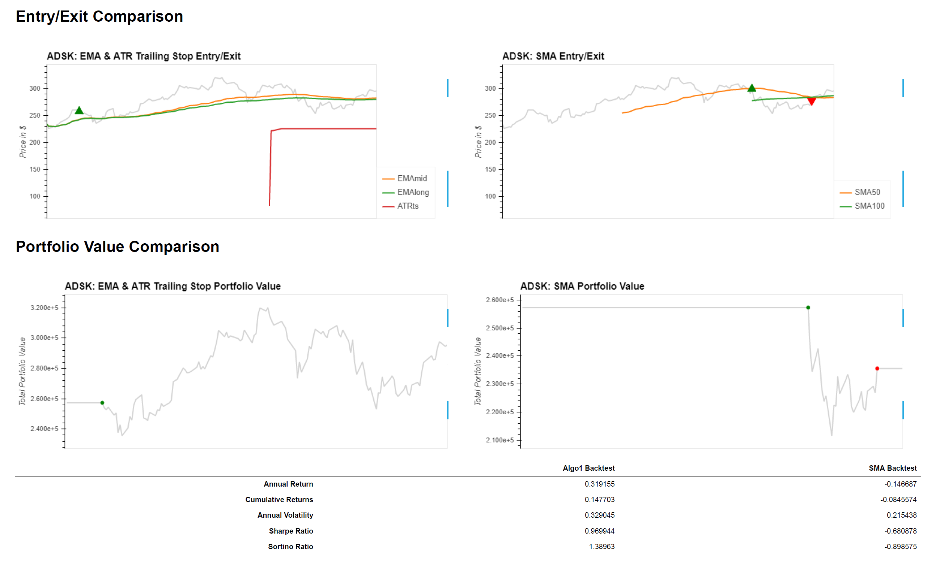
Algo Analysis - ADSK

Slide 17

Notes and Assumptions
Notes:
In the last 6 months, the market has been in uptrend due to recovery from COVID impact. Back-test should be study through longer periods and include
market during recession.
EMA-ATR-Trailing Stop method may work for the above 5 stocks, but different companies have different micro-economy and market cycle, the test should be performed on wider range of companies and industry.
Assumption:
100% of portfolio is invested in each stock during back-test period

Slide 18

Project Observations
In the 5 stocks that were back-tested for 6 months, EMA-ATR-Trailing Stop method produced significantly higher cumulative return in 4 stocks. In FBHS, SMA method produced slightly higher cumulative return (0.4% higher)
With exception of FBHS, EMA-ATR-Trailing Stop method produced better performances in all categories.

Slide 19

Project Conclusion
Not been able to conclude on Hypothesis 1 that dual EMA with ATR provides better Algo-trading signals than SMA for stocks selected based on positive sentiment analysis.

Slide 20

Next Steps beyond this Project
Our expansion on this Project would have included the following:
Run Sentiment analysis for period of six months
Create list of top 5 negative sentiment stocks
Carryout fundamental analysis on selected positive sentiment stocks along with negative sentiment stocks
Use LSTM to project prices of selected stocks 30days to 60 days in future
Use short-selling strategy on negative sentiment stocks
Use Algo-Trading model on predicted prices of positive sentiment and negative sentiment stocks

Slide 21
The End

Slide 22
Q&A

