Slide 1
Angular
Services
Dependency Injection
Http
Json-Server

Slide 2
Services
Service is a piece of reusable code with a focused purpose.
A code that you will use in many components across your application.
Our components need to access the data.
You can write data access code in each component, but that is very inefficient and breaks the rule of single responsibility.
The Component must focus on presenting data to the user.
The task of getting data from the back-end server must be delegated to some other class.
We call such a class a Service class. Because it provides the service of providing data to every component that needs it.

Slide 3
Run ng generate to create a service.
Syntax:-
ng generate service <Servicename>.
ng g s servicename
And then place the service in providers section in app.module.ts file.
Next, export the service class. We need to export so that the Components & Other service class import it and use it.
We create an instance of Serivce in the constructor of the Componet.
In real-life Angular Apps, we use the Dependency Injection in Angular to inject the Serivce in the component constructor.

Slide 4
Dependency Injection
Dependency Injection is a coding pattern in which a class receives its dependencies from external source rather than creating them itself.
Here we sending dependencies to constructor like parameters. If two or three
its possible but more than that it is difficult to handle it.
Here, Angular dependency injection as a framework comes into picture.
Injector:-
Injector has to register all dependencies that means injector is like a container for all dependencies.

Slide 5
HTTP
The standard HTTP methods like GET, PUT, POST and DELETE, these methods allow you to communicate with a REST API server.
In order to use HttpClient API to make the communication with Http remote server, you must set up this service in your Angular app.
Go to app.module.ts and paste the following code.
import { HttpClientModule } from '@angular/common/http';
Include the HttpClientModule in @NgModule's imports array.
@NgModule({
imports: [
HttpClientModule
]
})
And Inject this Httpclient in Service class constructor.

Slide 6
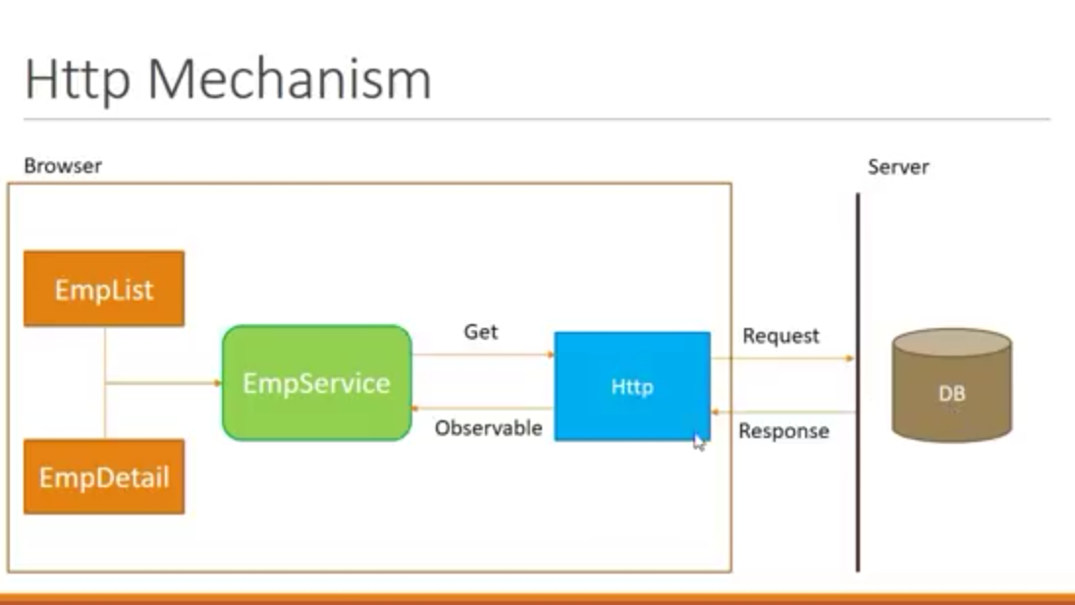

Slide 7
Local Json-server Setup:-
First step:- npm install -g json server
Second Step:- create a file in assets db.json and paste some data in the db.json file.
Third step:- Go to the db.json file directory
Cd src/assets/ press Enter
Fourth Step:- json-server –-watch db.json
Run this command and you will get an URL.
With this URL we can make Http requests to the server.

Slide 8
Thankyou
Presented By
Patnana Santosh Kumar

