Slide 1
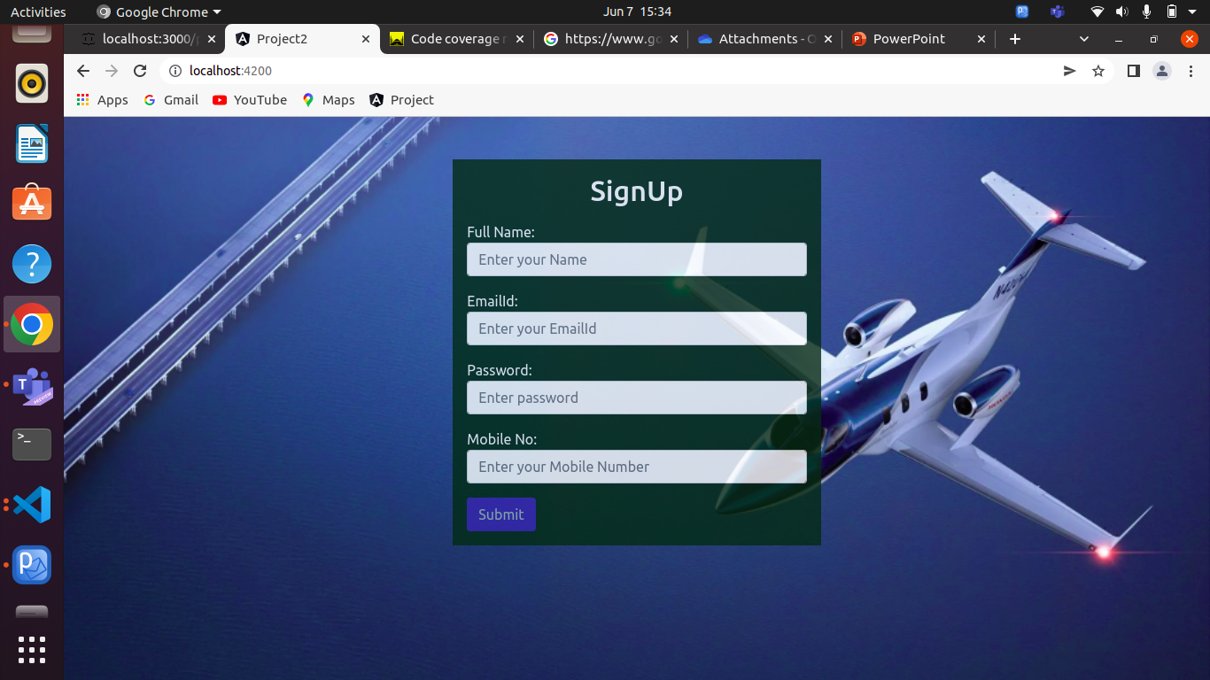
SignUp Component
User needs to SignUp by giving his Credentials and then it route to the Login Page

Slide 2
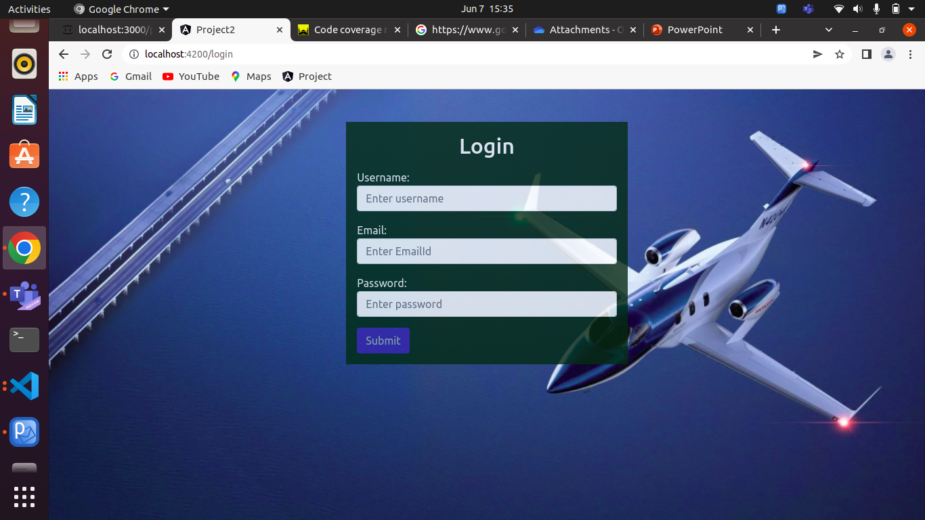
Login Component
After Signup the User,user needs to login by his credentials and it will validate the user details and it will route to the Dashboard Page

Slide 3
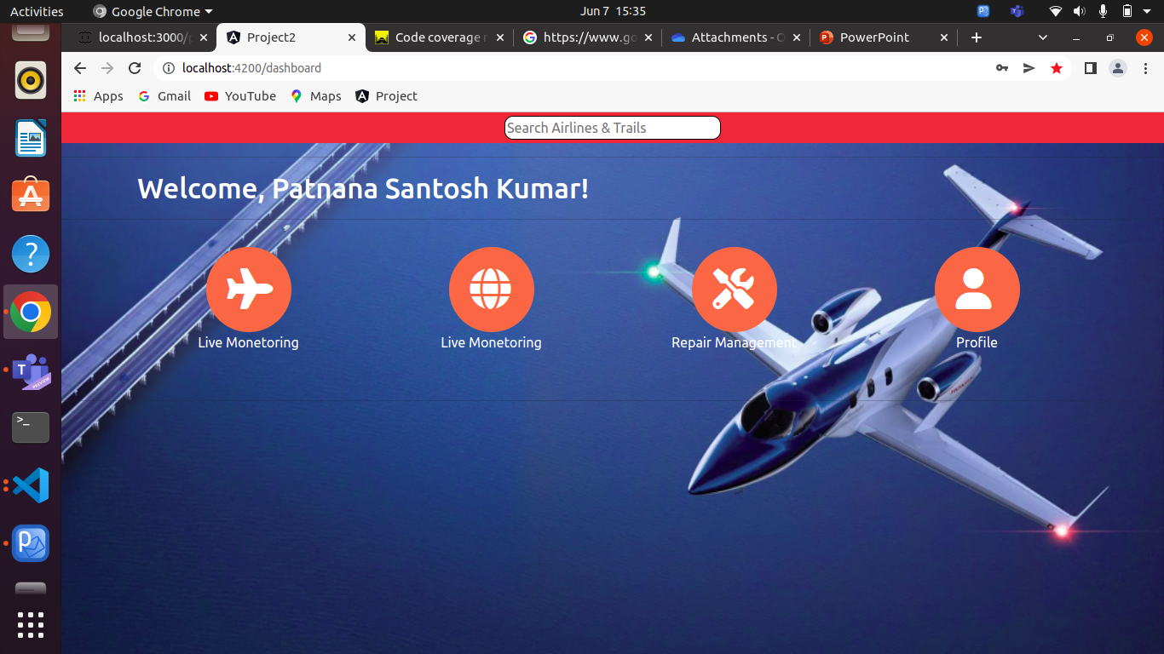
DashBoard Component
Disigned Ui part in Responsive and used routing and wild card routes.

Slide 4
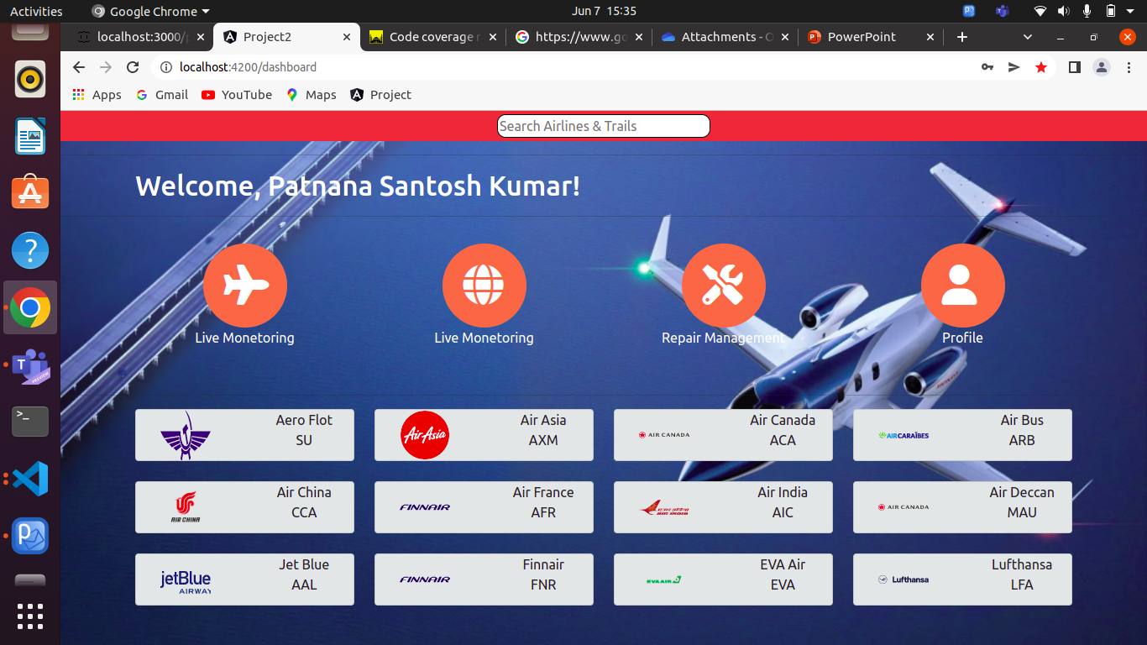
DashBoard Component
While Clicking the Live monetoring icon it will display a cards. While Clicking the cards it will navigate to the AeroComponent

Slide 5
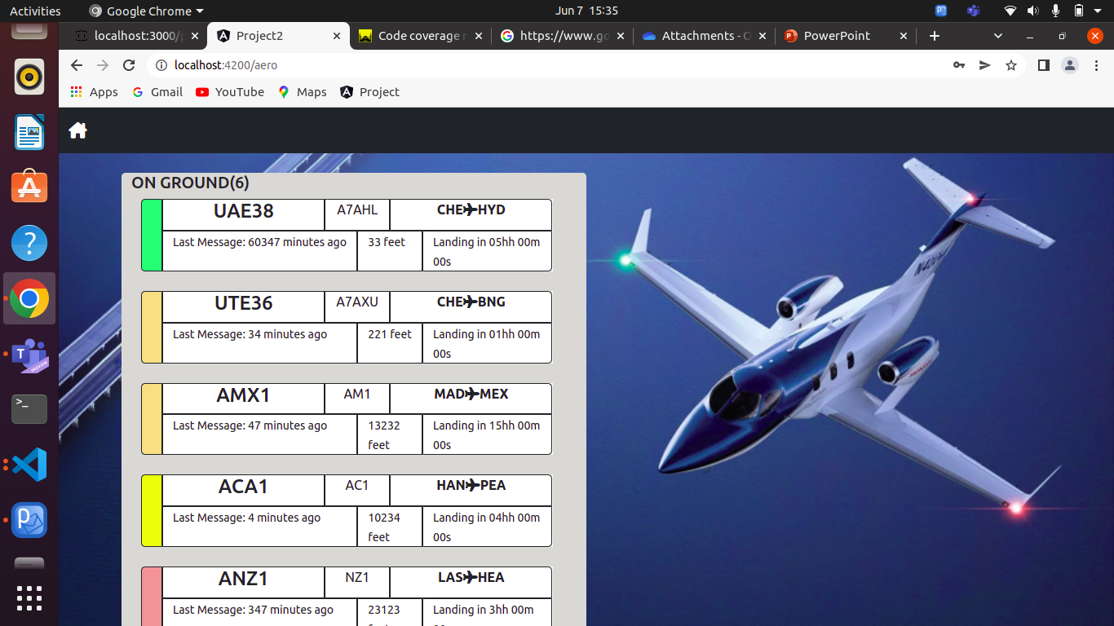
Aero Component
In this component it shows the departure and arrival of flights.
Implemented in responiveness and used json-server to display the data.

Slide 6
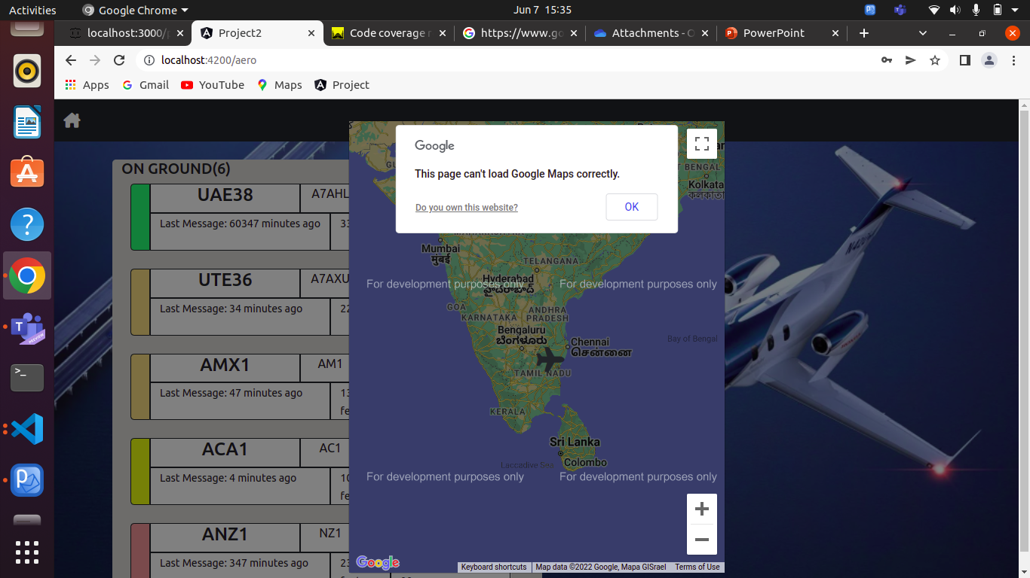
Aero Component Map Integration
Integrated Google Maps.When the user onmouseover to the particular flight data it will display a popup window with map and it shows the place from to to location.

Slide 7
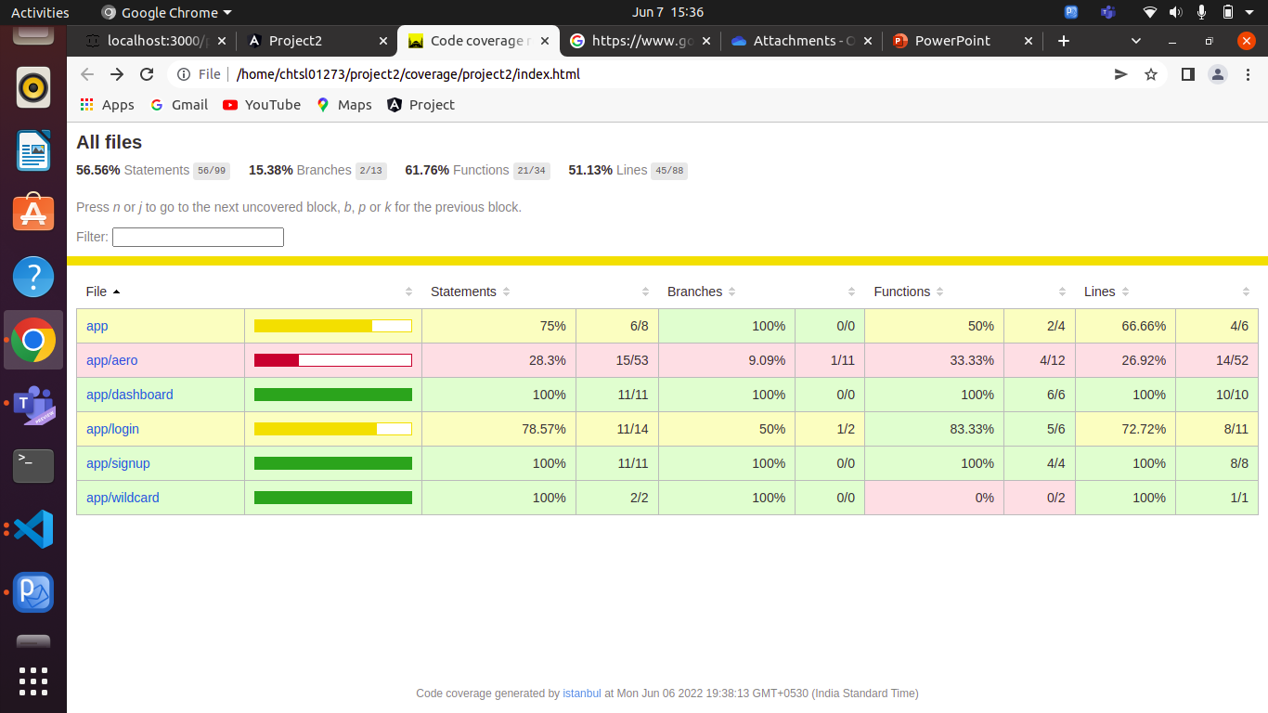
Unit Testing
Unit Testing have to done on Every component

Slide 8
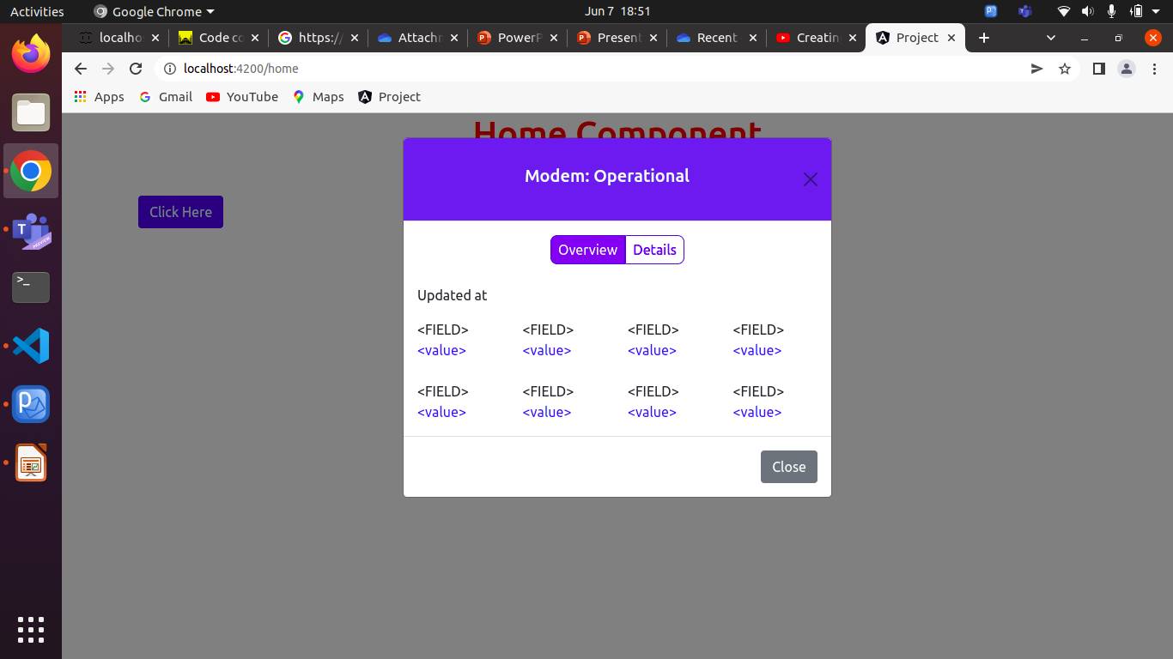
Modal Popup Window
When Clicking on a button it will show a popup window and if we click on overview it will display a data and we click on Details it will show the some data

