Slide 1
GigaVoxels: Ray-Guided Streaming for Efficient and Detailed Voxel Rendering
Cyril Crassin, Fabrice Neyret, Sylvain Lefebvre, Elmar Eisemann
summarized by Sarah Kushner

Slide 2
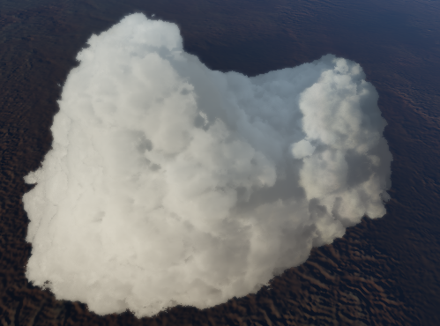
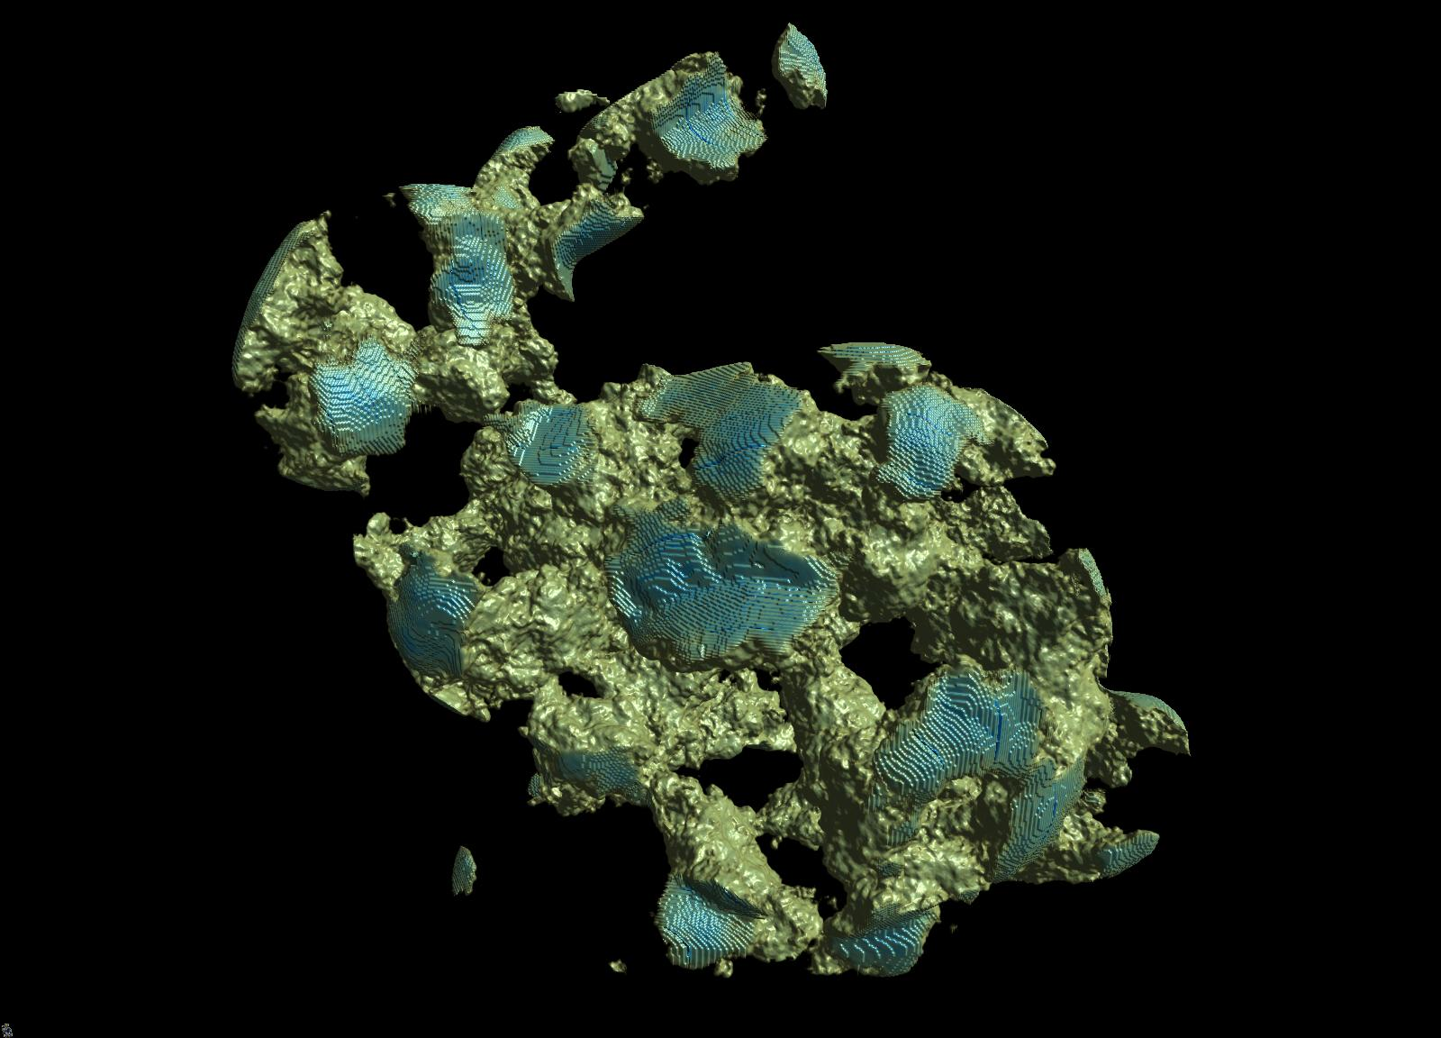

Volume Rendering and Voxels
Used to represent pseudo-surfaces
like foliage, clouds, smoke and
even extremely detailed geometry
These two techniques together
are used in conjunction to deal
with the level-of-detail problem.

Slide 3
Proposal
Current hardware is ready to render massive amounts (several billion voxels) of volume data in real-time or at an interactive rate.

Slide 4
Problems
Memory limitations
The transfer of 512MB of data onto the GPU prevents real-time performance.
Costly rendering
Costly because of large amounts of voxels.

Slide 5
Approach
-The norm for concentration of scene details in CG is usually an interface between dense clusters of detail and empty space.
-Focuses on out-of-core voxel rendering.

Slide 6
Optimizations
-Depending on the camera, not everything needs to be in memory all the time.
-Distant objects can have lower mipmap levels, less detail, and in turn take less memory.

Slide 7
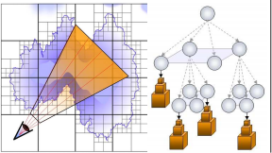
Data Structures
-N³ trees and mipmapped texture tiles.
-Each node is single pointer to a "brick" or an empty space.
-Brick: small voxel grid of size M³
(usually M = 32) that approximates part of the original volume.
-All bricks stored in brick pool.
-Updates only triggered if data in the brick pool is missing.
-New bricks stored in oldest locations according to timestamp. (Last Recently Used)

Slide 8
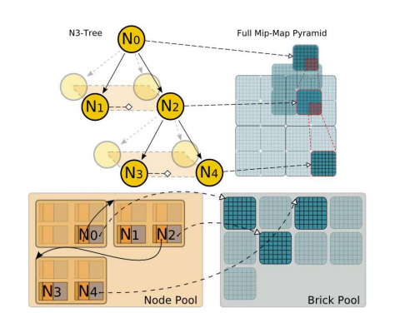
Organization
-All nodes in 3D texture called "node pool".
-Grouping gains access
to all children through 1
pointer.
-16x memory improvement
since nodes are now 64
partitioned accordingly.

Slide 9
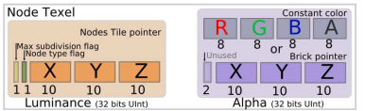
Nodes
-30 bits - encode a pointer to the child nodes
-1 bit - whether the node is refined to a maximum or contains more data
-1 bit - whether the content is a constant RGBA8 value or described by a brick
-30/32 bits - either a pointer to an M³ brick or the average value at this location

Slide 10
Rendering
-March the data in the structure along the view rays while accumulating color and opacity.
-Iterative descent from the tree root like the kd-restart algorithm.
-Level-of-detail determined in shader.
-Ray-casting in one big fragment shader.
-Adapt sampling rate & mipmap level during the ray marching depending on viewpoint.

Slide 11
Communication with CPU
-Brick pool on CPU.
-Texture-update calls -> modifications go to GPU (Node pool).
-Unified management of the brick pool and the node pool as two Last Recently Used controlled caches.

Slide 12
Node List
-During rendering, traverse the node tree. Stop on node corresponding to the needed level-of-detail.
-If the required data is present, we traverse the mipmapped brick.
-For CPU to keep correct nodes in pool, collect the current node index in a node-list.
-If level-of-detail is missing or the node is terminal, it is added to the node-list.

Slide 13
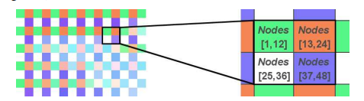
Neighbor Rays
-Group rays in packages in the image plane.
-Instead of brute-force sorting, rays are only compared with neighboring rays.
-Sort to ensure only one instance of each node reference.
-Sorting can also be costly.

Slide 14
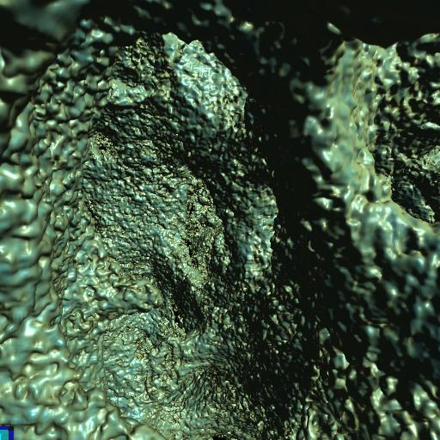
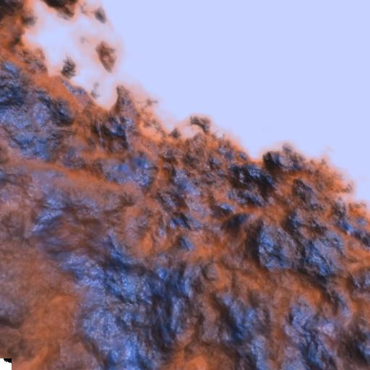
Results
- 20 octaves of Perlin noise, shading, materials
-20 fps for a 1024³ volume
-1024³ scanned volume of bone
-N = 2 and M = 16
-60 fps

Slide 15
Conclusion
Through compact data structures and limited, clever CPU to GPU communication, interactive and real-time rendering speeds are possible for extremely large volume data.

Slide 16
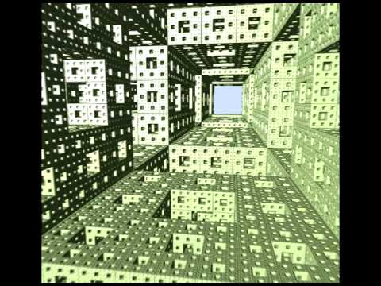
Demo
https://www.youtube.com/watch?v=HScYuRhgEJw

