Slide 1

MTH-209 Group Project: Vector Victors

Slide 2

AGENDA
Raghav Govind - 220852
Parnapalli Sarath Kumar - 220754
Jiya Verma - 220480
Priyanshu Gupta - 220826
Suresh Rana - 231080096

Slide 3

Modeling and Forecasting Exchange Rates

Slide 4

Project overview
OBJECTIVE:
This project aimed to develop robust models for predicting exchange rates (INR/USD) using
Three different methods and subsequently evaluating their performance metric {Time Series Models, Linear Regression Models, Artificial Neural Networks [1]}
[1]: https://www.kybernetika.cz/content/2002/6/685/paper.pdf

Slide 5
About the DATASET
Over the span of last 45 years, the dataset contains records for eight parameters along with their corresponding values. These parameters are expected to demonstrate a certain degree of correlation with exchange rates. The variable encompass the GDP growth rate, trade deficit, total foreign reserves, foreign direct investment(FDI), inflation rates, population growth rate, interest rate and the price of crude oil.

Slide 6

APPROACH
Data Preprocessing: Z-score normalization was applied to data to standardize it; Correlation matrices were utilized to visualize relationships and identify trends among the various variables
Multicollinearity Analysis: Variance Inflation Factor (VIF) analysis was conducted to assess multicollinearity. The analysis identified and addressed potential redundancy among predictors, enhancing the model’s reliability.
Variable Selection: Independent variables like GDP growth, Trade Deficit (% of GDP), FDI (% GDP), Inflation, Real Interest Rates, and Crude Oil Prices (dollar per barrel) were considered. Variables with high correlation with the target variable and VIF scores less than 5 were retained, while Population Growth and Total Reserves were excluded
Model Implementation: Time series forecasting models, including ARIMA and ARMA, were implemented. Multiple Linear Regression was employed for predicting exchange rates The performance of each model was evaluated using metrics such as MAE, RMSE, and MAPE

Slide 7
Outcomes
Linear Regression Performance:
Achieved an impressive R-squared value of 0.96, indicating a strong linear relationship between predictors and the exchange rate.
The adjusted R-squared value, considering model complexity, was around 0.7.
Time Series Models (ARMA, ARIMA)
ARIMA outperformed other models, exhibiting the lowest RMSE, MAE, and MAPE. ARIMA performed better than the ARMA because of the extra differencing as the data was not stationary. That differencing step made the data stationary, which is required for the ARIMA model
This suggests that the time series components captured by ARIMA contributed significantly to accurate predictions.
Artificial Neural Networks
Attempted to use ANN for prediction, but no big difference compared to linear regression.

Slide 8
Conclusions AND Further work
The project demonstrated the effectiveness of various models in predicting exchange rates.
Linear regression showcased a strong linear relationship, while time series models, especially ARIMA, excelled in forecasting accuracy.
The decision to exclude certain variables based on correlation and VIF analysis contributed to model refinement
Further Work:
Further exploration of advanced time series models or deep learning approaches like Long Short-Term Memory (LSTM) networks or Gated Recurrence Units (GRUs) could be considered for even more accurate predictions.
Continuous monitoring and updating of the model may be necessary to adapt to changing economic conditions.
L2 regularization can be used as we saw that some features are highly correlated to others, so it may further reduce multicollinearity.

Slide 9
MATHEMATICAL TOOLS INVOLVED
Taking a deep dive

Slide 10
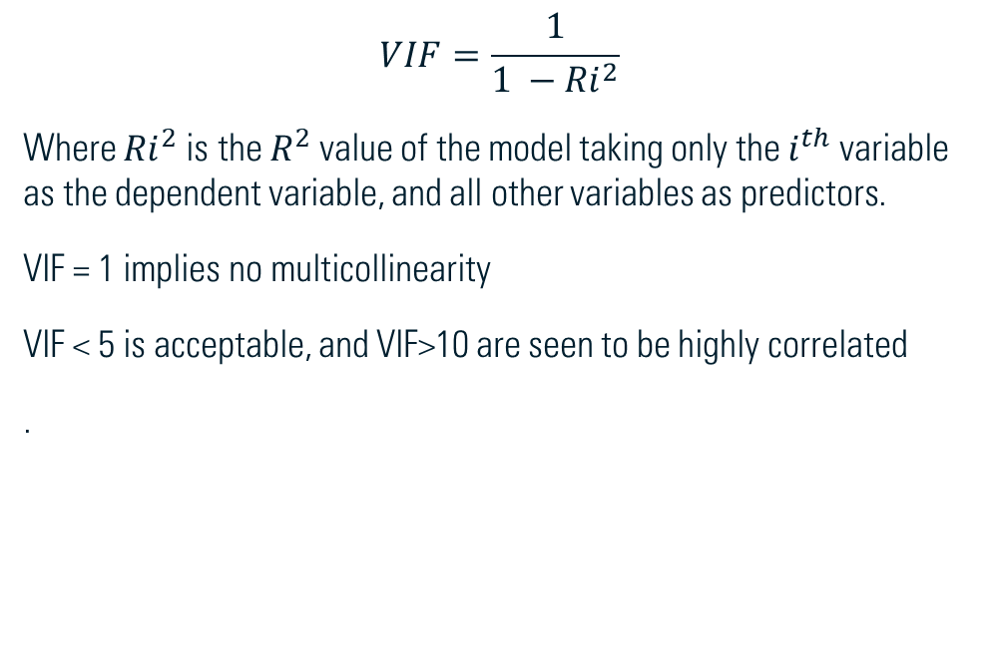
VIF Values calculation and analysis
In ordinary least square (OLS) regression analysis, multicollinearity exists when two or more of the independent variables demonstrate a linear relationship between them.
This cannot affect the model performance, but leads to an unreliable model as we effectively “double count” these variables in our model, leading to inflation of standard errors
$$VIF=\frac{1}{1 −{Ri}^{2}}$$
Where ${Ri}^{2}$ is the $R^{2}$ value of the model taking only the $i^{th}$ variable as the dependent variable, and all other variables as predictors.
VIF = 1 implies no multicollinearity
VIF < 5 is acceptable, and VIF>10 are seen to be highly correlated
.

Slide 11
Handling multicolinearity
To handle multicollinearity:
We can either
remove a highly correlated variable
combine or transform the highly related variables into a single one
use PCA to create uncorrelated linear combination of variables

Slide 12
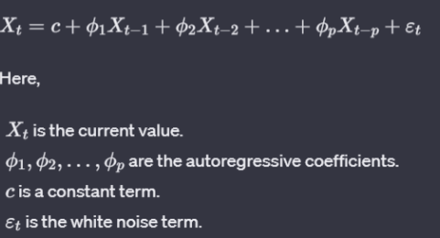
ARMA, ARIMA
ARMA and ARIMA are time series forecasting models that combine:
Autoregression[AR], Moving Averages[MA], and Integrated Component which take the difference of two consecutive values[I(d)]
When expressed in the probabilistic term, an autoregressive model [AR(p)] distributes independent variables over n-possible steps, assuming that earlier variables conditionally influence the outcome of the next one. It can be expressed as:

Slide 13
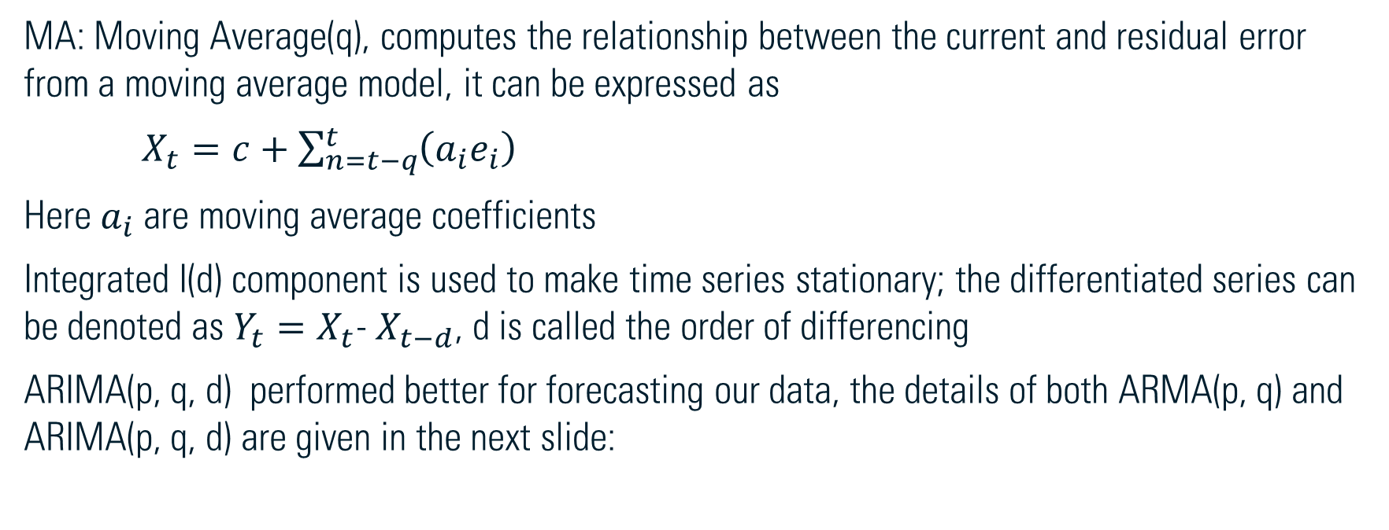
EXPLORING arima and arma
MA: Moving Average(q), computes the relationship between the current and residual error from a moving average model, it can be expressed as
$X_{t}=c+\sum_{n=t−q}^{t}{\left(a_{i}e_{i}\right)}$
Here $a_{i}$ are moving average coefficients
Integrated I(d) component is used to make time series stationary; the differentiated series can be denoted as $Y_{t}=X_{t}$- $X_{t−d}$, d is called the order of differencing
ARIMA(p, q, d) performed better for forecasting our data, the details of both ARMA(p, q) and ARIMA(p, q, d) are given in the next slide:

Slide 14
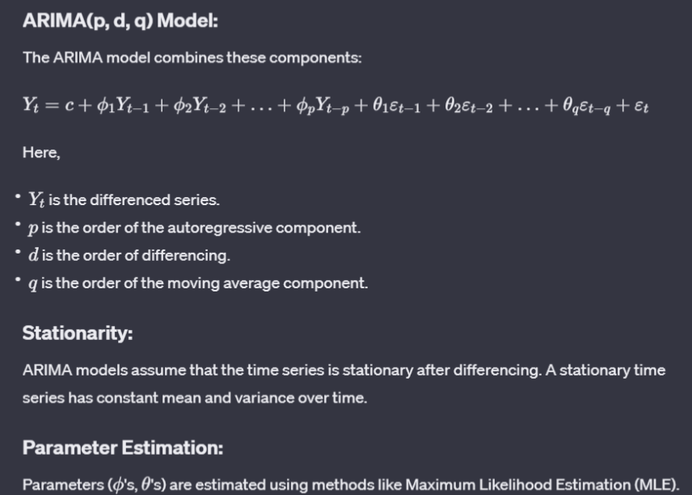
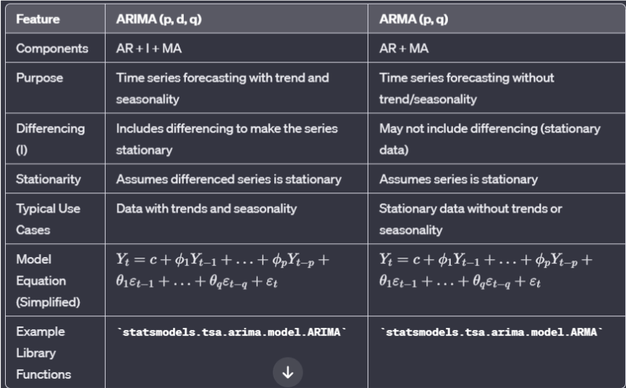
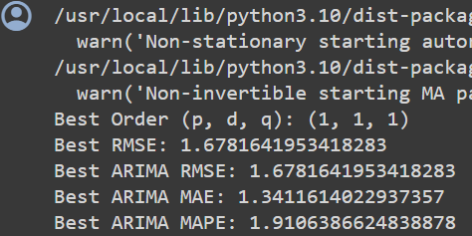
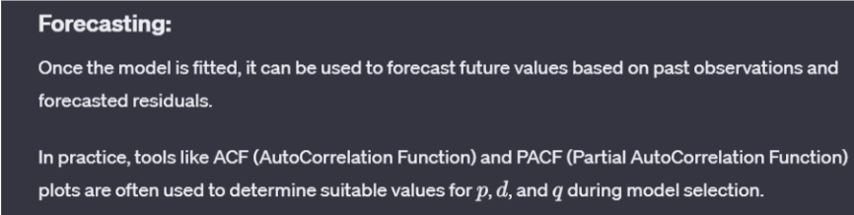

Slide 15
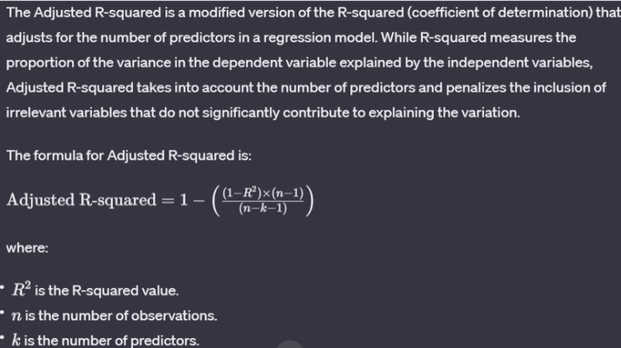

R2 value and adjusted r2 value
$R^{2}$ value is defined as follows:
$$1−\frac{\sum_{i}{(y_{i}−f_{i})x^{2}}}{\sum_{i}{(y_{i}−mean\left(y\right))x^{2}}}$$

Slide 16

THANK YOU
Team Vector Victors

