Slide 1



Fast Incremental Proximity Search in Large Graphs
Purnamrita Sarkar
Andrew W. Moore
Amit Prakash
Notes:
Hi I am going to talk about finding nearest neighbors in large graphs very very quickly. This is joint work with …

Slide 2
Content-based search in databases^{{1,2}}
maximum
paper-has-word
Find top k papers matching “SVM” in Citeseer
margin
Paper #1
classification
paper-cites-paper
paper-has-word
large
Paper #2
scale
SVM
1. Dynamic personalized pagerank in entity-relation graphs. (Soumen Chakrabarti, WWW 2007)
2. Balmin, A., Hristidis, V., & Papakonstantinou, Y. (2004). ObjectRank: Authority-based keyword
search in databases. VLDB 2004.
Notes:
Another example is content based search in databases. We can represent the citeseer dataset by a graph of paper and word-nodes. Papers are connected via citation. Words are connected to the paper if they appeared in the title of the paper. Now we want to ask….

Slide 3
Ranking problem on graphs
All the previous applications require ranking on graphs
Several other applications:
  Semi-supervised learning: How to detect web-spam?
  Recommending friends in a friendship network

Slide 4
Proximity measures on graphs
For ranking we need proximity measures
  Personalized pagerank
  Hitting/commute times
  Truncated hitting and commute times
We will present an algorithm to compute nearest neighbors in truncated hitting and commute times on the fly.
Empirically show that these truncated measures perform better than the others in most cases.
Notes:
Motivate random walks before the outline

Slide 5
Outline
Ranking Problem on graphs
Background
  Random walks
  Standard and truncated measures
  Previous work
Our contribution
  Theoretical justification
  Algorithm sketch
Experimental results
Notes:
I just talked about ranking problems on graphs. Now we will go over some background material. Then I will talk about our contribution in this paper. I will conclude with experiments.

Slide 6
Hitting time from i to j
Graph G
h(n₁,j)
P(i,n₁)
n₁
i
j
h(n₂,j)
P(i,n₂)
n₂
h(i,j)=1+P(i,n₁)*h(n₁,j)+P(i,n₂)*h(n₂,j)

Slide 7
Proposed work: sketch
Return k approximate nearest neighbors of the query node with truncated commute time ≤ 2τ
Theoretical justification: number of nodes within 2τ truncated commute time is small.
  #nodes with hitting time ≤ τ from the query is small
  #nodes with hitting time ≤ τ to the query is small
We present an algorithm which adaptively finds a neighborhood which contains all nodes with commute time ≤ 2τ w.h.p.
Then we perform ranking on these nodes
Notes:
Come back to 21

Slide 8

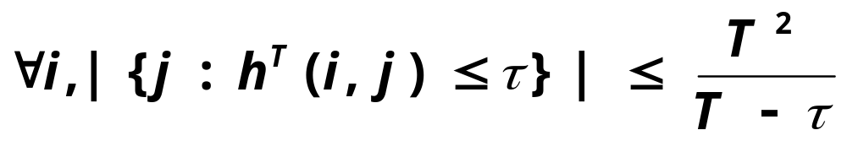
Number of nodes with hitting time ≤ τ from the query
G
How many nodes will I hit within τ time?
What is the size of
the set ?
Notes:
Make everything comic sans
Remove G/ replace with graph?
If T and tau are constant, then this is a small number

Slide 9

Number of nodes with hitting time ≤ τ to the query
G
How many nodes will hit me within τ time?
What is the size of
the set ?
Directed graphs:
Not too many nodes will have a lot of neighbors
within a small hitting time to them.
Notes:
Say it out in words in 22. Say it in a positive way

Slide 10
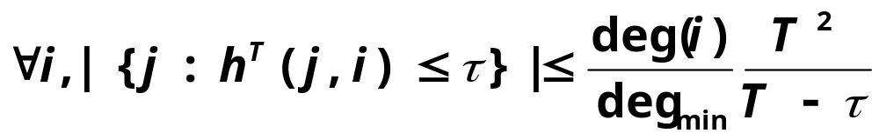
Number of nodes with hitting time ≤ τ to the query
G
How many nodes will hit me within τ time?
What is the size of
the set ?
Stronger guarantee for
undirected graphs!
Notes:
Mention reversibility

