Slide 1



Fast Incremental Proximity Search in Large Graphs
Purnamrita Sarkar
Andrew W. Moore
Amit Prakash

Slide 2




Recommender systems
Alice
What are the top k movie recommendations for Alice?
Bob
Charlie
Brand, M. (2005). A Random Walks Perspective on Maximizing Satisfaction and Profit. SIAM '05.
Notes:
Lets start with a few examples which require ranking on large graphs. Take for example recommender networks.
Here we have a bipartite graph of customers and movies. A customer has a link to a movie if he/she rated that movie.

Slide 3
Content-based search in databases^{{1,2}}
maximum
paper-has-word
Find top k papers matching SVM
margin
Paper #1
classification
paper-cites-paper
paper-has-word
large
Paper #2
scale
SVM
1. Dynamic personalized pagerank in entity-relation graphs. (Soumen Chakrabarti, WWW 2007)
2. Balmin, A., Hristidis, V., & Papakonstantinou, Y. (2004). ObjectRank: Authority-based keyword
search in databases. VLDB 2004.
Notes:
Put margin on one

Slide 4
Proximity measures on a graph
2
1
5
Random walks
3
4
How similar are 1 and 2?
Many short paths from 1 to 2 ➔ highly similar
Notes:
Connect this to the last few slides

Slide 5
Random walks
Start at 1
Pick a neighbor i uniformly at random
Move to i
Continue.
t=1
2
1
5
3
t=3
4
t=2
Notes:
Use the later graph

Slide 6
Outline
Proximity measures on a graph
  Standard measures: hitting/commute times
  Improved measure: truncated versions
Ranking using truncated measures
Theoretical results
Algorithm sketch
Experimental results

Slide 7
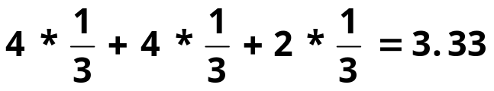
Random walk based proximity measures
Length = 4
Probability = 1/3
i
j
Length = 4
Probability = 1/3
Length = 2
Probability = 1/3
Expected path length =
Notes:
About hitting time
Put definition of hitting time at the bottom

Slide 8
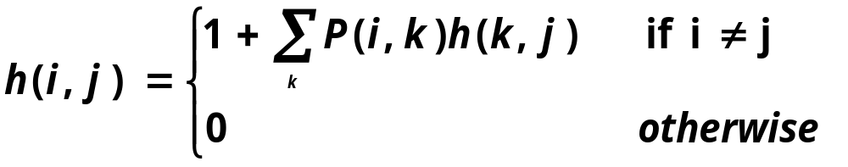

Random walk-based proximity measures
Hitting time can be defined recursively
Symmetric version: commute time
Aldous, D., & Fill, J. A. (2001). Reversible markov chains.
Notes:
Remove the first definition

Slide 9
Hitting & Commute times: Drawbacks
Predictive power
Hitting time and Commute times often take into account very long paths.^{1,2}
You are more prone to pick up popular entities.^{1,2}
  Bad for personalization.
  Alice likes cartoons, so her top 10 recommendations should not be the 10 most popular movies.
As a result these do not perform well for link prediction^{1,2}.
Liben-Nowell, D., & Kleinberg, J. The link prediction problem for social networks CIKM '03.
Brand, M. (2005). A Random Walks Perspective on Maximizing Satisfaction and Profit. SIAM '05.
Notes:
REAL EXAMPLE

Slide 10
Hitting & Commute times: Drawbacks
Computational complexity
Recent “efficient” approximation algorithm for computing commute times in “undirected graphs^{”1.}
For directed graphs, these measures are hard to compute.
For many real world applications
  Underlying graphs are directed
  We need fast incremental algorithms for computing nearest neighbors of a query.
1. Spielman, D., & Srivastava, N. (2008). Graph sparsification by effective resistances. STOC'08

Slide 11
Outline
Proximity measures on a graph
  Standard measures: hitting/commute times
  Improved measure: truncated versions
Ranking using truncated measures
Theoretical results
Algorithm sketch
Experimental results
Notes:
Describe the whole talk

Slide 12
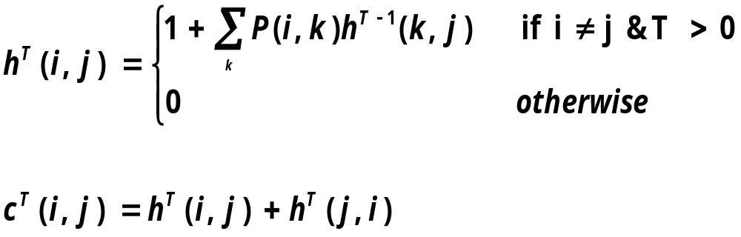
A better proximity measure based on truncated random walks
We use a truncated version of hitting and commute times, which only considers paths of length at most T
Sarkar, P., & Moore, A. (2007). A tractable approach to finding closest truncated-commute-time
neighbors in large graphs. Proc. UAI.
Notes:
CITE UAI

Slide 13
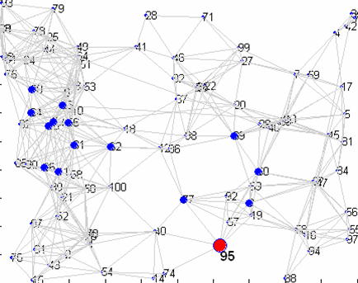
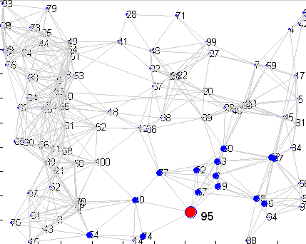
15 nearest neighbors of node 95 (in red)
Un-truncated vs truncated hitting time from a node
Un-truncated hitting time
Truncated hitting time
Random walk gets lost here.

Slide 14
Truncated Hitting & Commute times
For small T
  Are not sensitive to long paths.
  Do not favor high degree nodes
    For a randomly generated undirected graph, average correlation coefficient (R_{avg}) with the degree-sequence is
      R_{avg} with truncated hitting time is -0.087
      R_{avg} with untruncated hitting time is -0.75
Important for
personalized search!
Notes:
REORDER (remember to say what T is)

Slide 15
Computational complexity of truncated hitting time
Hitting time to node j
Have to fill up entire matrix!
O(num_nodes*T*num_edges)!!
Can compute using Dynamic programming in O(T*num_edges)
Hitting time from node i
H^{T}(i,j)=h^{T}(i,j)
Our goal : « O(n²)

Slide 16
Outline
Proximity measures on a graph
  Standard measures: hitting/commute times
  Improved measure: truncated versions
Ranking using truncated measures
Theoretical results
Algorithm sketch
Experimental results

Slide 17
Problem
  Return k approximate nearest neighbors of the query node in truncated commute time without looking at entire graph.
Hitting time FROM
Hitting time TO
☹ | ☺
☺ | ☹
Previous Work: GRANCH
DP
Sampling
Current Work
Sarkar, P., & Moore, A. (2007). A tractable approach to finding closest truncated-commute-time
neighbors in large graphs. Proc. UAI.
Notes:
Previous Work

Slide 18
GRANCH: computing hitting time to a node
hitting time to node j
Use dynamic programming to fill up interesting patches in the column
H^{T}(i,j)=h^{T}(i,j)
Sarkar, P., & Moore, A. (2007). A tractable approach to finding closest truncated-commute-time
neighbors in large graphs. Proc. UAI.

Slide 19
GRANCH: computing hitting time from a node
Fill up all columns
H^{T}(i,j)=h^{T}(i,j)

Slide 20
GRANCH: computing hitting time from a node
hitting time from node i
H^{T}(i,j)=h^{T}(i,j)
Notes:
May be remove

Slide 21
GRANCH: Pros & Cons
Pros: The amortized time and space per node is small.
Cons:
  Large pre-processing time: Looks at entire graph.
  Significant space required: caches neighborhoods for all nodes.
What if the graph changes between two consecutive queries?
➔ Need fast, incremental, space-efficient search algorithms!
Notes:
The good thing is the amortized cost!

Slide 22
Problem
Given τ, k,ε for any node i, find k other nodes y within truncated hitting time 2τ , s.t.
c^{T}_{iy} · c^{T}_{ix}(1+ε)
where x is the true k-th-nearest neighbor.
How many nodes do we need to examine?
  Number of nodes with hitting time ≤ τ from the query
  Number of nodes with hitting time ≤ τ to the query
Theoretical justification that these two quantities are small.
Notes:
Come back to 21

Slide 23
Outline
Proximity measures on a graph
  Standard measures: hitting/commute times
  Improved measure: truncated versions
Ranking using truncated measures
Theoretical results
Algorithm sketch
Experimental results

Slide 24

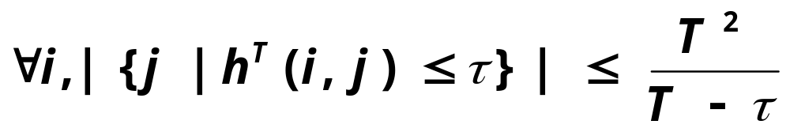
Local properties
G
How many nodes will I hit within τ time?
What is the size of
the set
Notes:
Make everything comic sans
Remove G/ replace with graph?
If T and tau are constant, then this is a small number

Slide 25

Local properties
G
How many nodes will hit me within τ time?
What is the size of
the set
Not too many nodes will have a lot of neighbors
within a small hitting time to them.
Notes:
Say it out in words in 22. Say it in a positive way

Slide 26
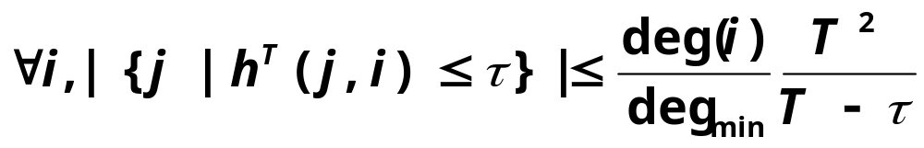
Local properties
G
How many nodes will hit me within τ time?
What is the size of
the set
Undirected Graphs!

Slide 27
Outline
Proximity measures on a graph
  Standard measures: hitting/commute times
  Improved measure: truncated versions
Ranking using truncated measures
Theoretical results
Algorithm sketch
Experimental results

Slide 28
Combining sampling and dynamic programming: Algorithm sketch
Use sampling to estimate hitting time from node i
Maintain a neighborhood NB(i) around node i
Use estimated hitting times and dynamic programming to compute bounds on commute time of nodes in NB(i) and i.
As we expand the neighborhood these bounds get tighter.
Rank using bounds on commute times.
Notes:
Dynamic programming to compute hitting time to.

Slide 29
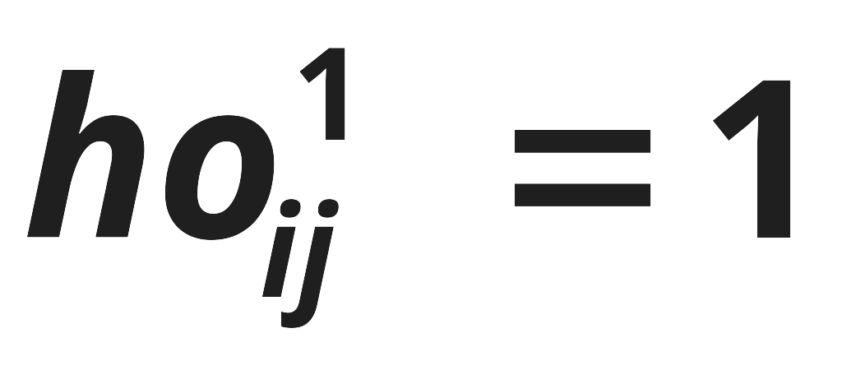
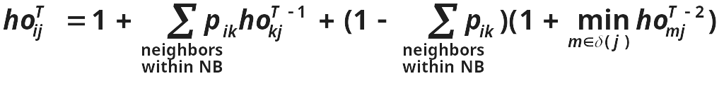
Optimistic bounds (ho-values)
UAI’07
What is fastest way to go back ?
  Jump to the boundary node that has smallest hitting time to the destination (2)
11
2
1
5
3
NB(1) = {2 3 4 5 }
δ(1) = {2 5}
4
Notes:
CHANGE the MATH to ENGLISH

Slide 30
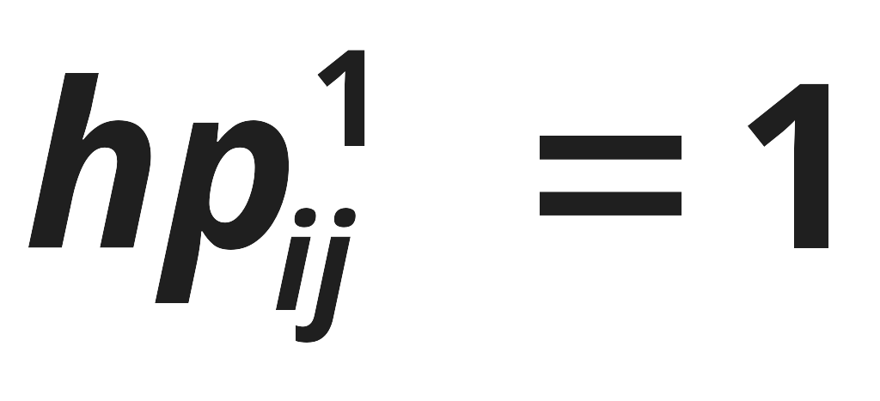
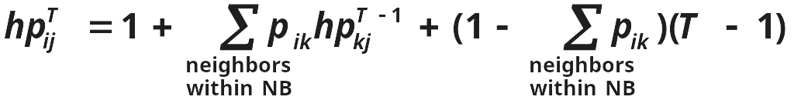
Pessimistic bounds (hp-values)
UAI’07
What is the worst case ?
  Don’t go back at all, i.e. take at least T time.
11
11
2
2
5
1
5
1
3
3
NB(1) = {2 3 4 5 }
δ(1) = {2 5}
4

Slide 31
Sampling for computing hitting time from a node
T=5
10
h(1,5) = 1
h(1,9) = 2
h(1,7) = 4
h(1,-) = 5
9
11
2
8
7
1
5
3
6
4
1 5 9 5 7

Slide 32
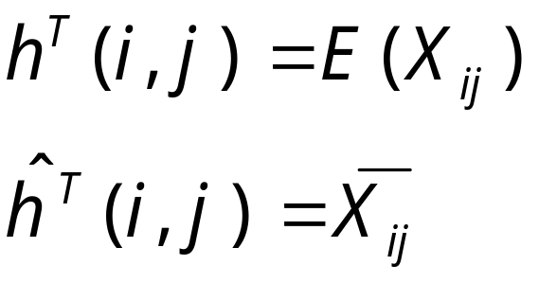
Sampling for computing hitting time from a node
Define X(i,j) as the first hitting time at j.
If the random walk never hits j, X(i,j) = T.
Notes:
INTUITION

Slide 33
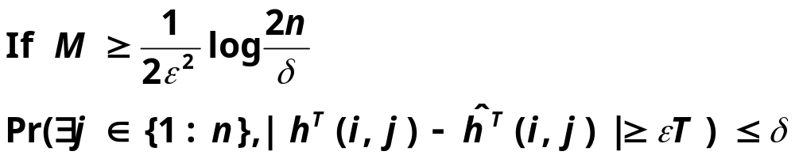
Sample complexity bounds
Estimating h(i,j), j=1,…,n
  The number of samples needed to achieve low error with high probability is proportional to log(n).

Slide 34
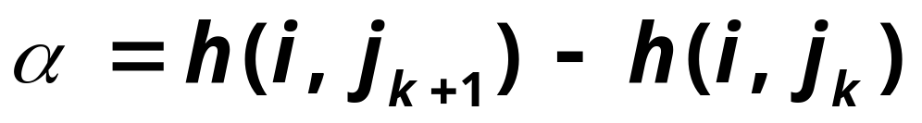
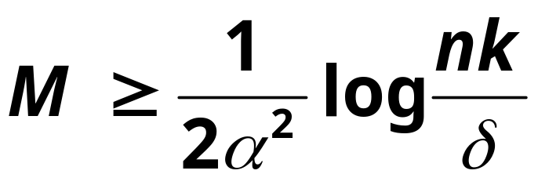
Sample complexity bounds
Let {j₁ j₂ j_{3 ….} j_{k}} be the true k nearest neighbors of i.
Also, let
If
then we can retrieve the top k neighbors with high probability.

Slide 35
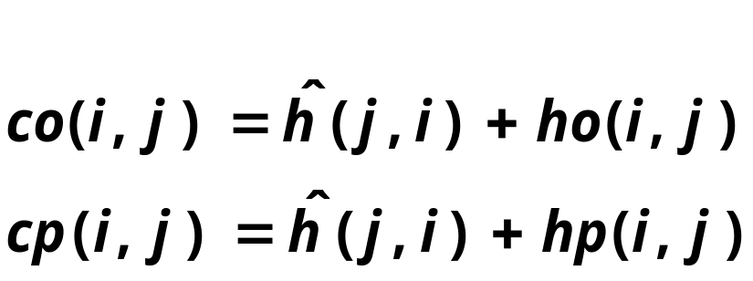


New upper and lower bounds on commute times
w.h.p
w.h.p
Can estimate from samples
co(i,j) = lb_{ct}(j)
cp(i,j) = 2T

Slide 36
Outline
Proximity measures on a graph
  Standard measures: hitting/commute times
  Improved measure: truncated versions
Ranking using truncated measures
Theoretical results
Algorithm sketch
Experimental results

Slide 37
Citeseer graph: Average query processing time
Find k nearest neighbors of a query node in truncated hitting/commute times
628,000 nodes. 2.8 Million edges on a single CPU machine.
  Sampling (1000 samples) 0.7 seconds
  Exact truncated commute time: 88 seconds
  Hybrid commute time: 4 seconds
Notes:
Check the sample seconds

Slide 38
Keyword-author-citation graphs
words
papers
authors
Existing work use Personalized Pagerank (PPV) .
We present quantifiable link prediction tasks
We compare PPV with truncated hitting and commute times.
Dynamic personalized pagerank in entity-relation graphs. (Chakrabarti, S., WWW 2007)
Balmin, A., Hristidis, V., & Papakonstantinou, Y. (2004). ObjectRank: Authority-based keyword
search in databases. VLDB 2004.
Notes:
CHANGE the links

Slide 39
Word Task
words
papers
authors
Remove the links between the words and the paper
Rank the papers for these words.
See if the paper comes up in top 1,3,5,…

Slide 40
Author Task
words
papers
authors
Remove the links between the authors and the paper
Rank the papers for these authors.
See if the paper comes up in top 1,3,5,…

Slide 41
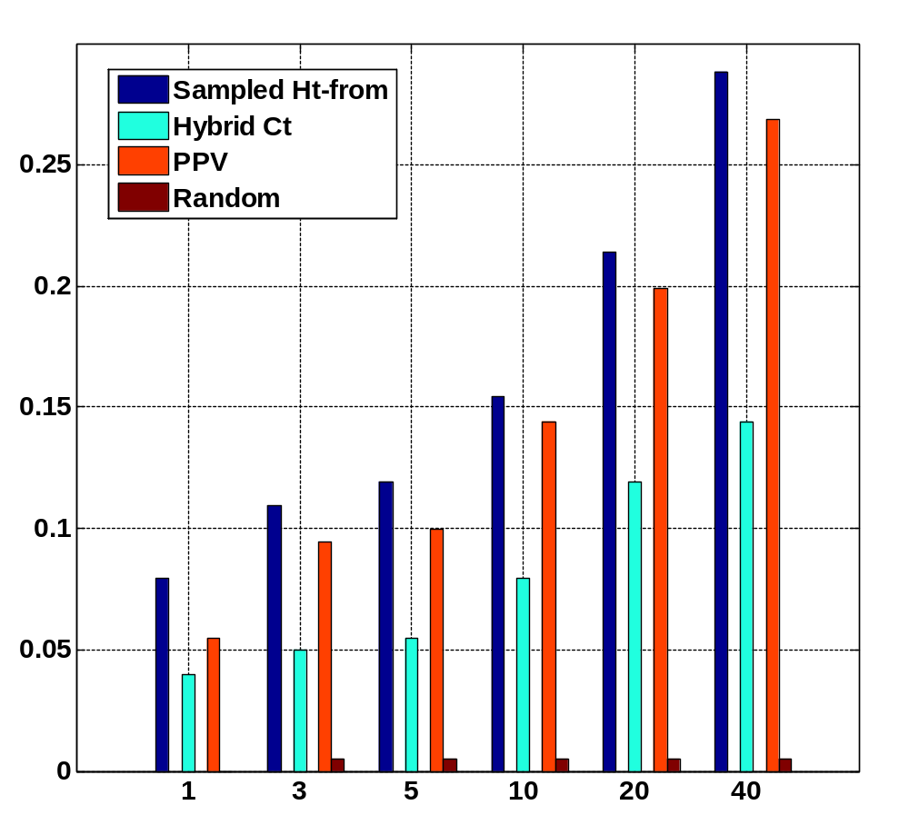
Word Task
Fraction of queries with the held out paper in top k
k

Slide 42
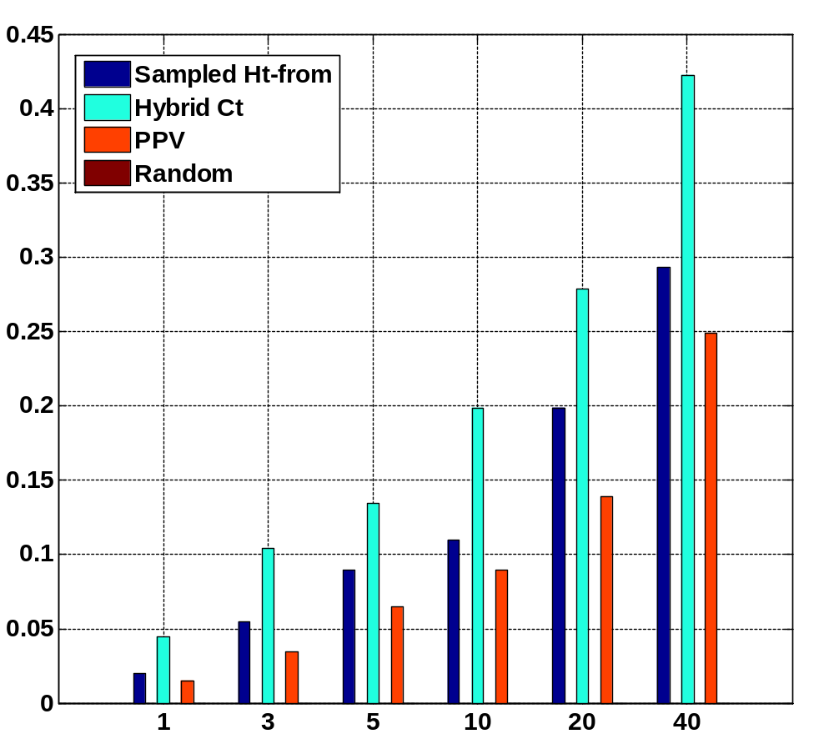
Author Task
Fraction of queries with the held out paper in top k
k

Slide 43
Conclusion
Incremental algorithm to compute approximate nearest neighbors in truncated hitting and commute time.
If the graph changes between consecutive queries, our algorithm is fast.
On most quantifiable link prediction tasks our measures outperform personalized pagerank.
On a single CPU machine, we can process queries in 4 seconds on average in a graph with 600,000 nodes and 3 million edges.
Notes:
Emphasize the fact that its incremental, fast even if the graph changes between queries

Slide 44
Acknowledgement
Soumen Chakrabarti
Anupam Gupta
Geoffrey Gordon
Tamás Sarlós
Martin Zinkevich

Slide 45
Thank you

