Slide 1



Fast Incremental Proximity Search in Large Graphs
Purnamrita Sarkar
Andrew W. Moore
Amit Prakash

Slide 2




Recommender systems
Alice
What are the top k movie recommendations for Alice?
Bob
Charlie
Brand, M. (2005). A Random Walks Perspective on Maximizing Satisfaction and Profit. SIAM '05.

Slide 3
Content-based search in databases^{{1,2}}
modeling
paper-has-word
Find top k papers matching OLAP
multidimensional
Paper #1
databases
paper-cites-paper
paper-has-word
range
Paper #2
queries
OLAP
1. Dynamic personalized pagerank in entity-relation graphs. (Soumen Chakrabarti, WWW 2007)
2. Balmin, A., Hristidis, V., & Papakonstantinou, Y. (2004). ObjectRank: Authority-based keyword
search in databases. VLDB 2004.

Slide 4
Proximity measures
2
1
5
3
4
How easily can information flow from 1 to 2?

Slide 5
Proximity measures
2
1
5
3
Random walks
4
How easily can information flow from 1 to 2?
More paths => easier flow of information

Slide 6
Random walks
Start at 1
2
1
5
3
4

Slide 7
Random walks
Start at 1
Pick a neighbor i uniformly at random
Move to i
t=1
2
1
5
3
4

Slide 8
Random walks
Start at 1
Pick a neighbor i uniformly at random
Move to i
Continue.
t=1
2
1
5
3
4
t=2

Slide 9
Random walks
Start at 1
Pick a neighbor i uniformly at random
Move to i
Continue.
t=1
2
1
5
3
t=3
4
t=2

Slide 10
Proximity between nodes i and j using random walks
If we start the random walk at i what is the probability of hitting j.
  Personalized pagerank^{{1,2,3}}
If we start the random walk at i what is the expected time to hit j
  Hitting and commute times
1.Scaling Personalized Web Search, Jeh, Widom. 2003.
2.Topic-sensitive PageRank, Haveliwala, 2001
3. Towards scaling fully personalized pagerank, D. Fogaras and B. Racz, 2004
Notes:
Footnotes: not all citations

Slide 11

Personalized pagerank
Personalized pagerank for node i
  Start from node i
  At any timestep jump to node i with probability c
  Stop when the distribution does not change.
  Solve for v such that
  r is a distribution
Notes:
vague

Slide 12
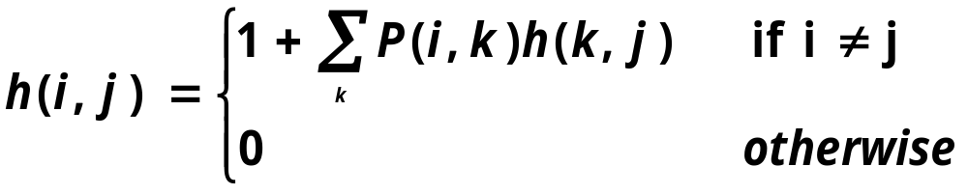
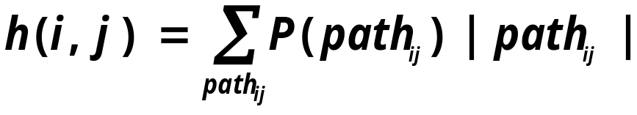
Hitting time from node i to node j
Expected time to hit node j starting at node i.
In essence it is the expected path length
Is not symmetric.
Aldous, D., & Fill, J. A. (2001). Reversible markov chains.

Slide 13
Commute time between nodes i and j
C(i,j) = H(i,j) + H(j,i)
  = Avg. # hops to reach j and come back to i
For undirected graphs, C(i,j) can be computed using pseudo-inverse of the graph Laplacian¹
1. Qiu, H., & Hancock, E. R. (2005). Image segmentation using commute times. BMVC.

Slide 14
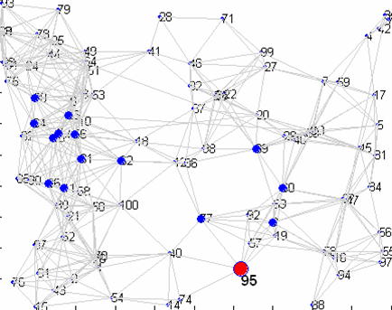
Hitting time from a node: drawbacks
15 nearest neighbors of node 95 (in red)
Random walk gets lost here.

Slide 15
Hitting & Commute times : Drawbacks
Hitting time and Commute times often take into account very long paths.^{1,2}
You are more prone to pick up popular entities.^{1,2}
  Bad for personalization.
As a result these do not perform well for link prediction^{1,2}.
Liben-Nowell, D., & Kleinberg, J. The link prediction problem for social networks CIKM '03.
Brand, M. (2005). A Random Walks Perspective on Maximizing Satisfaction and Profit. SIAM '05.

Slide 16
Hitting & Commute times : Drawbacks
Recent “efficient” approximation algorithm for computing commute times in “undirected graphs^{”1.}
For directed graphs, these measures are hard to compute.
For many real world applications
  Underlying graphs are directed
  We need fast incremental algorithms for computing nearest neighbors of a query.
1. Spielman, D., & Srivastava, N. (2008). Graph sparsification by effective resistances. STOC'08

Slide 17
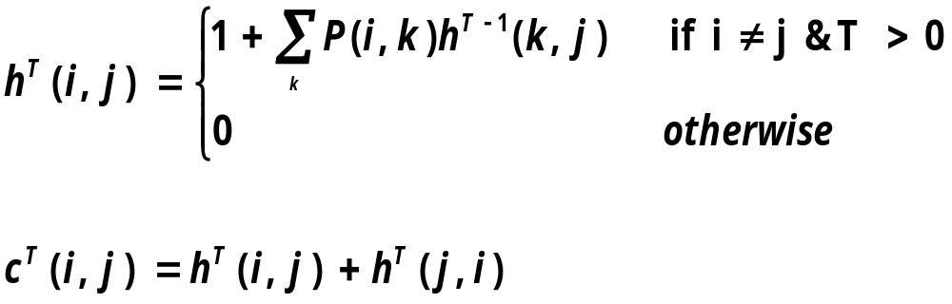
Short term random walks
We propose a truncated version of hitting and commute times, which only considers paths of length T

Slide 18
Truncated Hitting & Commute times
For small T
  Are not sensitive to long paths.
  Do not favor high degree nodes
    For a randomly generated undirected graph, average correlation coefficient (R_{avg}) with the degree-sequence is
      R_{avg} with truncated hitting time is -0.087
      R_{avg} with untruncated hitting time is -0.75
Notes:
REORDER (remember to say what T is)

Slide 19
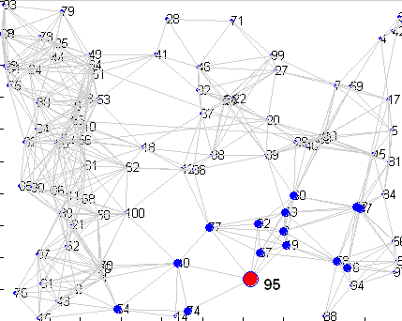
15 nearest neighbors of node 95 (in red)
Un-truncated VS. truncated hitting time from a node
Un-truncated hitting time
Truncated hitting time

Slide 20
Computational complexity
Easy to compute hitting time to node O(T|E|)
Compute all pairs O(Tn|E|)
Hard to compute hitting time from a node O(Tn|E|)
Our goal : « O(n²)

Slide 21
Computing truncated hitting time to a node
Naïve: just do dynamic programming. Will take T|E| time.
Can we do better?
For a given real value τ≤T, how “local” are these measures?
  i.e. how many nodes will have hitting time smaller than τ ?

Slide 22

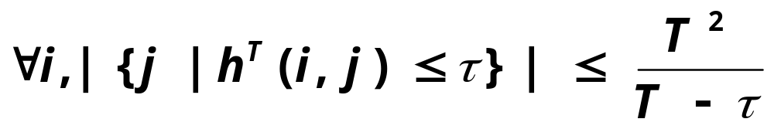
Local properties
G
How many nodes will I hit within τ time?
What is the size of
the set
Notes:
Explain T again

Slide 23

Local properties
G
How many nodes will hit me within τ time?
What is the size of
the set
Can only give weak counting arguments for
Directed Graphs.

Slide 24
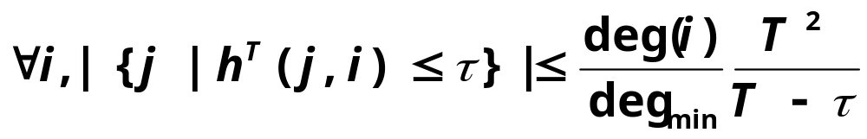
Local properties
G
How many nodes will hit me within τ time?
What is the size of
the set
Undirected Graphs!

Slide 25
Objective
What are the questions that we want to answer ?
  Given τ, k,ε for any node i, find k other nodes y within truncated hitting time τ, s.t.
  h^{T}_{iy} · h^{T}_{ix}(1+ε)
  where x is the true k-th-nearest neighbor.
We want to only look at entities which are potential nearest neighbors.
Notes:
THINK ABT IT

Slide 26
GRANCH: the branch and bound algorithm
We know that there is a small neighborhood containing potential neighbors in hitting time.
How do we find this neighborhood before computing the exact distances?
We will use upper and lower bounds on hitting time, and use those to prune away most of the graph.
Sarkar, P., & Moore, A. (2007). A tractable approach to finding closest truncated-commute-time
neighbors in large graphs. Proc. UAI.
Notes:
Citation

Slide 27
GRANCH: Hitting time to a node j
Maintain a neighborhood NB(j) around j.
For all nodes inside the neighborhood compute upper and lower bounds on hitting time to j.
Characterize hitting time from all other nodes with a single lower and upper bound.
Bounds get tighter as we expand the neighborhood.

Slide 28
Optimistic & Pessimistic bounds on truncated hitting times
If i 2 NB(j)
  ho^{T}_{ij} · h^{T}_{ij} · hp^{T}_{ij}
If i∉ NB(j)
  lb(j) · h^{T}_{ij} · T
We do NOT need to compute the optimistic and pessimistic bounds for all pairs.
Notes:
ANIMATE

Slide 29
Expanding the Neighborhood of j
Start with all nodes within one or two hops of node j.
  Compute ho^{T}, hp^{T} values of current neighborhood.
  Compute lb(j)
  Expand neighborhood
Stop when lb(j)¸ τ
11
11
2
2
5
1
5
1
3
3
4
4
NB(1) = {2 3 4 5 }
δ(1) = { 5}
11
2
NB(1) is the neighborhood
δ(1) is the boundary
Notes:
SHOW ONE LINE AT A TIME
DEFINE delta and NB

Slide 30
Completeness guarantee
Once we have expanded the neighborhoods,
  For any node j all nodes i∉ NB(j) will have h^{T}ij ¸ τ.
  We are not interested in these nodes.
➔ We will never miss a potential nearest neighbor in h^{T} .

Slide 31
Hitting time from a node
H^{T} : Truncated hitting time matrix
Notes:
Connect with former

Slide 32
Hitting time from a node
hitting time to node j
Expand neighborhood of all nodes
Fill up interesting patches in the columns
H^{T}

Slide 33
Hitting time from a node
hitting time to node j
H^{T}

Slide 34
Hitting time from a node
hitting time from node i
H^{T}

Slide 35
How to rank with bounds
We want: all nodes closer than the TRUE k-th nearest neighbor.
I will skip these details for time constraint.
Notes:
ANIMATE / REMOVE

Slide 36
GRANCH: Drawbacks
Need to cache the neighborhoods for all nodes.
Large pre-processing time.
➔ Need fast, incremental, space-efficient search algorithms!
Use sampling to compute
estimates of hitting time from a node

Slide 37
Sampling for computing hitting time from a node
10
9
11
2
8
7
1
5
3
6
4
1

Slide 38
Sampling for computing hitting time from a node
10
9
11
2
8
7
1
5
3
6
4
1 5

Slide 39
Sampling for computing hitting time from a node
10
9
11
2
8
7
1
5
3
6
4
1 5 9

Slide 40
Sampling for computing hitting time from a node
10
9
11
2
8
7
1
5
3
6
4
1 5 9 5

Slide 41
Sampling for computing hitting time from a node
10
9
11
2
8
7
1
5
3
6
4
1 5 9 5 7

Slide 42
Sampling for computing hitting time from a node
T=5
10
h(1,5) = 1
h(1,9) = 2
h(1,7) = 4
h(1,-) = 5
9
11
2
8
7
1
5
3
6
4
1 5 9 5 7

Slide 43
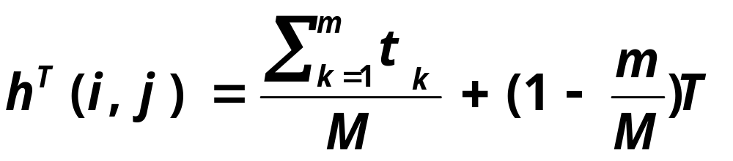
Sampling for computing hitting time from a node
Calculate M samples from i
Suppose m of these hit j for the first time at
{t₁ t₂ ……t_{m}}.
Notes:
INTUITION

Slide 44
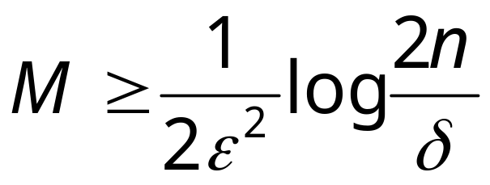
How close can you get in error?
If

Slide 45
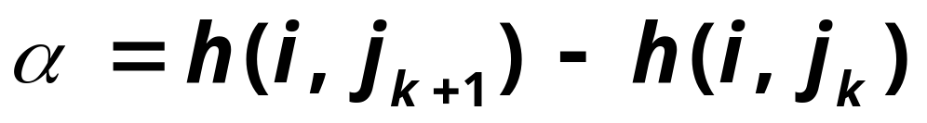
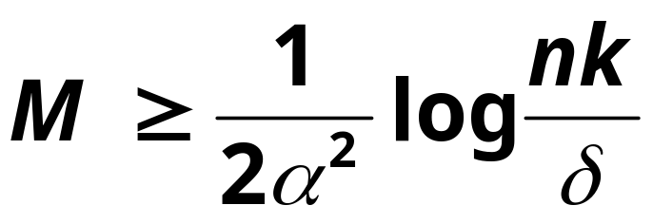
How close can you get in ranking?
Let {j₁ j₂ j_{3 ….} j_{k}} be the true k nearest neighbors of i.
Also, let
If
then we can retrieve the top k neighbors with high probability.

Slide 46
How close can you get in ranking?
Let {j₁ j₂ j_{3 ….} j_{k}} be the true k nearest neighbors of i.
Also, let
If
Well separated: easy to retrieve!
then we can retrieve the top k neighbors with high probability.

Slide 47
Sampling and DP
Hitting time FROM
Hitting time TO
☹ | ☺
☺ | ☹
DP
Sampling

Slide 48
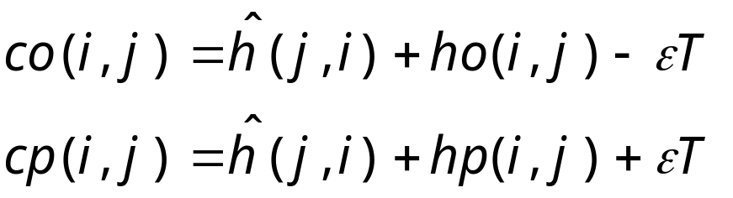


New upper and lower bounds on commute times
w.h.p
w.h.p
Can estimate from samples
co(i,j) = lb_{ct}(j)
cp(i,j) = 2T

Slide 49
The hybrid algorithm
Use sampling to estimate hitting time from node j
Use the same neighborhood expansion scheme, with the bounds on commute time.
Stop when the lower bound on commute time from outside the neighborhood exceeds 2τ.
We start τ with a small value and increase it until we have tight enough bounds for returning k nearest neighbors.
Rank using bounds
Notes:
ANIMATE

Slide 50
Keyword-author-citation graphs¹
words
papers
authors
Existing work use Personalized Pagerank (PPV)^{1,2} .
We present quantifiable link prediction tasks
We compare PPV with truncated hitting and commute times.
1.Dynamic personalized pagerank in entity-relation graphs. (Soumen Chakrabarti, WWW 2007)
2. Balmin, A., Hristidis, V., & Papakonstantinou, Y. (2004).
ObjectRank: Authority-based keyword search in databases. VLDB 2004.
Notes:
CHANGE the links

Slide 51
Word Task
words
papers
authors

Slide 52
Word Task
words
papers
authors
Rank the papers for these words.
See if the paper comes up in top 1,3,5,…

Slide 53
Author Task
words
papers
authors
Rank the papers for these authors.
See if the paper comes up in top 1,3,5,…

Slide 54
Citeseer graph: Average query processing time
628,000 nodes. 2.8 Million edges on a single CPU machine.
  Sampling (1000 samples) 0.1 seconds
  Exact truncated commute time: 86 seconds
  Hybrid: 4 seconds

Slide 55
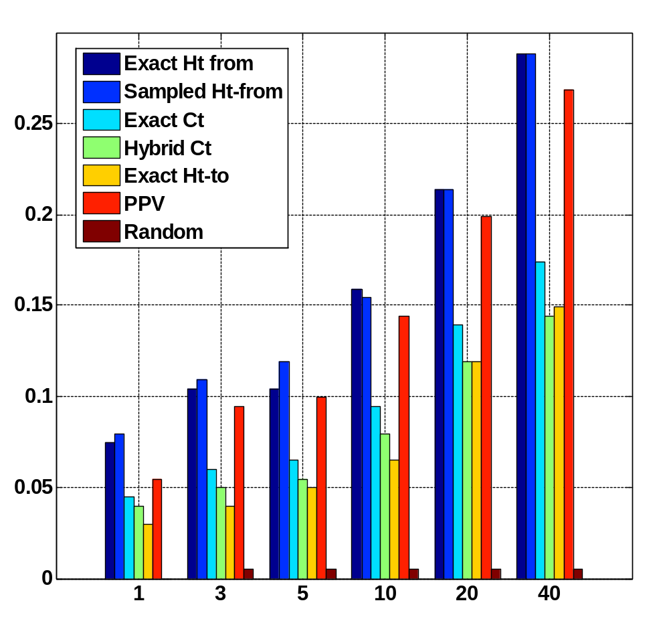

Word Task
Fraction of queries with the held out paper in top k
k

Slide 56
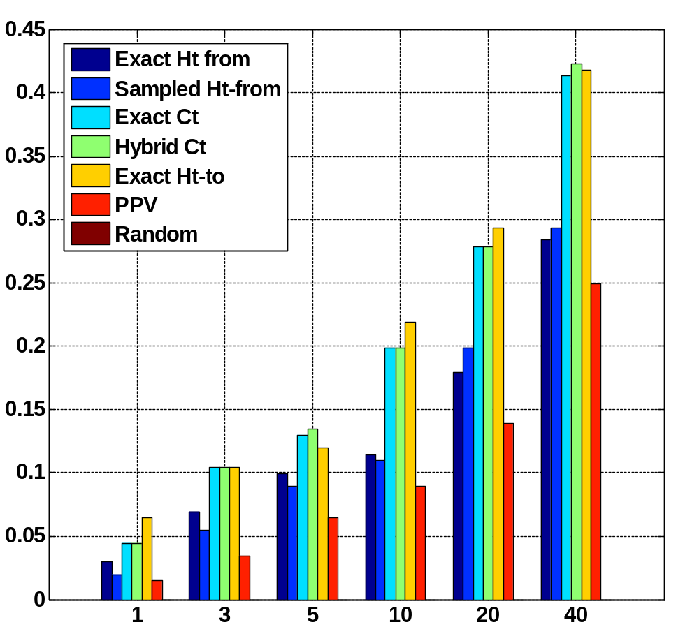
Author Task
Fraction of queries with the held out paper in top k
k

Slide 57
PPV & hitting times
What is PPV
  Sample L from a geometric distribution with the teleportation probability
  Sample a path of length L from i
  For most practical purposes L=10/12
  PPV_{i}(j) is the probability that node j appears at the end of this path
Approximate PPV uses less information that truncated hitting times!

Slide 58
Acknowledgement
Soumen Chakrabarti
Anupam Gupta
Geoffrey Gordon
Tamás Sarlós
Martin Zinkevich

Slide 59
Thank you

Slide 60
Computing truncated hitting time to node 1
10
9
11
2
8
7
1
5
3
6
4

Slide 61
Computing truncated hitting time to node 1
10
9
11
2
8
7
1
5
3
6
4
H¹(i,1)=1 8 i≠ 1

Slide 62

Computing truncated hitting time to node 1
10
9
11
2
8
7
1
5
3
6
4

Slide 63
Computing truncated hitting time to node 1
2
2
2
10
1.75
9
11
2
1.67
2
7
8
5
2
1
3
0
1.67
6
2
4
1.67

Slide 64
Computing truncated hitting time to node 1
2
2
2
10
1.75
9
11
2
1.67
2
7
8
5
2
1
3
0
1.67
6
2
Hitting times to each node
can be computed
independently!!
4
1.67

Slide 65
GRANCH: Basic Idea
H^{T}(2,1)= ?
11
2
1
5
3
4
Notes:
LEGENDS: put an arc

Slide 66
GRANCH: Basic Idea
H^{T}(2,1)= ?
11
2
1
5
3
4

Slide 67

GRANCH: Basic Idea
H^{T-1}(11,1)= ?
H^{T}(2,1)= ?
11
2
1
5
3
4

Slide 68

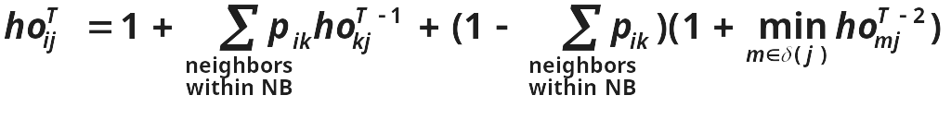
Optimistic bounds (ho-values)
What is fastest way to go back ?
  Jump to the boundary node that has smallest hitting time to the destination (2)
11
2
1
5
3
NB(1) = {2 3 4 5 }
δ(1) = {2 5}
4
Notes:
CHANGE the MATH to ENGLISH

Slide 69

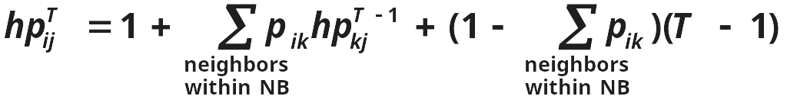
Pessimistic bounds (hp-values)
What is the worst case ?
  Don’t go back at all, i.e. take at least T time.
11
11
2
2
5
1
5
1
3
3
NB(1) = {2 3 4 5 }
δ(1) = {2 5}
4

Slide 70
Formal definitions
nxn Adjacency matrix A
  A(i,j) = weight on edge from i to j
  If the graph is undirected A(i,j)=A(j,i), i.e. A is symmetric
nxn Transition matrix P
  P is row stochastic
  P(i,j) = probability of stepping on node j from node i
  = A(i,j)/∑_{i}A(i,j)
nxn Laplacian matrix L
  L is symmetric positive semi-definite for undirected graphs
  L = D-A
D is a diagonal matrix of degrees.

Slide 71
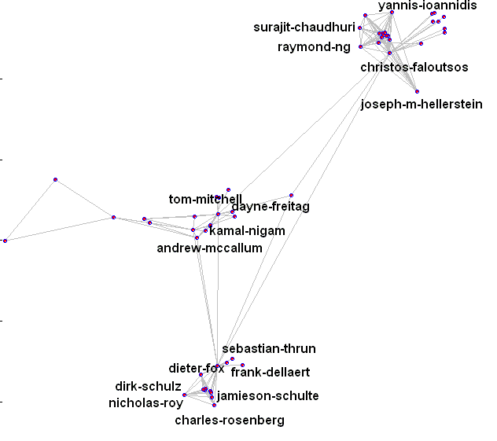
Link prediction
Will Andrew McCallum and Christos Faloutsos write a paper together?
Who are the most likely co-authors of a given author?
Liben-Nowell, D., & Kleinberg, J. (2003). The link prediction problem for social networks. CIKM '03.

Slide 72
Proximity measures : how to reach 2 from 1?
Paths
2
1
5
1,2
3
4

Slide 73
Proximity measures : how to reach 2 from 1?
Paths
2
1
5
1,2
1,4,2
3
4

Slide 74
Proximity measures : how to reach 2 from 1?
Paths
2
1
5
1,2
1,4,2
1,3,2
3
4

Slide 75
Proximity measures : how to reach 2 from 1?
Paths
2
1
5
1,2
1,4,2
1,3,2
1,4,3,2
…..
…..
3
4
So many paths! Which one should you take?

Slide 76
Proximity measures : how to reach 2 from 1?
Paths
2
1
5
1,2
1,4,2
1,3,2
1,4,3,2
…..
…..
3
4
So many paths! Which one should you take?

