Slide 1



Fast Incremental Proximity Search in Large Graphs
Purnamrita Sarkar
Andrew W. Moore
Amit Prakash

Slide 2




Recommender systems
Alice
What are the top k movie recommendations for Alice?
Bob
Charlie
Brand, M. (2005). A Random Walks Perspective on Maximizing Satisfaction and Profit. SIAM '05.

Slide 3
Content-based search in databases^{{1,2}}
modeling
paper-has-word
Find top k papers matching OLAP
multidimensional
Paper #1
databases
paper-cites-paper
paper-has-word
range
Paper #2
queries
OLAP
1. Dynamic personalized pagerank in entity-relation graphs. (Soumen Chakrabarti, WWW 2007)
2. Balmin, A., Hristidis, V., & Papakonstantinou, Y. (2004). ObjectRank: Authority-based keyword
search in databases. VLDB 2004.

Slide 4
Proximity measures
2
1
5
3
Random walks
4
How similar are 1 and 2?
Lots of short paths ➔ similar in many ways

Slide 5
Random walks
Start at 1
2
1
5
3
4

Slide 6
Random walks
Start at 1
Pick a neighbor i uniformly at random
Move to i
t=1
2
1
5
3
4

Slide 7
Random walks
Start at 1
Pick a neighbor i uniformly at random
Move to i
Continue.
t=1
2
1
5
3
4
t=2

Slide 8
Random walks
Start at 1
Pick a neighbor i uniformly at random
Move to i
Continue.
t=1
2
1
5
3
t=3
4
t=2

Slide 9
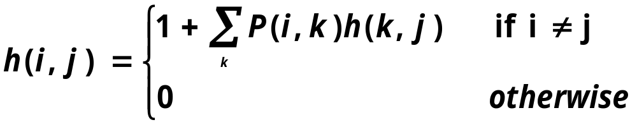
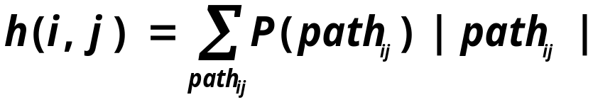
Hitting time from node i to node j
Expected time to hit node j starting at node i.
In essence it is the expected path length
Is not symmetric.
Aldous, D., & Fill, J. A. (2001). Reversible markov chains.
Notes:
cartoon

Slide 10
Commute time between nodes i and j
C(i,j) = H(i,j) + H(j,i)
  = Avg. # hops to reach j and come back to i
For undirected graphs, C(i,j) can be computed using pseudo-inverse of the graph Laplacian¹
1. Qiu, H., & Hancock, E. R. (2005). Image segmentation using commute times. BMVC.

Slide 11
Hitting & Commute times : Drawbacks
Hitting time and Commute times often take into account very long paths.^{1,2}
You are more prone to pick up popular entities.^{1,2}
  Bad for personalization.
  Alice likes cartoons, so her top 10 recommendations should not be the 10 most popular movies.
As a result these do not perform well for link prediction^{1,2}.
Liben-Nowell, D., & Kleinberg, J. The link prediction problem for social networks CIKM '03.
Brand, M. (2005). A Random Walks Perspective on Maximizing Satisfaction and Profit. SIAM '05.
Notes:
REAL EXAMPLE

Slide 12
Hitting & Commute times : Drawbacks
Recent “efficient” approximation algorithm for computing commute times in “undirected graphs^{”1.}
For directed graphs, these measures are hard to compute.
For many real world applications
  Underlying graphs are directed
  We need fast incremental algorithms for computing nearest neighbors of a query.
1. Spielman, D., & Srivastava, N. (2008). Graph sparsification by effective resistances. STOC'08

Slide 13
Our objective
Use a better measure (truncated hitting/commute times)
  Proposed in UAI-07
Compute approximate nearest neighbors w.r.t truncated hitting/commute times without looking at the entire graph.
Notes:
DISTINGUISH FROM UAI PAPER

Slide 14
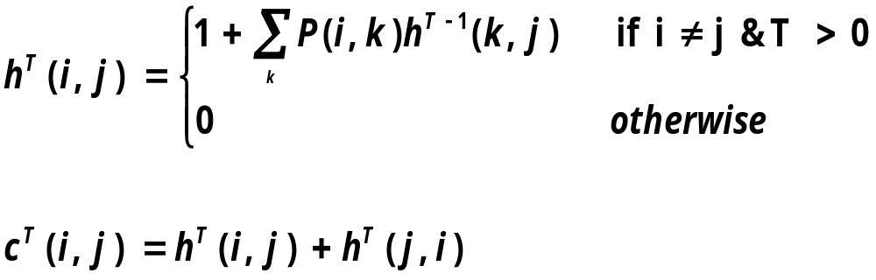
Short term random walks
We propose a truncated version of hitting and commute times, which only considers paths of length at most T
Notes:
CITE UAI

Slide 15
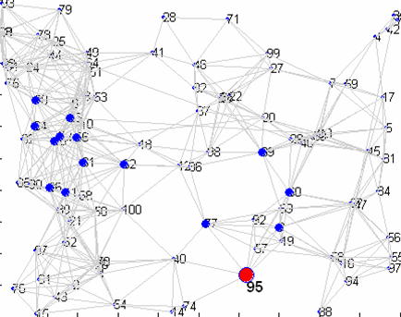
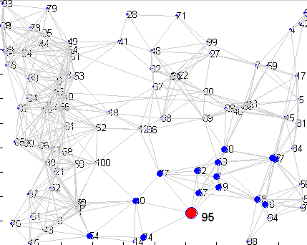
15 nearest neighbors of node 95 (in red)
Un-truncated VS. truncated hitting time from a node
Un-truncated hitting time
Truncated hitting time
Random walk gets lost here.

Slide 16
Truncated Hitting & Commute times
For small T
  Are not sensitive to long paths.
  Do not favor high degree nodes
    For a randomly generated undirected graph, average correlation coefficient (R_{avg}) with the degree-sequence is
      R_{avg} with truncated hitting time is -0.087
      R_{avg} with untruncated hitting time is -0.75
Notes:
REORDER (remember to say what T is)

Slide 17
Computational complexity
Easy to compute hitting time to node O(T|E|)
Compute all pairs O(Tn|E|)
Hard to compute hitting time from a node O(Tn|E|)
Our goal : « O(n²)
Notes:
Color to and from
Label T and E
Put the objective here under our goal

Slide 18
Objective
What are the questions that we want to answer ?
  Return k approximate nearest neighbors in truncated commute time
Hitting time FROM
Hitting time TO
☹ | ☺
☺ | ☹
DP
Sampling
Sarkar, P., & Moore, A. (2007). A tractable approach to finding closest truncated-commute-time
neighbors in large graphs. Proc. UAI.
Notes:
THINK ABT IT

Slide 19
Computing truncated hitting time to a node
Naïve: just do dynamic programming. Will take T|E| time.
Can we do better?
For a given real value τ≤T, how “local” are these measures?
  i.e. how many nodes will have hitting time smaller than τ ?

Slide 20

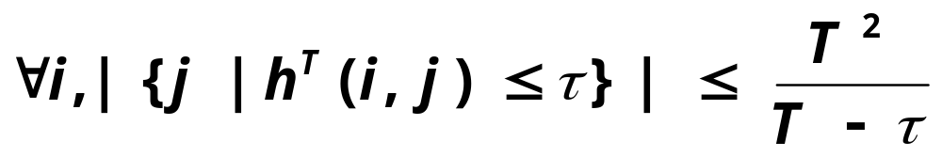
Local properties
G
How many nodes will I hit within τ time?
What is the size of
the set
Notes:
Explain T again

Slide 21

Local properties
G
How many nodes will hit me within τ time?
What is the size of
the set
Can only give weak counting arguments for
Directed Graphs.

Slide 22
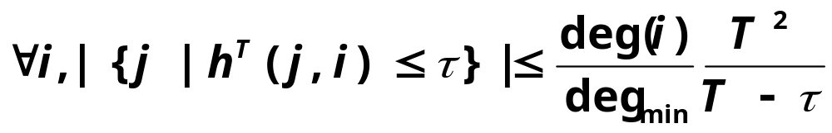
Local properties
G
How many nodes will hit me within τ time?
What is the size of
the set
Undirected Graphs!

Slide 23
GRANCH: the branch and bound algorithm
Compute k nearest neighbors within hitting time τ
We know that there is a small neighborhood containing potential neighbors in hitting time.
How do we find this neighborhood before computing the exact distances?
We will use upper and lower bounds on hitting time, and use those to prune away most of the graph.
Notes:
Citation

Slide 24
GRANCH: Hitting time to a node j
Maintain a neighborhood NB(j) around j.
For all nodes inside the neighborhood compute upper and lower bounds on hitting time to j.
Characterize hitting time from all other nodes with a single lower and upper bound.
Bounds get tighter as we expand the neighborhood.

Slide 25
Hitting time from a node
hitting time to node j
Expand neighborhood of a node
Fill up interesting patches in the column
H^{T}

Slide 26
Hitting time from a node
hitting time to node j
H^{T}

Slide 27
Hitting time from a node
hitting time from node i
H^{T}
Notes:
May be remove

Slide 28
GRANCH: Drawbacks
Need to cache the neighborhoods for all nodes.
Large pre-processing time.
➔ Need fast, incremental, space-efficient search algorithms!
Use sampling to compute
estimates of hitting time from a node

Slide 29
Sampling for computing hitting time from a node
10
9
11
2
8
7
1
5
3
6
4
1

Slide 30
Sampling for computing hitting time from a node
10
9
11
2
8
7
1
5
3
6
4
1 5

Slide 31
Sampling for computing hitting time from a node
10
9
11
2
8
7
1
5
3
6
4
1 5 9

Slide 32
Sampling for computing hitting time from a node
10
9
11
2
8
7
1
5
3
6
4
1 5 9 5

Slide 33
Sampling for computing hitting time from a node
10
9
11
2
8
7
1
5
3
6
4
1 5 9 5 7

Slide 34
Sampling for computing hitting time from a node
T=5
10
h(1,5) = 1
h(1,9) = 2
h(1,7) = 4
h(1,-) = 5
9
11
2
8
7
1
5
3
6
4
1 5 9 5 7

Slide 35
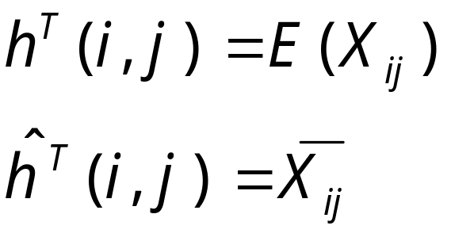
Sampling for computing hitting time from a node
Define X(i,j) as the first hitting time at j.
If the random walk never hits j, X(i,j) = T.
Notes:
INTUITION

Slide 36
Sample complexity bounds
Estimating h(i,j), j=1,…,n
  [Theorem]: The number of sampled needed to achieve low error with high probability is proportional to log(n).
Retrieving top k neighbors
  [Theorem]: Number of samples needed to retrieve top k neighbors with high probability is small if the gap between the true k^{th} and k+1th neighbor is large.

Slide 37
The hybrid algorithm
Use sampling to estimate hitting time from node j
Use neighborhood expansion scheme from GRANCH, with the bounds on commute time.
Stop when the lower bound on commute time from outside the neighborhood exceeds 2τ.
We start τ with a small value and increase it until we have tight enough bounds for returning k nearest neighbors.
Rank using bounds
Notes:
ANIMATE

Slide 38
Citeseer graph: Average query processing time
628,000 nodes. 2.8 Million edges on a single CPU machine.
  Sampling (1000 samples) 0.7 seconds
  Exact truncated commute time: 86 seconds
  Hybrid: 4 seconds
Notes:
Check the sample seconds

Slide 39
Keyword-author-citation graphs¹
words
papers
authors
Existing work use Personalized Pagerank (PPV)^{1,2} .
We present quantifiable link prediction tasks
We compare PPV with truncated hitting and commute times.
1.Dynamic personalized pagerank in entity-relation graphs. (Soumen Chakrabarti, WWW 2007)
2. Balmin, A., Hristidis, V., & Papakonstantinou, Y. (2004).
ObjectRank: Authority-based keyword search in databases. VLDB 2004.
Notes:
CHANGE the links

Slide 40
Word Task
words
papers
authors

Slide 41
Word Task
words
papers
authors
Rank the papers for these words.
See if the paper comes up in top 1,3,5,…

Slide 42
Author Task
words
papers
authors
Rank the papers for these authors.
See if the paper comes up in top 1,3,5,…

Slide 43
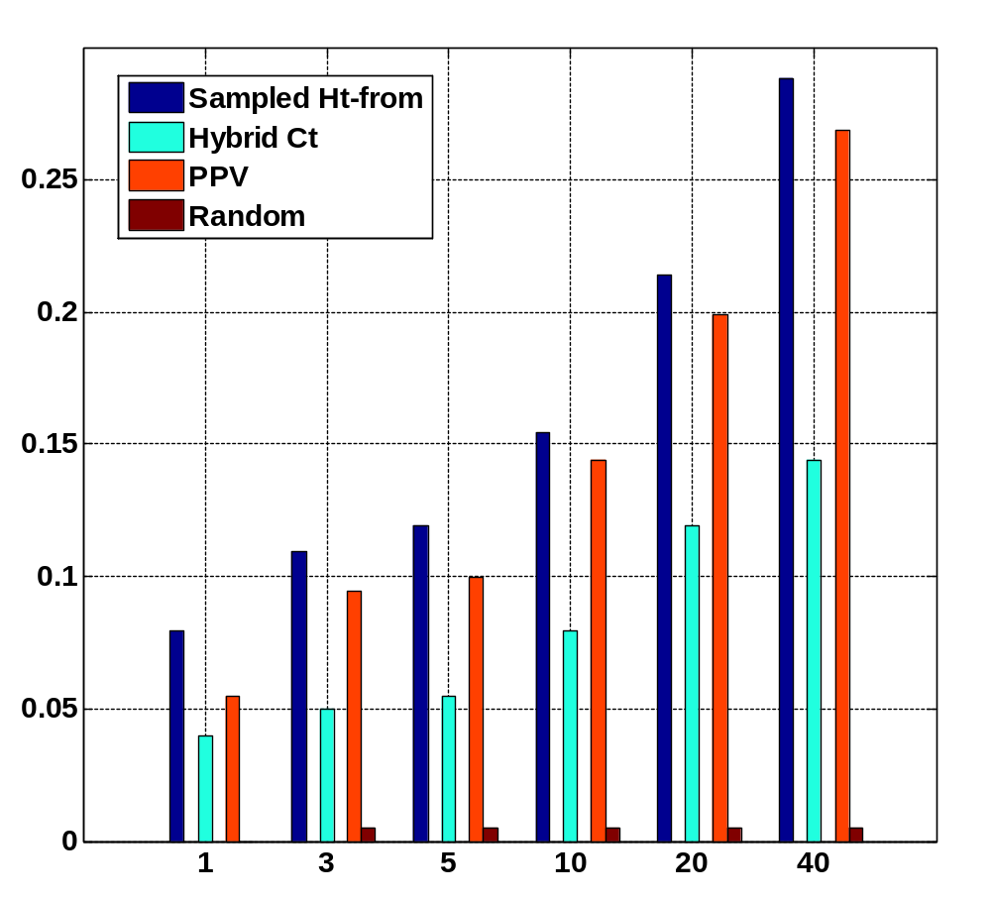
Word Task
Fraction of queries with the held out paper in top k
k

Slide 44
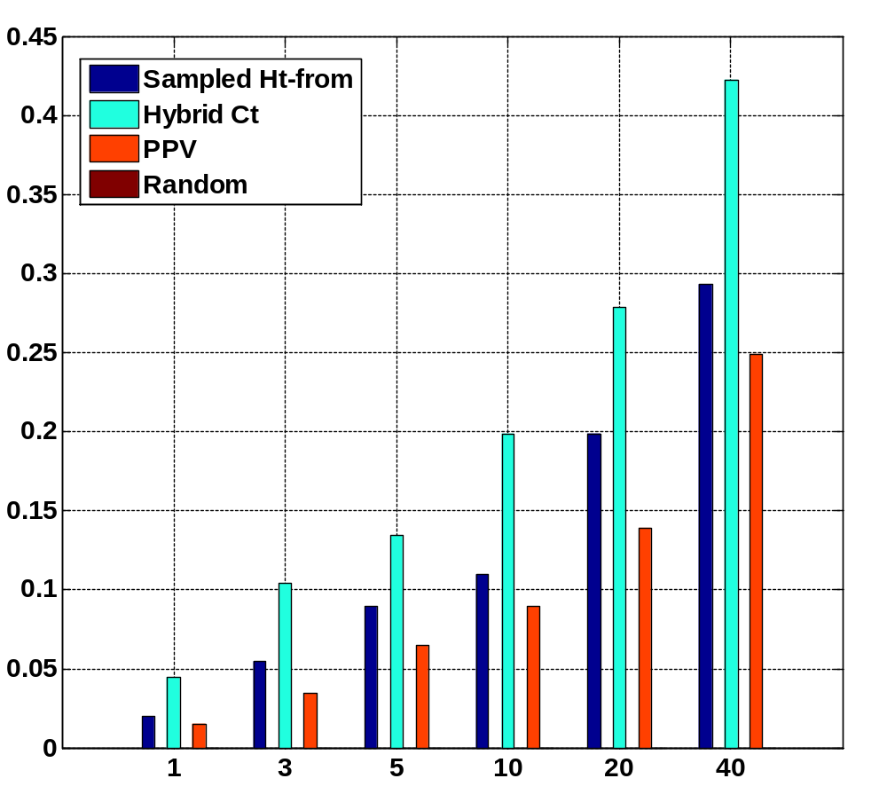
Author Task
Fraction of queries with the held out paper in top k
k

Slide 45
Conclusion
We presented an incremental algorithm to compute approximate nearest neighbors in truncated hitting and commute time with high probability.
We present quantifiable link prediction tasks, on most of which our measures beat personalized pagerank.
On a single CPU machine, our algorithm takes around 4 seconds on average to process a query for a 600,000 node graph.

Slide 46
Acknowledgement
Soumen Chakrabarti
Anupam Gupta
Geoffrey Gordon
Tamás Sarlós
Martin Zinkevich

Slide 47
Thank you

