Slide 1

Fast Algorithms for Proximity Search on Large Graphs
Purnamrita Sarkar
Machine Learning Department
Carnegie Mellon University

Slide 2
Committee
Andrew Moore (Chair)
Geoffrey Gordon
Anupam Gupta
Jon Kleinberg (Cornell)

Slide 3
Graphs: A broad picture
General questions
Characterize real-world graphs.
How can you model the evolution of a real-world graph?
Specific queries
Given a node, find which nodes are similar to it.
Cluster the nodes in a graph.
The internet
Biological networks
Social networks
Real world graphs

Slide 4
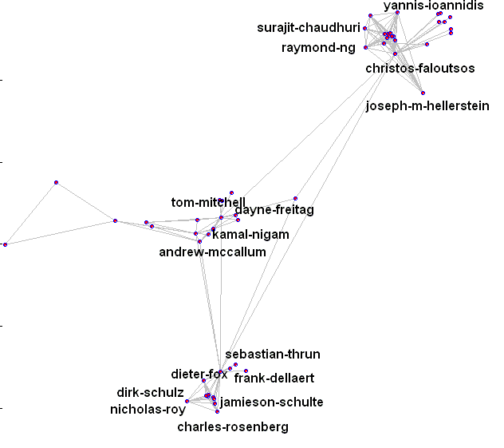
Motivation: Link prediction
Will Andrew McCallum and Christos Faloutsos write a paper together?
Liben-Nowell, D., & Kleinberg, J. (2003). The link prediction problem for social networks. CIKM '03.

Slide 5




Motivation: Recommender systems
Alice
Which movies should be recommended to Alice?
Bob
Charlie
Brand, M. (2005). A Random Walks Perspective on Maximizing Satisfaction and Profit. SIAM '05.

Slide 6
Motivation: Content-based search in databases^{{1,2}}
modeling
paper-has-word
Find top k papers matching OLAP
multidimensional
Paper #1
databases
paper-cites-paper
paper-has-word
range
Paper #2
queries
OLAP
1. Dynamic personalized pagerank in entity-relation graphs. (Soumen Chakrabarti, WWW 2007)
2. Balmin, A., Hristidis, V., & Papakonstantinou, Y. (2004). ObjectRank: Authority-based keyword
search in databases. VLDB 2004.

Slide 7
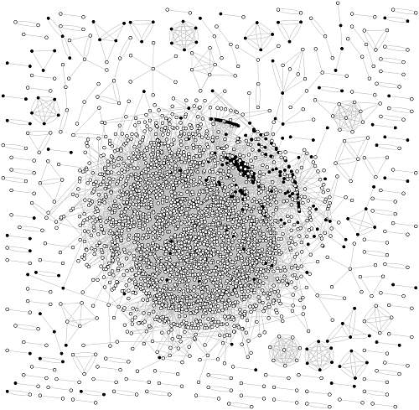
Semi-supervised learning
How to detect webspam?
Partial corpus of webpages from webspam-UK2007.
Black nodes have been labeled spam
Szummer, M., & Jaakkola, T. (2001). Partially labeled classi¯cation with markov random walks. Proc. NIPS.

Slide 8
All these are ranking problems!
Authors linked by
co-authorship
Bipartite graph of customers & products
Citeseer graph
Web graph
Who are the most likely co-
authors of “Manuel Blum”?
Top k book recommendations
for Purna from Amazon
Top k matches for query OLAP
k “closest” nodes of a spam
node
Notes:
Connect with previous

Slide 9
Proximity measures
2
1
5
3
4
How easily can information flow from 1 to 2?

Slide 10
Proximity measures : how to reach 2 from 1?
Paths
2
1
5
1,2
3
4

Slide 11
Proximity measures : how to reach 2 from 1?
Paths
2
1
5
1,2
1,4,2
3
4

Slide 12
Proximity measures : how to reach 2 from 1?
Paths
2
1
5
1,2
1,4,2
1,3,2
3
4

Slide 13
Proximity measures : how to reach 2 from 1?
Paths
2
1
5
1,2
1,4,2
1,3,2
1,4,3,2
…..
…..
3
4
So many paths! Which one should you take?

Slide 14
Proximity measures : how to reach 2 from 1?
Paths
2
1
5
1,2
1,4,2
1,3,2
1,4,3,2
…..
…..
3
Random walks
4
So many paths! Which one should you take?

Slide 15
Random walks
Start at 1
2
1
5
3
4

Slide 16
Random walks
Start at 1
Pick a neighbor i uniformly at random
Move to i
t=1
2
1
5
3
4

Slide 17
Random walks
Start at 1
Pick a neighbor i uniformly at random
Move to i
Continue.
t=1
2
1
5
3
4
t=2

Slide 18
Random walks
Start at 1
Pick a neighbor i uniformly at random
Move to i
Continue.
t=1
2
1
5
3
t=3
4
t=2

Slide 19
Formal definitions
nxn Adjacency matrix A
  A(i,j) = weight on edge from i to j
  If the graph is undirected A(i,j)=A(j,i), i.e. A is symmetric
nxn Transition matrix P
  P is row stochastic
  P(i,j) = probability of stepping on node j from node i
  = A(i,j)/∑_{i}A(i,j)
nxn Laplacian matrix L
  L is symmetric positive semi-definite for undirected graphs
  L = D-A
D is a diagonal matrix of degrees.

Slide 20
Proximity between nodes i and j using random walks
If we start the random walk at i what is the probability of hitting j.
  Personalized pagerank^{{1,2,3}}
  Fast random walk with restart (Tong, Faloutsos 2006)
  Fast direction-aware proximity for graph mining (Tong et al,2007)
If we start the random walk at i what is the expected time to hit j
  Hitting and commute times
1.Scaling Personalized Web Search, Jeh, Widom. 2003.
2.Topic-sensitive PageRank, Haveliwala, 2001
3. Towards scaling fully personalized pagerank, D. Fogaras and B. Racz, 2004
Notes:
Footnotes: not all citations

Slide 21

Personalized pagerank
Personalized pagerank for node i
  Start from node i
  At any timestep jump to node i with probability c
  Stop when the distribution does not change.
  Solve for v such that
  r is a distribution
Notes:
vague

Slide 22
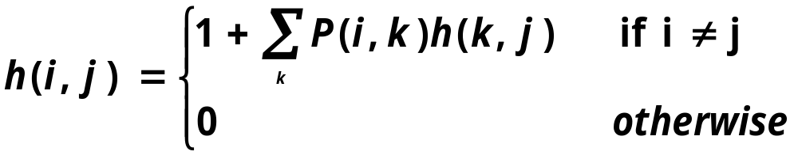
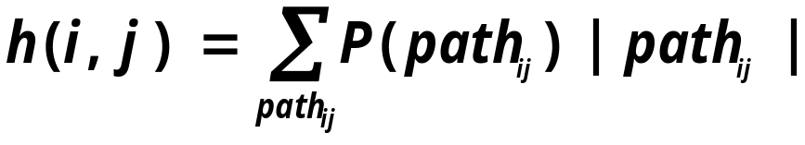
Hitting time from node i to node j
Expected time to hit node j starting at node i.
In essence it is the expected path length
Is not symmetric.
Aldous, D., & Fill, J. A. (2001). Reversible markov chains.

Slide 23
Commute time between nodes i and j
C(i,j) = H(i,j) + H(j,i)
  = Avg. # hops to reach j and come back to i
For undirected graphs, C(i,j) can be computed using pseudo-inverse of the graph Laplacian¹
  Efficient approximation algorithm by Spielman et al, 2008.
1. Qiu, H., & Hancock, E. R. (2005). Image segmentation using commute times. BMVC.
2. Spielman, D., & Srivastava, N. (2008). Graph sparsi¯cation by e®ective resistances. STOC'08

Slide 24
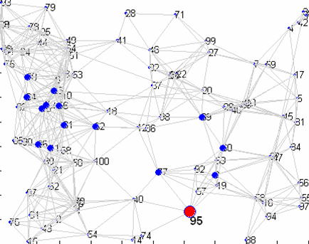
Hitting time from a node: drawbacks
15 nearest neighbors of node 95 (in red)
Random walk gets lost here.

Slide 25
Hitting & Commute times : Drawbacks
Hitting time and Commute times often take into account very long paths.^{1,2}
You are more prone to pick up popular entities.^{1,2}
  Bad for personalization.
As a result these do not perform well for link prediction^{1,2}.
Liben-Nowell, D., & Kleinberg, J. The link prediction problem for social networks CIKM '03.
Brand, M. (2005). A Random Walks Perspective on Maximizing Satisfaction and Profit. SIAM '05.

Slide 26
Hitting & Commute times : Drawbacks
Recent “efficient” approximation algorithm for computing commute times in “undirected graphs^{”1.}
  We would talk about this in the proposed work section.
For directed graphs, these measures are hard to compute.
For many real world applications
  Underlying graphs are directed
  We need fast incremental algorithms for computing nearest neighbors of a query.
1. Spielman, D., & Srivastava, N. (2008). Graph sparsification by effective resistances. STOC'08

Slide 27
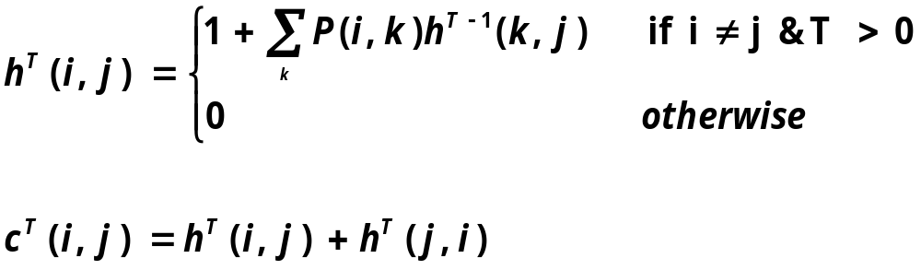
Short term random walks
We propose a truncated version of hitting and commute times, which only considers paths of length T

Slide 28
Truncated Hitting & Commute times
For small T
  Are not sensitive to long paths.
  Do not favor high degree nodes
    For a randomly generated undirected graph, average correlation coefficient (R_{avg}) with the degree-sequence is
      R_{avg} with truncated hitting time is -0.087
      R_{avg} with untruncated hitting time is -0.75
Notes:
REORDER (remember to say what T is)

Slide 29
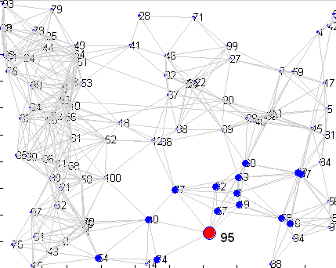
15 nearest neighbors of node 95 (in red)
Un-truncated VS. truncated hitting time from a node
Un-truncated hitting time
Truncated hitting time

Slide 30
Computational complexity
Easy to compute hitting time to node O(T|E|)
Compute all pairs O(Tn|E|)
Hard to compute hitting time from a node O(Tn|E|)
Our goal : « O(n²)

Slide 31
Computing truncated hitting time to node 1
10
9
11
2
8
7
1
5
3
6
4

Slide 32
Computing truncated hitting time to node 1
10
9
11
2
8
7
1
5
3
6
4
H¹(i,1)=1 8 i≠ 1

Slide 33

Computing truncated hitting time to node 1
10
9
11
2
8
7
1
5
3
6
4

Slide 34
Computing truncated hitting time to node 1
2
2
2
10
1.75
9
11
2
1.67
2
7
8
5
2
1
3
0
1.67
6
2
4
1.67

Slide 35
Computing truncated hitting time to node 1
2
2
2
10
1.75
9
11
2
1.67
2
7
8
5
2
1
3
0
1.67
6
2
Hitting times to each node
can be computed
independently!!
4
1.67

Slide 36
Computing truncated hitting time to a node
Naïve: just do dynamic programming. Will take T|E| time.
Can we do better?
For a given real value τ≤T, how “local” are these measures?
  i.e. how many nodes will have hitting time smaller than τ ?

Slide 37

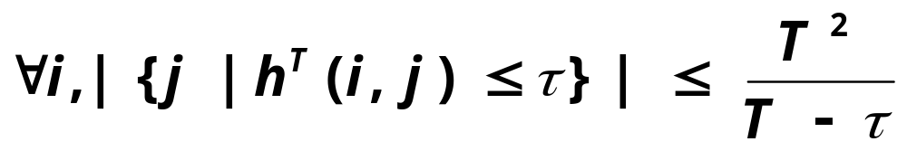
Local properties
G
How many nodes will I hit within τ time?
What is the size of
the set
Fast incremental algorithms for nearest neighbor search on large graphs in hitting and commute times, Sarkar P., Moore A., Prakash A., ICML 2008
Notes:
Explain T again

Slide 38

Local properties
G
How many nodes will hit me within τ time?
What is the size of
the set
Can only give weak counting arguments for
Directed Graphs.

Slide 39
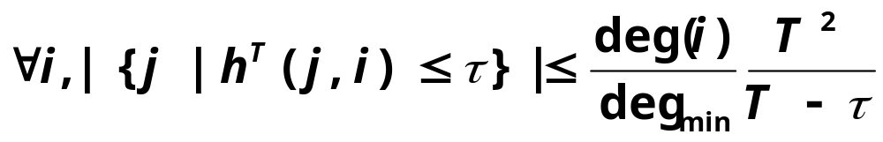
Local properties
G
How many nodes will hit me within τ time?
What is the size of
the set
Undirected Graphs!

Slide 40
Objective
What are the questions that we want to answer ?
  Given τ, k,ε for any node i, find k other nodes y within truncated hitting time τ, s.t.
  h^{T}_{iy} · h^{T}_{ix}(1+ε)
  where x is the true k-th-nearest neighbor.
We want to only look at entities which are potential nearest neighbors.
Notes:
THINK ABT IT

Slide 41
GRANCH: the branch and bound algorithm
We know that there is a small neighborhood containing potential neighbors in hitting time.
How do we find this neighborhood before computing the exact distances?
We will use upper and lower bounds on hitting time, and use those to prune away most of the graph.
Sarkar, P., & Moore, A. (2007). A tractable approach to finding closest truncated-commute-time
neighbors in large graphs. Proc. UAI.
Notes:
Citation

Slide 42
GRANCH: Hitting time to a node j
Maintain a neighborhood NB(j) around j.
For all nodes inside the neighborhood compute upper and lower bounds on hitting time to j.
Characterize hitting time from all other nodes with a single lower and upper bound.
Bounds get tighter as we expand the neighborhood.

Slide 43
GRANCH: Basic Idea
H^{T}(2,1)= ?
11
2
1
5
3
4
Notes:
LEGENDS: put an arc

Slide 44
GRANCH: Basic Idea
H^{T}(2,1)= ?
11
2
1
5
3
4

Slide 45

GRANCH: Basic Idea
H^{T-1}(11,1)= ?
H^{T}(2,1)= ?
11
2
1
5
3
4

Slide 46

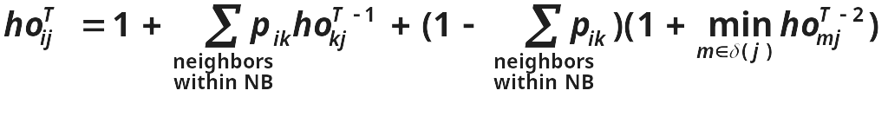
Optimistic bounds (ho-values)
What is fastest way to go back ?
  Jump to the boundary node that has smallest hitting time to the destination (2)
11
2
1
5
3
NB(1) = {2 3 4 5 }
δ(1) = {2 5}
4
Notes:
CHANGE the MATH to ENGLISH

Slide 47

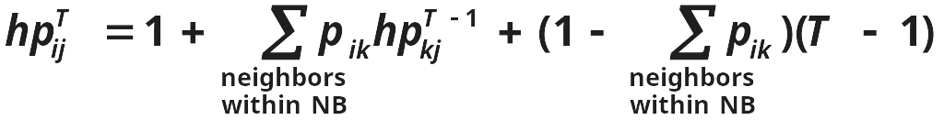
Pessimistic bounds (hp-values)
What is the worst case ?
  Don’t go back at all, i.e. take at least T time.
11
11
2
2
5
1
5
1
3
3
NB(1) = {2 3 4 5 }
δ(1) = {2 5}
4

Slide 48
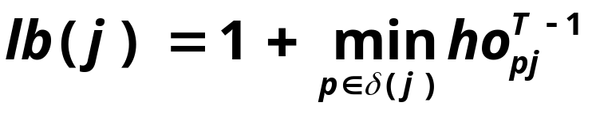
Optimistic & Pessimistic bounds on truncated hitting times
If i 2 NB(j)
  ho^{T}_{ij} · h^{T}_{ij} · hp^{T}_{ij}
If i∉ NB(j)
  lb(j) · h^{T}_{ij} · T
We do NOT need to compute the optimistic and pessimistic bounds for all pairs.
Notes:
ANIMATE

Slide 49
Expanding the Neighborhood of j
Start with all nodes within one or two hops of node j.
  Compute ho^{T}, hp^{T} values of current neighborhood.
  Find q=argmin_{m2δ(j)}ho^{T-1}_{mj}
  lb(j)=1+ho^{T-1}_{qj}
  Add (m,j) to NB(j), s.t. m2 nbs(q) and m∉ NB(j)
Stop when lb(j)¸ τ
q = 2
11
11
2
2
5
1
5
1
3
3
4
4
NB(1) = {2 3 4 5 }
δ(1) = { 5}
11
2
NB(1) is the neighborhood
δ(1) is the boundary
Notes:
SHOW ONE LINE AT A TIME
DEFINE delta and NB

Slide 50
Completeness guarantee
Once we have expanded the neighborhoods,
  For any node j all nodes i∉ NB(j) will have h^{T}ij ¸ τ.
  We are not interested in these nodes.
➔ We will never miss a potential nearest neighbor in h^{T} .

Slide 51
Hitting time from a node
H^{T} : Truncated hitting time matrix
Notes:
Connect with former

Slide 52
Hitting time from a node
hitting time to node j
Expand neighborhood of all nodes
Fill up interesting patches in the columns
H^{T}

Slide 53
Hitting time from a node
hitting time to node j
H^{T}

Slide 54
Hitting time from a node
hitting time from node i
H^{T}

Slide 55
How to rank with bounds
We want: all nodes closer than the TRUE k-th nearest neighbor.
I will skip these details for time constraint.
Notes:
ANIMATE / REMOVE

Slide 56
GRANCH: Drawbacks
Need to cache the neighborhoods for all nodes.
Large pre-processing time.
➔ Need fast, incremental, space-efficient search algorithms!
Use sampling to compute
estimates of hitting time from a node

Slide 57
Sampling for computing hitting time from a node
10
9
11
2
8
7
1
5
3
6
4
1

Slide 58
Sampling for computing hitting time from a node
10
9
11
2
8
7
1
5
3
6
4
1 5

Slide 59
Sampling for computing hitting time from a node
10
9
11
2
8
7
1
5
3
6
4
1 5 9

Slide 60
Sampling for computing hitting time from a node
10
9
11
2
8
7
1
5
3
6
4
1 5 9 5

Slide 61
Sampling for computing hitting time from a node
10
9
11
2
8
7
1
5
3
6
4
1 5 9 5 7

Slide 62
Sampling for computing hitting time from a node
T=5
10
h(1,5) = 1
h(1,9) = 2
h(1,7) = 4
h(1,-) = 5
9
11
2
8
7
1
5
3
6
4
1 5 9 5 7

Slide 63
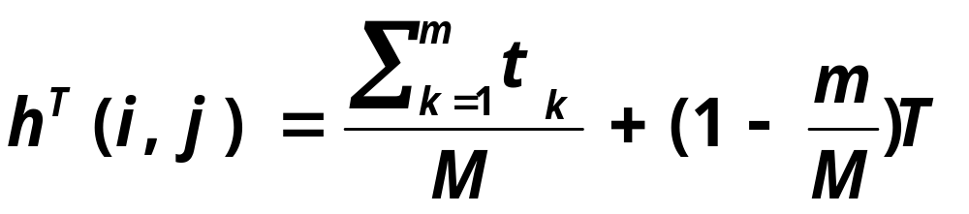
Sampling for computing hitting time from a node
Calculate M samples from i
Suppose m of these hit j for the first time at
{t₁ t₂ t₃ ……t_{m}}.
Notes:
INTUITION

Slide 64
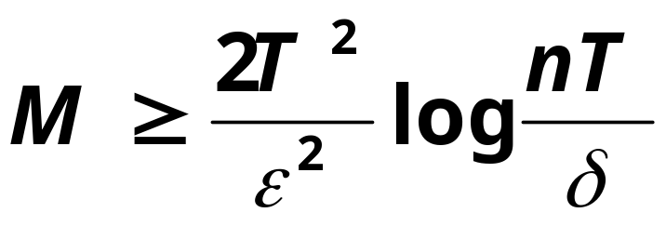
How close can you get in error?
If

Slide 65
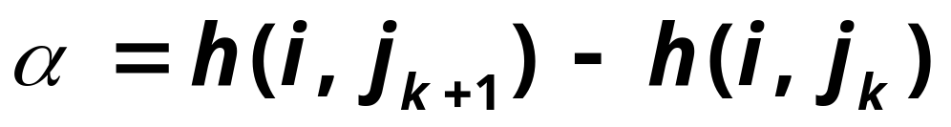
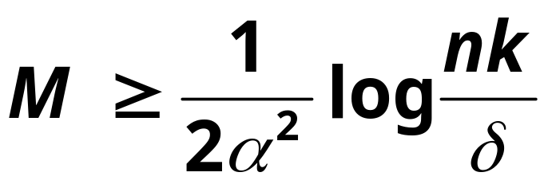
How close can you get in ranking?
Let {j₁ j₂ j_{3 ….} j_{k}} be the true k nearest neighbors of i.
Also, let
If
then we can retrieve the top k neighbors with high probability.

Slide 66
How close can you get in ranking?
Let {j₁ j₂ j_{3 ….} j_{k}} be the true k nearest neighbors of i.
Also, let
If
Well separated: easy to retrieve!
then we can retrieve the top k neighbors with high probability.

Slide 67
Sampling and DP
Hitting time FROM
Hitting time TO
☹ | ☺
☺ | ☹
DP
Sampling
Fast incremental algorithms for nearest neighbor search on large graphs in hitting and
commute times, Sarkar P., Moore A., Prakash A., ICML 2008

Slide 68
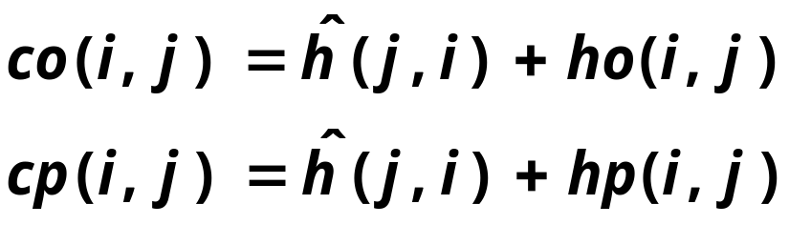


New upper and lower bounds on commute times
w.h.p
w.h.p
Can estimate from samples
co(i,j) = lb_{ct}(j)
cp(i,j) = 2T

Slide 69
The hybrid algorithm
Use sampling to estimate hitting time from node j
Use the same neighborhood expansion scheme, with the bounds on commute time.
Stop when the lower bound on commute time from outside the neighborhood exceeds 2τ.
We start τ with a small value and increase it until we have tight enough bounds for returning k nearest neighbors.
Rank similar to GRANCH
Notes:
ANIMATE

Slide 70
Results: undirected co-authorship networks from Citeseer
Remove 30% links from the graph.
Rank neighbors of i
Report % of held out links that come up in top 10 neighbors
We present the accuracy for
Hybrid commute times (HC)
Number of hops (truncated at 5)
Jaccard score
Katz score
Personalized pagerank
Notes:
Put only the interesting ones. Add experimental methodology

Slide 71
Results: accuracy (%)
N | E | HC T=10 | HC T=6 | hops | Jaccard | Katz | PPV
19,500 | 54,400 | 85 | 86 | 47 | 80 | 78 | 78
52,000 | 150,000 | 80 | 82 | 41 | 76 | 72 | 74
103,500 | 279,495 | 81 | 80 | 38 | 73 | 73 | 75

Slide 72
Results: average time per query (s)
N | E | HC T=10 | HC T=6 | Katz | PPV
19,500 | 54,400 | .05 | .03 | .8 | .5
52,000 | 150,000 | .11 | .05 | 2.6 | 1.7
103,500 | 279,495 | .2 | .1 | 6 | 3.7

Slide 73
Keyword-author-citation graphs¹
words
papers
authors
Existing work use Personalized Pagerank (PPV)^{1,2} .
We present quantifiable link prediction tasks
We compare PPV with truncated hitting and commute times.
1.Dynamic personalized pagerank in entity-relation graphs. (Soumen Chakrabarti, WWW 2007)
2. Balmin, A., Hristidis, V., & Papakonstantinou, Y. (2004). ObjectRank: Authority-based keyword search in databases. VLDB 2004.
Notes:
CHANGE the links

Slide 74
Word Task
words
papers
authors

Slide 75
Word Task
words
papers
authors
Rank the papers for these words.
See if the paper comes up in top 10,20,30,…

Slide 76
Author Task
words
papers
authors
Rank the papers for these authors.
See if the paper comes up in top 10,20,30,…

Slide 77
Citeseer graph: Average query processing time
628,000 nodes. 2.8 Million edges on a single CPU machine.
  Sampling (1000 samples) 0.1 seconds
  Exact truncated commute time: 86 seconds
  Hybrid: 3 seconds

Slide 78
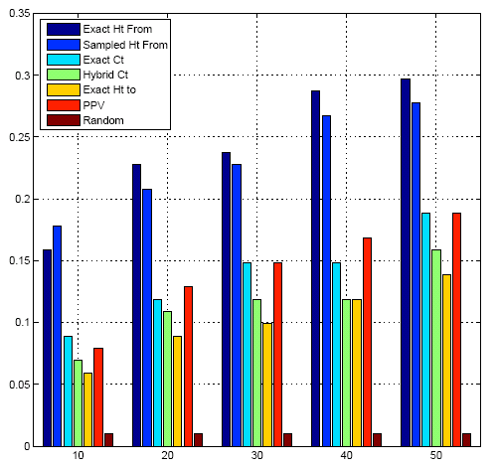
Word Task: hitting times does the best
Fraction of queries with the held out paper in top k
k

Slide 79
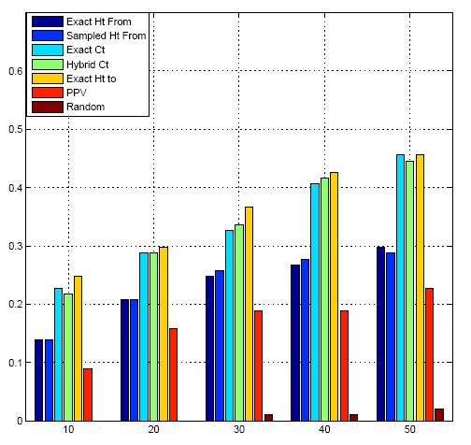
Author Task: commute times does the best
Fraction of queries with the held out paper in top k
k

Slide 80
PPV & hitting times
What is PPV
  Sample L from a geometric distribution with the teleportation probability
  Sample a path of length L from i
  PPV_{i}(j) is the probability that node j appears at the end of this path
PPV uses less information that truncated hitting times!

Slide 81
Proposed work
Improving & extending the hybrid algorithm (3.5 months)
Meta Learning Approach for Link prediction (2.5 months)
Other proximity measures (4 months)
Applications (8 months)

Slide 82
Improving & extending the algorithm
GRANCH
Hybrid
Cache neighbors of all nodes.
Don’t cache any information
Cache nearest neighbors of the nodes with a lot of nearest neighbors in commute time.
How do I find them?
Undirected graphs
Find the high degree nodes!
Notes:
May be change color

Slide 83
Improving & extending the algorithm
GRANCH
Hybrid
Cache neighbors of all nodes.
Don’t cache any information
Cache nearest neighbors of the nodes with a lot of nearest neighbors in commute time.
How do I find them?
Can do!
Directed graphs
Use sampling to spot those nodes!

Slide 84
How to analyze the runtime?
We propose to
  use reversibility of random walks in undirected graphs
  enumerate the shape of the τ-neighborhood

Slide 85
How can we use reversibility?
So far we have only shown that
  the measures are local
  empirical proof of runtime
How can we guess the incoming potential neighbors from the outgoing nearest neighbors?
For (τ, τ’) can we show that the incoming τ neighborhood of j is contained in the outgoing τ’ neighborhood of j.
Use sampling to find the incoming τ neighborhood of j .
Probably can do!

Slide 86
Shape of the τ neighborhood
Hybrid algorithm finds the τ neighborhood.
We want to enumerate the shape of this neighborhood for different graphs.
In other words we want to bound the number of hops c between nodes i and j such that the hitting time from i to j is at most τ.
If c is small, then we can argue that an incremental search algorithm does not have to look ahead very far.
Maybe..

Slide 87
Meta Learning Approach for Link prediction
Use different proximity measures as features, and learn a regression model.
Weights on different proximity measures will vary from task to task.
Based on our experiments, different tasks require different proximity measures. This framework would automatically detect that.
Can do!

Slide 88
Other proximity measures
Can do!
How about discounted hitting times? We can use our algorithms for computing these as well.
Very recently Spielman et al. came up with a novel algorithm for computing pairwise commute times using random projections.
  We want to explore this direction more.

Slide 89
Applications
Will do two of these!
Semi-supervised learning
  Detecting Web spam
Information retrieval
  A lot of applications use random walks as an internal routine to obtain ranking. Our algorithms will make them a lot faster.
Recommender networks
Notes:
Put in the beginning

Slide 90
Acknowledgement
Gary Miller
Amit Prakash
Jeremy Kubica
Martin Zinkevich
Soumen Chakrabarti
Tamás Sarlós

Slide 91
Thank you

