Slide 1



Fast Dynamic Reranking in Large Graphs
Purnamrita Sarkar
Andrew Moore

Slide 2
Talk Outline
Ranking in graphs
Reranking in graphs
Harmonic functions for reranking
Efficient algorithms
Results

Slide 3
Graphs are everywhere
The world wide web
Publications - Citeseer, DBLP
Friendship networks – Facebook
Find webpages related to ‘CMU’
Find papers related to word SVM in DBLP
All are search problems
in graphs
Find other people similar to ‘Purna’

Slide 4
Graph Search: underlying question
Given a query node, return k other nodes which are most similar to it
Need a graph theoretic measure of similarity
  minimum number of hops (Not robust enough)
  average number of hops (huge number of paths!)
  probability of reaching a node in a random walk

Slide 5
Graph Search: underlying technique
Pick a favorite graph-based proximity measure and output top k nodes
  Personalized Pagerank (Jeh, Widom 2003)
  Hitting and Commute times (Aldous & Fill)
  Simrank (Jeh, Widom 2002)
  Fast random walk with restart (Tong, Faloutsos 2006)

Slide 6
Talk Outline
Ranking in graphs
Reranking in graphs
Harmonic functions for reranking
Efficient algorithms
Results

Slide 7



Why do we need reranking?
mouse
Search algorithms use -query node -graph structure
User feedback
Current techniques (Jin et al, 2008) are too slow for this particular problem setting.
Reranked list
Often unsatisfactory – ambiguous query – user does not know the right keyword
We propose fast algorithms to obtain quick reranking of search results using random walks

Slide 8
What is Reranking?
User submits query to search engine
Search engine returns top k results
  p out of k results are relevant.
  n out of k results are irrelevant.
  User isn’t sure about the rest.
Produce a new list such that
  relevant results are at the top
  irrelevant ones are at the bottom

Slide 9
Reranking as Semi-supervised Learning
Given a graph and small set of labeled nodes, learn a function f that classifies all other nodes
Want f to be smooth over the graph, i.e. a node classified as positive is
  “near” the positive labeled nodes
  “further away” from the negative labeled nodes
Harmonic Functions!

Slide 10
Talk Outline
Ranking in graphs
Reranking in graphs
Harmonic functions for reranking
Efficient algorithms
Results

Slide 11
Harmonic functions: applications
Image segmentation (Grady, 2006)
Automated image colorization (Levin et al, 2004)
Web spam classification (Joshi et al, 2007)
Classification (Zhu et all, 2003)

Slide 12
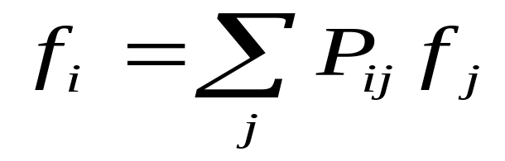
Harmonic functions in graphs
Fix the function value at the labeled nodes, and compute the values of the other nodes.
Function value at a node is the average of the function values of its neighbors
Function value at node i
Prob(i->j in one step)

Slide 13
Harmonic Function on a Graph
Can be computed by solving a linear system
  Not a good idea if the labeled set is changing quickly
f(i,1) = Probability of hitting a 1 before a 0
f(i,0) = Probability of hitting a 0 before a 1
If graph is strongly connected we have
f(i,1)+f(i,0)=1

Slide 14
T-step variant of a harmonic function
f ^{T}(i,1) = Probability of hitting a node 1 before a node 0 in T steps
f ^{T}(i,1)+f ^{T}(i,0) ≤ 1
Simple classification rule:
node i is class ‘1’ if f ^{T}(i,1) ≥ f ^{T}(i,0)
Want to use the information
from negative labels more
Notes:
Fix f (sajid)
Add a splash to motivate next slide

Slide 15

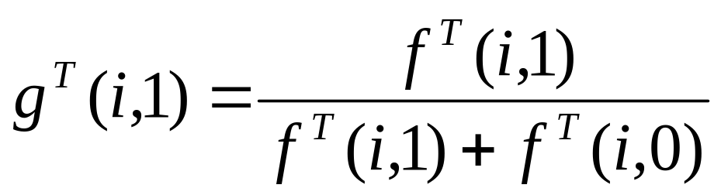
Conditional probability
Has no ranking information when
f ^{T}(i,1)=0
Condition on the event that you hit some label
conditional probability at i
Probability of hitting a 1 before a 0 in T steps
Probability of hitting some label in T steps

Slide 16
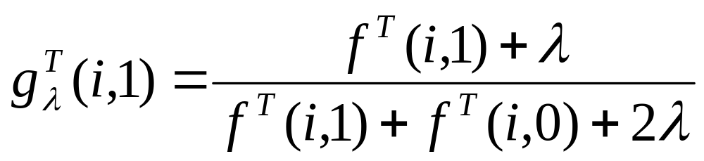
Smoothed conditional probability
If we assume equal priors on the two classes the smoothed version is
When f ^{T}(i,1)=0, the smoothed function uses f^{T}(i,0) for ranking.

Slide 17
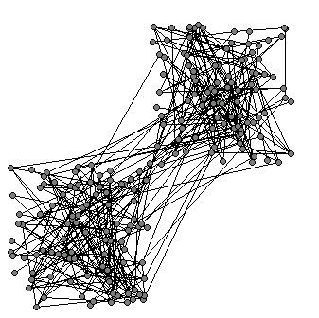
A Toy Example
200 node graph
  2 clusters
  260 edges
  30 inter-cluster edges
Compute AUC score for T=5 and 10 for 20 labeled nodes
  Vary the number of positive labels from 1 to 19
  Average AUC score for 10 random runs for each configuration

Slide 18
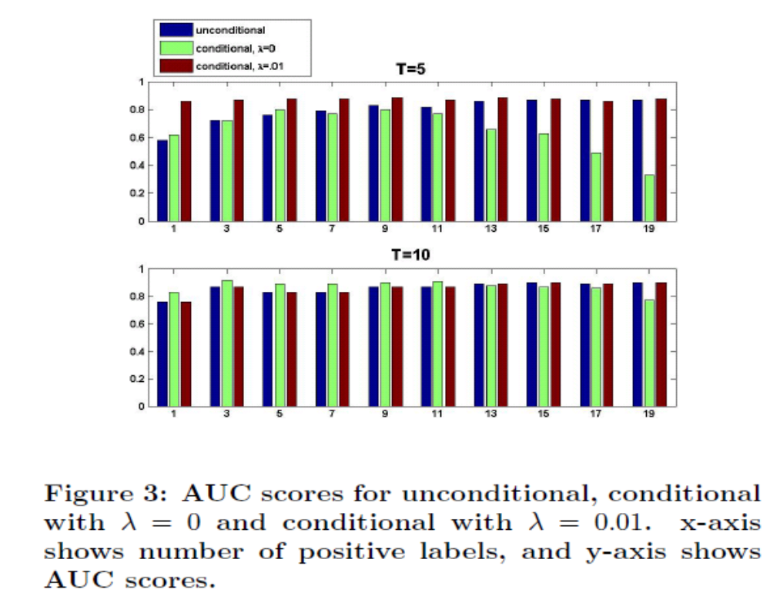
Unconditional becomes better as # of +ve’s increase.
AUC score (higher is better)
Smoothed conditional
always works well.
Conditional is good
when the classes
are balanced
# of positive labels
For T=10 all measures perform well
Notes:
fix higher is better

Slide 19
Talk Outline
Ranking in graphs
Reranking in graphs
Harmonic functions for reranking
Efficient algorithms
Results
Notes:
computing harmonic functions efficiently

Slide 20
Two application scenarios
Rank a subset of nodes in the graph
Rank all the nodes in the graph.

Slide 21
Application Scenario #1
User enters query
Search engine generates ranklist for a query
User enters relevance feedback
Reason to believe that top 100 ranked nodes are the most relevant
  Rank only those nodes.

Slide 22
Sampling Algorithm for Scenario #1
I have a set of candidate nodes
Sample M paths of from each node.
  A path ends if it reached length T
  A path ends if it hits a labeled node
Can compute estimates of harmonic function based on these
With ‘enough’ samples these estimates get ‘close to’ the true value.

Slide 23

Application Scenario #2
My friend Ting Liu
- Former grad student at CS@CMU
-Works on machine learning
Ting Liu from Harbin
Institute of Technology
-Director of an IR lab
-Prolific author in NLP
Majority of a ranked list
of papers for “Ting Liu ”
will be papers by the
more prolific author.
Cannot find relevant results
by reranking only the top 100.
Must rank all nodes in the graph
DBLP treats both as one node

Slide 24
Branch and Bound for Scenario #2
Want
  find top k nodes in harmonic measure
Do not want
  examine entire graph
  (labels are changing quickly over time)
How about neighborhood expansion?
  successfully used to compute Personalized Pagerank (Chakrabarti, ‘06), Hitting/Commute times (Sarkar, Moore, ‘06) and local partitions in graphs (Spielman, Teng, ‘04).

Slide 25
Branch & Bound: First Idea
Find neighborhood S around labeled nodes
Compute harmonic function only on the subset
However
  Completely ignores graph structure outside S
  Poor approximation of harmonic function
  Poor ranking

Slide 26
Branch & Bound: A Better Idea
Gradually expand neighborhood S
Compute upper and lower bounds on harmonic function of nodes inside S
Expand until you are tired
Rank nodes within S using upper and lower bounds
Captures the influence of nodes outside S

Slide 27
Harmonic function on a Grid T=3
y=1
y=0

Slide 28
Harmonic function on a Grid T=3
[.33,.56]
y=1
[.33,.56]
[0,.22]
[0,.22]
y=0
[lower bound, upper bound]

Slide 29
Harmonic function on a Grid T=3
tighter bounds!
[.39,.5]
y=1
[.17,.17]
tightest ☺
[.43,.43]
[0,.22]
[.11,.33]
[0,.22]
y=0

Slide 30
Harmonic function on a Grid T=3
[.11,.11]
[.43,.43]
[.17,.17]
[.43,.43]
[0,0]
[1/9,1/9]
Might miss good nodes
outside neighborhood.
[0,0]
tight bounds for all nodes!

Slide 31
Branch & Bound: new and improved
Given a neighborhood S around the labeled nodes
Compute upper and lower bounds for all nodes inside S
Compute a single upper bound ub(S) for all nodes outside S
Expand until ub(S) ≤ α
All nodes outside S are guaranteed to have harmonic function value smaller than α
Guaranteed to find all good
nodes in the entire graph

Slide 32
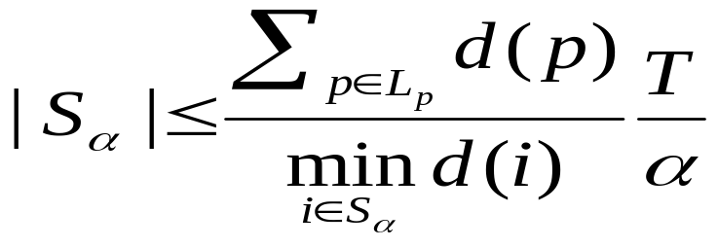
What if S is Large?
S_{α} = {i|f^{T}≥α}
L_{p} = Set of positive nodes
Intuition: S_{α} is large if
  α is small <We will include lot more nodes>
  the positive nodes are relatively more popular within S_{α}
  For undirected graphs we prove
Likelihood of hitting a positive label
Number of steps
Size of S_{α}
α is in the denominator

Slide 33
Talk Outline
Ranking in graphs
Reranking in graphs
Harmonic functions for reranking
Efficient algorithms
Results

Slide 34
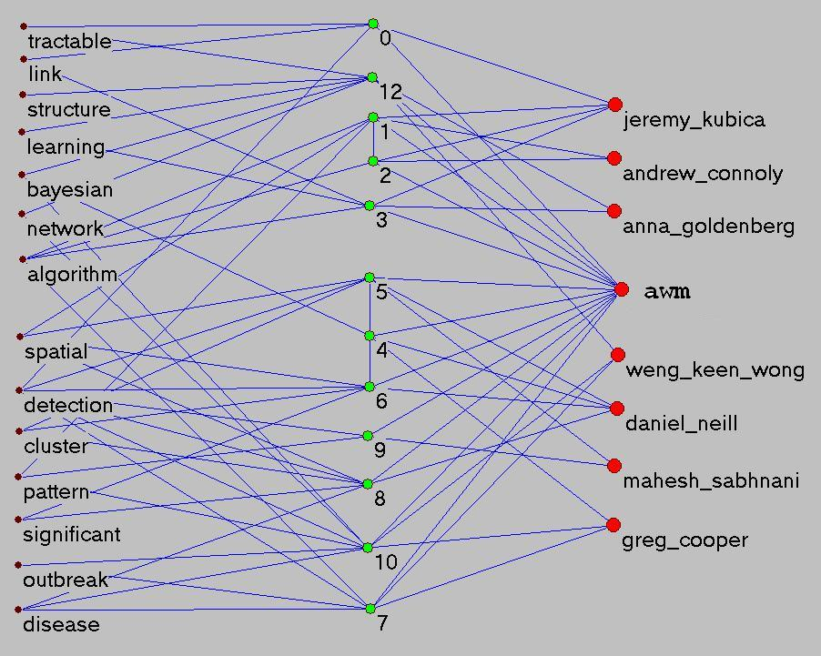
An Example
Bayesian Network structure learning, link prediction etc.
words
papers
authors
Machine Learning for disease outbreak detection

Slide 35
An Example
words
papers
authors
awm
+ disease
+ bayesian
query

Slide 36
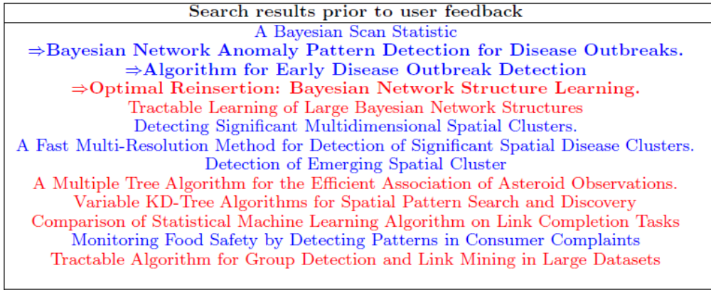
Results for awm, bayesian, disease
Relevant
Irrelevant

Slide 37
User gives relevance feedback
words
papers
authors
irrelevant
relevant

Slide 38

Final classification
words
papers
authors
Relevant results

Slide 39
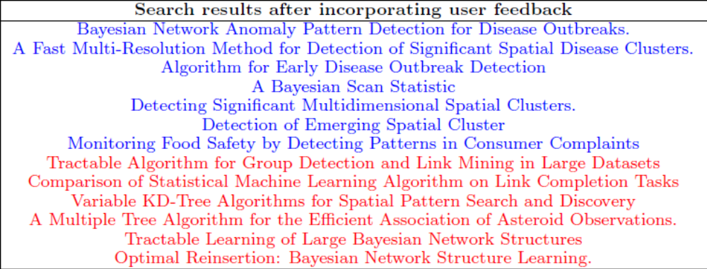
After reranking
Relevant
Irrelevant

Slide 40
Experiments
DBLP: 200K words, 900K papers, 500K authors
Two Layered graph [Used by all authors]
  Papers and authors
  1.4M nodes, 2.2 M edges
Three Layered graph [Please look at the paper for more details]
  Include 15K words (frequency > 20 and <5K)
  1.4 M nodes,6M edges

Slide 41


Entity disambiguation task
Pick 4 authors with the same surname “sarkar” and merge them into a single node.
Now use a ranking algorithm (e.g. hitting time) to compute nearest neighbors from the merged node.
Label the top L papers in this list.
Use the rest of papers in the ranklist as testset and compute AUC score for different measures against the ground truth.
Paper-564: S. sarkar
Paper-22: Q. sarkar
Paper-61: P. sarkar
Paper-1001:R. sarkar
Paper-121: R. sarkar
Paper-190: S. sarkar
Paper-88 : P. sarkar
Paper-1019:Q. sarkar
0 0 1 0
0.2 0.3 0.5 0.1
harmonic measure
ground truth
P. sarkar
Paper-564: S. sarkar
Paper-22: Q. sarkar
Paper-61: P. sarkar
Paper-1001:R. sarkar
Paper-121: R. sarkar
Paper-190: S. sarkar
Paper-88 : P. sarkar
Paper-1019:Q. sarkar
Paper-564: S. sarkar
Paper-22: Q. sarkar
Paper-61: P. sarkar
Paper-1001:R. sarkar
Paper-121: R. sarkar
Paper-190: S. sarkar
Paper-88 : P. sarkar
Paper-1019:Q. sarkar
Want to find “P. sarkar”
P sarkar
Test-set
Q sarkar
sarkar
R sarkar
Merge
S sarkar
Paper-564: S. sarkar
Paper-22: Q. sarkar
Paper-61: P. sarkar
Paper-1001:R. sarkar
Paper-121: R. sarkar
Paper-190: S. sarkar
Paper-88 : P. sarkar
Paper-1019:Q. sarkar
Q. sarkar
R. sarkar
Compute AUC score
Hitting time
sarkar
S. sarkar
relevant
irrelevant

Slide 42
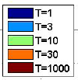
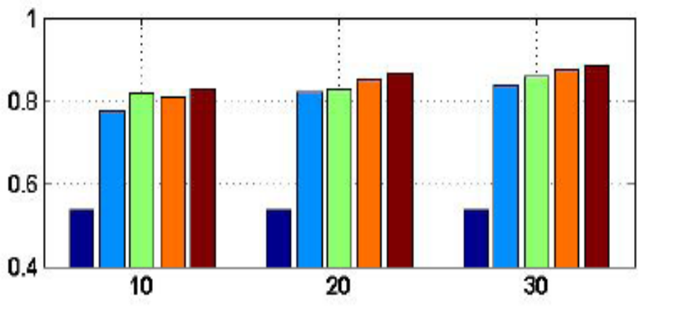
Effect of T
T=10 is good enough
AUC score
Number of labels

Slide 43
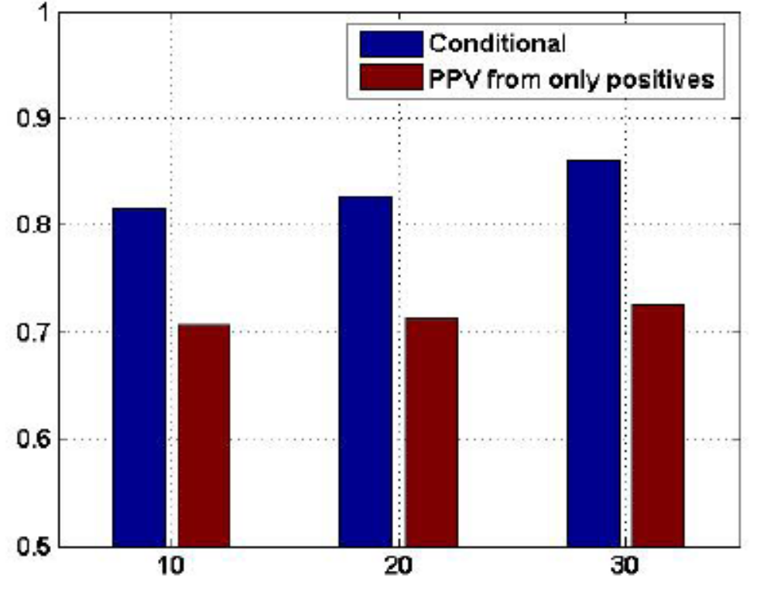
Personalized Pagerank (PPV) from the positive nodes
Conditional harmonic probability
PPV from positive labels
AUC score
Number of labels

Slide 44
Timing Results for retrieving top 10 results in harmonic measure
Two layered graph
  Branch & bound: 1.6 seconds
  Sampling from 1000 nodes: 90 seconds
Three layered graph
  See paper for results

Slide 45
Conclusion
Proposed an on-the-fly reranking algorithm
  Not an offline process over a static set of labels
  Uses both positive and negative labels
Introduced T-step harmonic functions
  Takes care of skewed distribution of labels
Highly efficient and scalable algorithms
On quantitative entity disambiguation tasks from DBLP corpus we show
  Effectiveness of using negative labels
  Small T does not hurt
  Please see paper for more experiments!

Slide 46
Thanks!

Slide 47
Reranking Challenges
Must be performed on-the-fly
  not an offline process over prior user feedback
Should use both positive and negative feedback
  and also deal with imbalanced feedack
  (e.g, “ many negative, few positive”)

Slide 48
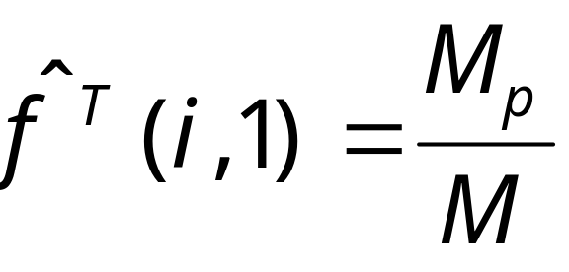
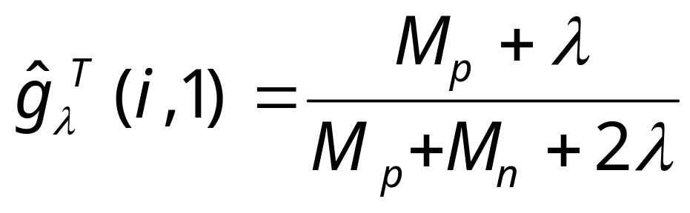
Scenario #2: Sampling
Sample M paths of from the source.
A path ends if it reached length T
A path ends if it hits a labeled node
If M_{p} of these hit a positive label and M_{n} hit a negative label, then
Can prove that
with enough samples can get
close enough estimates
with high probability.

Slide 49
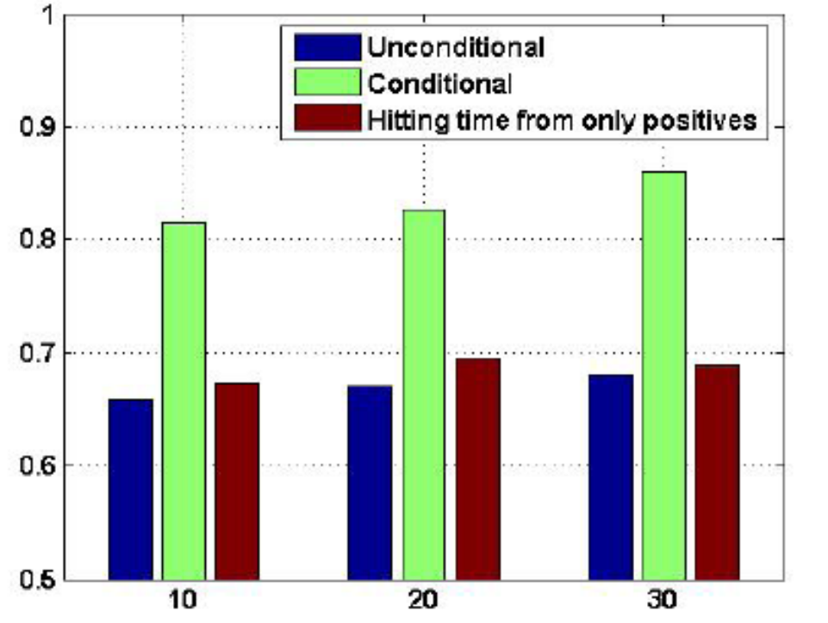
Hitting time from the positive nodes
Conditional harmonic probability
AUC
Hitting time from positive labels
Number of labels
Two layered graph

Slide 50
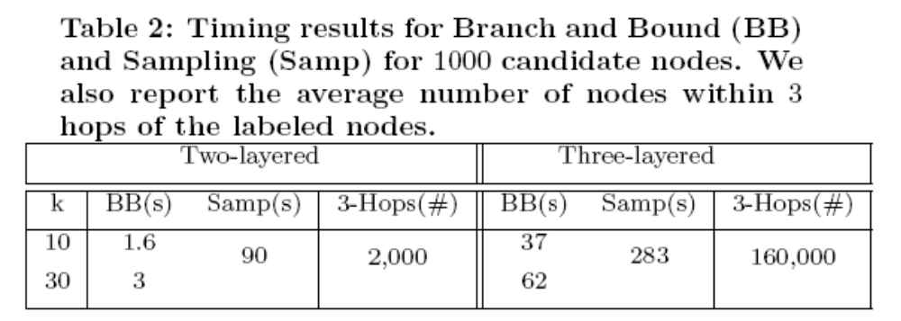
Timing results
The average degree increases by a factor of 3, and so does the average time for sampling.
The expansion property (no. of nodes within 3-hops) increases by a factor 80
The time for BB increases by a factor of 20.

