Slide 1
Theoretical Justification for Popular Link Prediction Heuristics
Purnamrita Sarkar (Carnegie Mellon)
Deepayan Chakrabarti (Yahoo! Research)
Andrew W. Moore (Google, Inc.)

Slide 2




Link Prediction
Which pair of nodes {i,j} should be connected?
Variant: node i is given
Alice
Bob
Charlie
Friend suggestion in Facebook
Movie recommendation in Netflix
Notes:
Here is your current friendlist. I want to suggest friends for you. This is a link prediction problem. Here are the movies you have liked. I want to suggest new movies to you. This is also a link prediction problem. There are a variety of such problems.

Slide 3
Link Prediction Heuristics
Predict link between nodes
With the minimum number of hops
With max common neighbors (length 2 paths)
Alice
1000
followers
Prolific common friends
→Less evidence
Bob
Less prolific
→Much more evidence
8 followers
Charlie
The Adamic/Adar score gives more weight to low degree common neighbors.
Notes:
In general this is answered using heuristics. For example predict the pair connected via the minimum number of hops. Or predict the pair with the maximum number of common neighbors. In fact Facebook mentions the number of common neighbors on its friend suggestions. Often it is important to look at the features of the common neighbors. For example a very prolific common neighbor gives much less information about the similarity between two nodes, whereas a less prolific common neighbor indicates that the nodes are likely to be part of a tight niche. The adamid adar score weights the more popular common neighbors less.

Slide 4
Link Prediction Heuristics
Predict link between nodes
With the minimum number of hops
With more common neighbors (length 2 paths)
With larger Adamic/Adar
With more short paths (e.g. length 3 paths )
…
Notes:
Common neighbors can be extended to number of length 3 paths, or length 4 paths…In fact some measures examine the ensemble of short paths between two nodes.

Slide 5
Previous Empirical Studies*
How do we justify these observations?
Especially if the graph is sparse
Link prediction accuracy*
Random
Shortest Path
Common Neighbors
Adamic/Adar
Ensemble of short paths
*Liben-Nowell & Kleinberg, 2003; Brand, 2005; Sarkar & Moore, 2007
Notes:
There has been a lot of work on link prediction. Here is a figure summarizing the common trends in these empirical studies. This is not taken from an actual experiment. …..

Slide 6
Link Prediction – Generative Model
Raftery et al.’s Model:
Points close in this space are more likely to be connected.
Unit volume universe
Nodes are uniformly distributed in a latent space
The problem of link prediction is to find the nearest neighbor who is not currently linked to the node.
Equivalent to inferring distances in the latent space
Notes:
We will use the latent space model proposed by Raftery et al. The model assumes that the points are uniformly distributed in some latent space. Points close in this space are more likely to be connected. Now, the link prediction problem is simply to find the nearest neighbor in this euclidean space, which is not connected. Hence now, we have to infer the distances in the latent space.

Slide 7
Link Prediction – Generative Model
Two sources of randomness
Point positions: uniform in D dimensional space
Linkage probability: logistic with parameters α, r
α, r and D are known
Higher probability of linking
α determines the steepness
1
½
radius r
Notes:
Note that there are two sources of randomness. Point positions are uniform……The probability of linking is a logistic function of pairwise distance. This has two parameters: r and alpha. When the pair are within distance r, probability of linking is higher, in this case, >1/2.

Slide 8
Previous Empirical Studies*
Especially if the graph is sparse
Link prediction accuracy
Random
Shortest Path
Common Neighbors
Adamic/Adar
Ensemble of short paths
*Liben-Nowell & Kleinberg, 2003; Brand, 2005; Sarkar & Moore, 2007

Slide 9
Common Neighbors
i
j
Pr₂(i,j) = Pr(common neighbor|d_{ij})
Product of two logistic probabilities, integrated over a volume determined by d_{ij}
As α➔∞ Logistic → Step function
Much easier to analyze!
Notes:
The math will essentially carry over from this case to the general case, with some looseness of bounds.

Slide 10
Common Neighbors
Unit volume universe
Everyone has same radius r
i
j
η=Number of common neighbors
Empirical Bernstein
V(r)=volume of radius r in D dims
Bounds on distance

Slide 11
Common Neighbors
OPT = node closest to i
MAX = node with max common neighbors with i
Theorem:
d_{OPT} ≤ d_{MAX} ≤ d_{OPT} + 2[ε/V(1)]^{1/D}
ε = c₁ (var_{N}/N)^{½} + c₂/(N-1)
D=dimensionality
w.h.p
Common neighbors is an asymptotically optimal heuristic as N→∞

Slide 12
Common Neighbors: Distinct Radii
Node k has radius r_{k} .
i→k if d_{ik} ≤ r_{k} (Directed graph)
r_{k} captures popularity of node k
Type 1: i← k → j
Type 2: i → k ← j
k
k
i
j
r_{j}
r_{k}
i
j
r_{k}
r_{i}
A(r_{i} , r_{j} ,d_{ij})
A(r_{k} , r_{k} ,d_{ij})

Slide 13
Type 2 common neighbors
Example graph:
N₁ nodes of radius r₁ and N₂ nodes of radius r₂
η₁ ~ Bin[N₁ , A(r₁, r₁, d_{ij})]
η₂ ~ Bin[N₂ , A(r₂, r₂, d_{ij})]
k
i
j
Maximize Pr[η₁ , η₂ | d_{ij}] = product of two binomials
w(r₁) E[η₁|d*] + w(r₂) E[η₂|d*] = w(r₁)η₁ + w(r₂) η₂
RHS ↑ ➔ LHS ↑ ➔ d* ↓
Notes:
Lets consider an example. Suppose that we have N1 nodes of radius r1, and N2 nodes of radius r2, and these are the only two possible radii in the graph. ……Solving for the optimal distance d* we get this equation.

Slide 14
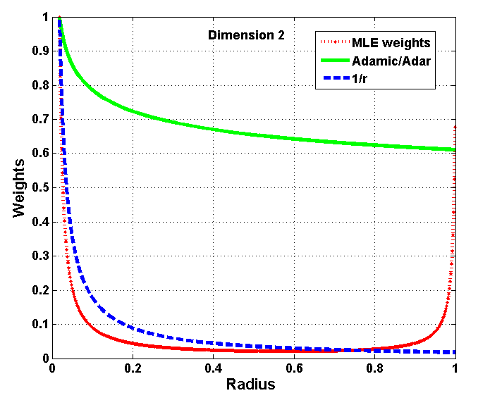
Type 2 common neighbors
Jacobian
{
Adamic/Adar
Variance
Small variance →Presence is more surprising
Small variance →Absence is more surprising
1/r
r is close to max radius
Real world graphs generally fall in this range

Slide 15
Previous Empirical Studies*
Especially if the graph is sparse
Link prediction accuracy
Random
Shortest Path
Common Neighbors
Adamic/Adar
Ensemble of short paths
*Liben-Nowell & Kleinberg, 2003; Brand, 2005; Sarkar & Moore, 2007

Slide 16
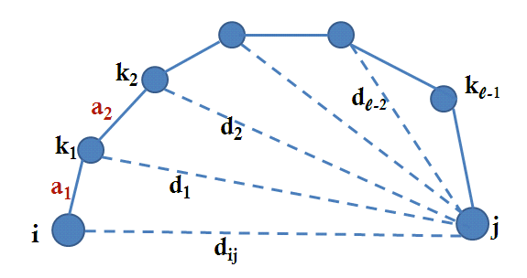
l hop Paths
Common neighbors = 2 hop paths
Analysis of longer paths: two components
1. Bounding E(η_{l} | d_{ij}). [η_{l} = # l hop paths]
Bounds Pr_{l} (i,j) by using triangle inequality on a series of common neighbor probabilities.
2. η_{l} ≈ E(η_{l} | d_{ij})
Triangulation

Slide 17
l hop Paths
Common neighbors = 2 hop paths
Analysis of longer paths: two components
1. Bounding E(η_{l} | d_{ij}). [η_{l} = # l hop paths]
Bounds Pr_{l} (i,j) by using triangle inequality on a series of common neighbor probabilities.
2. η_{l} ≈ E(η_{l} | d_{ij})
Bounded dependence of η_{l} on position of each node
➔ Can use McDiarmid’s inequality to bound |η_{l} - E(η_{l}|d_{ij})|

Slide 18
l hop Paths
Bound d_{ij} as a function of η_{l} using McDiarmid’s inequality.
For l’ ≥ l we need η_{l’} >> η_{l} to obtain similar bounds
Also, we can obtain much tighter bounds for long paths if shorter paths are known to exist.
Notes:
For longer paths we need to see far more of them to obtain similar bounds on distance. This follows from the exact expression of g. This is why, longer paths are not very useful, unless you see extraordinarily many of them.

Slide 19
Revisiting Raftery et al.’s model
1
½
Factor ¼ weak bound for Logistic
Can be made tighter, as logistic approaches the step function.
Notes:
Up till now, we have looked at the analysis where logistic was essentially a step function. In the general case, this might not be true. But the math and intuitions carry over. We see that there is an extra ¼ weakness associated with the area term, along with some additional terms. This is without any assumptions about alpha. But in a real world setting, alpha will be very large, and for that case, we can obtain a much tighter bound (in paper).

Slide 20
Conclusion
Three key ingredients
Closer points are likelier to be linked.
Small World Model- Watts, Strogatz, 1998, Kleinberg 2001
Triangle inequality holds
➔necessary to extend to l hop paths
Points are spread uniformly at random
➔ Otherwise properties will depend on location as well as distance

Slide 21
Summary
In sparse graphs, length 3 or more paths help in prediction.
Differentiating between different degrees is important
For large dense graphs, common neighbors are enough
Link prediction accuracy*
The number of paths matters, not the length
Random
Shortest Path
Common Neighbors
Adamic/Adar
Ensemble of short paths
*Liben-Nowell & Kleinberg, 2003; Brand, 2005; Sarkar & Moore, 2007

Slide 22
Thanks!

Slide 23
Problem Statement
Generative model
Link Prediction Heuristics
A few properties
Most likely neighbor of node i ?
node a
node b
Compare
➔ Can justify the empirical observations
➔ We also offer some new prediction algorithms
Notes:
Here is the problem statement….

Slide 24
New Estimators
Combine bounds from different radii
But there might not be enough data to obtain individual bounds from each radius
New sweep estimator
Q_{r} = Fraction of nodes w. radius ≤ r, which are common neighbors.
Higher Q_{r}➔ smaller d_{ij} w.h.p

Slide 25
New Estimators
Q_{r} = Fraction of nodes w. radius ≤ r, which are common neighbors
larger Q_{r} → smaller d_{ij} w.h.p
T_{R} : = Fraction of nodes w. radius ≥ R, which are common neighbors.
Smaller T_{R}➔ large d_{ij} w.h.p
Notes:
Summarize.

Slide 26
Sweep Estimators
Number of common neighbors of a given radius
r
Q_{r} = Fraction of nodes with radius ≤ r which are common neighbors
T_{R} = Fraction of nodes with radius ≥ R which are common neighbors
Large Q_{r} ➔ small d_{ij}
Small T_{R} ➔ large d_{ij}

