Slide 1



Fast Proximity Search on Large Graphs
Purnamrita Sarkar
Committee:
Andrew W. Moore (Chair)
Geoffrey J. Gordon
Anupam Gupta
Jon Kleinberg (Cornell)

Slide 2
Ranking in Graphs: Friend Suggestion in Facebook
New friend-suggestions
Two friends Purna
added
Purna just joined Facebook
Notes:
Ranking comes up in many everyday problems. Take for example friend suggestion problem in facebook. This is a graph of entities, where the links are based on who-knows-whom.

Slide 3




Ranking in Graphs : Recommender systems
Alice
Top-k movies Alice is most likely to watch.
Bob
Music: last.fm
Movies: NetFlix, MovieLens¹
Charlie
Brand, M. (2005). A Random Walks Perspective on Maximizing Satisfaction and Profit. SIAM '05.
Notes:
Lets start with a few examples which require ranking on large graphs. Take for example recommender networks.
Here we have a bipartite graph of customers and movies. A customer has a link to a movie if he/she rated that movie. Now the question is…

Slide 4
Ranking in Graphs: Content-based search in databases^{{1,2}}
maximum
paper-has-word
k most relevant papers about SVM.
margin
Paper #1
classification
paper-cites-paper
paper-has-word
large
Paper #2
scale
SVM
1. Dynamic personalized pagerank in entity-relation graphs. (Soumen Chakrabarti, WWW 2007)
2. Balmin, A., Hristidis, V., & Papakonstantinou, Y. (2004). ObjectRank: Authority-based keyword search in databases. VLDB 2004.
Notes:
Another example is content based search in databases. We can represent the citeseer dataset by a graph of paper and word-nodes. Papers are connected via citation. Words are connected to the paper if they appeared in the title of the paper. Now we want to ask….

Slide 5
All These are Ranking Problems!
Friends connected by who knows-whom
Bipartite graph of users & movies
Citeseer graph
Who are the most likely
friends of Purna?
Top k movie recommendations
for Alice from Netflix
Top k matches for query SVM
Notes:
Connect with previous

Slide 6
Graph Based Proximity Measures
Number of common neighbors
Number of hops
Number of paths (Too many to enumerate)
Number of short paths?
Random Walks naturally examines the ensemble of paths
Notes:
For ranking we need a graph-based measure of similarity. Here are some examples. …. Random Walks is an intuitive and useful mathematical tool which summarizes this ensemble of paths between two nodes.

Slide 7
Brief Introduction
Popular random walk based measures
Personalized pagerank
….
Hitting and Commute times
Intuitive measures of similarity
Used for many applications
Possible query types:
Find k most relevant papers about “support vector machines”
Queries can be arbitrary
Computing these measures at query-time is still an active area of research.
Notes:
Now we will briefly motivate our problem setting.

Slide 8
Problem with Current Approaches
Iterating over entire graph
→ Not suitable for query-time search
Pre-compute and cache results
→ Can be expensive for large or dynamic graphs
Solving the problem on a smaller sub-graph picked using a heuristic
→ Does not have formal guarantees

Slide 9
Our Main Contributions
Local algorithms for approximate nearest neighbors computation with theoretical guarantees (UAI’07, ICML’08)
Fast reranking of search results with user feedback (WWW’09)
Local algorithms often suffer from high degree nodes.
Simple solution and analysis
Extension to disk-resident graphs
Theoretical justification of popular link prediction heuristics (COLT’10)
KDD’10

Slide 10
Outline
Ranking is everywhere
Ranking using random walks
Measures
Fast Local Algorithms
Reranking with Harmonic Functions
The bane of local approaches
High degree nodes
Effect on useful measures
Disk-resident large graphs
Fast ranking algorithms
Useful clustering algorithms
Link Prediction
Generative Models
Results
Conclusion

Slide 11
Random Walk Based Proximity Measures
Personalized Pagerank
Hitting and Commute Times
And many more…
Simrank
Hubs and Authorities
Salsa

Slide 12
Random Walk Based Proximity Measures
Personalized Pagerank
Start at node i
At any step reset to node i with probability α
Stationary distribution of this process
Hitting and Commute Times
And many more…
Simrank
Hubs and Authorities
Salsa

Slide 13
Random Walk Based Proximity Measures
Personalized Pagerank
Hitting and Commute Times
Hitting time is the expected time to hit a node j in a random walk starting at node i
Commute time is the roundtrip time.
And many more…
Simrank
Hubs and Authorities
Salsa
a
b
h(a,b)>h(b,a)

Slide 14
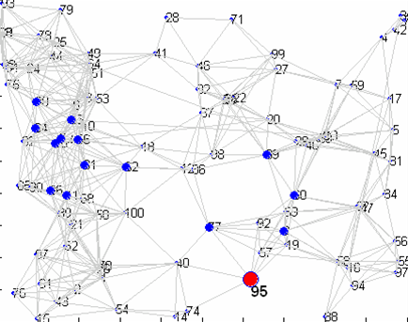
Pitfalls of Hitting and Commute Time
Problems with hitting and commute times
Sensitive to long paths
Prone to favor high degree nodes
Harder to compute
Liben-Nowell, D., & Kleinberg, J. The link prediction problem for social networks CIKM '03.
Brand, M. (2005). A Random Walks Perspective on Maximizing Satisfaction and Profit. SIAM '05.

Slide 15
Truncated Hitting Time
We propose a truncated version¹ of hitting and commute times, which only considers paths of length T
1. This was also used by Mei et al. for query suggestion
Notes:
Mention that it is at most T

Slide 16
Algorithms to Compute H^{T}
Easy to compute hitting time from all nodes to query node
→ Use dynamic programming
→ T|E| computation
Hard to compute hitting time from query node to all nodes
End up computing all pairs of hitting times
O(n²)
Want fast local algorithms which only examine a small neighborhood around the query node

Slide 17
Local Algorithm
Is there a small neighborhood of nodes with small hitting time to node j?
S_{τ} = Set of nodes within hitting time τ to j
, for undirected graphs
→Small neighborhood with potential nearest neighbors!
→How do we find it without computing all the hitting times?
How easy it is to reach j

Slide 18
GRANCH
Compute hitting time only on this subset
?
j
NB_{j}
Completely ignores graph structure outside NB_{j}
Poor approximation ➔ Poor ranking

Slide 19
GRANCH
Upper and lower bounds on h(i,j) for i in NB(j)
Bounds shrink as neighborhood is expanded
Expand
?
lb(NB_{j})
j
NB_{j}
Stop expanding when lb(NB_{j}) ≥ τ
For all i outside NB_{j} , h(i,j) ≥ lb(NB_{j}) ≥ τ ➔ Guaranteed to not miss a potential nearest neighbor!
Captures the influence of nodes outside NB
But can miss potential neighbors outside NB

Slide 20
Nearest Neighbors in Commute Times
Top k nodes in hitting time TO → GRANCH
Top k nodes in hitting time FROM → Sampling
Commute time = FROM + TO
Can naively add the two
Poor for finding nearest neighbors in commute times
We address this by doing neighborhood expansion in commute times
→ HYBRID algorithm

Slide 21
Experiments
628,000 nodes. 2.8 Million edges on a single CPU machine.
Sampling (7,500 samples) 0.7 seconds
Exact truncated commute time: 88 seconds
Hybrid algorithm: 4 seconds
Existing work use Personalized Pagerank (PPV) .
We present quantifiable link prediction tasks
We compare PPV with truncated hitting and commute times.
Citeseer graph
words
papers
authors
Notes:
Check the sample seconds

Slide 22
Word Task
words
papers
authors
Accuracy
Rank the papers for these words.
See if the paper comes up in top k
k
Hitting time and PPV from query node is much better than commute times.

Slide 23
Author Task
words
papers
authors
Accuracy
Rank the papers for these authors. See if the paper comes up in top k
k
Commute time from query node is best.

Slide 24
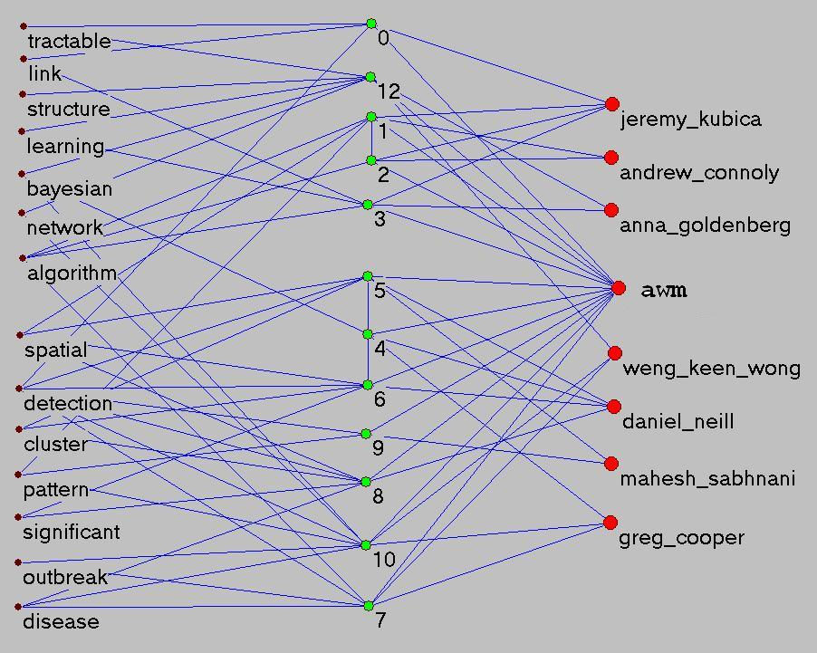
An Example
Bayesian Network structure learning, link prediction etc.
words
papers
authors
Machine Learning for disease outbreak detection

Slide 25
An Example
words
papers
authors
awm
+ disease
+ bayesian
query

Slide 26
Results for awm, bayesian, disease
Does not have Bayesian in title, but relevant!
Does not have disease in title, but relevant!
{
{
Are about Bayes Net Structure Learning
Disease outbreak detection
Relevant
Irrelevant

Slide 27
Results for awm, bayesian, disease
→
→
→
Relevant
Irrelevant

Slide 28
After Reranking
Relevant
Irrelevant

Slide 29
Reranking: Challenges and Our Contributions
Must consider negative information
Probability of hitting a positive node before a negative node : Harmonic functions
T-step variant of this.
Must be very fast. Since the labels are changing fast.
Can extend the GRANCH setting to this scenario
1.5 seconds on average for ranking in the DBLP graph with a million nodes

Slide 30
What is Reranking?
User submits query to search engine
Search engine returns top k results
p out of k results are relevant.
n out of k results are irrelevant.
User isn’t sure about the rest.
Produce a new list such that
relevant results are at the top
irrelevant ones are at the bottom
}
Must use both positive and negative examples
Must be On-the-fly

Slide 31
Outline
Ranking is everywhere
Ranking using random walks
Measures
Fast Local Algorithms
Reranking with Harmonic Functions
The bane of local approaches
High degree nodes
Effect on useful measures
Disk-resident large graphs
Fast ranking algorithms
Useful clustering algorithms
Link Prediction
Generative Models
Results
Conclusion

Slide 32
High Degree Nodes
Real world graphs with power law degree distribution
Very small number of high degree nodes
But easily reachable because of the small world property
Effect of high-degree nodes on random walks
High degree nodes can blow up neighborhood size.
Bad for computational efficiency.
We will consider discounted hitting times for ease of analysis.
We give a new closed form relation between personalized pagerank and discounted hitting times.
We show the effect of high degree nodes on personalized pagerank
→ similar effect on discounted hitting times.
Notes:
Don’t go into adamic adar
summarize: high degree nodes hurt link prediction, and computational efficiency

Slide 33
High Degree Nodes
Main idea:
When a random walk hits a high degree node, only a tiny fraction of the probability mass gets to its neighbors.
Why not stop the random walk when it hits a high degree node?
Turn the high degree nodes into sink nodes.
t
t+1
p/1000
p/1000
}
p
p/1000
degree=1000
degree=1000
Notes:
Drawing.

Slide 34
Effect on Personalized Pagerank
We are computing personalized pagerank from node i
If we make node s into sink
PPV(i,j) will decrease
By how much?
Can prove: the contribution through s is
probability of hitting s from i * PPV (s,j)
Is PPV(s,j) small if s has huge degree?
v_{i}(j) = α Σ_{t} (1- α)^{t} P^{t}(i,j)
Undirected Graphs
Can show that error at a node is ≤
Can show that for making a set of nodes S sink, error is ≤
This intuition holds for directed graphs as well. But our analysis is only true for undirected graphs.

Slide 35
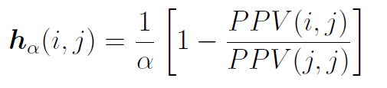
Effect on Hitting Times
Discounted hitting times: hitting times with a α probability of stopping at any step.
Main intuition:
PPV(i,j) = Pr_{α}(hitting j from i) * PPV(j,j)
We show→
Hence making a high degree node into a sink has a small effect on h_{α}(i,j) as well

Slide 36
Outline
Ranking is everywhere
Ranking using random walks
Measures
Fast Local Algorithms
Reranking with Harmonic Functions
The bane of local approaches
High degree nodes
Effect on useful measures
Disk-resident large graphs
Fast ranking algorithms
Useful clustering algorithms
Link Prediction
Generative Models
Results
Conclusion

Slide 37
Random Walks on Disk
Constraint 1: graph does not fit into memory
Cannot have random access to nodes and edges
Constraint 2: queries are arbitrary
Solution 1: streaming algorithms¹
But query time computation would need multiple passes over entire dataset
Solution 2: existing algorithms for computing a given proximity measure on disk-based graphs
Fine-tuned for the specific measure
We want a generalized setting
1. A. D. Sarma, S. Gollapudi, and R. Panigrahy. Estimating pagerank on graph streams. In PODS, 2008.

Slide 38
Simple Idea
Cluster graph into page-size clusters*
Load cluster, and start random walk. If random walk leaves the cluster, declare page-fault and load new cluster
→ Most random walk based measures can be estimated using sampling.
What we need
Better algorithms than vanilla sampling
Good clustering algorithm on disk, to minimize page-faults
* 4 KB on many standard systems, or larger in more advanced architectures

Slide 39
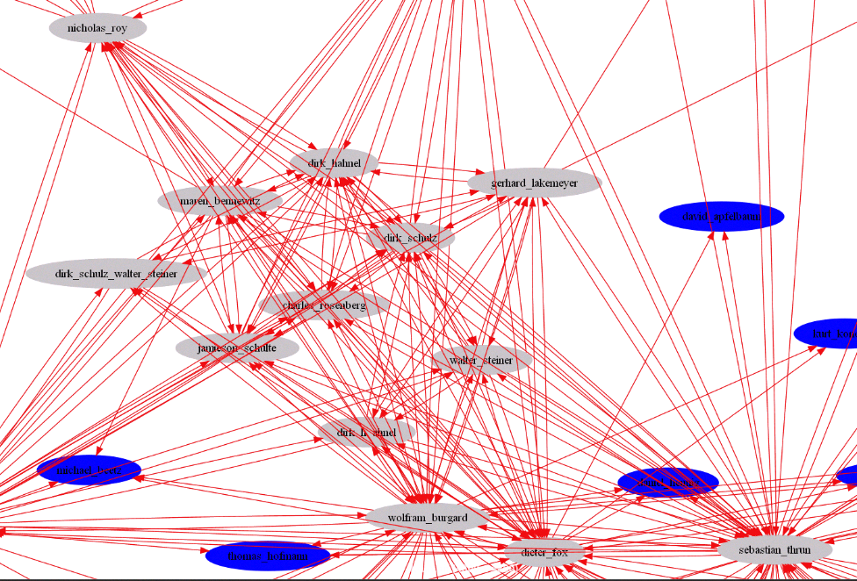
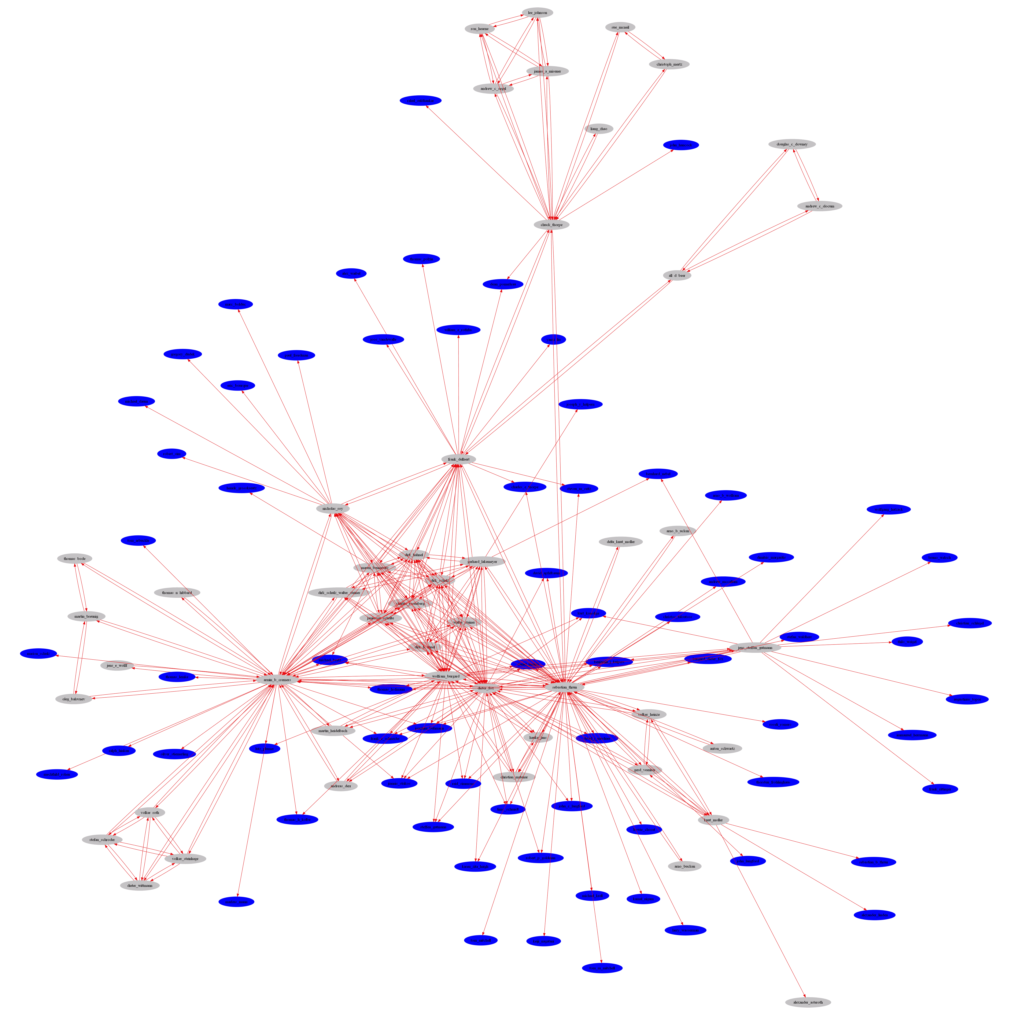
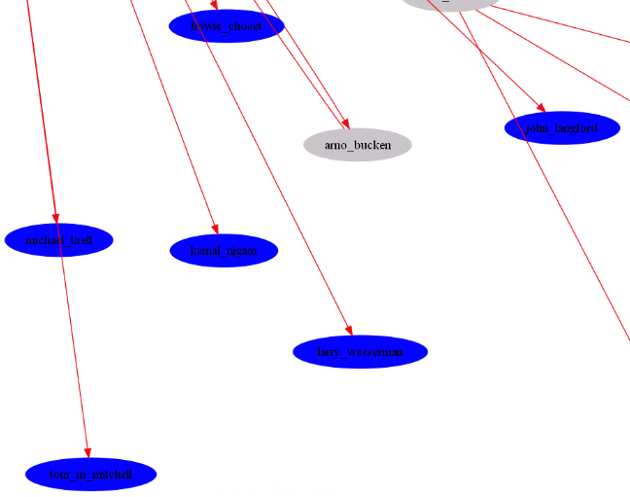
Nearest neighbors on Disk-based graphs
Robotics
howie_choset
david_apfelbauu
john_langford
kurt_kou
michael_krell
kamal_nigam
michael_beetz
larry_wasserman
daurel_
Machine learning and Statistics
thomas_hoffmann
Grey nodes are inside the cluster
Blue nodes are neighbors of boundary nodes
tom_m_mitchell

Slide 40
Nearest neighbors on Disk-based graphs
A random walk mostly stays inside a good cluster
Wolfram Burgard
Dieter Fox
Mark Craven
Kamal Nigam
Dirk Schulz
Armin Cremers
Tom Mitchell
Top 7 nodes in personalized pagerank from Sebastian Thrun
Grey nodes are inside the cluster
Blue nodes are neighbors of boundary nodes

Slide 41
Sampling on Disk-based graphs
1. Load cluster in memory.
2. Start random walk
Can also maintain a LRU buffer to store the clusters in memory.
Page-fault every time the walk leaves the cluster
Number of page-faults on average
Ratio of cross edges with total number of edges
Quality of a cluster

Slide 42
Sampling on Disk-based graphs
Better cluster. Conductance ≈ 0.2
Bad cluster.
Cross/Total-edges ≈ 0.5
Conductance of a cluster
Good cluster. Conductance ≈ 0.3
A length T random walk escapes outside roughly T/2 times
Can we do any better than sampling on the clustered graph?
How do we cluster the graph on disk?

Slide 43
GRANCH on Disk
Upper and lower bounds on h(i,j) for i in NB(j)
Add new clusters when you expand.
Expand
?
lb(NB_{j})
j
NB_{j}
Many fewer page-faults than sampling!
We can also compute PPV to node j using this algorithm.

Slide 44
How to cluster a graph on disk?
Pick a measure for clustering
Personalized pagerank – has been shown to yield good clustering¹
Compute PPV from a set of A anchor nodes, and assign a node to its closest anchor.
How to compute it on disk?
Personalized pagerank on disk
Nodes/edges do not fit in memory: no random access
→ RWDISK
R. Andersen, F. Chung, and K. Lang. Local graph partitioning using pagerank vectors. In FOCS '06.

Slide 45
RWDISK
Compute personalized pagerank using power iterations
Each iteration = One matrix-vector multiplication
Can compute by join operations between two lexicographically sorted files.
Intermediate files can be large
Round the small probabilities to zero at any step.
Has bounded error, but brings down file-size from O(n²) → O(|E|)

Slide 46
Experiments
Turning high degree nodes into sinks
Significantly improves the time of RWDISK (3-4 times).
Improves number of pagefaults in sampling a random walk
Improves link prediction accuracy
GRANCH on disk improves number of page-faults significantly from random sampling.
RWDISK yields better clusters than METIS with much less memory requirement. (will skip for now)

Slide 47
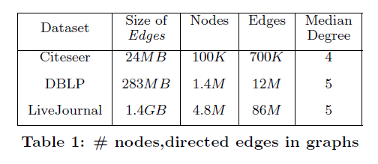
Datasets
Citeseer subgraph : co-authorship graphs
DBLP : paper-word-author graphs
LiveJournal: online friendship network

Slide 48
Effect of High Degree Nodes on RWDISK
Dataset | Sink Nodes |  | Time
 | Minimum degree | Number of sinks
DBLP | None | 0 | ≥ 2.5 days
 | 1000 | 900 | 11 hours
LiveJournal | 1000 | 950 | 60 hours
 | 100 | 134K | 17 hours
4 times faster
Minimum degree of a sink node
Number of sinks
3 times faster

Slide 49
Effect of High Degree Nodes on Link Prediction Accuracy and Number of Page-faults
Dataset | Minimum degree of Sink Nodes | Accuracy | Page-faults
Citeseer | None | 0.74 | 69
 | 100 | 0.74 | 67
DBLP | None | 0.1 | 1881
 | 1000 | 0.58 | 231
LiveJournal | None | 0.2 | 1502
 | 100 | 0.43 | 255
6 times better
8 times less
2 times better
6 times less

Slide 50
Effect of Deterministic Algorithm on Page-faults
10 times less than sampling
Dataset | Mean page-faults | Median Page-faults
Citeseer | 6 | 2
DBLP | 54 | 16.5
LiveJournal | 64 | 29
4 times less than sampling
4 times less than sampling

Slide 51
Outline
Ranking is everywhere
Ranking using random walks
Measures
Fast Local Algorithms
Reranking with Harmonic Functions
The bane of local approaches
High degree nodes
Effect on useful measures
Disk-resident large graphs
Fast ranking algorithms
Useful clustering algorithms
Link Prediction
Generative Models
Results
Conclusion

Slide 52
Link Prediction- Popular Heuristics
Who are more likely to be friends?
(Alice-Bob) or (Bob-Charlie)?
128 friends
Popular common friends
→Less evidence
Alice
Adamic/Adar = .24
1000 friends
2 common friends
Bob
8 friends
Adamic/Adar = .8
Less popular
→Much more evidence
2 common friends
Charlie
4 friends
The Adamic/Adar score weights the more popular common neighbors less

Slide 53
Link Prediction- Popular Heuristics
Previous work suggests that different graph-based measures perform differently on different graphs.
Number of common neighbors often perform unexpectedly well
Adamic/Adar, which weights high degree common neighbors less, performs better than common neighbors
Length of shortest path does not perform very well.
Ensemble of short paths perform very well.

Slide 54
Problem Statement
Generative model
Link Prediction Heuristics
Most likely future neighbor of node i ?
node a
node b
Compare

Slide 55
Link Prediction – Generative Model
Raftery et al’s Model
Higher probability of linking
1
Logistic probability of linking
½
Uniformly distributed in 2D latent space
The problem of link prediction is to find the nearest neighbor who is not currently linked to the node.
Equivalent to inferring distances in the latent space

Slide 56
Simple Deterministic Extension
Everyone has same radius r
1
½
i
j
Pr (it is a common neighbor of i and j)
= Probability that a point will fall in this region
= A (r,r,d_{ij})
Also depends on the dimensionality of the latent space

Slide 57
Link Prediction
Common neighbors = η₂(i,j)= Binomial(n,A)
Can estimate A
Can estimate d_{ij}
Distance to TRUE nearest neighbor
Distance to node with most common neighbors
d_{OPT} d_{MAX}
≤
≤
d_{OPT} + √3 r ε
Is small when there are many common neighbors

Slide 58
Distinct Radii
Common neighbors = number of nodes both i and j point to → e.g. cite the same paper
If d_{ij} is larger than 2r, then i and j cannot have a common neighbor of radius r
We will consider a simple case where there are two types of radii r and R, such that r<< R
k
r
i
j

Slide 59
Distinct Radii
d_{ij} = ?
1 r-neighbor
1 R-neighbor
d_{ij} < 2r
d_{ij} < 2R
4 r-neighbors
Need many R neighbors
to achieve similar bounds
Weighting small radius (degree) neighbors more gives better discriminative power → Adamic/Adar

Slide 60
Longer vs. Shorter Paths
In presence of many length-2 paths, length 3 or higher paths do not give much more information.
Hence, in a sparse graph examining longer paths will be useful.
This is often the case, where PPV, hitting times work well.
The number of paths is important, not the length
One length 2 path
< 4 length 2 paths
< 4 length 2 paths and 5 length 3 paths
< 8 length 2 paths
Agrees with previous empirical studies, and our results!
Can extend this to the non-deterministic cases

Slide 61
Our Main Contributions
Local algorithms for approximate nearest neighbors computation (UAI’07, ICML’08)
Never missed a potential nearest neighbor
Suitable for fast dynamic reranking using user feedback (WWW’09)
Local algorithms often suffer from high degree nodes.
Simple transformation of the graph can solve the problem
Theoretical analysis shows that this has bounded error
Disk-resident graphs
Extension of our algorithms to a clustered representation on disk
Also provide a fully external memory clustering algorithm
Link prediction – great way of quantitative evaluation of proximity measures.
We provide a framework to theoretically justify popular measures
This brings together a generative model with simple geometric intuitions (COLT’10)
KDD’10

Slide 62
Thanks!

Slide 63
Conclusion
Fast Local Algorithms for ranking with random walks
Fast algorithms for dealing with ambiguity and noisy data by incorporating user feedback
Connections between different measures, and the effect of high degree nodes on them
Fast ranking algorithms on large disk-resident graphs
Theoretical justification of link prediction heuristics

Slide 64




Link Prediction- Popular Heuristics
130,000 other people liked this
Popular movies
→Less evidence
Alice
150,000 other people liked this
2 common
Bob
8 other people liked this
Obscure movies
→Much more evidence
Charlie
7 other people liked this

Slide 65
Our Main Contributions
Local algorithms for approximate nearest neighbors computation (UAI’07, ICML’08)
Never missed a potential nearest neighbor
Generalizes to other random walk-based measures like harmonic functions
Suitable for the interactive setting (WWW’09)
Local algorithms often suffer from high degree nodes.
Simple transformation of the graph can solve the problem
Theoretical analysis shows that this has bounded error
Disk-resident graphs
Extension of our algorithms to this setting.
Also
All our algorithms and measures are evaluated via link-prediction tasks. Finally, we provide a theoretical framework to justify the use of popular heuristics for link-prediction on graphs. Our analysis matches a number of observations made in previous empirical studies. (COLT’10)
KDD’10

Slide 66
Truncated Hitting & Commute times
For small T
Are not sensitive to long paths.
Do not favor high degree nodes
For a randomly generated undirected geometric graph, average correlation coefficient (R_{avg}) with the degree-sequence is
R_{avg} with truncated hitting time is -0.087
R_{avg} with untruncated hitting time is -0.75
Notes:
REORDER (remember to say what T is)

Slide 67
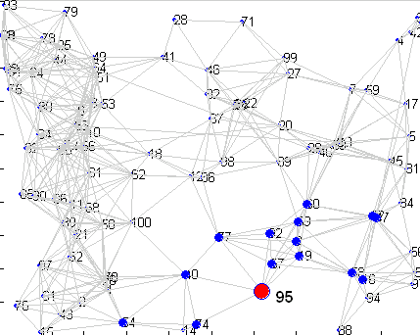
15 nearest neighbors of node 95 (in red)
Un-truncated VS. truncated hitting time from a node
Un-truncated hitting time
Truncated hitting time

Slide 68
RWDISK
Power iterations for PPV
x₀(i)=1, v = zero-vector
For t=1:T
x_{t+1} = P^{T} x_{t}
v = v + α(1- α)^{t-1} x_{t+1}
1. Edges file to store P: {i, j, P(i,j)}
2. Last file to store x_{t}
3. Newt file to store x_{t+1}
4. Ans file to store v
Can compute by join-type operations on files Edges and Last.
But Last/Newt can have A*N lines in intermediate files, since all nodes can be reached from A anchors.
Round probabilities less than ε to zero at any step.
Has bounded error, but brings down file-size to roughly A*d_{avg}/ ε

Slide 69
Harmonic Function for Reranking
Given a set of positive and negative nodes, the probability of hitting a positive label before a negative label is also known as the harmonic function.
Usually requires solving a linear system, which isn’t ideal in an interactive setting.
We look at the T-step variant of this probability, and extend our local algorithm to obtain ranking using these values.
On the DBLP graph with a million nodes, it takes 1.5 seconds on average to rank using this measure.

