Slide 1
H2S-NN
Heterogeneous Sheaf-Hodge Neural Networks with Learned Schema-to-Cell Discovery
Peeradon Sarnkaew
Notes:
.

Slide 2
Two Problems, One Graph
Real graphs are heterogeneous — many node types, many relation types
...and often heterophilic — connected nodes don't share labels or meaning
Ordinary GNNs struggle twice:
over-smooth dissimilar neighbors together
only see edges — miss higher-order typed patterns entirely

Slide 3
How the Field Answers This Today
Approach | What it actually does
Meta-path HGNNs (HAN, search methods) | Follow a path to collect a neighborhood, then discard the path
Heterogeneous Sheaf Nets (HetSheaf) | Learn typed geometry — but only on the original graph edges
H2S-NN (ours) | Turn the path itself into structure that reshapes the model

Slide 4
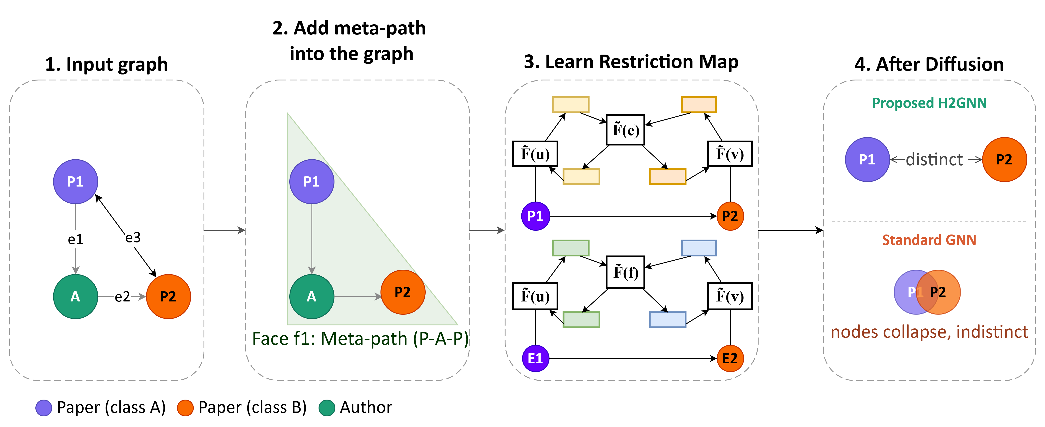
Our Idea: A Path Becomes a Cell
A concrete meta-path instance becomes a face of a topological complex — not just a routing rule

Slide 5
What This Buys Us
Higher-order structure that reshapes the model's diffusion operator, not just an aggregation channel
Full Hodge diffusion on both nodes and edges (δ0, δ1, L0, L1)
Learns which paths matter automatically — a schema-level gate (α) and an instance-level gate (β)
A training-free score picks candidate paths before any model training happens

Slide 6
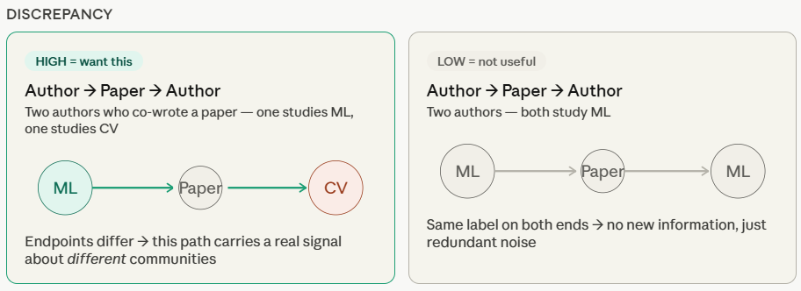
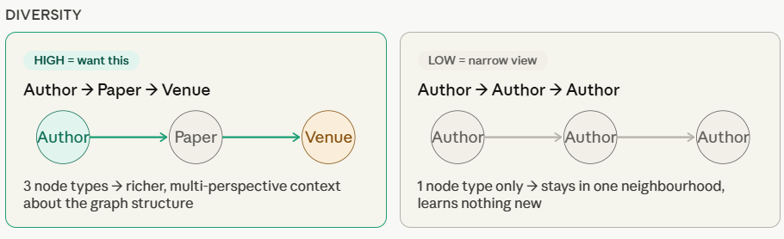
Learning Which Paths Deserve to Matter
A training-free score rewards paths that are discrepant (informative) and diverse (not redundant)

Slide 7
Putting It to the Test
Task | Datasets
Node classification | ACM, DBLP, IMDB
Graph classification | MUTAG, PROTEINS, ENZYMES, NCI1
Link prediction | LastFM, PubMed, Amazon, YouTube

Slide 8
General Experimental Settings
Task | Split | Seeds | Metrics
Node classification | Transductive, 24% / 6% / 70% (train / val / test) | 3 | Macro-F1, Micro-F1
Graph classification | 80% / 10% / 10%, 10-fold cross-validation | 5 | Macro-F1, Micro-F1
Link prediction | ~81% / 9% / 10% (train / val / test) | — | AUPR, AUROC
Node classification split follows the official HGB benchmark protocol exactly

Slide 9
Results: Node Classification
Macro-F1 / Micro-F1, averaged across seeds
Dataset | Best prior method | H2S-NN (ours)
ACM | HetSheaf — 95.09 / 94.94 | 95.91 / 95.72
DBLP | H2SGNN — 95.82 / 95.11 | 96.01 / 96.31
IMDB | H2SGNN — 74.23 / 75.29 | 75.05 / 76.68
Best result on every dataset, against 14 baselines spanning
homogeneous, heterogeneous, and sheaf-based models

Slide 10
Results: Graph Classification
Macro-F1 / Micro-F1, 10-fold cross-validation
Dataset | Best prior method | H2S-NN (ours)
MUTAG | HetSheaf (tie) — 100 / 100 | 100 / 100
PROTEINS | HetSheaf — 80.56 / 82.14 | 84.44 / 86.23
ENZYME | HetSheaf — 62.35 / 63.33 | 64.52 / 65.10
NCI1 | HetSheaf — 79.46 / 79.46 | 81.22 / 81.52

Slide 11
Results: Link Prediction & Efficiency
Dataset | Best prior (AUPR/AUROC) | H2S-NN (ours)
LastFM | HetSheaf — 98.51 / 98.33 | 100 / 100
PubMed | HGT — 97.58 / 96.48 | 99.63 / 99.28
Amazon | HGT — 96.15 / 95.66 | 99.71 / 98.34
YouTube | HGT — 94.95 / 92.51 | 98.37 / 96.30
On ACM: also the fastest (18.4s), smallest (134K params), and lowest-memory (810MB) model tested

Slide 12
Proof the Discovery Mechanism Matters
DBLP node classification, Macro-F1 / Micro-F1
Configuration | Macro-F1 | Micro-F1
No meta-path at all | 93.85 | 93.72
Predefined (manual) meta-path | 95.75 | 96.01
Auto-discovered, schema gate only | 95.88 | 95.92
Auto-discovered, full gating (ours) | 96.01 | 96.31
Each added mechanism helps — discovery beats both no-structure and hand-picked schemas

Slide 13
Ablation Study: Pooling Design Matters
Pooling head | Macro-F1 | Micro-F1
Sum + MLP | 61.25 | 61.79
Mean + MLP | 61.42 | 62.09
Max + MLP | 61.38 | 61.62
SheafPool | 64.05 | 64.96
S2Pool (ours) | 64.52 | 65.10

Slide 14
What We're Confident About — and What's Next
Solid today:
Core sheaf/Hodge operators dense-reference tested
Best result on every benchmark tested
Two completed ablations: discovery mechanism and pooling design
Still finishing:
Ablations across all datasets, not just one
Multi-seed statistical significance
Node clustering implementation

Slide 15
Conclusion
Meta-path instances aren't just neighborhoods to aggregate — they're structure the model can learn to see
Two contributions, evidenced together:
Sheaf-Hodge diffusion over higher-order cells built from real path instances
Automatic, training-free discovery of which paths deserve to become cells
Next: formal search guarantees, larger-scale graphs, node clustering

Slide 16
Thank You
Questions?

