Slide 1
H2SNN Project
Peeradon Sarnkaew
Notes:
.

Slide 2
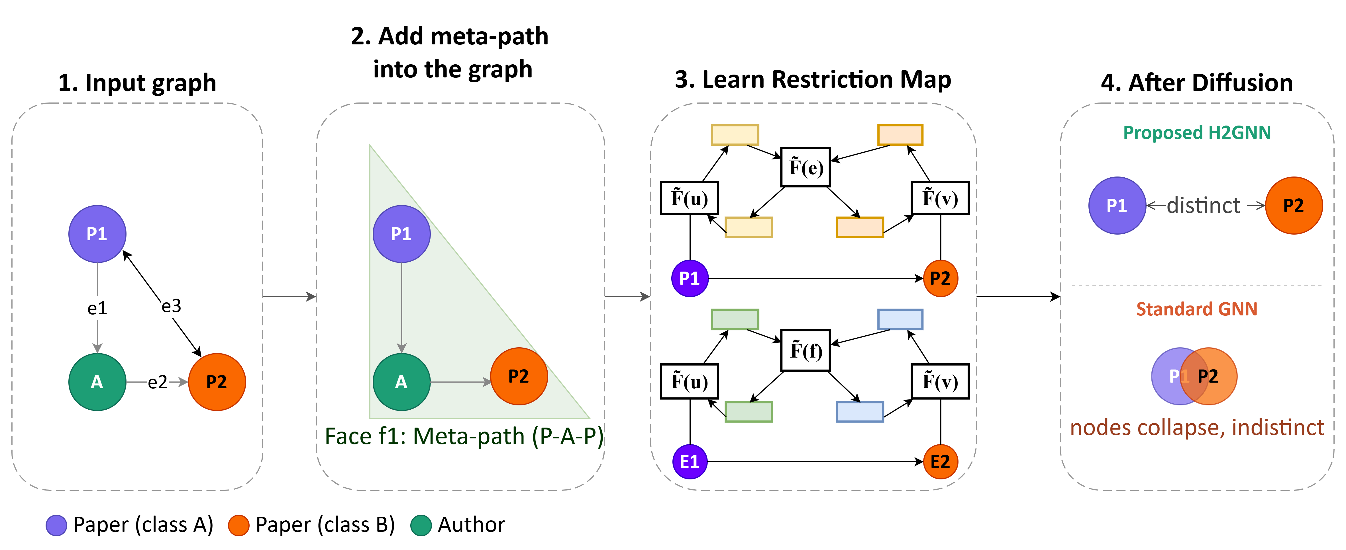
H2SNN Model
Automatic Meta-Path Selection via Sheaf (AMPSS)
Pass Typed MLP
Graph Readout Function
Notes:
A 2D cellular complex is a structure containing 0-dimensional cells, 1-dimensional cells, and 2-dimensional cells.
In my graph setting:
0-cells are nodes.
1-cells are edges.
2-cells can represent meta-path instances or higher-order relational structures.
This lets us model not only direct edges but also meaningful typed paths.
By treating a meta-path instance as a higher-order structure, the model can preserve the relation as one meaningful unit instead of reducing it to a simple projected edge.

Slide 3
Related Works of Meta-Path Selections
Problem with existing automatic meta-path selection | LMSPS | AMP-HGNAS | MCTS-HGNN | PMMM | HG-Search | PM-HGNN | H2S-NN (Ours)
Learns a soft importance score per schema type (not a hard keep/drop decision) | Yes | Yes | No | Yes | No | No | Yes
Learns importance of each individual path instance (not just the schema type) | No | No | No | No | No | No | Yes
Jointly optimize schema-level and instance-level weights | No | No | No | No | No | No | Yes
Redundancy Control | No | Yes | No | No | No | No | Yes
Evaluates schema quality using graph structural signals (2D-graph) | No | No | No | No | No | No | Yes
Notes:
Let me first give some background. Continuous-time dynamic graph neural networks or CTDGNNs are deep learning models for graphs whose structures or attributes change over time. They are used in applications such as social interaction graphs.

Slide 4
Problem of Current Meta-Path Selections
Cannot Handle 2D-structure graph
Ignore structural graph information in selection
Schema-level and instance-level meta-path should be jointly trained together
Notes:
Let me first give some background. Continuous-time dynamic graph neural networks or CTDGNNs are deep learning models for graphs whose structures or attributes change over time. They are used in applications such as social interaction graphs.

Slide 5
Automatic Meta-Path Selection via Sheaf (AMPSS)
Step 01: Meta-path Selections
Build the Schema-Graph
Use DFS for schema candidate with start and end as the target node types
Score Each Candidate by Graph Structure from label dissimilarity
Greedy selection
Create faces
Notes:
Let me first give some background. Continuous-time dynamic graph neural networks or CTDGNNs are deep learning models for graphs whose structures or attributes change over time. They are used in applications such as social interaction graphs.

Slide 6
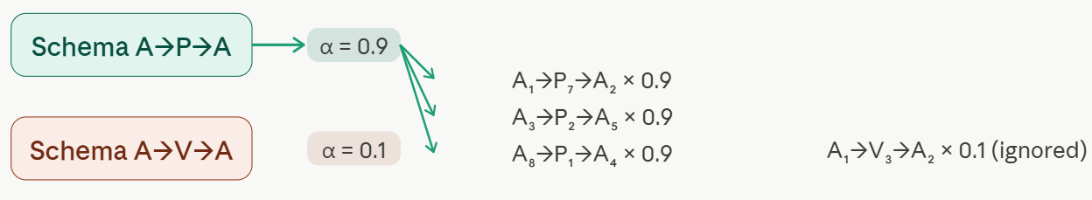
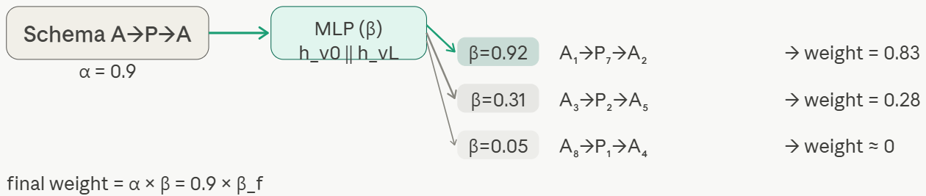
Automatic Meta-Path Selection via Sheaf (AMPSS)
Step 02: Instance Meta-path selections
Giving each face based on alpha (Schema based attention) x beta (Instance based attention)
Learnable during training with regularizers
Notes:
Let me first give some background. Continuous-time dynamic graph neural networks or CTDGNNs are deep learning models for graphs whose structures or attributes change over time. They are used in applications such as social interaction graphs.

Slide 7
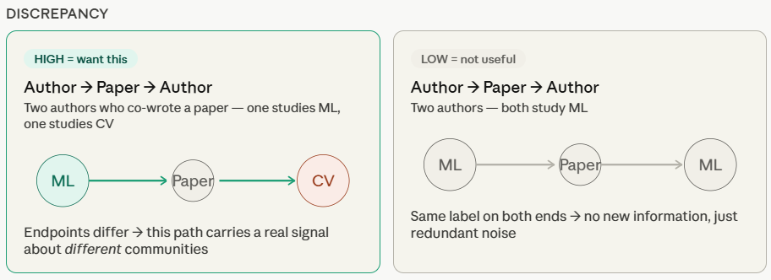
Automatic Meta-Path Selection via Sheaf (AMPSS)
Notes:
Let me first give some background. Continuous-time dynamic graph neural networks or CTDGNNs are deep learning models for graphs whose structures or attributes change over time. They are used in applications such as social interaction graphs.

Slide 8

Automatic Meta-Path Selection via Sheaf (AMPSS)
Notes:
Let me first give some background. Continuous-time dynamic graph neural networks or CTDGNNs are deep learning models for graphs whose structures or attributes change over time. They are used in applications such as social interaction graphs.

Slide 9
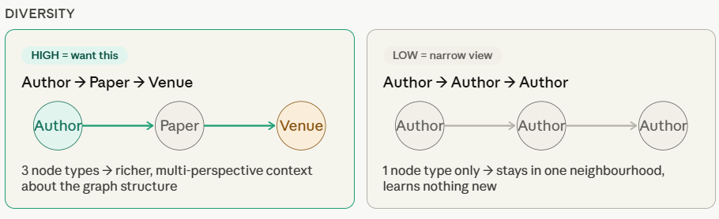
AMPSS: Automatic Meta-Path Selection for Sheaf (AMPSS)
Notes:
Let me first give some background. Continuous-time dynamic graph neural networks or CTDGNNs are deep learning models for graphs whose structures or attributes change over time. They are used in applications such as social interaction graphs.

Slide 10
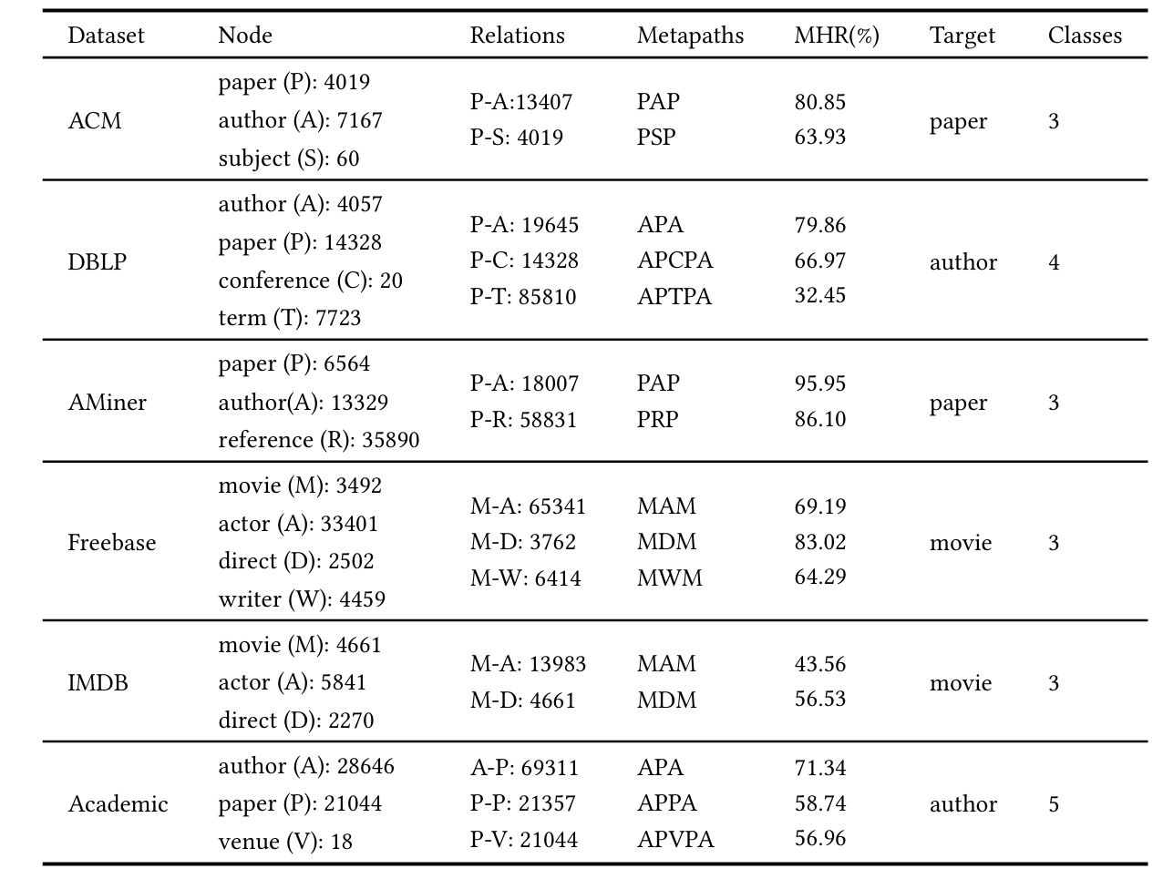
Datasets
Notes:
Let me first give some background. Continuous-time dynamic graph neural networks or CTDGNNs are deep learning models for graphs whose structures or attributes change over time. They are used in applications such as social interaction graphs.

Slide 11
Experiment: Node Classification
Transductive Node classification (24:6:70)
3 Random Seeds
10 Folds CV
Notes:
Let me first give some background. Continuous-time dynamic graph neural networks or CTDGNNs are deep learning models for graphs whose structures or attributes change over time. They are used in applications such as social interaction graphs.

Slide 12
Ablation Study: With vs Without Meta-path
Tested on Node Classification + ACM dataset
Models | DBLP (59.76)
 | Macro | Micro
H2SNN – No Meta-Path | 93.85 | 93.72
H2SNN- Predefined Meta-Path | 95.75 | 96.01
H2SNN – AMPSS – alpha | 95.88 | 95.92
H2SNN | 96.01 | 96.31
Notes:
Let me first give some background. Continuous-time dynamic graph neural networks or CTDGNNs are deep learning models for graphs whose structures or attributes change over time. They are used in applications such as social interaction graphs.

Slide 13
Preliminary Results: Node Classification (Avg)
Types | Models | DBLP (59.76) |  | ACM (72.39) |  | IMDB (50.04)
 |  | Macro | Micro | Macro | Micro | Macro | Micro
Homophilic homogeneous graph | GCN (2016) | 90.77 | 90.28 | 91.63 | 91.38 | 62.33 | 67.69
 | GAT (2021) | 94.39 | 92.52 | 92.07 | 90.71 | 62.13 | 68.09
Homophilic homogeneous graph | NSD (2022) | 92.96 | 93.42 | 92.33 | 92.05 | 61.61 | 65.23
 | CSNN (2026) | 93.73 | 92.12 | 93.13 | 92.81 | 62.92 | 62.59
 | ChebnetII (2022) | 92.89 | 92.67 | 91.7 | 91.59 | 62.97 | 68.47
Homophilic heterogeneous graph | HAN (2019) | 91.78 | 92.24 | 90.88 | 91.61 | 61.95 | 67.76
 | SeHGNN (2022) | 95.52 | 95.48 | 94.38 | 94.04 | 72.01 | 72.59
 | HiNormer (2023) | 94.06 | 94.14 | 91.87 | 89.64 | 64.13 | 67.53
 | PSHGCN (2024) | 95.58 | 95.7 | 93.66 | 94.70 | 71.82 | 74.34
Heterophilic heterogeneous graph | HDHGR (2023) | 95.35 | 95.00 | 93.99 | 94.13 | 59.41 | 59.63
 | Hetero2Net (2023) | 93.54 | 93.54 | 94.05 | 92.87 | 65.34 | 70.63
 | H2SGNN (2023) | 95.82 | 95.11 | 94.9 | 94.08 | 74.23 | 75.29
 | HETSHEAF (2024)* | 93.87 | 93.77 | 95.09 | 94.94 | 64.65 | 67.18
 | LatGRL (2021) | 94.32 | 94.51 | 93.47 | 92.29 | 58.27 | 58.81
 | H2SNN (Ours) | 96.01 | 96.31 | 95.91 | 95.72 | 75.05 | 76.68
Notes:
Let me first give some background. Continuous-time dynamic graph neural networks or CTDGNNs are deep learning models for graphs whose structures or attributes change over time. They are used in applications such as social interaction graphs.

Slide 14
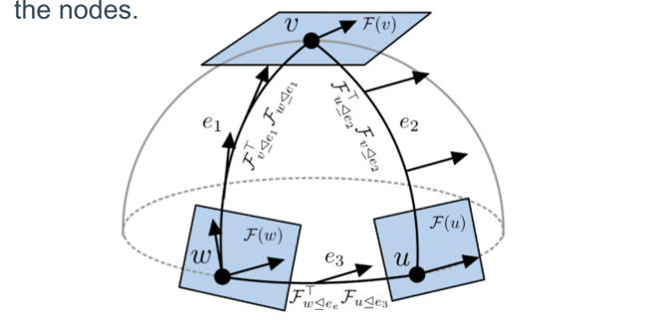
Readout Function for Graph Prediction
Trained Node Embeddings live on their own local space.
Can not directly combine node & edge embedding
Need to consider Permutation Invariant & Gauge Invariant
  Permutation Invariant
  Gauge Invariant
Notes:
Let me first give some background. Continuous-time dynamic graph neural networks or CTDGNNs are deep learning models for graphs whose structures or attributes change over time. They are used in applications such as social interaction graphs.

Slide 15
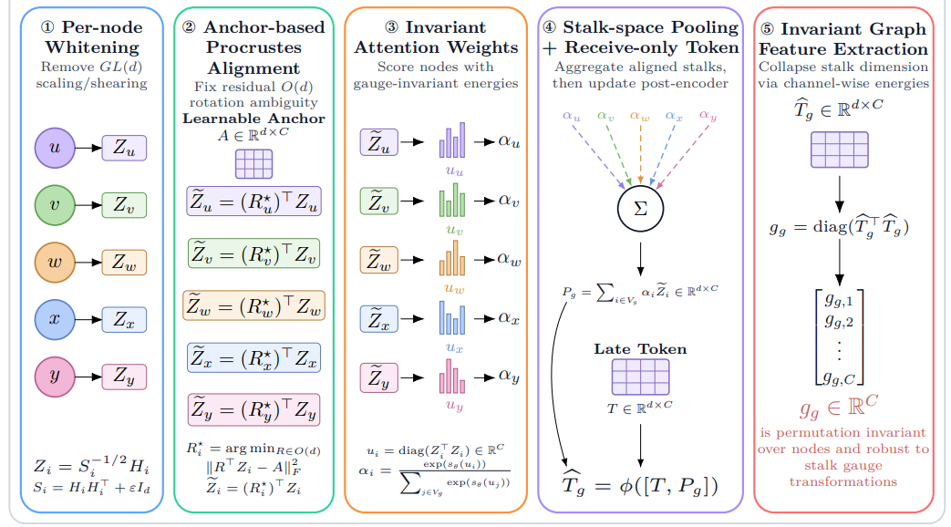
Existing Method: SHEAFPOOL
Notes:
After a sheaf encoder, each node has a stalk-space representation $H_{i}∈ℝ^{d×C}$. These node representations may not be written in the same local coordinate frame. Therefore, directly doing mean/sum/max/attention pooling can mix incompatible coordinates. So directly pooling can be wrong. Sheafpool tries to make node stalk embeddings comparable before pooling them.|
Whitening: remove local scaling/shearing normalize the local stalk coordinate system so that one node is not represented in a stretched, scaled, or sheared basis compared with another.
Anchor alignment: each node is “rotated” into a common reference frame before pooling.
Invariant attention uses energy like quantities not coordinates
do pooling T is learnable like a graph-specific token
Energy extraction.

Slide 16
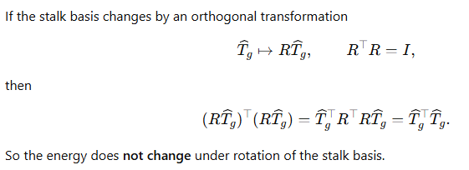
Energy invariance
Notes:
After a sheaf encoder, each node has a stalk-space representation $H_{i}∈ℝ^{d×C}$. These node representations may not be written in the same local coordinate frame. Therefore, directly doing mean/sum/max/attention pooling can mix incompatible coordinates. So directly pooling can be wrong. Sheafpool tries to make node stalk embeddings comparable before pooling them.|
Whitening: remove local scaling/shearing normalize the local stalk coordinate system so that one node is not represented in a stretched, scaled, or sheared basis compared with another.
Anchor alignment: each node is “rotated” into a common reference frame before pooling.
Invariant attention uses energy like quantities not coordinates
do pooling T is learnable like a graph-specific token
Energy extraction.

Slide 17
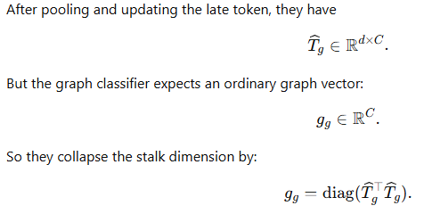
Energy invariance
Notes:
After a sheaf encoder, each node has a stalk-space representation $H_{i}∈ℝ^{d×C}$. These node representations may not be written in the same local coordinate frame. Therefore, directly doing mean/sum/max/attention pooling can mix incompatible coordinates. So directly pooling can be wrong. Sheafpool tries to make node stalk embeddings comparable before pooling them.|
Whitening: remove local scaling/shearing normalize the local stalk coordinate system so that one node is not represented in a stretched, scaled, or sheared basis compared with another.
Anchor alignment: each node is “rotated” into a common reference frame before pooling.
Invariant attention uses energy like quantities not coordinates
do pooling T is learnable like a graph-specific token
Energy extraction.

Slide 18
SHEAFPOOL: Problem
Consider that Node is in local and should make it comparable first using Gauge-fixing node stalks + weighted sum
Graph level summary can collapse due to weighted sum
Gauge fixing is unstable
Read only the node, not the sheaf relation
Notes:
Let me first give some background. Continuous-time dynamic graph neural networks or CTDGNNs are deep learning models for graphs whose structures or attributes change over time. They are used in applications such as social interaction graphs.

Slide 19
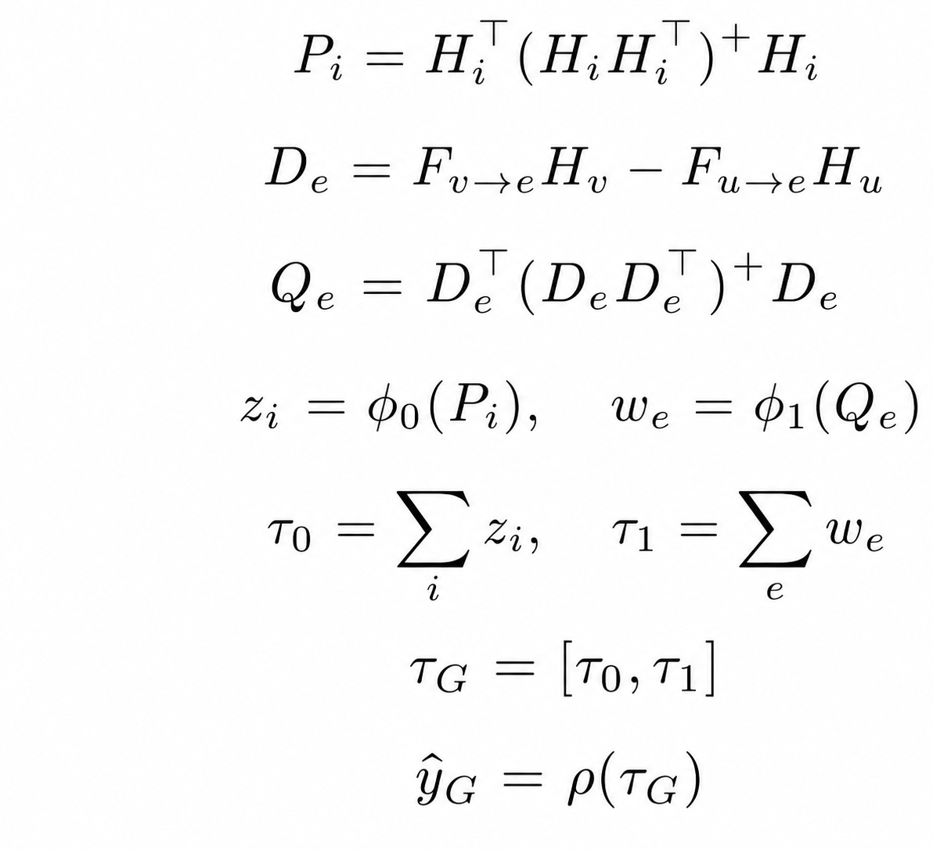
S2POOL: Readout Function for H2SNN Graph Prediction
Convert each node stalks to basis-free node descriptor
Calculate Sheaf disagreement on each edge
Convert each edge disagreement to basis-free edge descriptor
Used shared-MLP for Node/Edge
Aggregate and MLP
Notes:
Our readout builds a graph representation from two coordinate-free summaries: what the nodes contain, and how much neighboring nodes disagree under the sheaf.
“Instead of pooling raw local coordinates, we first describe what information the node carries in a coordinate-free way.”
“If two connected nodes agree under the sheaf, this value is small. If they conflict, it is large or structured.”
“We do not only ask what each node knows; we also ask where the sheaf says the graph is locally inconsistent.”
“The model learns which coordinate-free node patterns and which compatibility-error patterns are useful for classification.”
“Summation makes the result independent of node and edge ordering.”
Step 1 and 3 guarantee gauge invariant
Step 5 guarantee permutation invariant

Slide 20
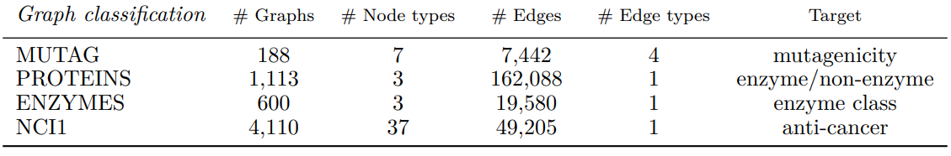
Experiment: Graph Classification
80:10:10 split
5 Random seeds
10 Folds CV
Notes:
MUTAG NCI1 Chemical compounds

Slide 21
Preliminary Results: Graph Classification (Avg)
Types | Models | MUTAG |  | PROTEINS |  | ENZYME |  | NCI1
 |  | Macro | Micro | Macro | Micro | Macro | Micro | Macro | Micro
Homophilic homogeneous graph | GCN (2016) | 89.58 | 90.00 | 75.92 | 79.83 | 12.75 | 28.33 | 64.17 | 64.96
 | GAT (2021 | 89.58 | 90.00 | 75.27 | 78.38 | 14.03 | 16.55 | 64.17 | 64.96
Homophilic homogeneous graph | NSD (2022) | 100 | 100 | 73.6 | 75.89 | 33.65 | 35 | 72.3 | 72.3
 | CSNN (2026) | 100 | 100 | 76.64 | 77.92 | 35.15 | 37.22 | 74.11 | 74.3
Homophilic heterogeneous graph | HAN (2019) | 82.91 | 85 | 79.19 | 82.22 | 46.24 | 45.02 | 77.6 | 77.5
 | PSHGCN (2024) | 94.88 | 95 | 70.61 | 72.32 | 20.18 | 28.33 | 64.17 | 64.96
Heterophilic heterogeneous graph | HDHGR (2023) | 84.65 | 85 | 77.64 | 81.25 | 48.27 | 48.33 | 79.29 | 79.32
 | Hetero2Net (2023) | 89.58 | 90 | 74.66 | 78.57 | 8.53 | 18.33 | 63.67 | 65.45
 | H2SGNN (2023) | 94.88 | 95 | 70.61 | 72.32 | 20.18 | 28.33 | 64.17 | 64.96
 | HETSHEAF (2024)* | 100 | 100 | 80.56 | 82.14 | 62.35 | 63.33 | 79.46 | 79.46
 | LatGRL (2021) | 90.88 | 91.01 | 71.61 | 72.32 | 25.41 | 29.03 | 77.98 | 78.10
 | H2SNN (Ours) | 100 | 100 | 84.44 | 86.23 | 64.52 | 65.10 | 81.22 | 81.52
Notes:
Let me first give some background. Continuous-time dynamic graph neural networks or CTDGNNs are deep learning models for graphs whose structures or attributes change over time. They are used in applications such as social interaction graphs.

Slide 22
Ablation Study: Pooling Method for Graph Classification
Tested on Graph Classification + PROTEINS dataset
Models | ENZYME
 | Macro | Micro
H2SNN – Sum + MLP | 61.25 | 61.79
H2SNN – Mean + MLP | 61.42 | 62.09
H2SNN – Max + MLP | 61.38 | 61.62
H2SNN – SHEAFPOOL | 64.05 | 64.96
H2SNN – S2POOL | 64.52 | 65.10
Notes:
Let me first give some background. Continuous-time dynamic graph neural networks or CTDGNNs are deep learning models for graphs whose structures or attributes change over time. They are used in applications such as social interaction graphs.

