Slide 1
H2S-NN
Heterogeneous Heterophilic Sheaf Neural Network
Peeradon Sarnkaew
05/08/26
Notes:
[ 0:15 · running 0:15 ]
Good morning. I am presenting H2S-NN, a Heterogeneous Heterophilic Sheaf Neural Network.
The one-sentence version of this talk: when a heterogeneous graph method uses a meta-path, it almost
always collapses that path into a shortcut between the two endpoints. We do not. We keep each
concrete path as a two-dimensional cell, and we let sheaf-Hodge diffusion run over both the nodes
and the edges of that enriched structure.
Evaluated on node classification, graph classification and link prediction.

Slide 2
ROADMAP
Outline
Following the section structure of the paper
1
Introduction
The joint problem, and what collapse discards
2
Preliminaries
Typed graphs · heterophily · schemas · sheaves
3
Methodology
AMPSS · Sheaf-Hodge encoding · diffusion · SheafCovPool
4
Experiments
Node · graph · link
5
Discussion
Two ablations
6
Conclusion
What holds, and what does not
A–F
Appendix
Readouts · tuning · clustering · efficiency
H2S-NN: Heterogeneous Heterophilic Sheaf Neural Network
2 / 24
Notes:
[ 0:15 · running 0:30 ]
The talk follows the paper's own section order.
Most of the time goes to Section 3, the methodology, because all three contributions live there.
I will then cover the three benchmark tasks, the two ablations, and finish with a compressed pass
over the appendix: the task readouts, the clustering diagnostic, the training dynamics, and the
computational cost. I include the cost deliberately, because it is a real part of the story rather
than something to bury.

Slide 3
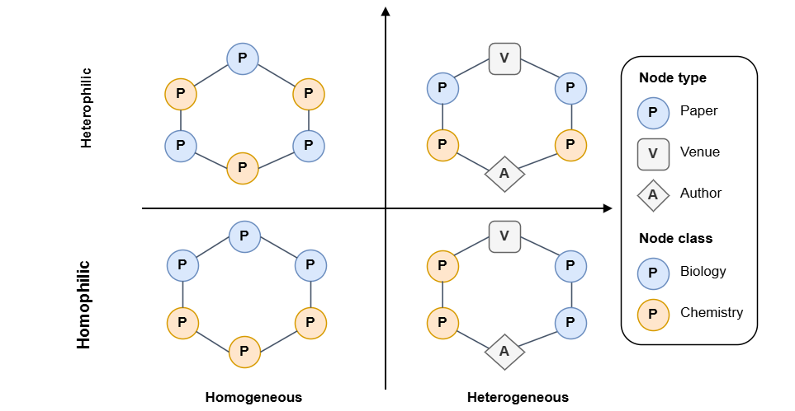
1. INTRODUCTION
Two properties, one hard problem
• Heterogeneity: many node and relation types
• Heterophily: adjacent nodes tend to have different labels
• Real heterogeneous graphs are both at once
• Assuming either away loses predictive performance
Several node and relation types - and adjacent nodes that disagree.
H2S-NN: Heterogeneous Heterophilic Sheaf Neural Network
3 / 24
Notes:
[ 0:50 · running 1:20 ]
Two properties define the setting.
HETEROGENEITY means the graph has several node types and several relation types, each with a
distinct semantic role — citation networks, social interaction networks. Formally that is more
than one node type or more than one relation type.
HETEROPHILY means that two connected nodes often disagree: different labels, different features. So
the standard "average your neighbours" move is not merely unhelpful, it is actively harmful, and it
drives oversmoothing.
Real graphs are frequently both at once, as in the figure. And this is not the union of two easy
problems. Model such a graph as homogeneous and you throw away the type semantics; assume homophily
and you smooth away exactly the signal you need. The paper's phrasing is that these simplifying
assumptions produce an incomplete representation of the original graph and degrade predictive
performance.
The state of the literature, in the box: the heterogeneous line of work — HGT, HiNormer,
PSHGCN, SeHGNN, HAN — does not usually treat heterophily explicitly. The heterophilic sheaf
line — NSD, CSNN — does not usually treat typed nodes and relations. Recent work has begun
to join the two using latent subgraphs, rewiring, transformers, or sheaf maps; that is our starting
point.

Slide 4
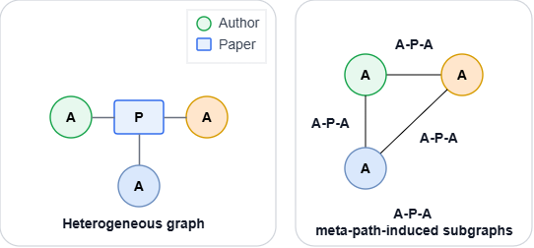
1. INTRODUCTION
What meta-path collapse throws away
• A meta-path carries what neither endpoint holds alone
• But it is used as a view: A-P-A becomes author–author
• The shared paper leaves the propagation operator
Under A-P-A, authors sharing a paper are joined directly, and the paper disappears.
A second, independent gap: granularity
Selection happens at the schema level. PAP can be useful overall while individual PAP instances link unrelated papers.
H2S-NN: Heterogeneous Heterophilic Sheaf Neural Network
4 / 24
Notes:
[ 0:55 · running 2:15 ]
Now the specific gap, and it has two halves.
FIRST HALF — representation. Meta-path schemas are valuable precisely because they express
information that is in neither endpoint. An Author-Paper-Author path is a co-authorship relation;
you cannot read that off either author alone.
But look at what existing methods do with the schema. They use it as a semantic view — a
filtered edge set, or an aggregation channel. Concretely: A-P-A becomes an author-to-author edge. At
that moment the shared paper and the two authorship edges stop shaping the propagation operator.
They have been summarised down to the mere existence of a shortcut.
Under homophily you can often get away with this. Under heterophily you cannot, because whether a
neighbour's signal should be reinforced or contrasted depends on which relations and which
intermediate nodes you travelled through. Collapsing the path discards exactly that local relational
structure, and the higher-order information the concrete instance carries.
SECOND HALF — granularity, in the box. Even the automatic meta-path search methods —
greedy selection, progressive sampling, tree search, reinforcement learning — decide at the
SCHEMA level. But PAP can be useful on average while specific PAP instances link entirely unrelated
papers. A schema-level decision cannot separate those two cases: you either keep the schema together
with its noise, or discard it together with its signal. Nothing tells you which of its concrete
occurrences should influence propagation.
Those two halves map onto our first two contributions.

Slide 5
1. INTRODUCTION
Contributions
H2S-NN
AMPSS
SheafCovPool
• Keep each path instance as a 2D-cell
• Build node→edge and edge→face geometry
• No homophily assumption
• Stage I - which schemas? (training only)
• Stage II - which instances? (learned)
• Weights act inside the face creation
• Transport edge states into node stalks
• Attention-weighted Gram means + covariances
• Permutation- and gauge-invariant
Evaluated on node classification, graph classification, and link prediction - where H2S-NN attains the best overall performance among the compared methods.
H2S-NN: Heterogeneous Heterophilic Sheaf Neural Network
5 / 24
Notes:
[ 0:35 · running 2:50 ]
Three contributions, one per card.
FIRST, the model. H2S-NN retains concrete path instances as path-supported two-dimensional cells in
an augmented 2D cellular complex, and builds the compatible node-to-edge and edge-to-face geometry
that sheaf-Hodge diffusion needs on top of them. Nothing is collapsed; nothing assumes homophily.
SECOND, AMPSS — Adaptive Meta-path Schema-to-cell Searching and Selection. It answers the two
questions in sequence. Stage I: which typed patterns are worth keeping? That runs on training data
only. Stage II: which concrete occurrences of those patterns should influence propagation? That one
is differentiable and schema-conditioned, and its weights act inside the upper edge Laplacian. That
second question is the one schema-level methods cannot ask.
THIRD, SheafCovPool, a graph-level readout designed specifically for sheaf models — because
sheaf states live in local coordinate frames, and naive pooling mixes incompatible bases. It
transports incident edge states into node stalks, then summarises node and edge states through
attention-weighted Gram means and covariances, giving a permutation- and gauge-invariant
representation.
We evaluate on all three heterogeneous graph tasks, and the framework attains the best overall
performance among the methods we compare against.

Slide 6

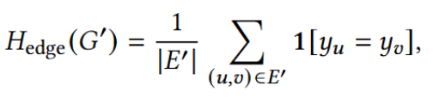
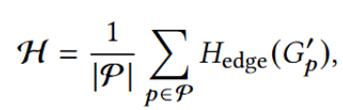
2. PRELIMINARIES
Typed graphs, heterophily, schema vs. instance
Heterogeneous Graph
Meta-path
G = (V, E, φ, ψ)
φ types the nodes, ψ types the edges. Heterogeneous as soon as there is more than one node type or relation type.
Meta-path schema - a type-level sequence
Induces the walk-count matrix A_{π} = A_{r₁} ⋯ A_{rℓ}.
Concrete path instance - one occurrence
f = (v₀, e₁, v₁, …, e_{ℓ}, v_{ℓ})
Heterogeneous graph
Homophily / heterophily
Averaged over the meta-path-induced subgraphs:
H2S-NN: Heterogeneous Heterophilic Sheaf Neural Network
6 / 24
Notes:
[ 0:40 · running 3:30 ]
Four definitions, quickly, because everything after this depends on them.
A heterogeneous graph carries a node-typing map phi and an edge-typing map psi. It is heterogeneous
as soon as there is more than one node type OR more than one relation type; with exactly one of
each it reduces to an ordinary homogeneous graph.
EDGE HOMOPHILY is the fraction of edges whose endpoints share a label. In a heterogeneous graph the
endpoint labels are not always comparable — an author and a paper are not the same kind of
thing — so we follow the convention of computing homophily on each meta-path-induced subgraph
and averaging over the schemas considered. Those are the numbers in gold: DBLP about 60, ACM about
72, IMDB about 50. Remember IMDB is the genuinely heterophilic one; it will matter in the results.
Now the distinction the whole paper turns on, on the right. A META-PATH SCHEMA, pi, is a TYPE-LEVEL
pattern — a sequence of node types and relation types. It induces a walk-count matrix, the
product of the per-relation adjacency matrices, whose entries count the walks following that
pattern; and when the endpoint types agree, thresholding it produces the homogeneous endpoint graph
everyone uses.
A CONCRETE PATH INSTANCE, f, is one actual occurrence of that pattern in the observed graph, with
specific nodes and specific edges.
Prior work selects and weights at the level of pi. We keep f. Please hold on to that
distinction.

Slide 7

2. PRELIMINARIES
Cellular sheaves in one slide
• A graph is a 1D cellular complex: nodes + edges
• A sheaf gives every cell a stalk, its own local frame
• And every incidence a restriction map F_{c⊴τ}
Sheaf Disagreement
Sheaf Laplacian: L₀ = δ₀^{T} δ₀ ,
Energy: x^{T} L₀ x = ‖δ₀ x‖²
The graph will become a sheaf when energy = 0
Existing sheaf models: stop at observed node-edge incidences.
H2S-NN adds path-supported 2D-cells and edge-to-face maps.
Why sheaves suit heterophily
Two neighbours can look different and still be perfectly consistent in the learned geometry.
H2S-NN: Heterogeneous Heterophilic Sheaf Neural Network
7 / 24
Notes:
[ 0:45 · running 4:15 ]
Sheaves in one slide, for anyone who has not met them.
View a graph as a one-dimensional cellular complex: nodes are zero-cells, edges are one-cells. We
write c-incident-tau for the incidence relation. A cellular sheaf attaches a vector space — a
STALK — to every cell, and a linear RESTRICTION MAP to every incidence. So instead of one
feature vector per node, each node carries its own small local coordinate system. The node
assignments form the zeroth cochain space, the edge assignments the first.
The key operator is the first coboundary, delta-zero. On an oriented edge it transports BOTH
endpoint signals into the shared edge stalk and takes their difference. The sheaf Laplacian L-zero
is delta-zero transpose delta-zero, and its quadratic form is the squared norm of delta-zero x
— it measures disagreement AFTER transport, not raw feature difference.
That is exactly why sheaf models handle heterophily, as in the box on the left: two neighbours may
look completely different and still be perfectly consistent in the learned geometry. Sheaf networks
are known to address oversmoothing, oversquashing, and heterophily for this reason. And with
one-dimensional stalks and identity restriction maps you recover the ordinary graph Laplacian, so
this is a strict generalisation, not a different object.
Now the opening we work in, on the right. Cellular complexes in general admit two-dimensional cells
bounded by edges. But sheaf networks ON GRAPHS — including HetSheaf, which adapts sheaf maps to
heterogeneous graphs — define their structure over observed node-edge incidences only. We add
the missing level.

Slide 8
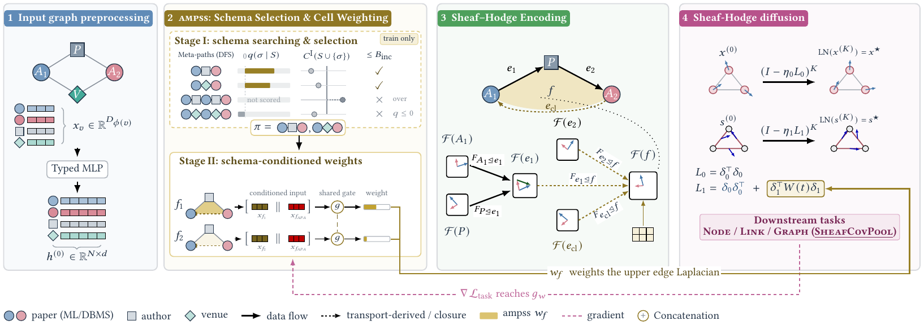
3. METHODOLOGY
Pipeline
1 Preprocessing
Typed features → shared d-dim stalks.
2 AMPSS
Select schemas, then weight instances.
3 Encoding
Path-supported 2D-cells and their maps.
4 Diffusion
K Euler steps → task readout.
H2S-NN: Heterogeneous Heterophilic Sheaf Neural Network
8 / 24
Notes:
[ 0:50 · running 5:05 ]
The formal problem, then the pipeline.
We learn a predictor g-theta over a directed heterogeneous graph with type-dependent raw features.
The supervised object o is deliberately abstract — a target node, a candidate typed node pair,
or an entire graph — so ONE backbone serves all three tasks and only the readout changes. The
loss is cross-entropy for single-label node and graph classification, and binary cross-entropy for
multilabel node classification and link prediction. Script-I-Sigma denotes the retained instances of
the selected schemas.
This figure is the map for the next six slides.
STAGE ONE, far left: type-specific encoders map heterogeneous features of different dimensions into
one shared d-dimensional stalk space.
STAGE TWO, AMPSS: depth-first search over the type graph enumerates candidate schemas; Stage I
selects a task-relevant subset using training data only; Stage II learns weights for the individual
instances that survive.
STAGE THREE, the sheaf-Hodge encoding: each retained instance becomes a two-cell, closed by that
dashed synthetic edge, and the edge-to-face maps are built by transport rather than emitted freely.
STAGE FOUR, the diffusion itself: two lanes, one for node cochains, one for edge cochains, then the
task heads.
Two details in the figure to notice now, because they close the loop. The GOLD line running along
the bottom: the instance weight w_f enters the upper edge Laplacian. The PINK DASHED line: the
gradient of the task loss reaching back into the weighting network. That loop is the whole of Stage
II.

Slide 9
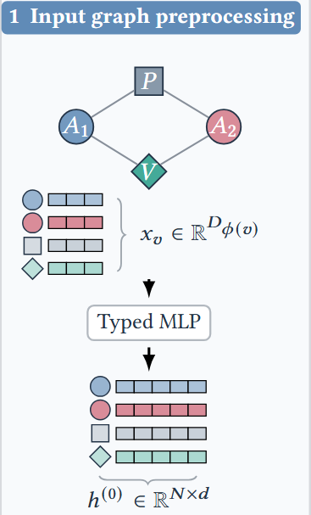
3.3 METHODOLOGY
Node stalks and sheaf restrictions
Type-specific node encoder
hᵥ⁽⁰⁾ = MLP(W_φ(v) xᵥ + b_φ(v)) + q_φ(v)
s_e⁽⁰⁾ = MLP( h_u ‖ h_v ‖ ζ_r ‖ (δ₀h)_e )
Every type lands in one shared d-dimensional stalk space.
Relation-conditioned restriction maps
F_{z⊴e} = λ_{z,e} Q_{z,e} , QᵀQ = I , λ > 0
The orthogonal part aligns coordinates; the scale weights the disagreement.
H2S-NN: Heterogeneous Heterophilic Sheaf Neural Network
9 / 24
Notes:
[ 0:40 · running 5:45 ]
Stage one, in detail. Two ingredients, and everything later is built from them.
FIRST, the node encoder. Different node types have raw feature vectors of different dimensions and
different meanings. The type-specific encoder maps each into one shared d-dimensional stalk space,
with its own weight matrix, its own bias, a learned type embedding, then LayerNorm, GELU and
dropout. If a node type has no attributes at all, we simply use a trainable node embedding directly.
Each relation also gets an embedding zeta-r. The node cochain is initialised to this encoding.
SECOND, the restriction maps. For each oriented typed edge, two relation-conditioned networks
produce the endpoint restrictions from the two endpoint states and the relation embedding. We
constrain each to be a POSITIVE SCALE times an ORTHOGONAL matrix. The orthogonal factor aligns the
two endpoint coordinate systems; the scale modulates how strongly the resulting disagreement counts.
Why that form? Two reasons, in the box. Orthogonal transport is norm-preserving, so diffusion
neither blows up nor collapses the stalk geometry. And the inverse — which the transport
construction will need in two slides — is just the transpose divided by lambda squared, so
there is no matrix inversion inside the training loop. In the implementation these come from the
Fast Householder Product parameterisation.
One design choice on the top right deserves emphasis. We initialise the edge cochain INDEPENDENTLY.
It sees both endpoints, the relation embedding, and the transported disagreement — but it is
not constrained to live in the image of delta-zero. So an edge carries genuine state of its own
rather than a shadow of its endpoints. Without that, the face-induced term we introduce later would
have nothing of its own to act on.

Slide 10
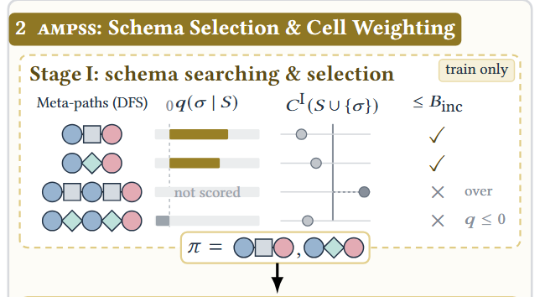
3.4 METHODOLOGY · AMPSS
Stage I - which schemas?
Runs once, before training, on training data only
• Bounded DFS over the type graph → candidate pool Π
• Quotas fix which instances each schema retains
• Greedily add the schema with the best held-out gain
• Stop when a budget binds or nothing helps
Structural cost = edge-face incidences
Cᴵ(S) = Σ_π Σ_f (ℓ_f + 1)
A hard, auditable cap on how much structure is added.
Greedy gain on a held-out split
q(π|S) = ℒ_sel(S) − ℒ_sel(S ∪ {π})
Subject to |S| ≤ K_Σ and Cᴵ ≤ B_inc .
H2S-NN: Heterogeneous Heterophilic Sheaf Neural Network
10 / 24
Notes:
[ 0:50 · running 6:35 ]
AMPSS Stage I. This runs ONCE, before training, and it never touches validation or test
data.
We build a type graph from the relation types available, and run BOUNDED DEPTH-FIRST SEARCH to
enumerate a candidate pool of schemas with lengths between ell-min and ell-max. Any candidate with
no feasible SIMPLE path instances is discarded immediately — that simple-path restriction
matters later, for the proposition.
For a trial schema set, DETERMINISTIC INSTANCE AND INCIDENCE QUOTAS decide which instances are
retained. Those retained instances do double duty: they generate the features for the selection
model, and they determine the structural cost.
That cost, top right, is simply the number of retained edge-face incidences: each instance
contributes its ell path edges plus one closure edge. This is worth pausing on. It means the
incidence budget bounds the SUPPORT of the face-induced operator directly — the extra structure
we add is capped by an auditable number, not by a hope.
Selection itself is GREEDY ON HELD-OUT TASK GAIN. We fit a cheap auxiliary LINEAR selection model on
an inner-training partition, score it on a DISJOINT held-out selection partition, and add whichever
feasible schema most reduces that held-out loss. The model is refitted for each trial set, using
outer-training labels only. Feasibility means respecting both the schema-count limit K-Sigma and the
incidence budget B-inc. We start from the empty set and stop when no candidate gives a positive
reduction or a budget binds. After selection, the retained instances are rebuilt on the full
outer-training graph.
For link prediction there is an extra precaution, bottom right: we delete the inner-selection
positive links AND their reverse counterparts from the graph used for selection, so the probe cannot
see its own targets.
And an honest note, bottom left: because selection is discrete, the task-loss gradient does not
reach Stage I. We report that as a limitation.

Slide 11
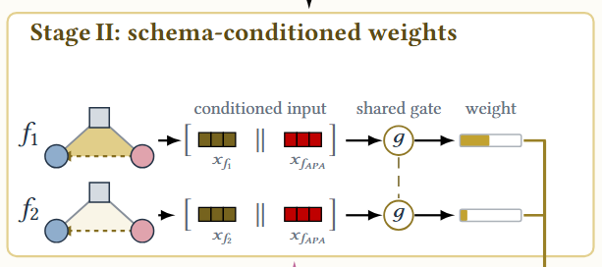
3.4 METHODOLOGY · AMPSS
Stage II - which instances?
Fully differentiable; trained by the supervised task loss alone
A positive weight per retained instance
Where the weight acts
w_f = (1−r) + 2r · sigmoid( g_w( ξ_f ‖ e_π(f) ) )
• ξ_f - tells instances apart within a schema
• e_π(f) - tells PAP from PSP
• r - warm-up & learnable
δ₁ᵀ W(τ) δ₁ , W = diag(w_f)
Only the face-induced component. Since w_f > 0, it stays positive semidefinite.
H2S-NN: Heterogeneous Heterophilic Sheaf Neural Network
11 / 24
Notes:
[ 0:40 · running 7:15 ]
Stage II is where the granularity gap gets addressed directly.
Every retained instance gets a POSITIVE WEIGHT, and the gate sees two things. Xi-f is the
ordered-path latent produced by the face encoder — it distinguishes instances WITHIN a single
schema, which is precisely the discrimination schema-level methods cannot make. The schema embedding
lets one shared gate tell PAP from PSP. And r-of-tau is a warm-up schedule that ramps the operator
from uniform weights to learned ones. The output lies between zero and two.
Two properties matter. First, the gate's output layer is ZERO-INITIALISED, so w_f equals exactly one
at initialisation. Training therefore starts from precisely the unweighted face-induced operator and
departs from it only if the task loss rewards doing so. Second, these weights are learned purely
from the supervised task loss — no auxiliary discovery objective, no schema gate.
Top right: the weight enters ONLY the face-induced component, as delta-one transpose W delta-one.
Because every weight is strictly positive, that component stays positive semidefinite, so the
diffusion remains well posed for any value the gate can produce. Intuitively: a weight near zero
mutes an instance's higher-order coupling, a weight near two amplifies it.
And what the weights do NOT touch, bottom right — this is the safety property. The closure
edges remain part of the extended edge domain no matter what w_f does. They keep contributing to
delta-zero, to L-zero, to the node-mediated component of the edge operator, to the weighted face
boundary, and to the edge readout. So Stage II modulates the INFLUENCE of higher-order supports; it
never prunes the complex, and it cannot silently disconnect the graph.

Slide 12
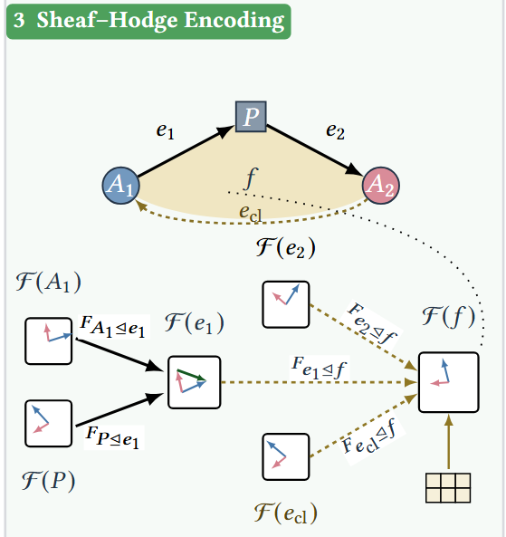
3.5 METHODOLOGY
One free map per face - and exactness
Predict A_f , then transport it around the path
A_f = MLP_ℓ( h_{v₀} ‖ ⋯ ‖ h_{vℓ} ‖ ζ_{r₁} ‖ ⋯ )
T_{vᵢ} = T_{vᵢ₋₁} F⁻¹_{u⊴eᵢ} F_{v⊴eᵢ}
F_{eᵢ⊴f} = T_{vᵢ₋₁} F⁻¹_{u⊴eᵢ}
The closure maps come from the same transport - no new learned map.
H2S-NN: Heterogeneous Heterophilic Sheaf Neural Network
13 / 24
Notes:
[ 0:50 · running 8:45 ]
This slide is the mathematical heart of the paper, so let me take it carefully.
For each instance we predict exactly ONE free matrix, A_f, from the ordered path — the node
states in path order, concatenated with the schema's relation embeddings, through a
path-length-specific MLP. A_f defines the local coordinate FRAME of the face stalk.
Every OTHER map around that face is then DERIVED, not learned. We transport A_f along the path
through the node-to-edge restriction maps: the running transport at node i is the previous transport
composed with the inverse source map and the target map; the edge-to-face map falls out of the same
recursion. The closure edge uses the same transport — its first map is the identity, its second
is the accumulated product along the whole path, and its face map is A_f itself. So the closure edge
introduces NO additional learned restriction map. All ell-plus-one boundary maps are generated by
one matrix.
Why go to this trouble? PROPOSITION ONE, in gold. For simple-path instances with the default forward
orientation, delta-one composed with delta-zero is EXACTLY ZERO — identically, for every node
cochain and every value of the learned parameters. Not approximately. Not encouraged by a penalty
term. By construction.
The proof is a telescoping argument. By construction the edge-to-face map composed with the source
restriction gives the transport at the previous node, and composed with the target restriction gives
the transport at this node. So the i-th path term is a difference of consecutive transported values;
summing along the path telescopes to the endpoint difference; and the closure term contributes
exactly its negative. Total: zero.
And here is why it matters practically, bottom right. Because the composition vanishes, the HODGE
DECOMPOSITION STAYS CLEAN: edge signals in the image of delta-zero are precisely the ones induced by
node representations, and the face-induced component acts on the edge-level RESIDUAL — the part
nodes cannot explain. If the composition were only approximately zero, the face term would be partly
re-diffusing node information, and the whole higher-order story would be unfalsifiable.
The simple-path condition is exactly what the proof needs: transport assigns ONE map per node
position, so a revisited node would demand two different transported values at the same
node.

Slide 13
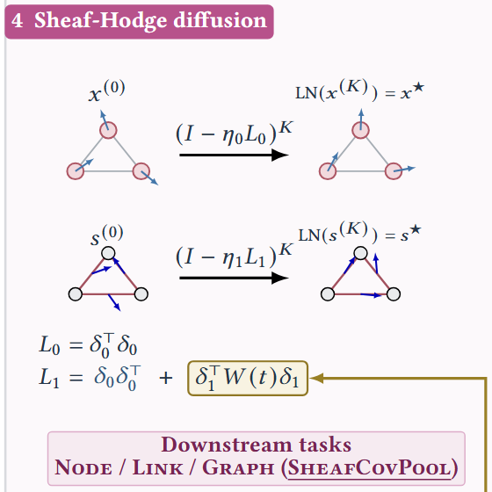
3.6 METHODOLOGY
Sheaf-Hodge diffusion
Two operators, two lanes
L₀ x = δ₀ᵀ δ₀ x
L₁ s = δ₀ δ₀ᵀ s + δ₁ᵀ W δ₁ s
• node-mediated - through shared incident nodes
• face-induced - inside a 2D-cell; Stage II weights this
K explicit Euler steps
x⁽ᵏ⁺¹⁾ = x⁽ᵏ⁾ − α₀ L₀ x⁽ᵏ⁾
s⁽ᵏ⁺¹⁾ = s⁽ᵏ⁾ − α₁ L₁ s⁽ᵏ⁾
H2S-NN: Heterogeneous Heterophilic Sheaf Neural Network
14 / 24
Notes:
[ 0:40 · running 9:25 ]
Diffusion. Two operators, two lanes.
L-ZERO on nodes is the familiar sheaf Laplacian.
L-ONE on edges has two parts, and the split is the interesting bit. The NODE-MEDIATED, or lower,
component relates edge signals through shared incident nodes — that is standard Hodge theory.
The FACE-INDUCED, or upper, component couples boundary edges within a selected two-cell. That upper
term exists ONLY because we built the faces, and it is exactly the term AMPSS Stage II weights.
Because each closure cell is a first-class member of the extended edge set, it participates in both
components with no separate node-side correction.
The update is K explicit Euler steps on each cochain, starting from the encoded node states and the
independently initialised edge states, with positive step sizes that may be learned, followed by
LayerNorm to give the terminal states x-star and s-star.
One honest note on the architecture: the two lanes are NOT exchanged between steps. They are coupled
through the shared restriction geometry and the shared initial node representations, rather than by
mixing at every step.
Top right: this is all MATRIX-FREE. We batch local d-by-d maps and aggregate with indexed sums,
applying delta-zero, its transpose, delta-one and its transpose directly on node, edge and face
tensors. No global operator is ever materialised, which is what keeps the cost linear in graph size.
Bottom right, three boundaries we state explicitly rather than leave to a reader's assumption.
Delta-one uses the FULL boundary cycle — the ell path edges plus the closure cell, not a
truncation. Incidence signs are explicit and are plus one here because enumeration is forward-only.
And simple paths only. Under those constraints the chain condition is a property of the constructed
operator, not a penalty added to the objective.

Slide 14
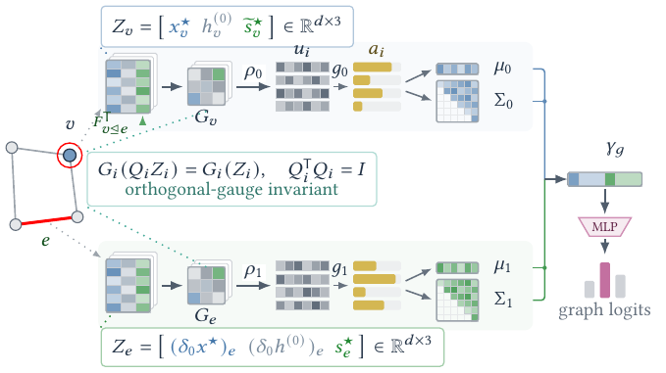
3.7 METHODOLOGY
SheafCovPool: a gauge-invariant readout
• Node and edge states live in different local frames
• So transport edge states into node stalks first
• Three views per cell → a 3×3 Gram matrix
• Attention → weighted mean and covariance
γ_g = [ μ₀ ‖ triu(Σ₀) ‖ μ₁ ‖ triu(Σ₁) ]
Two lanes: views → Gram → attention → mean and covariance.
The Gram matrix cancels the common orthogonal orientation - so γ_g is invariant to ordering AND to stalk basis.
The Gram order is fixed at 3 by the three semantic views - capacity is tuned through the post-Gram width F instead.
H2S-NN: Heterogeneous Heterophilic Sheaf Neural Network
15 / 24
Notes:
[ 0:45 · running 10:10 ]
The third contribution, and the last method slide.
Graph classification needs ONE vector per graph. But in a sheaf model every node and every edge has
its own local coordinate frame. If you simply average incident edge states you are adding vectors
expressed in different bases — the result is not meaningful.
So SheafCovPool TRANSPORTS FIRST. Each incident edge state is projected into its endpoint node space
using the TRANSPOSE of the restriction map, then averaged over the incidences at that node, across
both observed and closure edges; an isolated node gets the zero vector. Both endpoints contribute
with a POSITIVE sign, because what we want here is incident context, not the orientation-sensitive
divergence.
Then we form THREE complementary views at each cell. For a node: the diffused state, the initial
typed state, and the transported edge summary. For an edge: two transported node disagreements and
the edge's own diffused state. Each stack is d-by-three.
The trick is what we do with those views: we take the three-by-three GRAM MATRIX of the stack. That
records the energies and pairwise alignments of the three views while CANCELLING their common
orthogonal orientation. Formally, if you change the node and edge bases by independent orthogonal
matrices and transform the restriction maps consistently, the node stack transforms by Q, the edge
stack by R, and both Gram descriptors are unchanged.
Attention then runs over those invariant descriptors, and we keep both a weighted MEAN and a
weighted COVARIANCE, for nodes and for edges. The mean says what the attention emphasised; the
covariance says how much that evidence varies across the graph. Concatenating gives gamma-g, which
lives in F-squared plus 3F dimensions.
Because every learned score acts on an invariant Gram matrix and every aggregation is symmetric,
gamma-g is invariant to node and edge ordering, and to independent orthogonal changes of stalk
basis.
One detail people ask about: the Gram order is fixed at THREE because three is the number of
semantic views, not a hyperparameter. Changing it would mean adding or removing stalk-valued views
— a different readout, not a wider one. Capacity is tuned through the post-Gram width F
instead.

Slide 15
4. EXPERIMENTS
Settings
Task | Datasets | Protocol | Metrics
Node classification | DBLP, IMDB (HGB); ACM | HGB; transductive 20 / 20 / 60 | Macro-F1, Micro-F1
Graph classification | MUTAG, PROTEINS, ENZYMES, NCI1 (TUDataset) | 10-fold CV over 5 seeds | Macro-F1, Micro-F1
Link prediction | LastFM, PubMed, Amazon, YouTube (HGB) | HGB; 81 / 9 / 10; 1:1 two-hop negatives | AUPR, AUROC
Baselines, by graph type and homophily assumption
General setting
• Hom./hom. - GCN, GAT, ChebNetII
• Hom./het. - NSD, CSNN
• Het./hom. - HAN, SeHGNN, HiNormer, PSHGCN
• Het./het. - HDHGR, Hetero²Net, H2SGNN, HetSheaf, LatGRL
• Early stopping, patience 100
• 5 seeds, mean ± std
H2S-NN: Heterogeneous Heterophilic Sheaf Neural Network
16 / 24
Notes:
[ 0:35 · running 10:45 ]
Experimental setup, briefly.
Three tasks. NODE CLASSIFICATION on DBLP and IMDB from HGB, plus ACM, under the HGB protocol with a
twenty / twenty / sixty transductive split. GRAPH CLASSIFICATION on four TUDatasets — two
biological, PROTEINS and ENZYMES, two chemical, MUTAG and NCI1 — with ten-fold cross-validation
over five seeds, and one-vs-rest for the six-class ENZYMES. LINK PREDICTION on four HGB benchmarks
with an eighty-one / nine / ten split and negatives sampled one-to-one from the two-hop
neighbourhood.
Note the second row carefully. For the TUDatasets we read the provided NODE AND EDGE LABELS as node
types and relation types. So these are genuinely heterogeneous inputs, not homogeneous graphs with
categorical attributes — and that choice turns out to matter in the results.
Baselines are grouped along two axes: is the graph modelled as homogeneous or heterogeneous, and is
the method designed for homophily or heterophily. That gives four groups, and we keep
representatives of all four in every task. Graph classification and link prediction use a subset of
the node-classification baselines, still spanning all four groups. The most relevant comparison for
us is HetSheaf, in the bottom group — the closest heterogeneous SHEAF baseline.
Everything uses early stopping with patience one hundred, per-dataset sweeps, five seeds, and
reported standard deviations. AMPSS Stage I sees training data only, with selector and
materialisation seeds kept separate from training seeds.

Slide 16
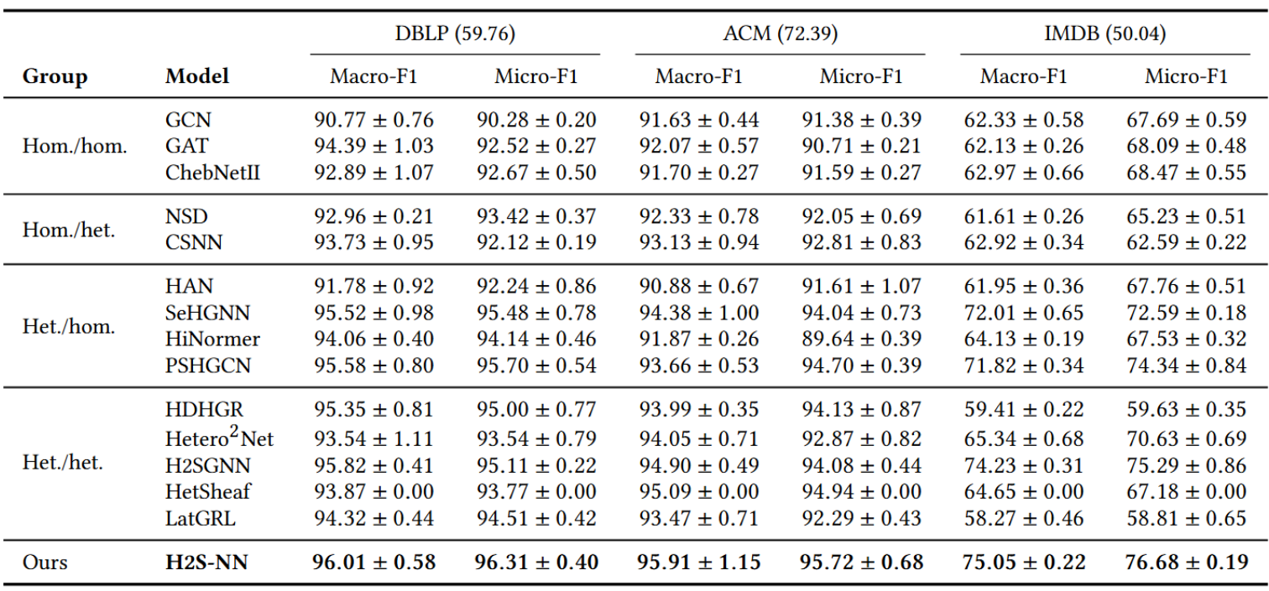
4.2 EXPERIMENTS
Node classification
Macro-F1 / Micro-F1; graph homophily ℋ in parentheses
H2S-NN: Heterogeneous Heterophilic Sheaf Neural Network
17 / 24
Notes:
[ 0:40 · running 11:25 ]
Node classification. Fifteen models, three datasets, two metrics each. Standard
deviations are in the paper; I have dropped them here for legibility, and they run from about 0.2 to
1.2.
H2S-NN is best on all three datasets and both metrics. But let me read the table the way a reviewer
would, rather than just claiming the win.
On DBLP we gain about two tenths of a point in Macro-F1 over H2SGNN, and six tenths of Micro-F1 over
PSHGCN. Those are small margins and I will not oversell them.
On ACM we gain roughly eight tenths over HetSheaf — the most DIRECT comparison in the table,
since HetSheaf also uses sheaf maps on typed graphs but stops at the node-edge complex. So that
margin is closest to isolating the contribution of the 2D-cells.
The result I would draw your attention to is IMDB. IMDB has the lowest homophily of the three
— about fifty — and it is the only multilabel task. There the margin is largest: eight
tenths of Macro-F1 and about one and four tenths of Micro-F1 over the strongest baseline. Look also
at how the homogeneous methods and the heterogeneous HOMOPHILIC methods behave on IMDB compared with
DBLP and ACM — several of them collapse into the fifties. The gap widens exactly where
heterophily is strongest, which is the pattern the motivation predicts.
Bottom right, a caution we state ourselves: several of these margins sit within one standard
deviation of the runner-up. So the claim we defend is BEST OVERALL PERFORMANCE AMONG THE COMPARED
METHODS UNDER THIS PROTOCOL — not unqualified state of the art. One bookkeeping note: HetSheaf
is reported with zero variance because it is a single reported configuration, not a five-seed
average.

Slide 17
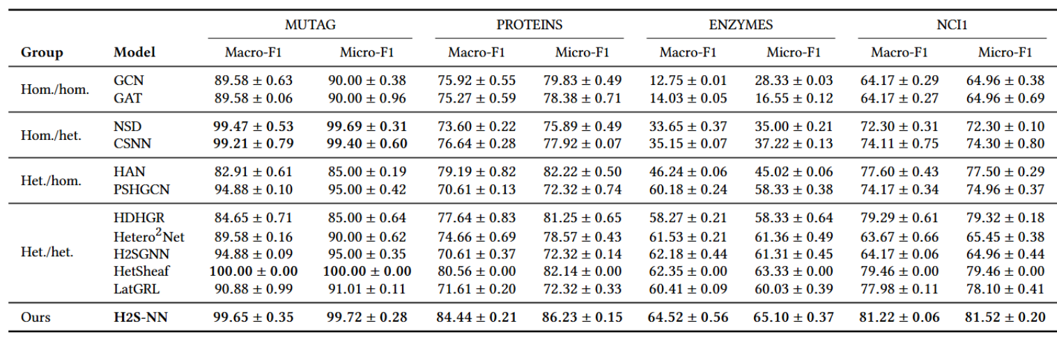
4.2 EXPERIMENTS
Graph classification
Macro-F1 / Micro-F1; 10-fold cross-validation over 5 seeds
H2S-NN: Heterogeneous Heterophilic Sheaf Neural Network
18 / 24
Notes:
[ 0:30 · running 11:55 ]
Graph classification, and here the picture is more interesting than a simple sweep.
On PROTEINS, ENZYMES and NCI1, H2S-NN has the highest mean Macro-F1 and Micro-F1. The margins are
LARGER than in node classification: nearly four points on PROTEINS over HetSheaf, about two and a
sixth on ENZYMES, and about one and three quarters on NCI1.
On MUTAG we TIE the best reported score rather than beat it. MUTAG has one hundred eighty-eight
graphs and is effectively saturated — HetSheaf reports a perfect one hundred. I would not read
anything into differences at that end, and we do not claim a win there.
Look also at the first two rows. Plain GCN and GAT score in the teens on ENZYMES Macro-F1 —
essentially failing on the six-class problem — while every sheaf-based and every heterogeneous
method is far above them. That is the clearest signal in the table that the structure being modelled
is doing the work.
The interpretation I would offer is on the right. These are molecular and protein structures, not
citation or social networks. We obtained the heterogeneity by reading the TUDataset node and edge
labels as node types and relation types. The fact that this HELPS suggests typed structure is useful
well outside the domains where heterogeneous graph learning is normally studied — atom types
and bond types really are different relations, not merely categorical features on a homogeneous
graph.
Standard deviations are omitted here for legibility; all are below 0.9 in the paper.

Slide 18
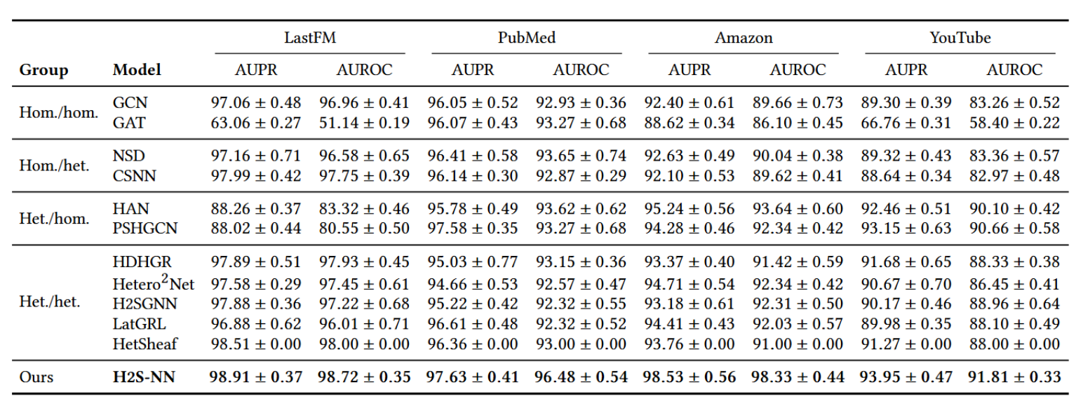
4.2 EXPERIMENTS
Link prediction
AUPR / AUROC; 1:1 negatives from the 2-hop neighbourhood
H2S-NN: Heterogeneous Heterophilic Sheaf Neural Network
19 / 24
Notes:
[ 0:30 · running 12:25 ]
Link prediction: best on all four datasets and all eight metrics.
I want to highlight the SPLIT in this table, because it makes the result a real test rather than a
sweep.
LastFM and PubMed are MULTI-NODE-TYPE graphs — users, artists and tags; and a biomedical
knowledge graph with four node types and ten relation types. Those are the comfortable case for a
meta-path method.
Amazon and YouTube are the UNCOMFORTABLE case: a SINGLE node type, with two and five relation types
respectively. A method that leans on typed endpoints has essentially nothing to work with there. And
yet Amazon is where we gain the most — over three points of AUPR and nearly five of AUROC over
the best baseline. That is consistent with our claim that the RELATION SEQUENCE along a path carries
signal even when the node types do not distinguish anything.
Note also GAT on LastFM: sixty-three AUPR, fifty-one AUROC — essentially chance. A single
attention mechanism over an untyped view can fail outright on these graphs.
One mechanism note, bottom right: the link decoder consumes POOLED INCIDENT-EDGE STATES, not just
node states. A shared projection combines the node state with its pooled edge summary before the
dot-product, MLP or DistMult decoder. So the task loss genuinely depends on the edge stream, and
therefore on the Stage-II instance weights. That is not incidental — it is what lets AMPSS
receive gradient on this task at all.

Slide 19
5. DISCUSSION
Ablation Study
AMPSS - DBLP node classification
SheafCovPool - ENZYMES graph classification
Configuration | Macro-F1 | Micro-F1
No path-supported 2D-cells | 93.85 | 93.92
Predefined meta-path schemas | 95.75 | 96.01
AMPSS, Stage I only | 95.88 | 96.02
AMPSS, schema weight only | 95.91 | 96.08
AMPSS, instance weight only | 95.95 | 96.13
AMPSS (full) | 96.01 | 96.31
Readout | Macro-F1 | Micro-F1
Sum + MLP | 61.25 | 61.79
Mean + MLP | 61.42 | 62.09
Max + MLP | 61.38 | 61.62
SheafPool | 64.05 | 64.96
SheafCovPool | 64.52 | 65.10
• Dropping the 2D-cells costs 2.2 Macro-F1
• Hand-chosen schemas recover most of it
• Instance weighting still adds on top of Stage I
• Sum, mean and max all sit near 61
• Gauge invariance alone buys most of the gain
• Covariances add the rest - +0.47 / +0.14
H2S-NN: Heterogeneous Heterophilic Sheaf Neural Network
20 / 24
Notes:
[ 0:40 · running 13:05 ]
Two ablations, one per contribution. Left: AMPSS on DBLP node classification. Right: the
readout on ENZYMES graph classification.
Read the LEFT column top to bottom. Remove the two-cells entirely and you lose about two point two
points of Macro-F1. That is the single largest step in the table, and it is the honest test of the
central claim: the higher-order structure is doing work, not just adding parameters.
Put back HAND-CHOSEN meta-path schemas — the standard APA, APCPA, APTPA — and you recover
most of that loss. I want to be fair here: DBLP's canonical meta-paths are good ones, so predefined
schemas are already a strong configuration, and that limits how much automatic search can add on
THIS dataset.
Automatic Stage-I selection then edges past them, and adding instance-level weighting gives a
further increment on top of Stage I, with the full model best. The gaps between those last four rows
are small — tenths of a point — but they are ordered exactly as the argument predicts, and
they support the specific claim we make: schema-level selection alone is not sufficient, and
instance-level weighting helps filter noisy or uninformative path realisations.
On the RIGHT the ablation is cleaner. The three plain aggregations — sum, mean, max — all
sit around sixty-one; they are indistinguishable from each other. SheafPool jumps to sixty-four,
which tells us most of the gain comes from GAUGE INVARIANCE alone, and I want to credit that
honestly rather than attribute it to our design. SheafCovPool then adds about half a point more by
pooling BOTH node and edge Gram matrices and by keeping the COVARIANCES, not just the means.
So the conclusion we draw is two-part: gauge invariance is useful but not sufficient, and
second-order statistics of the cochains carry additional graph-level signal.

Slide 20
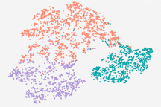
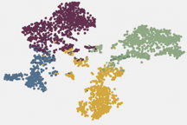
APPENDIX A, D, E
Readouts, clustering, training dynamics
A. One backbone, three light readouts
D. Node clustering (k-means, 5 seeds)
• Node - MLP over state, encoding, pooled edges
• Link - shared projection, then dot / MLP / DistMult
• Graph - MLP(γ_g)
Model | DBLP NMI | DBLP ARI | ACM NMI | ACM ARI
GAT | 71.50 | 77.26 | 57.22 | 60.47
NSD | 80.21 | 84.04 | 62.56 | 65.02
CSNN | 81.72 | 84.25 | 69.28 | 71.10
HAN | 79.12 | 84.76 | 60.63 | 64.28
PSHGCN | 80.38 | 82.65 | 71.89 | 74.31
Hetero²Net | 80.54 | 84.98 | 70.14 | 73.42
LatGRL | 81.36 | 86.07 | 72.52 | 76.75
H2S-NN | 82.41 | 86.52 | 75.78 | 78.29
E. Separability during training
On a controlled four-class synthetic dataset, classes start interleaved and become compact and separated.
A qualitative diagnostic - not a benchmark result.
• Best NMI and ARI on both - largest gain on ACM
H2S-NN: Heterogeneous Heterophilic Sheaf Neural Network
21 / 24
Notes:
[ 0:30 · running 13:35 ]
Three appendix items, compressed.
APPENDIX A, the readouts. The backbone is shared across all three tasks and only the readout
changes. For NODE classification we pool the states of observed AND closure edges incident to the
target node, and feed the concatenation of the diffused node state, the initial typed encoding, and
that edge summary into an MLP. For LINK prediction a shared projection combines the node state with
its pooled edge summary, then a dot-product, concatenation-MLP, or DistMult decoder produces the
logit — and as I said, that pooling is the mechanism by which the link loss reaches the
Stage-II instance weights at all. For GRAPH classification it is simply an MLP on gamma-g.
APPENDIX D, a clustering diagnostic. Following the evaluation procedure used for HAN, we run k-means
on the embeddings after supervised training, with k set to the number of classes — four for
DBLP, three for ACM — three hundred iterations, five seeds. H2S-NN has the best NMI and ARI on
both datasets, with the larger gain on ACM: about three and a quarter points of NMI over LatGRL. I
present this as a DIAGNOSTIC rather than a headline result — it says the learned representations
are more SEPARABLE, not merely that the classifier is better tuned. The two t-SNE plots below are
the qualitative version of the same claim.
APPENDIX E: on a controlled synthetic four-class dataset from PyTorch Geometric we recorded node
embeddings every five epochs. Classes begin strongly interleaved and become increasingly compact and
separated. Again — qualitative evidence that the diffusion behaves as designed, on synthetic
data, not a benchmark claim.

Slide 21
APPENDIX B, F
Computational efficiency
F. Linear in graph size for fixed d and K
Measured on ACM node classification
• Cubic in the stalk dimension d only - and d ≤ 64
• Maps are learned only for observed edges, then cached
• Stage I runs once; SheafCovPool builds no dense matrix
Model | Runtime (s) | Parameters | Memory (MB)
HAN | 28.9 | 2.2M | 1,780
HGT | 1,025.8 | 7.2M | 6,120
NSD | 47.6 | 155K | 980
HetSheaf | 55.7 | 174K | -
H2S-NN | 72.1 | 517K | 1,120
Slower and larger than HetSheaf - the price of keeping 2D-cells and diffusing both cochains.
H2S-NN: Heterogeneous Heterophilic Sheaf Neural Network
22 / 24
Notes:
[ 0:35 · running 14:10 ]
Cost, because it belongs in the talk and not only in the appendix.
ANALYTICALLY: the backbone is LINEAR in graph size and in retained boundary incidences once d and K
are fixed. The only cubic term is in the STALK DIMENSION, from constructing the d-by-d maps —
and d is at most sixty-four, so that is a small constant. Memory grows quadratically in d.
Crucially, node-to-edge maps are LEARNED only for the observed edges; every closure map and every
edge-to-face map comes from TRANSPORT, and the maps are cached across diffusion steps. So the
two-cells add incidences but not learned matrices. AMPSS Stage I runs once before training. And
SheafCovPool stays linear in the extended graph size — it builds neither a dense node-to-node
covariance nor a coarsened graph.
EMPIRICALLY, on ACM: seventy-two seconds, five hundred seventeen thousand parameters, about one
point one gigabytes. Let me be direct about the comparison. That is slower and larger than HetSheaf,
the closest sheaf baseline, at fifty-six seconds and one hundred seventy-four thousand parameters.
Retaining two-cells and diffusing both cochains is not free, and the paper says so. What we argue is
that the trade is favourable: we remain an order of magnitude cheaper than HGT on every axis —
HGT takes over a thousand seconds and seven million parameters — and the accuracy gains hold
across all three tasks.
Appendix B, briefly: Bayesian search with Hyperband early termination, with the optimiser family,
scheduler, gradient clipping, splits and Stage-I support all held FIXED so the comparison is about
the model rather than the tuning budget. Stalk dimensions are small, sixteen to sixty-four; the Gram
order in the pooling is fixed at three by construction rather than tuned; and pooling-family,
decoder-family and operator-ramp sweeps are treated as ablations rather than mixed into the primary
search.

Slide 22
6. CONCLUSION
What holds - and what does not
Established
• Path instances can be kept as 2D-cells
• δ₁δ₀ = 0 by construction on simple-path faces
• AMPSS splits schema choice from instance choice
• SheafCovPool is permutation- and gauge-invariant
Best results on every evaluated node-classification, graph-classification and link-prediction dataset, with ablations supporting both AMPSS and SheafCovPool.
Future Work:
a differentiable/optimization problem on Stage I
cheaper transports, scalable graphs.
H2S-NN: Heterogeneous Heterophilic Sheaf Neural Network
23 / 24
Notes:
[ 0:35 · running 14:45 ]
To conclude.
WHAT WE ESTABLISHED, on the left. Concrete meta-path instances can be retained as path-supported
two-dimensional cells rather than collapsed into endpoint views. Learned restriction maps and
sheaf-Hodge diffusion then update node and edge cochains together, with delta-one delta-zero equal
to zero BY CONSTRUCTION on simple-path faces — which is what keeps the Hodge decomposition
interpretable rather than merely suggestive. AMPSS separates the two questions prior work conflates:
which schemas, and then which of their occurrences. And SheafCovPool provides a permutation- and
gauge-invariant readout for graph-level tasks.
WHAT WE DO NOT CLAIM, on the right — because I would rather say it than be asked it. The claim
is best overall performance among the COMPARED methods under THIS protocol, not unqualified state of
the art, and not scalability beyond what we ran. Stage I is non-differentiable, so the task loss
never reaches schema selection. Faces are restricted to simple paths, and Proposition 1 is scoped
exactly to that construction and its aligned closure edges. And the model costs more time, memory
and parameters than the closest sheaf baseline.
Within those bounds: best results on every evaluated dataset across all three tasks, with ablations
supporting both components.
The natural next steps are a differentiable or amortised Stage I, faces beyond simple paths together
with the orientation bookkeeping that would require, and cheaper transports for larger graphs.
Thank you — I am happy to take questions.

Slide 23
Thank you
Questions welcome.
Backup material:
Proposition 1 proof · dataset statistics and semantic schemas · full search space · clustering and t-SNE · complexity derivations
Notes:
[ — ]
Likely questions, with short answers:
Q: Why not make Stage I differentiable? A: We kept it auditable — the incidence budget is a
HARD cap that a soft relaxation would blur. It is the clearest limitation and the first thing we
would change.
Q: Isn't the closure edge just the shortcut you criticised? A: No. It closes the boundary so
delta-one is defined, but it is not an observed relation and it carries no learned restriction map
of its own — both its maps come from the same transport as the rest of the face. Nothing
propagates along it as though it were a real edge.
Q: How sensitive is the result to the incidence budget? A: The budget bounds the support of the
face-induced operator directly, and Stage I stops when a budget binds — so it degrades
gracefully toward the no-2D-cell ablation, the 93.85 / 93.92 row.
Q: Why fix the Gram order at three? A: Three is the number of semantic views in each stack, not a
hidden width. Changing it means adding or removing stalk-valued views, which defines a DIFFERENT
readout rather than a wider one.
Q: Why are the node-classification margins so small? A: They are, on DBLP and ACM. The honest
reading is that those benchmarks are close to saturated and their canonical meta-paths are already
good. IMDB — lowest homophily, multilabel — is where the margin is largest, and graph
classification and link prediction show larger gaps.
Q: What about scalability? A: Costs are linear in graph size for fixed d and K, and no dense
Laplacian is formed — but the largest graph we ran is YouTube at about 1.18M edges, so I would
not claim beyond that.
Q: Does the model need meta-paths to be supplied? A: No — that is the point of AMPSS Stage I.
Manual schemas are supported, and are the 'predefined' ablation row.

