Slide 1
Gmail
Asim Al Harbi
Ali Al Qahtani

Slide 2
introduction
This project is a traditional typical software engineering work that contains famous common concepts of of describing and advertising a software to clients in a professional clear way we will see the software engineering fundamentals implemented on our sample app an email mobile application which is the “Gmail” app by using diagrams (activity diagram, use case diagrams, sequence diagram… etc) that help us clear the vagueness and brake down the description of the application.

Slide 3
Problems
Before the app people faced many problems, let us say human problems and software engineering-related problems. People before used to send mails via post-offices which included no videos or specific links that have a high degree of security, also people didn’t have the access to sending and receiving mails immediately with only putting their hands into their pockets and browsing mails or sending, deleting and editing them. these were some of the main problems that encouraged the creators of this app to decide to take the decision of making it.

Slide 4
Background
“Gmail” is a mobile application made by google that support IOS devices and android devices. it was built based on the first model which is the website version. the app was introduced by google in 2006 but not with the same developed services that the app offers to users today.

Slide 5
Proposed Solution
The solution that the app proposed which would reduce the difficulties in the world of communications specifically mails (even though other apps might have used these ideas also) is first making reaching to and getting mails much easier and faster which makes it more flexible and fun not as complicated and difficult as before thus having easier life.

Slide 6
WORK PLAN
We will start by defining the functional and non-functional requirements then show the diagrams respectively activity diagram, use case diagram, sequence diagram and finally class diagram.

Slide 7
Functional requirement
Click on the login button
Choose the type of account
Log in using your email
Log in using the password
Verify the login processes
Click on the Create button
Choose the future email address
Click send

Slide 8
Non-functional requirement
The system must verify the registration data
Verify the use of the real owner
Attachments should not exceed 25 MB
Select 500 recipients or less when sending

Slide 9
Diagrams

Slide 10
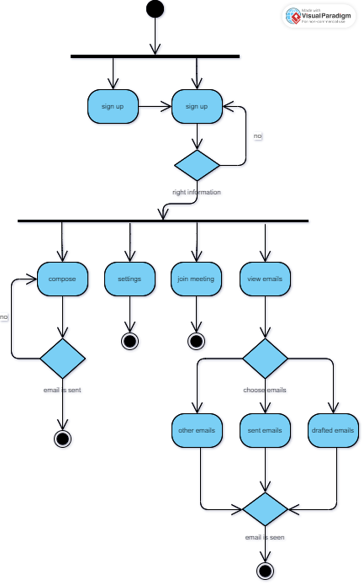
Activity Diagram

Slide 11
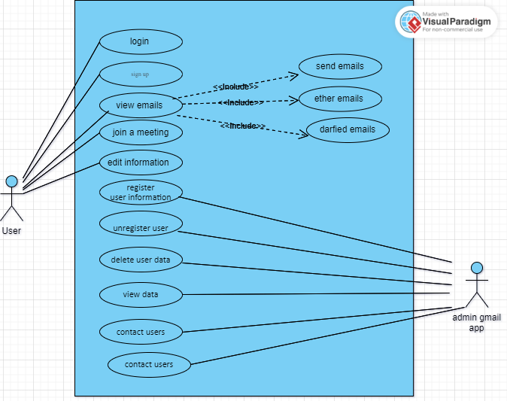
Use Case Diagram

Slide 12
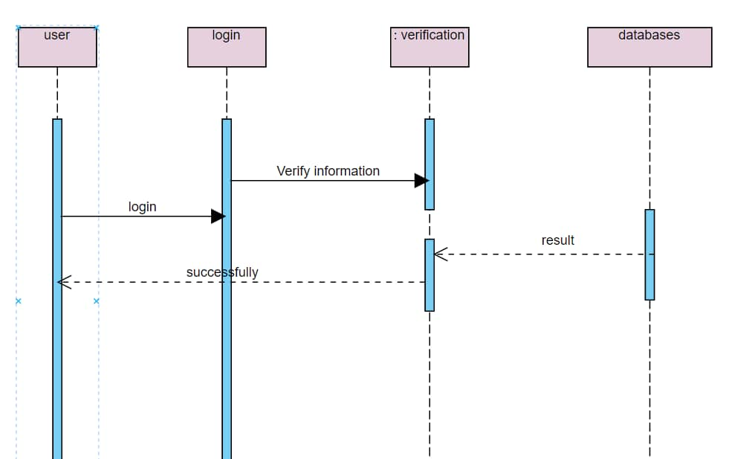
Sequence Diagram – log in

Slide 13
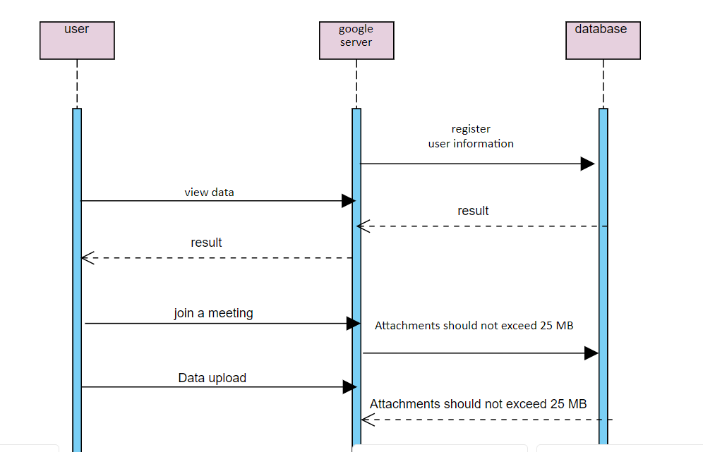
Sequence Diagram - user

Slide 14
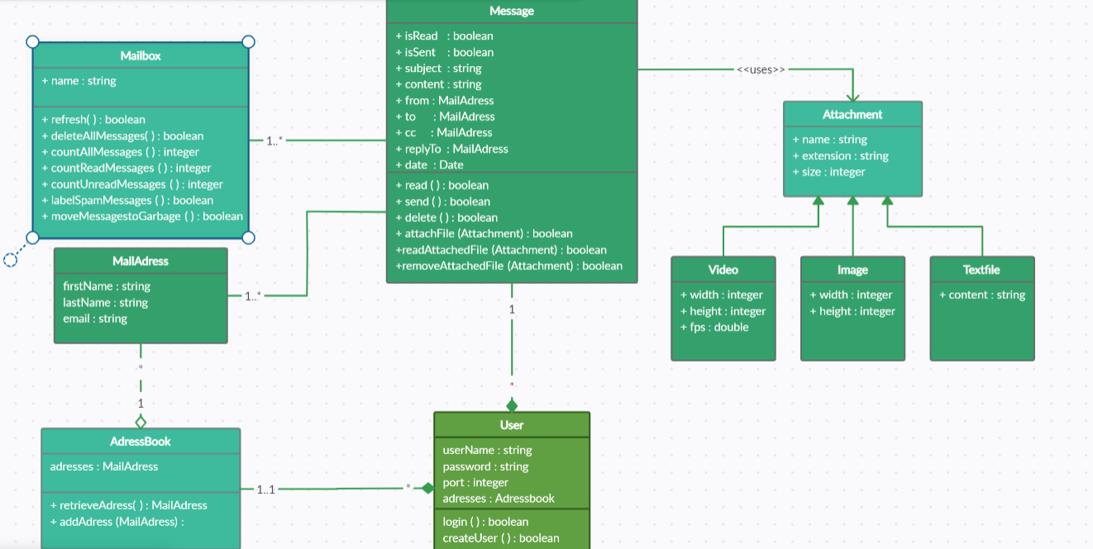
Class Diagram

Slide 15
thank you
Aism Al Harbi
Ali Al Qahtani

