Slide 1
Project Booking.com

Slide 2
1. Feasibility Study & Project Proposal

Slide 3
1.1- Introduction
Booking.com is a well-known online travel agency that serves as an online travel agency, allowing users to search for and book various accommodations, flights, car rentals, and other travel-related services.

Slide 4
1.2- Problems
Limited access to accommodation information
Inconvenience in booking
Difficulty in comparing prices and features
Inability to access reviews

Slide 5
1.3- Background
Booking.com was founded in 1996 in Amsterdam, Netherlands, and has grown into one of the largest travel e-commerce companies in the world. The mobile application was launched to meet the growing demand for on-the-go travel planning and to provide users with an accessible and user-friendly platform.

Slide 6
1.4- Proposed solution
Detailed information on accommodations
User-friendly interface
Price comparison
Access to genuine reviews

Slide 7
1.5.1- work plan
Market Research: Conduct detailed analysis to understand problems, audience, competition, and unique opportunities.
Feature Identification: Determine key functionalities required in the platform based on insights.
Requirement Determination: Define functional and non-functional requirements for the platform.
System Diagram Development: Create diagrams to represent processes and interactions.

Slide 8
1.5.2- work plan
User Interface Design: Focus on user experience, goals, and objectives of the platform.
System Implementation: Incorporate all requirements with iterative development cycles for continuous improvement.
Testing: Ensure the platform is reliable, performs optimally, and is bug-free.
Deployment & Maintenance: Deploy the platform and perform regular updates based on feedback and market trends.

Slide 9
2. Project Requirements

Slide 10
2.1.1- Functional Requirements (user)
Search & Sort: Enable users to find accommodations using various criteria, supported by a robust filter and sorting system for improved usability.
Detailed Information & Notifications: Allow access to comprehensive details about each accommodation and maintain a notification system for timely updates.
Customer Support: Provide instant access to customer services to address concerns or issues effectively.
Booking Capability: Facilitate the direct booking of accommodations within the platform itself.

Slide 11
2.1.2- Functional Requirements (System)
Effective Search: Powerful search engine processing various queries for accommodations considering location, price, dates, and amenities.
User-friendly Filtering & Sorting: Easy refinement of search results based on preferences like price, rating, location, stars, and facilities.
Detailed Accommodation Information: Utilization of a suitable API for comprehensive accommodation details. Caching mechanisms for optimized data retrieval.
Optimized Media Loading: Techniques to ensure quick loading of images and other media for a seamless user experience.

Slide 12
2.1.3- Functional Requirements (System)
Multi-Channel Customer Support: Integration of live chat, email ticketing, and phone support.
Comprehensive Booking Feature: Facility for users to input booking details like stay dates, number of guests, and room type preferences.
Confirmation Step: Review and confirmation steps in booking, with email confirmation and all relevant information.
Strong Notification System: Real-time updates to users about booking status, accommodation changes, payment confirmations, and support responses.

Slide 13
2.2- Non-Functional Requirements (NFR)
Operational: Maintain a 99.9% uptime, support 10,000 concurrent users without performance degradation.
Performance: Average response time under 2 seconds for smooth navigation.
Dependability: Recover from failures within 5 minutes for minimal impact on user experience and data integrity.
Ethical: Present unbiased search results with regular fairness assessment.
Security: Enforce secure authentication with 256-bit encryption for data transmission/storage and pass periodic security audits.
Accounting: Maintain maximum 1% error margin in invoicing and payment processing with quarterly financial reports.
Space: Utilize cloud-based solutions for at least 20% storage optimization.

Slide 14
3. Activity diagram

Slide 15
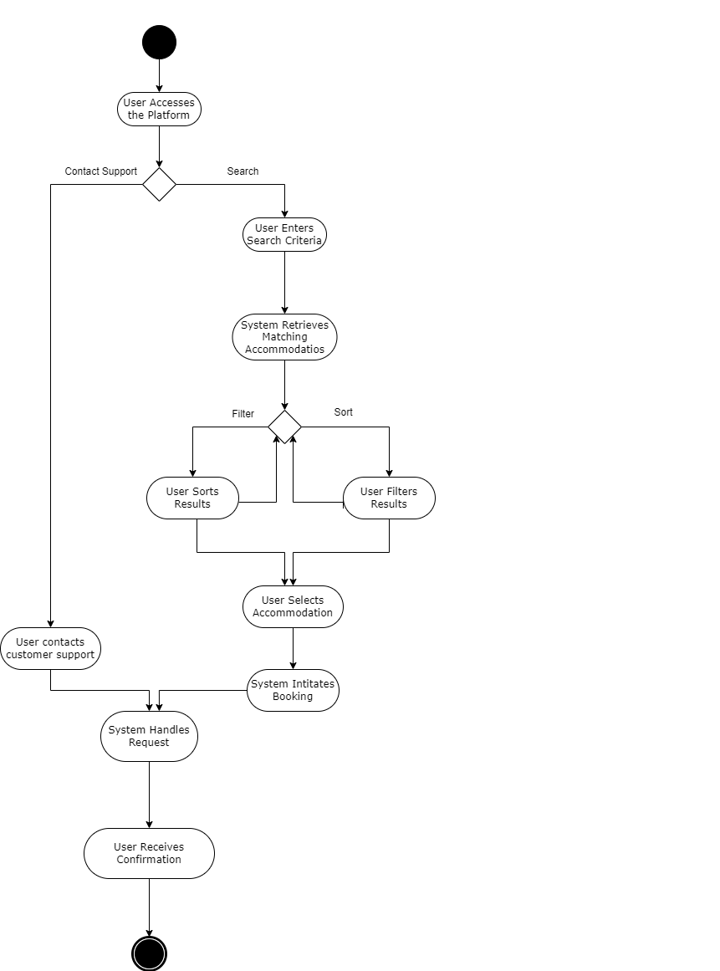
3. Activity Diagrams

Slide 16
4. Project Use Case Modelling

Slide 17
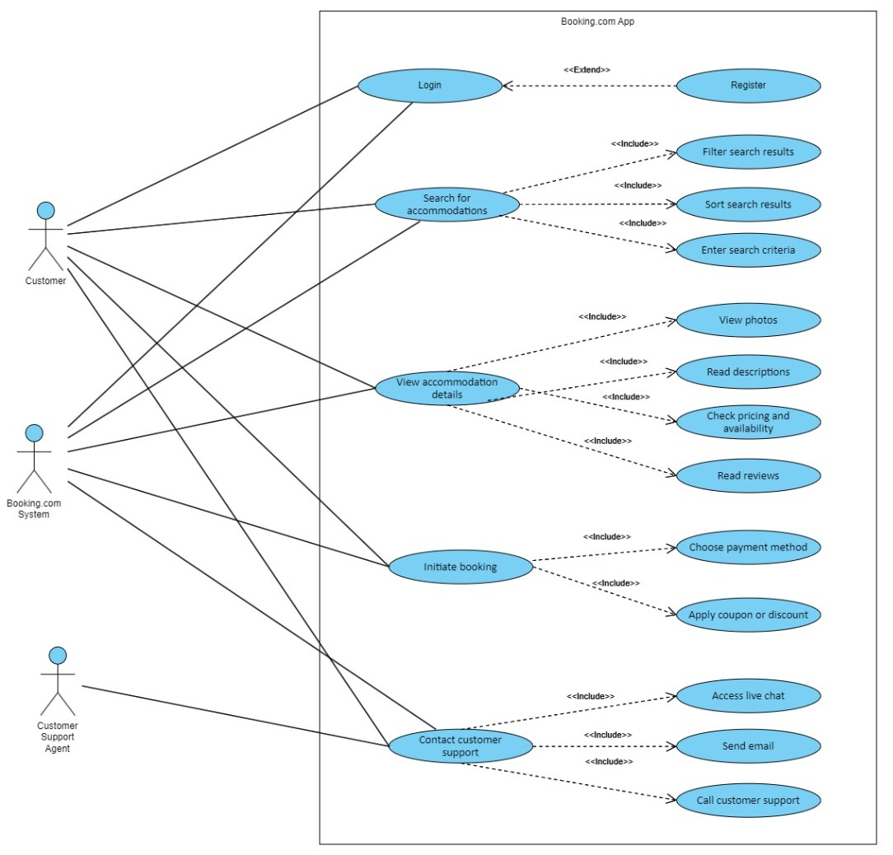
4.1 Use Case Diagram

Slide 18

Booking.com: View accommodation details
Actors | Customer, Booking.com System
Description | The "View accommodation" use case allows users to access comprehensive information, including a description, amenities, photos, and reviews, for a specific accommodation listing within the app.
Data | The data can include: photos and videos about the accommodation, reviews and ratings, pricing and room availability.
Stimulus | the user clicking a specific accommodation from the search results view its detailed information.
Response | System displays detailed information for the selected accommodation, including photos, reviews, pricing, and availability.
Comments | This use case includes another related use cases: View photos, Read description, Check pricing and availability, Read reviews
4.2 Use Case Table (Table 1)

Slide 19

Booking.com: View accommodation details
Actors | Customer, Customer Support Agent
Description | The "Contact Customer Support" use case enables users to connect with the app's customer support team to seek assistance, report issues, or ask questions, ensuring a seamless and responsive support experience.
Data | The data in the use case typically includes user information (name, contact details) and support ticket details (inquiry, attachments).
Stimulus | The stimulus for the use case is triggered when a user initiates a request for assistance or reaches out to the app's customer support agents through a designated contact channel.
Response | A ticket will be created and a customer support agent will be available to assist the customer with their issue
Comments | This use case includes another related use cases: Access live chat, Send email, Call customer support
4.3 Use Case Table (Table 2)

Slide 20
4. Sequence Diagram

Slide 21
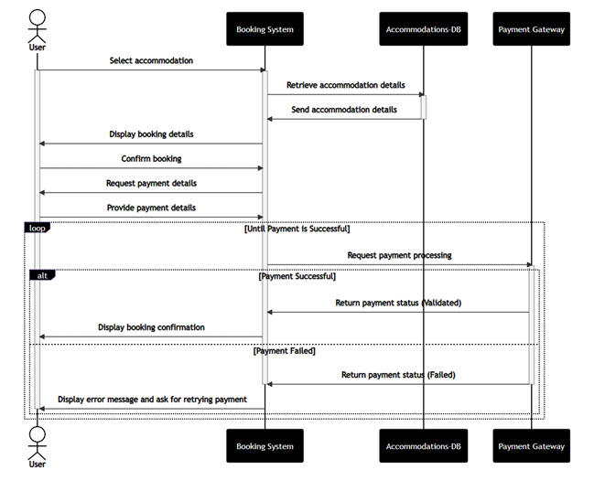
5. Sequence Diagrams

Slide 22
6. Class Diagram

Slide 23
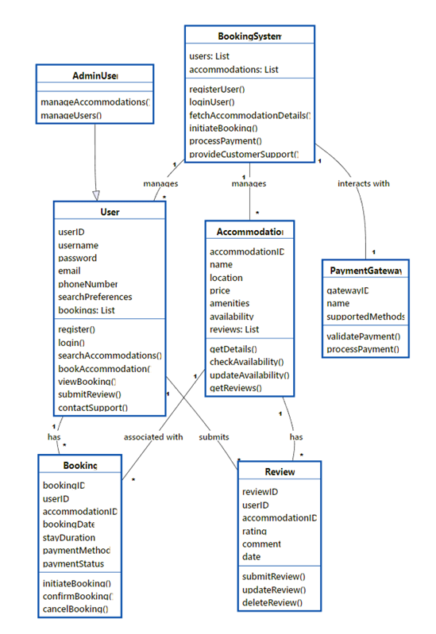
6. Class Diagrams

Slide 24
This project was made by:
Abdullah Fahad Tamim | 442050471
Rayan Abdullah Alsamari | 442050802
Naif Nasser Aldawsari | 442051143

