Slide 1
Foundations of software engineering -Presentation Slides -
Students name Rayan al-mujalli 443050767
Sultan al-ajmi 443050532
Supervised by
Dr. Mohammed Assiri

Slide 2

1.1 Introduction
This project aims to design a system for the YouTube app. The process starts with defining the app and identifying potential problems. Solutions are proposed, and a work plan is created. Activity, use-case, sequence, and class diagrams are designed to understand the tasks that the app will perform. The goal is to create an efficient system that can perform all necessary tasks seamlessly.

Slide 3
1.2 Background
YouTube is a digital platform that allows users to upload, view, and share videos and give a feedbacks. The project aims to provide a fast and easily accessible platform for sharing videos with a global audience. The platform is designed with creators who will be uploading videos to the system , and offering a suite of tools and analytics to help them optimize their content and grow their audience .

Slide 4
1.3 problems
1-the high amount of videos that being uploaded
2-content management :the problems of the copyrights and also the risk of inappropriate or harmful content being uploaded to the site.

Slide 5
1.4 Proposed solution
1- To manage a large number of videos, the system uses technologies such as CDN to reduce latency and MySQL to store data in Google data centers.
2- The system uses a CMS to manage content and copyright within the platform. Users can report inappropriate content, and the YouTube team will take action accordingly.

Slide 6
1.5 Work plan
First we need to identify and Figure out what the website is for, who the target audience will be , and what it’s should do , Make it easy for content creators to upload, and adding user-friendly interface, and watching videos with low latency , design a strong system for the database to store videos, also making diagrams to understand the system accurately , and add a ways for the channel owners to make money, like ads and sponsorships , Add features that let people interact and work together , Get the website noticed by search engines and promote it to attract visitors, Keep making the changes based on what users want and what's popular.

Slide 7
2.1 functional requirements
Search Functionality
Channel Management
Content Recommendations
Commenting and Interactivity
Monetization
Analytics and Metrics

Slide 8
2.2 Non-functional requirements
Performance
Availability
Security
Usability

Slide 9
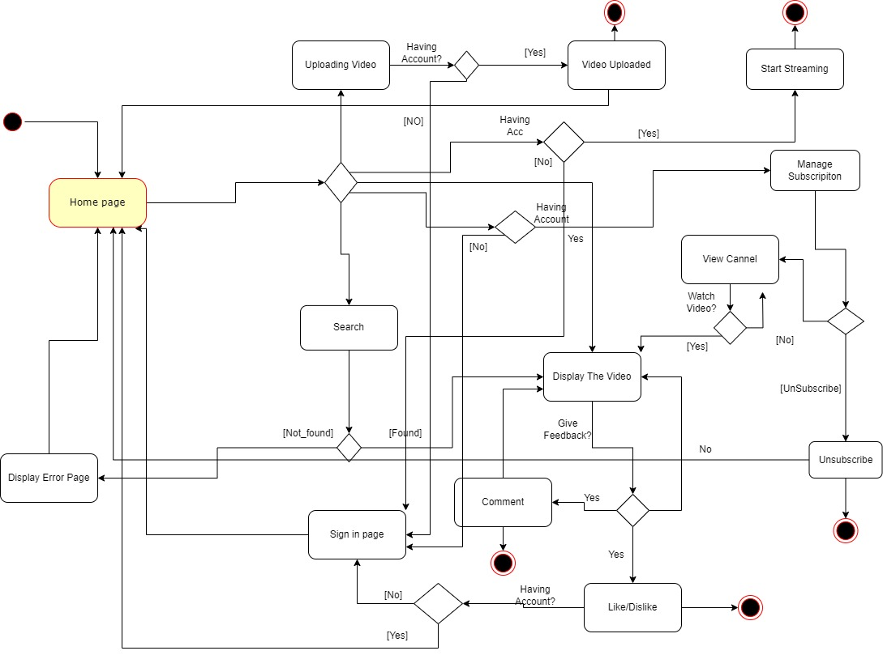
3.Activity diagram

Slide 10
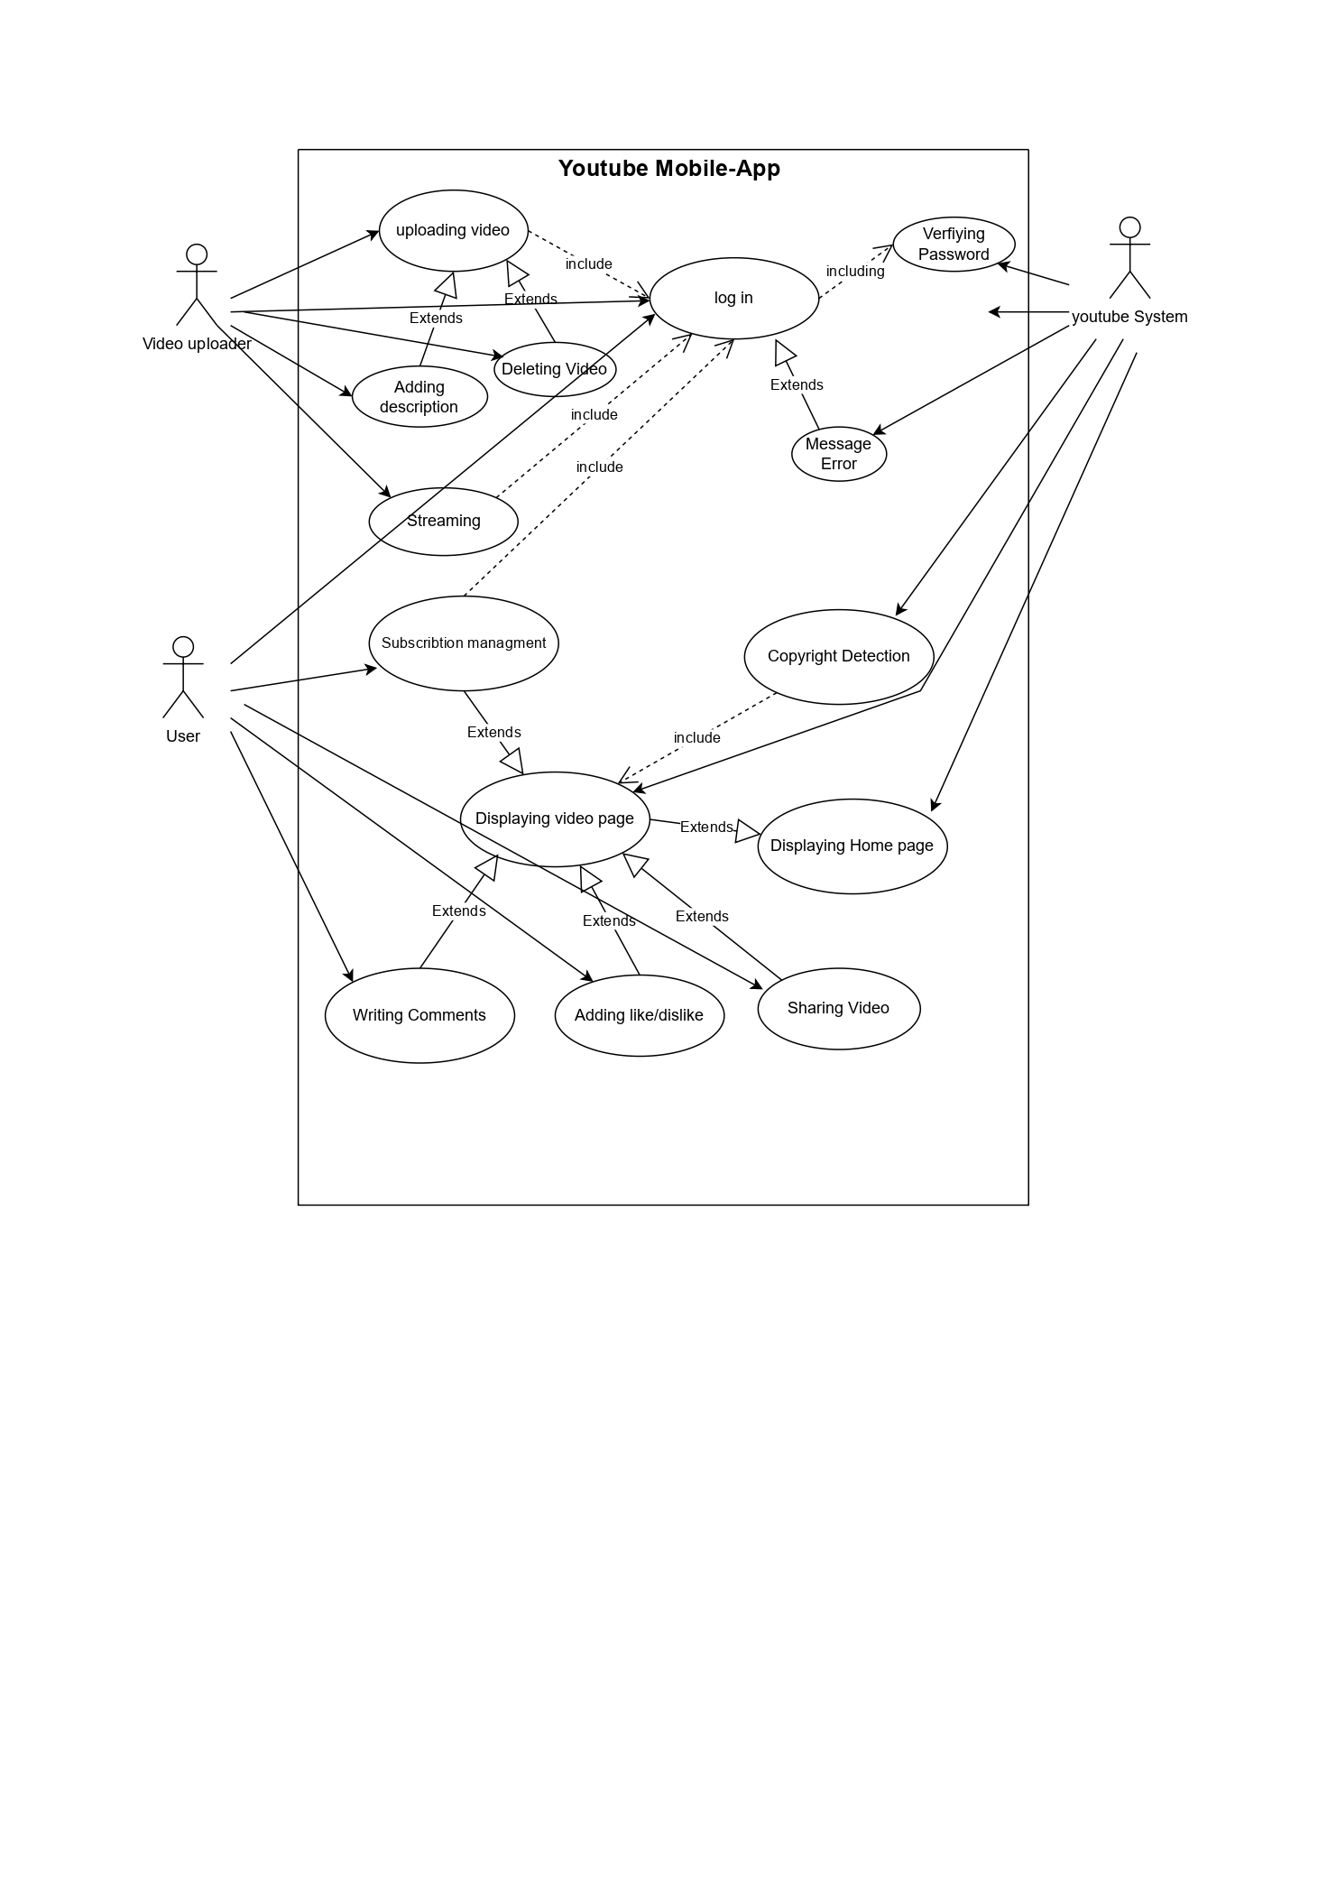
4. Use Case Modelling

Slide 11


4. Use Case Modelling
LOG IN
user YOUTUBE DB
Log in:
Actors | The user and YouTube's servers.
Description | A new user may want to log in in YouTube system.
Data | E-mail and password.
Stimulus | The new user has issued an order to log in.
Response | The new user is logged in.

Slide 12
4. Use Case Modelling
user YOUTUBE DB
Uploading Video
Uploading Video:
Actors | Creator or uploader, YouTube's servers, and viewers.
Description | The user may upload videos from his device to YouTube system.
Data | Videos, texts.
Stimulus | The user has issued an order to upload a video.
Response | The video has been uploaded.

Slide 13
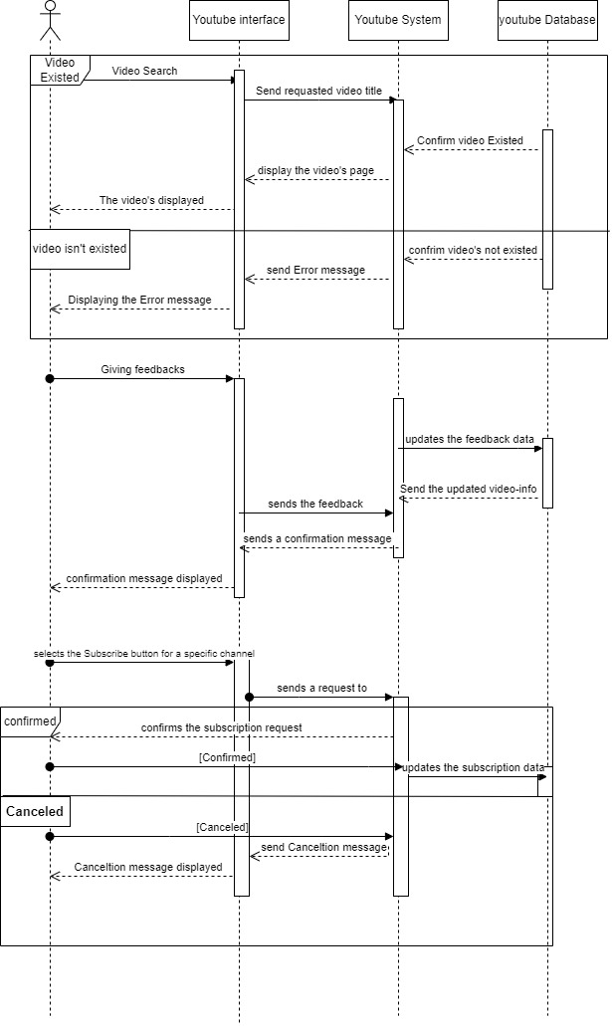
5.Sequence Diagrams

Slide 14
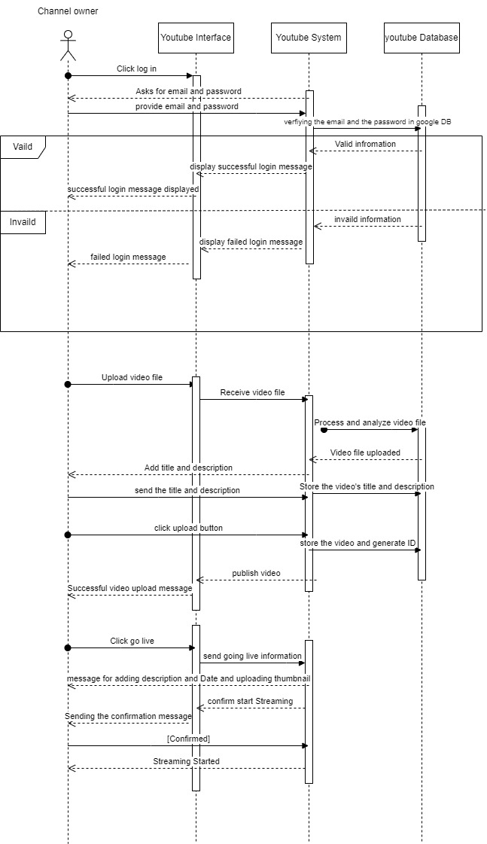

Slide 15
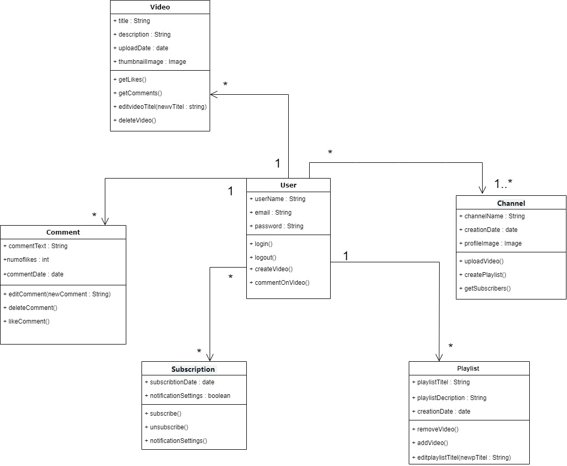
6. class diagram

