Slide 1

Mrsool Application
Prepared by
Supervised By
أريام عبدالرحمن النتيفات
أنجود غانم الهوامله
حصه مسفر العرجاني
ضي راشد الكبرى
د. محمد سعد عسيري
Year: 2023

Slide 2
1
Introduction
Content
2
Problem & Proposed Solution
3
Work Plan
4
Project Requirements
Functional requirements
Non-functional requirements
5
System Diagram
Use case diagram
Activity diagram
Sequence diagram
Class diagram

Slide 3
Introduction
In modern times, technology has become an integral part of our daily lives, and has significantly affected various areas of life including the delivery services sector.
Delivery apps have become an integral part of our life, meeting our growing needs for goods and services quickly and conveniently, saving us time and effort.

Slide 4
Problem & Proposed System
Problem
Changing overcrowded lifestyles and work makes it difficult for people to fulfil their needs and meet their requirements, thereby increasing their needs to have access to their requirements without having to go to markets.
There are a lot of markets that are difficult to access or that customers have never heard about it.
Proposed System
Create mobile app that connects the tradesman to the user, and providing a lot of delivery services including restaurant delivery service and many other products such as gifts, stationery, electronics, and even moving home furniture, also delivering orders from your home to any other place.
The app will provides tradesman with access to the largest segment of customers.

Slide 5
Wok plan
The following phase have been followed to complete this work via incremental model:
A feasibility study: collecting and analyzing information, studying the target market, competition, costing expected returns and identifying existing challenges.
Analyze the requirements: functional and non-functional on this phase the real cost may be defined. Design phase: via UML diagrams to clarify the requirements at this phase some requirement may be changed, and design the user interfaces.
Implementation phase: construction the app.
Validation phase: correction the errors
Marketing and Launch phase: by making the app available for the customers.
Finally the application remains in continuous development and add new features and requirement to get new versions based on customers evaluations and reviews.

Slide 6
Project Requirements
Functional Requirements
The system shall enable:
The client to add note to order.
The client to choose delivery offer.
The client to choose language.
The client to sign in by mobile or social media account.
The delivery representative to sign in by mobile number and password.
The delivery representative to receive order.
The client to rate the delivery and provide feedback on the quality of service.
Chatting between the client and the delivery representative.
The user to sign up as tradesman by entering registration information.
The user to sign up as Delivery representative by entering registration information.
The user to login by phone number and verification code.
The client to send order.
The client to define location.
The client to view stores and restaurants.
The client to define payment method.
The client to add coupon

Slide 7
Project Requirements
Non-Functional Requirements
The system shall be simple and easy to use so the user can train to use the system for 1 hour then can use it with no more than two mistakes.
The application shall be maintainable by using the following in the code: OOP, writing clean code, add comment, use suitable function and variable name.
The application should be scalable where more stores, restaurant, services are being added frequently.
The application should be compatible with different type of devices and OS, the application should be tasted on android and IOS and make sure that all services is working.

Slide 8
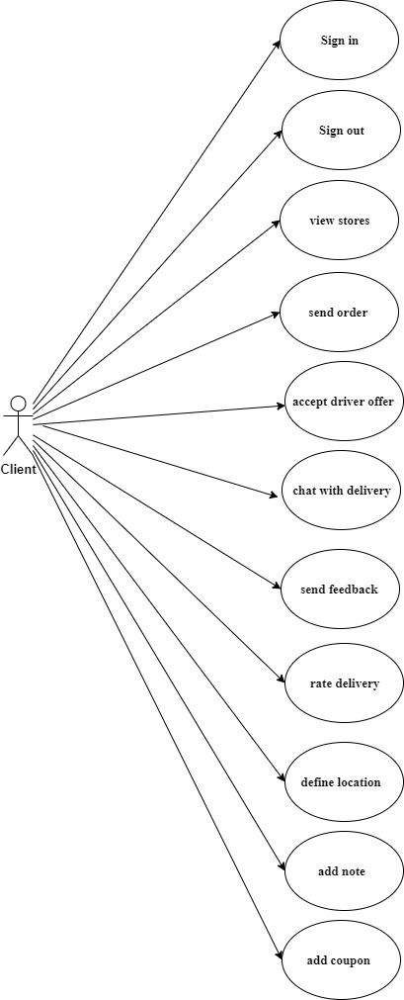
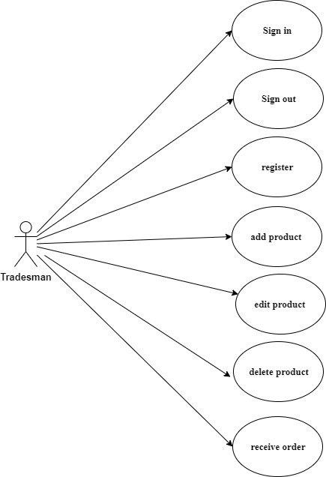
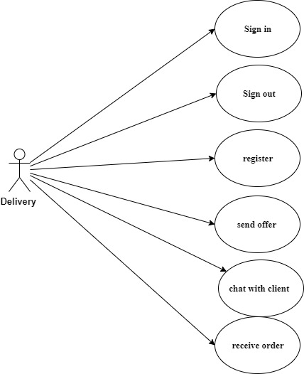
System Diagram
Use case Diagram
Client
Tradesman
Delivery

Slide 9
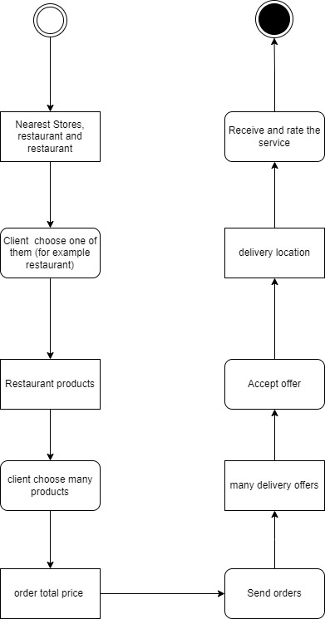
System Diagram
Activity Diagram

Slide 10
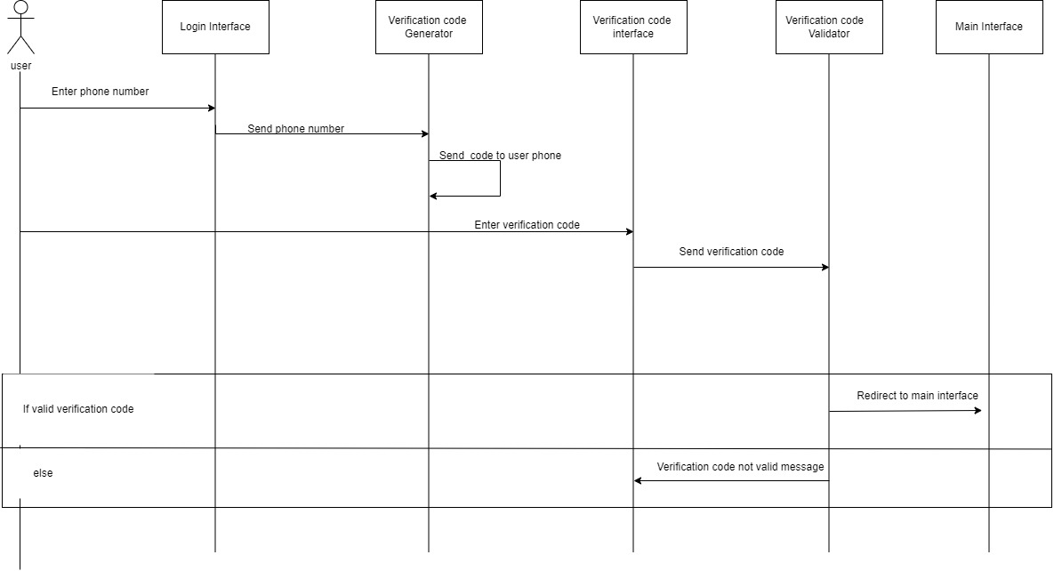
System Diagram
Sequence Diagram

Slide 11
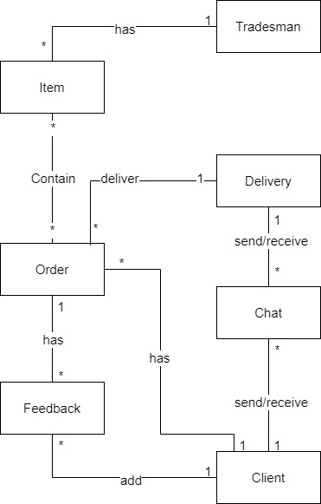
System Diagram
Class Diagram

Slide 12
THANK YOU

