Slide 1
Project
PlayStation App

Slide 2
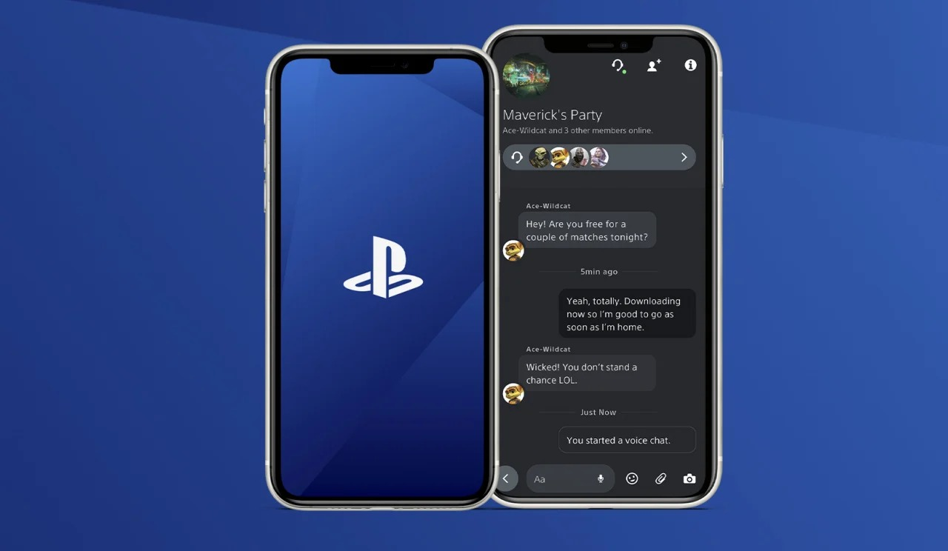
Introduction
It is a software application for iOS and Android devices that allows us to identify connected friends or view progress or compare awards with friends or create a personal profile to display to friends. The first version of the application was released on November 15 / 2013.

Slide 3

Problems
Is there any problem ?
Yes,
- You can't download games without Turn on a PS console.
- You cannot play/delete your PS games without Turn on a PS console.

Slide 4

Background
Sony Corporation is a Japanese electronics company, founded by Masaru Ibuka in 1946, under the name "Tokyo Communications Engineering Corporation". It is also one of the world's largest manufacturers of consumer electronic products.

Slide 5
Proposed solution
Is there any solution ?
Yes,
- Download games to your PS console remotely.
- Launch/ Delete Your PS Games Remotely.

Slide 6
Work Plan
In the PS App application we will use the Incremental model of application development where the application is developed in successive stages.
1 – Application requirements : are determined by collecting information from players and developers.
2 – Design : The application is designed according to the requirements specified in the first stage.
3 – Implementation : Design is performed like writing code or testing an application.
4 – validation : It is verified that the application meets the requirements.
5 – Evolution : The necessary modification are being made to the application based on feedback from players and developers.

Slide 7
Functional requirements
1 - The system must allow the player to log in using their (email and password).
2 - The system must send a verification message to verify the player's identity.
3 - The system must allow the player to use a unique name that has not been used before.
4 - The system can allow the player to view his downloaded games.

Slide 8
Non-functional requirements
1 - The running time of the application should not exceed four minutes.
2 - The system must enable the player to perform several tasks without reducing performance and efficiency.

Slide 9
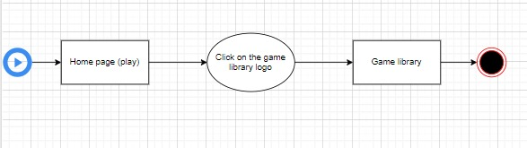
Activity diagram
View games

Slide 10
Project Use Case Modelling
Actor
Roles | Actors
- Create announcements - Communicate with users - Update system designs | Admin
- View games - Rate games - Voice chat with friends | User
- Review player ratings - Release games - Update games | Development

Slide 11
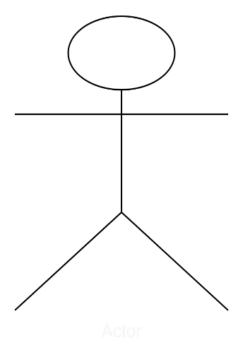
Project Use Case Modelling
Use cases & its related use
View games
Voice chat with friends
user
Rate games

Slide 12
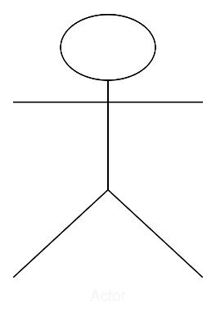
Project Use Case Modelling
View games
User
User : View Games
User and DB of games | Actors
It explains the interaction of the user (the player) and the way he views the games he has and those in the database designated for me to store games. | Description
User email, User password, Game code, And Verification code | Data
Want to view the games. User | Stimulus
Games information (Name, code) | Response
No Comments. | Comments

Slide 13
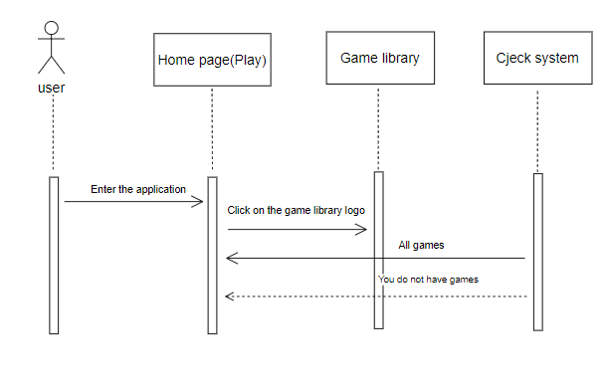
Sequence Diagrams
View games

Slide 14
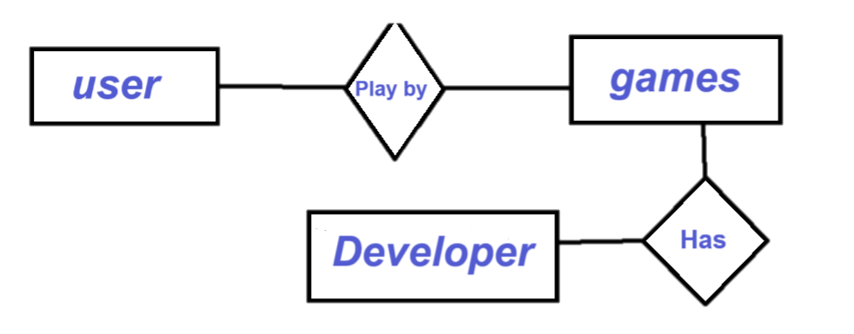
Creating a Class Diagram
Class user(player)
Contact ID (Int)- Name (String)- -Emile (String) - Nickname (String) -Address (String) -phone # (Int) -Bank account (Int) -password (Int) - language (String) -country (String)
-New account () -Add () -Delete () -Update () -Search () -download () - Review ()

Slide 15
Finally, we hope that our project was useful and interesting for everyone.
Thank you for your kind attention.

