Slide 1
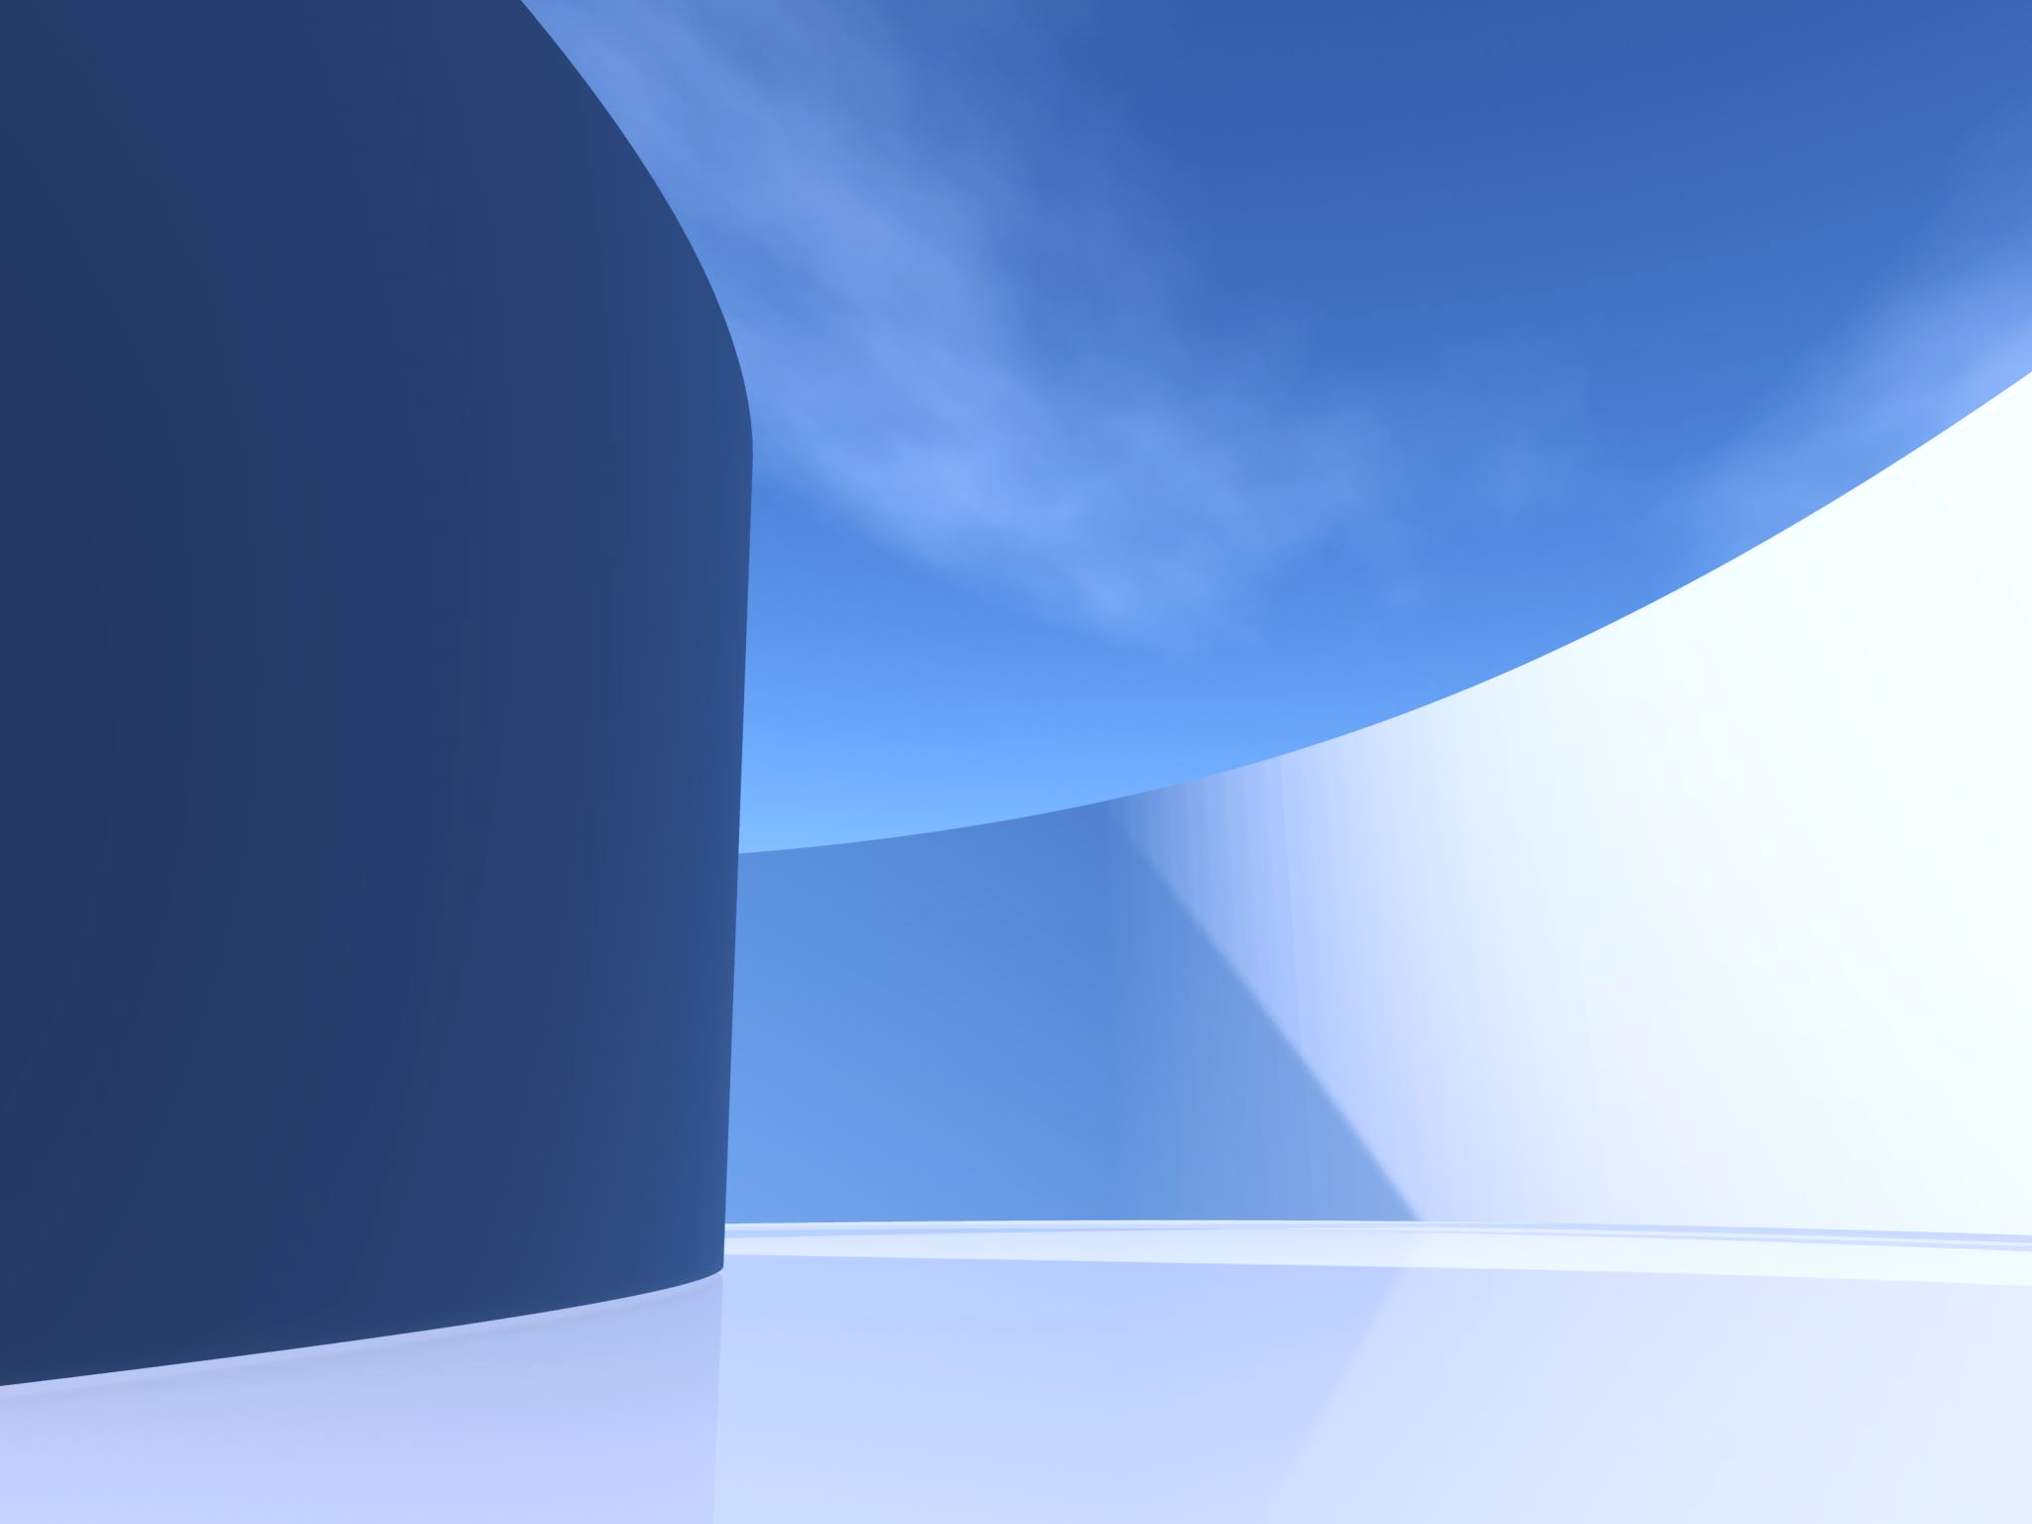

Discord
ناصر صالح الشبرين
بدر سعد جنيح

Slide 2
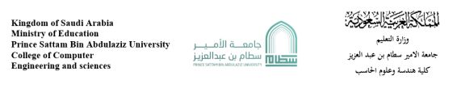
Project about
Discord
Student Name | Student ID
بدر سعد عبدالعزيز جنيح | 442051760
ناصر صالح الشبرين | 442050688
Supervised:
1444 / 2023
محمد سعد عسيري
Year:

Slide 3
Introduction
In this project, we have chosen the Discord app, which is a popular messaging and communication platform, We will be showing some of the problems that Discord has solved.

Slide 4
Background
Discord has over 140 million monthly active users and is available in over 27 languages. The platform has received investments from various companies, including Tencent and Index Ventures, and has a valuation of over $15 billion.
In 2017, the platform won the "Best Communication App" award at the Crunchies Awards, and in 2019, it won the "Fastest Rising Startup" award at the TechCrunch Disrupt conference.

Slide 5
Problems
Lack of Communication Tools
Poor User Experience
Limited Customization

Slide 6
Proposed solution (Respectively)
Discord offers a range of communication tools, such as text, voice, and video chat, allowing users to communicate and collaborate in real time, regardless of their location or device.
Discord allows users to create their own servers and channels, and customize their profiles.

Slide 7
Work plan
Task | Days | Start | End | Status
Introduction | 1 | 13/4 | 13/4 | complete
Problem | 1 | 14/4 | 14/4 | complete
Background | 1 | 20/4 | 20/4 | complete
Work plan | 2 | 23/4 | 24/4 | complete
Functional requirements | 2 | 26/4 | 27/4 | complete
Non-functional requirements | 1 | 29/4 | 29/4 | complete
Project activity model | 3 | 1/5 | 3/5 | complete
Project use case modelling | 2 | 2/5 | 3/5 | complete
Creating a class diagram | 1 | 12/5 | 12/5 | complete
Creating sequences diagram | 2 | 13/5 | 14/4 | complete
Report | 3 | 18/5 | 20/5 | complete
Presentation | 1 | 27/5 | 27/5 | complete

Slide 8
Functional Requirements:
Messaging: Users can send and receive real-time messages, including text, voice, and video messages.
Channel Management: Create and manage channels, including text, voice, and video channels. Users can invite other users to channels and manage access permissions.
Voice and Video Chat: Users make voice and video call with other users or groups.
File Sharing: Including images, documents, and videos, with other users and groups.
Bot Integration: In Discord, you can connect and configure bots to perform various actions, such as moderation, music playback, and game integration.
User Management: Discord gives users allow to manage their profiles and settings, including display name, avatar, and notification preferences.
Gaming Integration: You can join and create gaming groups, and provide integration with popular gaming platforms.
Emojis and Reactions: Discord allows users to use emojis and reactions to express emotions and reactions to messages.

Slide 9
Non-Functional requirements:
Security: Ensure the security of user data and communications by implementing appropriate security measures, such as encryption, firewalls, and access controls.
Reliability: Provide a reliable service with high availability and minimal downtime. The platform should have failover and disaster recovery mechanisms to ensure service continuity.
Performance: Provide a fast and responsive user experience, with minimal lag or delay in messaging and file sharing. The platform should optimize network usage and server resources to ensure optimal performance.
Usability: user-friendly interface that is easy to navigate the platform should provide clear and concise instructions and error messages to users.

Slide 10
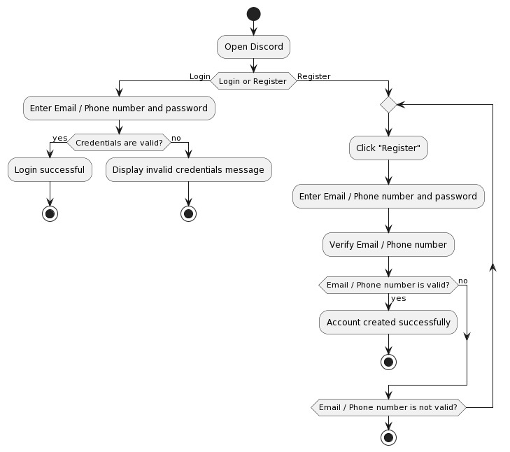
Activity diagram

Slide 11
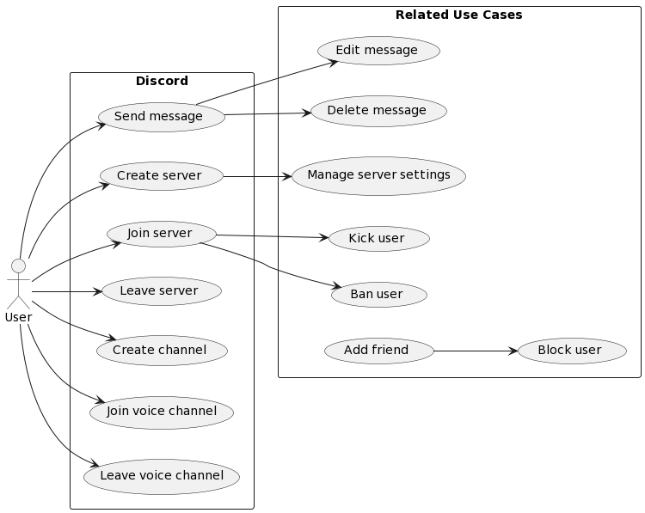
Project Use Case Modelling

Slide 12
Use Cases Table
Actors | Gamer, Server Administrator
Description | A gamer wants to send a message in a private Discord server created by a server administrator for a gaming community.
Data | User profile, chat logs, server settings
Stimulus | The gamer opens the Discord app or website and navigates to the private server they want to send a message in.
Response | he gamer selects the chat room they want to send a message in and types their message in the message box. They can also attach files or embed links in their message if desired. Once the message is complete, they click the "Send" button.
Comments | It's important to follow any rules or guidelines set by the server administrator when sending messages in a private server.

Slide 13
Related Use Cases Table
Actors | Gamer, Server Administrator
Description | A gamer wants to delete a message they sent in a private Discord server created by a server administrator for a gaming community.
Data | User profile, chat logs, server settings
Stimulus | The gamer opens the Discord app or website and navigates to the private server where they sent the message they want to delete.
Response | The gamer finds the message they want to delete in the chat log and right-clicks on it. They select the "Delete Message" option.
Comments | It's important to follow any rules or guidelines set by the server administrator when deleting messages in a private server.

Slide 14
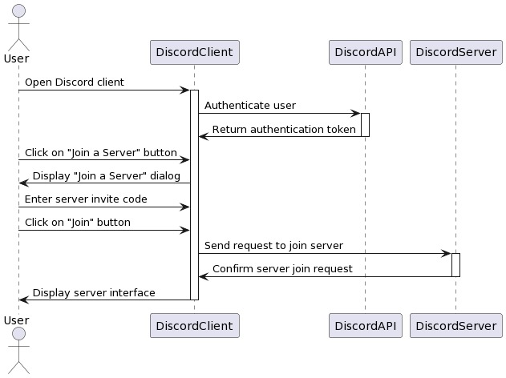
Sequence Diagrams

Slide 15
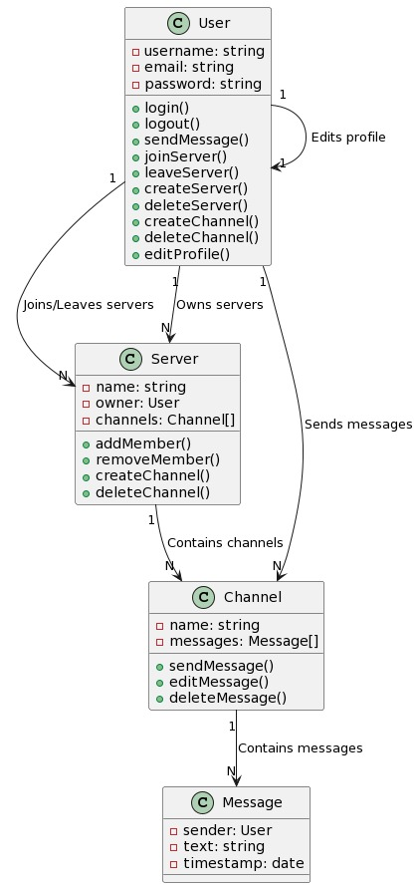
Class Diagram

